Slide 1
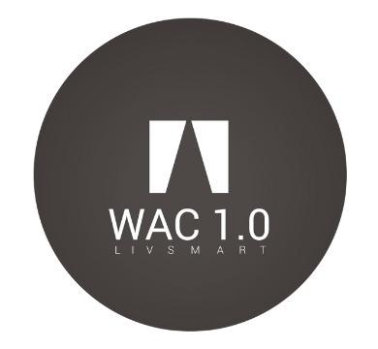
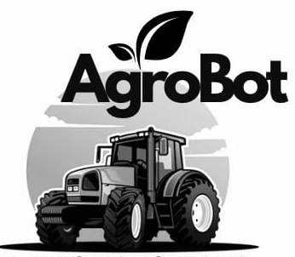
Greetings
IDEA NAME : AgroBot
TEAM WAC
KISHORE C DEEPAK K DEEPESH M PRASANNA KUMAR K

Slide 2
Problem Statement
Current farming methods lack precision in automation, leading to water wastage and suboptimal crop growth.
Absence of instant soil data disrupts timely irrigation adjustments, affecting water conservation and agricultural productivity.
Existing systems in farming fail to adapt dynamically, causing inconsistent water distribution and reduced agricultural efficiency.
Monitoring farms from a significant distance poses a significant challenge.

Slide 3
Existing Solutions:
Jain Irrigation Systems : Jain Irrigation
Netafim Irrigation India : Netafim
Mahindra Agri Solutions : Mahindra Agri
Note : These companies have automated the drip irrigation system and not the canal irrigation system . We should be very specific about our solution since these companies are already experts in that area.The first company “Jain Irrigation Systems” automated the drip irrigation for all the crops including coconut,wheat.
‹#›

Slide 4
Solution
Our innovative solution transforms agriculture by integrating advanced technology.
Sensors deployed across fields monitor vital soil conditions, while a user-friendly IoT app allows remote irrigation control via smartphones or tablets.
Preprocessed data, including crop type and soil specifications, are loaded in our system.
This intelligent system analyzes environmental factors and activates water pumps and valves as needed.
It ensures optimal irrigation, minimizing water wastage, and delivering precise water levels for each crop.

Slide 5
Uniqueness
Our product is developed with an algorithm to automate the water distribution in agricultural fields based on the crop requirement and field size.
Our system automates the entire irrigation process and makes it monitorable remotely.
Our system is preprocessed with data of all types of crops in India.So it can be feasible and used in real time applications.
Increase efficiency of irrigation, thus increasing groundwater level.
Promoting Make in India and Digital India in rural areas.

Slide 6
Challenges Overcome
Integrating advanced technology, sensors, and an IoT system can be expensive.
Remote agricultural areas may have limited internet connectivity.
Scaling the solution to different farm sizes and types while meeting specific needs.
The product should undergo regular maintenance.
Buying and selling the hardware components in large scale rapidly decrease the product cost.
GSM Module is used which can be accessed from any place.
Our system is designed to take decisions based on the real time data.
We would be providing regular technical support and services.

Slide 7
Market Size and Scalability
There are 11.88Crores(approx) farmers in India.
Among them over 68% of farmers are own land yielders who grow a diverse range of crops including rice,sugarcane, pulses,oilseeds,millets and other varieties of fruits and vegetables.
There is a huge market base for IOT and automation solutions in India and also Government is creating a beneficial environment for agricultural business growth.
Among the farmers in India,if 10% of farmers can buy our product, It makes a count of 1.18 crores. This huge demand in productivity of our product,reduces the cost to more than 45% from actual cost.

Slide 8
Market Strategy
Direct Sales : We will establish a direct sales team to target large-scale agricultural enterprises and offer customized solutions to meet their specific needs.
Online Marketing : Utilize online marketing strategies, including social media, content marketing, and SEO, to reach a broader audience, including individual farmers and smaller agricultural businesses.
Partnerships : Collaborate with agricultural equipment suppliers and distributors to expand our market reach.

Slide 9
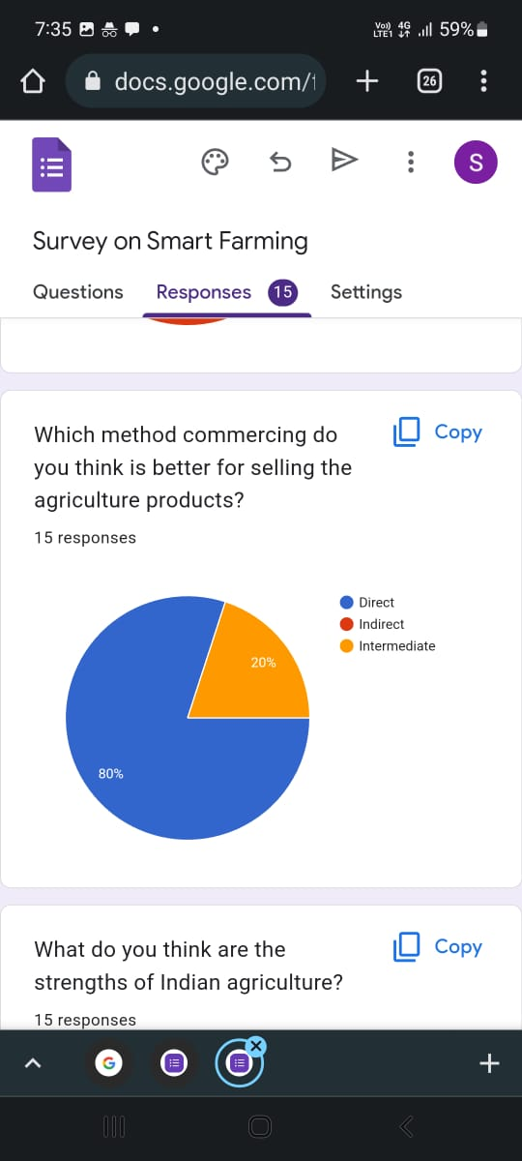
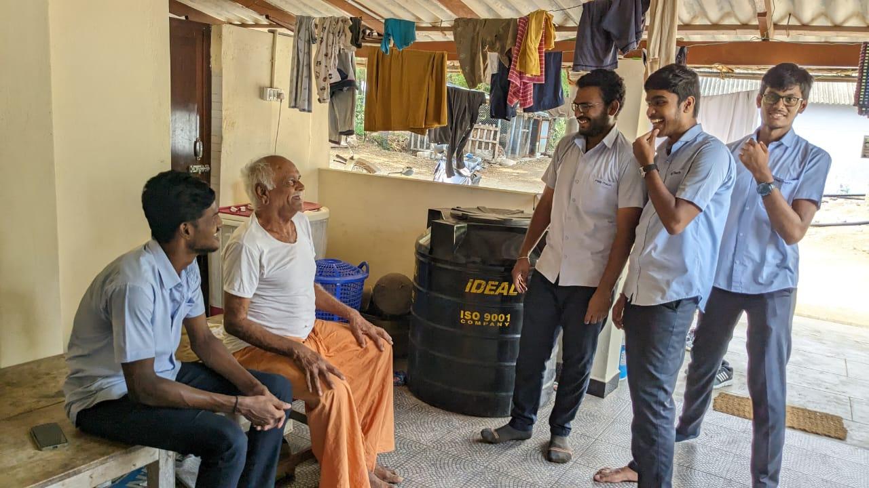
Real-Time User Research
We went to the nearby farms and implemented some sensors in the farm to get the training set of data for our algorithm .
We have been analyzing the data for almost six months.
From the survey we had conducted, We have improved our AI algorithms so that our product can be implemented for any type of crops.
‹#›

Slide 10
Advancements from Existing Market
Canal Irrigation Focus:
Differentiates from competitors focusing on automated drip irrigation.
Customization and Precision:
Integration of advanced sensors and AI algorithms to deliver optimal water levels for crops.
User-Friendly Interface:
Intuitive IoT app for remote monitoring and control through smartphones or tablets.
Sustainable Farming Practices:
Precision irrigation promotes optimal crop growth and minimize water wastage.
Direct Support and Ongoing Analytics:
Comprehensive support beyond product delivery.
Subscription-based services for direct assistance.
Notes:
hiiii

Slide 11
Business Concept
Product : Our core product is a comprehensive agricultural IoT system that integrates sensors, data analytics, and remote control through a user-friendly mobile app. The system is designed to monitor soil conditions, analyze environmental factors, and automate irrigation.
Market Opportunity : The global agricultural industry faces challenges related to water scarcity, increasing demand for food, and the need for sustainable farming practices. Our solution addresses these challenges by providing efficient and precise irrigation control.
Target Audience : Our primary customers include farmers, agronomists, and agricultural enterprises. We aim to serve both small-scale and large-scale farming operations.

Slide 12
Potential Benefits
Farmers: This helps farmers grow more crops and save money by using just the right amount of water, and they can control it from their phones.
Environment: It helps farms be kind to the environment by using water wisely.
Technology Providers: Companies that make smart farming tools can sell more and make new and better things.
Government and Leaders: Leaders help farmers use these smart tools and like them because they're good for the environment.
Researchers and Schools: People who study farming can learn new things and work with companies to make farming even better.
Supply Chain: The way we get food from farms to our tables becomes more stable and works better.

Slide 13
THANK YOU

