Slide 1



Fruitilicious
Cloud Cruise
Deepika Srinivasan 700693073
Bharath Lakshmi Naga Shyam Gopal Garaga 700700732
Saurabh Manocha 700699446
Sowmya Para 700692587

Slide 2



Techniques and tools
Python
Keras
Tensorflow
Jupyter Notebook
Amazon Web Service
FileZilla
SQL Workbench

Slide 3

CNN-Image Classification

Slide 4



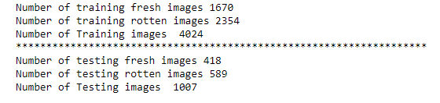
Dataset

Slide 5
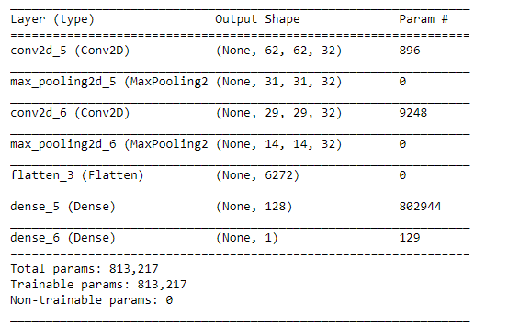
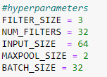
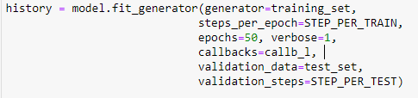

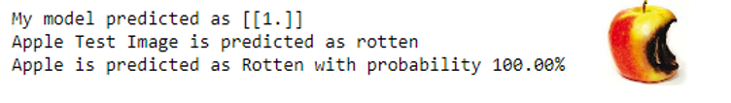
CNN Model

Slide 6
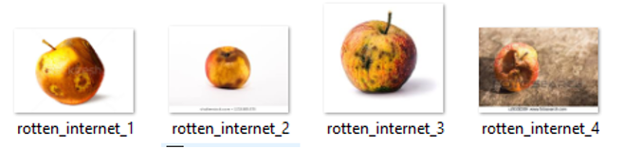
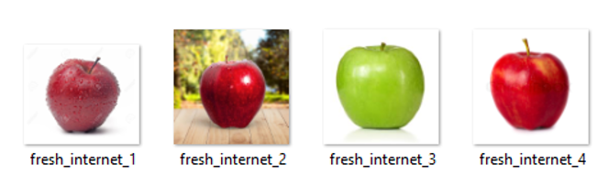
Sample images

Slide 7
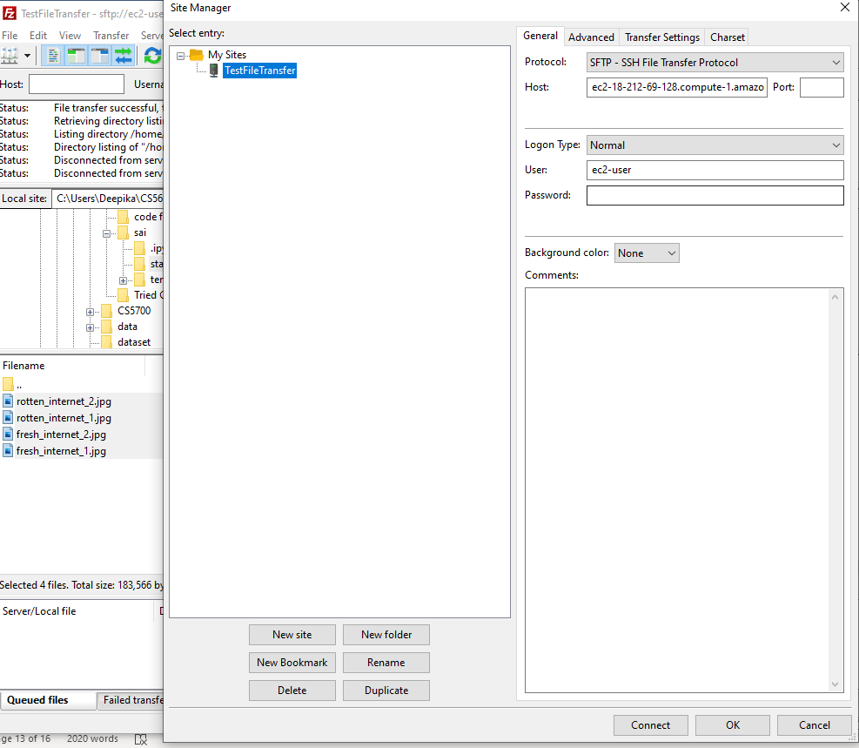
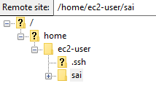

FileZilla

Slide 8

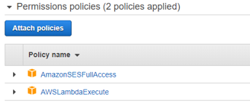
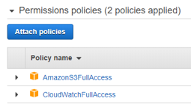
Identity access management-iam
Manage AWS services access and resources securely
Create and manage AWS users and groups
lambda_s3_ses,S3_Admin Access

Slide 9

Amazon Elastic Compute Cloud-ec2
Web service -secure, resizable compute capacity in the cloud
Complete control -computing resources

Slide 10
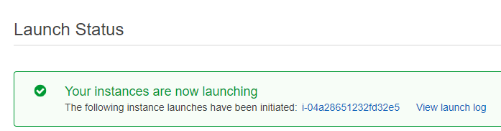

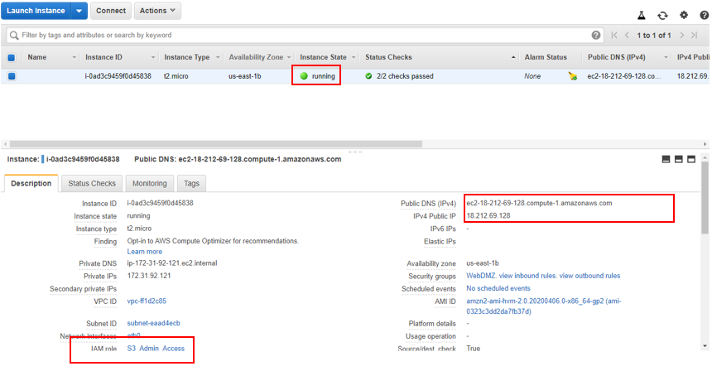


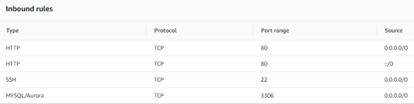

Slide 11

Amazon simple storage-S3
Object storage service
Industry-leading scalability, data availability, security, and performance
Store and protect data –Different use case

Slide 12
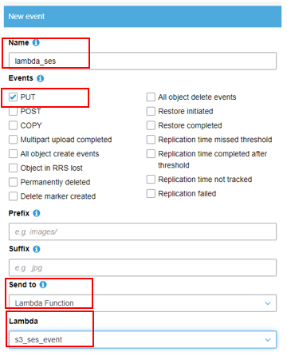
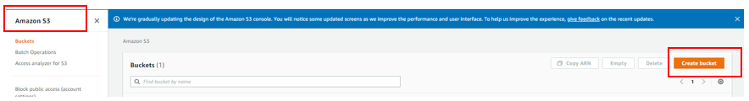
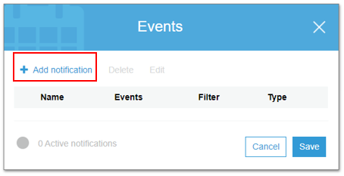
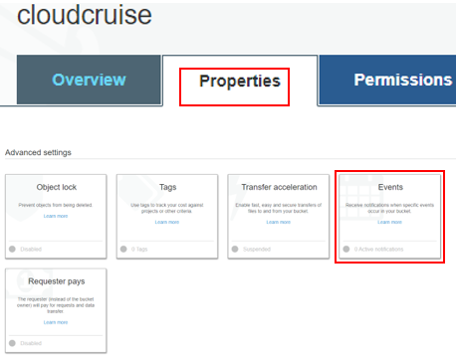

Slide 13
Lambda
Event-driven, serverless computing platform

Slide 14
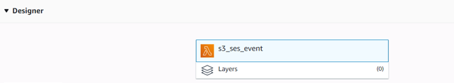
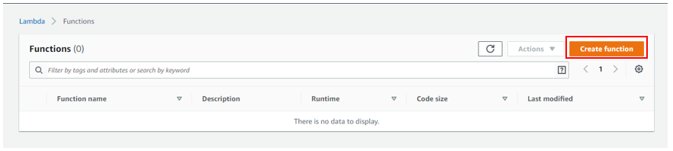
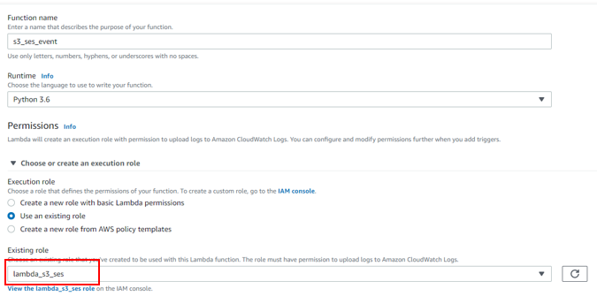
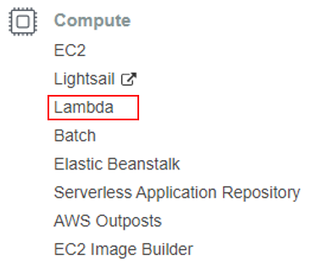
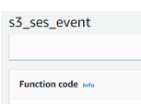

Slide 15

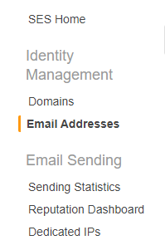


Simple Email Service-SES
Flexible, affordable, and highly-scalable email sending and receiving service
Cloud-based email sending service

Slide 16

Amazon relational database service-RDS
Easy to set up, operate, and scale a relational database in the cloud
Amazon Aurora, PostgreSQL, MySQL, MariaDB, Oracle Database and SQL Server

Slide 17
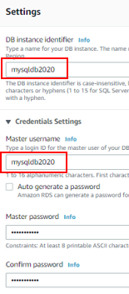
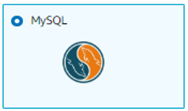
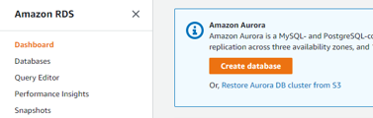
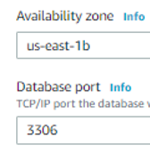
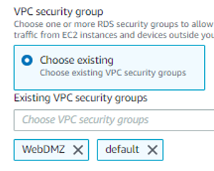
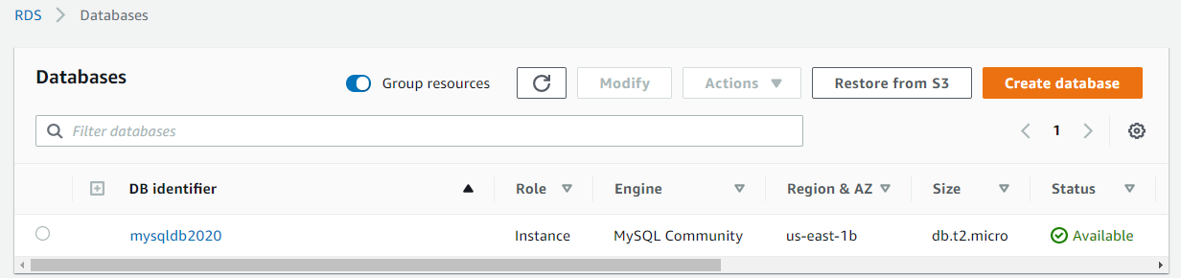
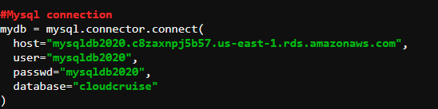

Slide 18

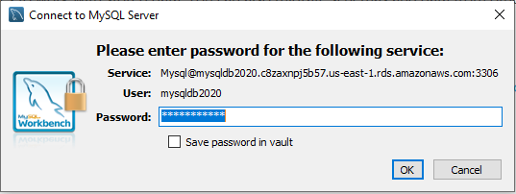

SQL Workbench
Visual database design tool
SQL development, administration, database design, creation and maintenance -MySQL database system

Slide 19
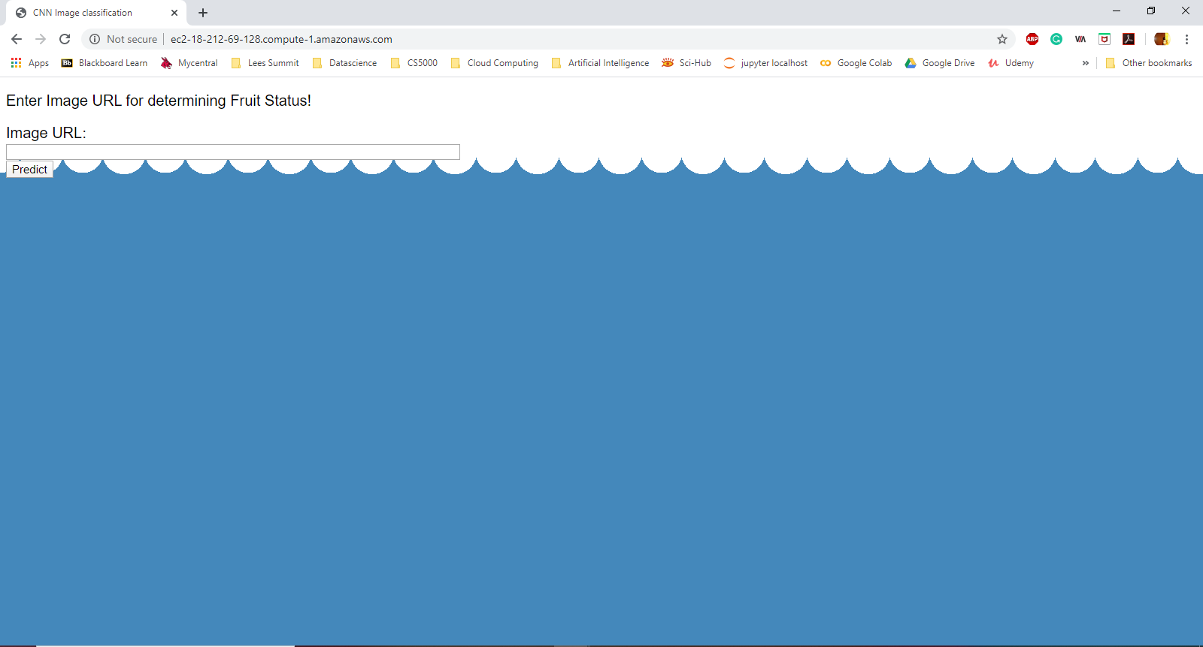
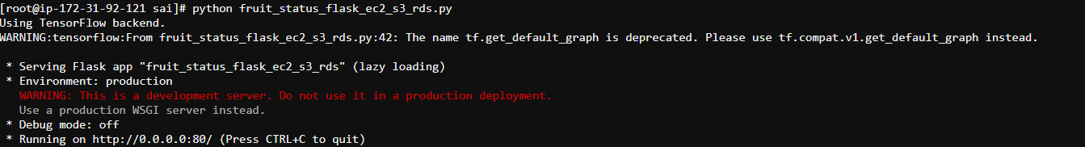

Implementation

Slide 20
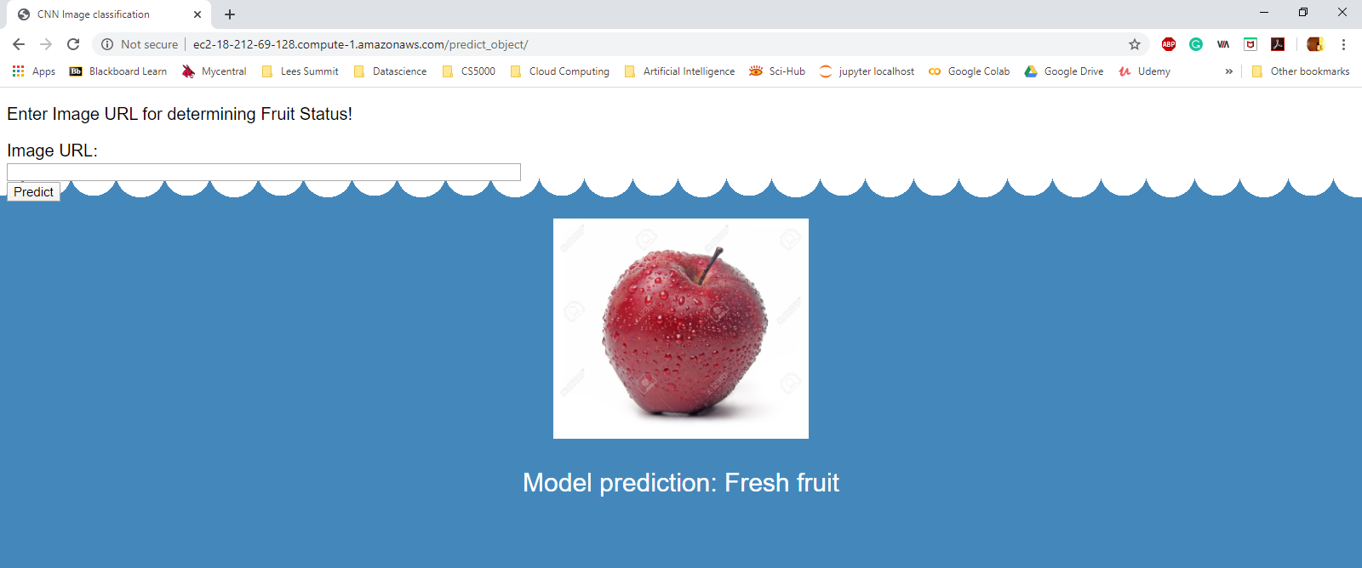
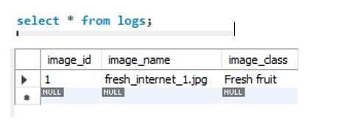
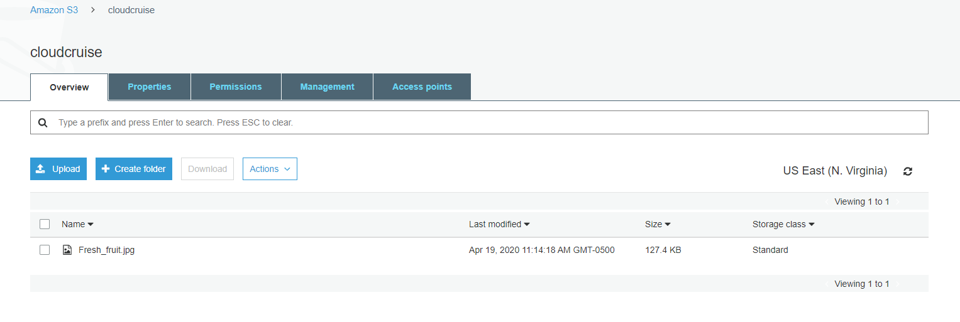
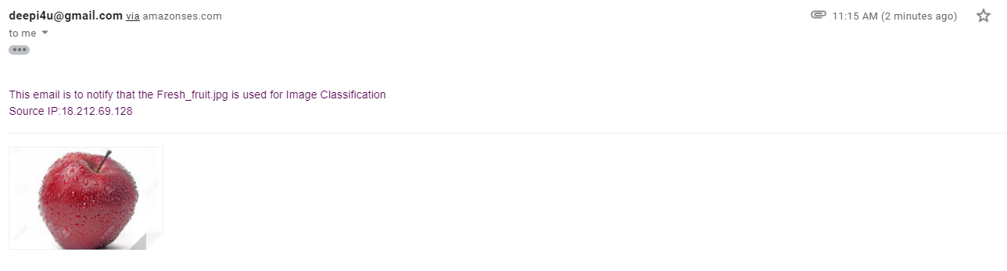

Slide 21


Slide 22

Tensorflow –Compatibility
Image Access
Integration

Slide 23


Deepika-Machine Learning Model, IAM and EC2
Sowmya-S3
Saurabh-Lambda and SES
Shyam-RDS

Slide 24




