Slide 1
TEAM MEMBERS: M.S.K. Haritha M. Deepika T.Kavi Priya
ZIVIMA
GUIDED BY Dr.M.Sujaritha
Professor
Dept of CSE

Slide 2
TABLE OF CONTENTS
Chapter NO TITLE ABSTRACT
1 INTRODUCTION
1.1 Overview
2 LITERATURE SURVEY
2.1 Exiting system
2.2 Proposed system
3 LIST OF MODULES

Slide 3
CONTD
Chapter NO TITLE
4 MODULE DESCRIPTION
4.1 Module identification
4.2 Module description
5 DATA FLOW DIAGRAM
6 CONCLUSION
7 FUTURE WORK
8 REFERENCES

Slide 4
ABSTRACT
An Android Application for Online Interaction between District Authorities and Students regarding projects.
The main objective of this application is student can solve different problems as their project by submitting solution in the form of report.
This application provide an opportunity for students to provide innovative solutions to their district daunting problems.

Slide 5
ABSTRACT (contd.,)
The students can use this application through their unique username and password by sign in with their personal and academic details.
If the student does not have the login Id before, he/she can register with their details by creating a new account.
If an essential field is not filled in the form then an error is thrown stating to fill in that field.

Slide 6
ABSTRACT (contd.,)
After the authentication the ministry for different department module list is displayed where the student can choose the department and corresponding problem statement.
Once the student select his/her project he/she can upload the abstract of his project so that the respective details of the student are stored in the database with their abstract.

Slide 7
INTRODUCTION
PROJECT OVERVIEW
The growing impact over smart phones increased the development of mobile application for Interacting with several domains.
The proposed system is an Android application to make a provision for online interaction between district Authorities and students.
The purpose is to manifest latent ideas into commercial products that can benefit humanity in general, and help to solve district’s existing social perils in particular.

Slide 8
Contd.,
The application is designed specifically for college and university students.
The main objective of this project is student can solve different problems as their project by submitting solution in the form of report.
The district Authorities can verify the details entered by the students and can validate the report submitted by the corresponding student.
In addition district Authorities can broadcast any new upcoming problem statements or projects to the students.

Slide 9
LITERATURE SURVEY

Slide 10
EXISTING SYSTEM
The existing System focus on over all projects and we don’t have any direct interaction with the district authority.
In the existing system, students can upload their ideas on corresponding projects only for the competition level.
There is no proper app for submitting student’s project abstract.
The existing application have more problems on registration process and Participation process.

Slide 11
PROPOSED SYSTEM
The proposed system provide a direct online interaction between students and district authority.
The application is designed specifically for college and university students.
Once the student create an account and login in successfully, they can view different problem statements and they can enroll themselves with particular project.

Slide 12
PROPOSED SYSTEM(contd).,
After completing their project the student can submit his/her project ideas as a report.
Since this application facilitate the district collector to upload the specific district problems, projects etc, the students who come up with new ideas and projects can provide a solution to several problems that exist in their own district.
This application is compatible with all major mobile platforms and can be used without limitations

Slide 13
ADVANTAGES
It is a facilitator for students with out-of-box ideas, or innovative working prototypes.
Creates online interaction between Students and Higher Authority.
Online submission of Abstract and Reports.
Admin alone visualizes the report.

Slide 14
ADVANTAGES (CONTD.,)
Reports are secured and easily validate by the admin.
It is easy portal that provide a new platform to students with ideas and prototypes, which can be transformed into working products.

Slide 15
LIST OF MODULES

Slide 16
MODULES INVOLVED
The various module involved are listed below
HOME PAGE
ADMIN LOGIN
View all abstract Submission
Can download the required abstract.
STUDENT LOGIN
Registration
Ministry Selection
Problem Statement Selection
Upload abstract PDF

Slide 17
MODULE DESCRIPTION

Slide 18
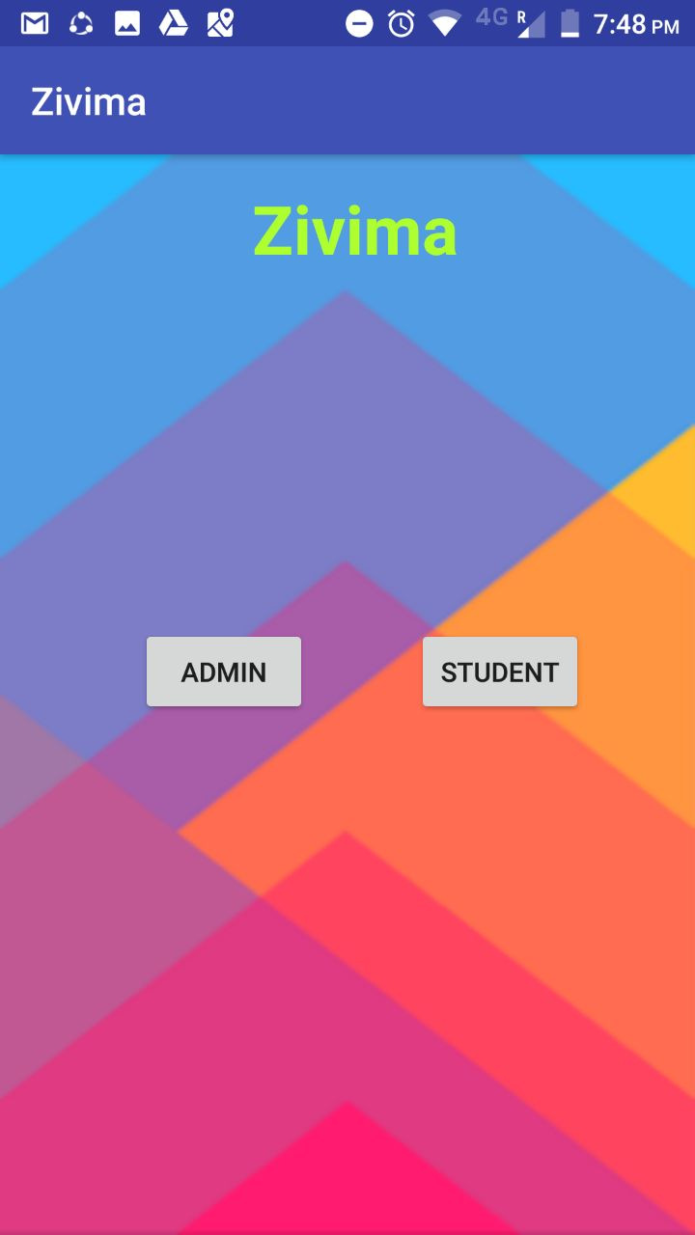
MODULE IDENTIFICATION
HOME PAGE:
The home page of the project contains the entry level access for the application ZIVIMA
Home links to the Student login page or Admin login page .

Slide 19
MODULE IDENTIFICATION
STUDENT LOGIN:
The students can use this application through their unique user ID and password by sign in through their personal and academic details.
The database will store the student’s login ID and password while registration process itself and verify it from database.
If the students type the invalid user ID or password, ‘Authentication failed’
error message will be thrown.

Slide 20
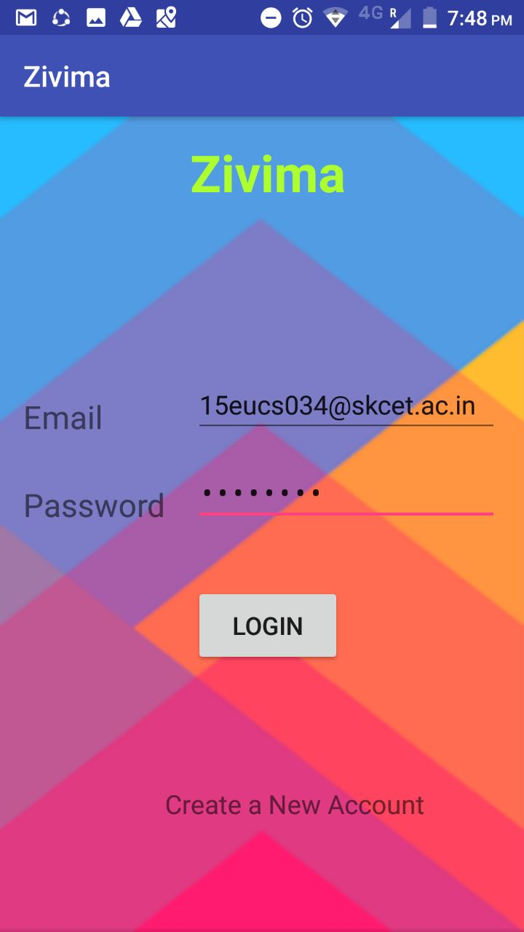
LOGIN PAGE

Slide 21
CREATE AN ACCOUNT
If the student does not have the login Id before, he/she can register with their details by creating a new account.
Registration form will contain the following fields.
User name
College Name
Year
Login ID
Password
Phone Number
If an essential field is not filled in the form then an error is thrown stating to fill in that field.

Slide 22
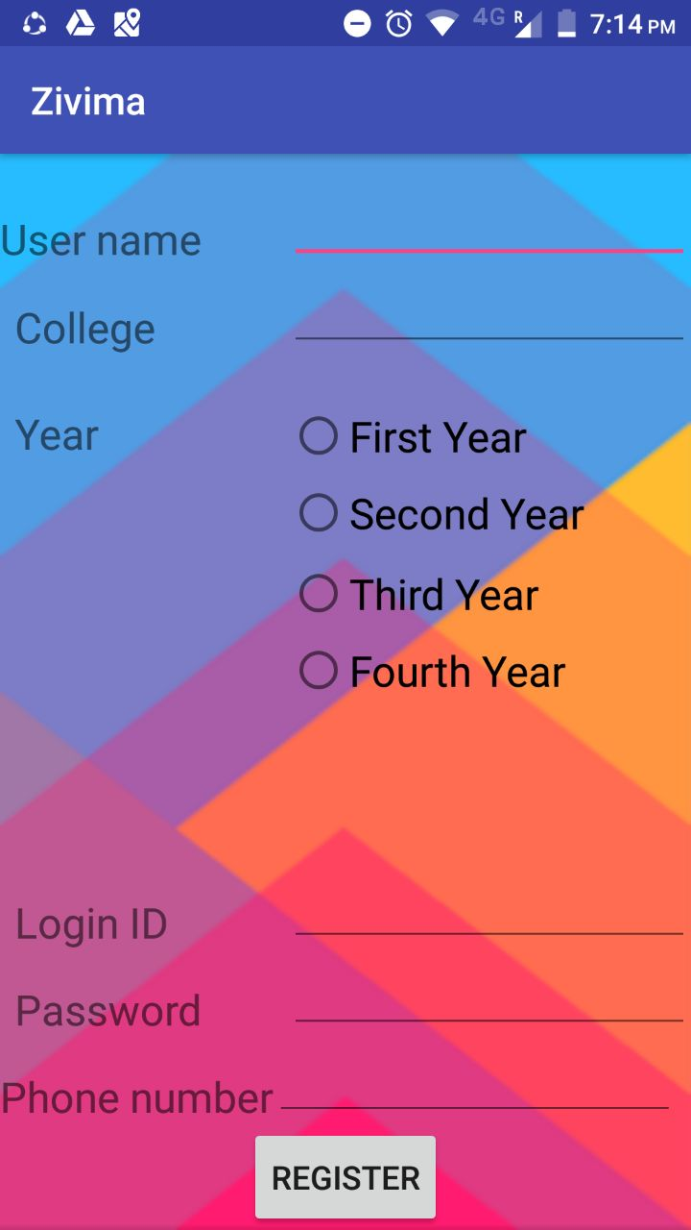
REGISTRATION PAGE

Slide 23
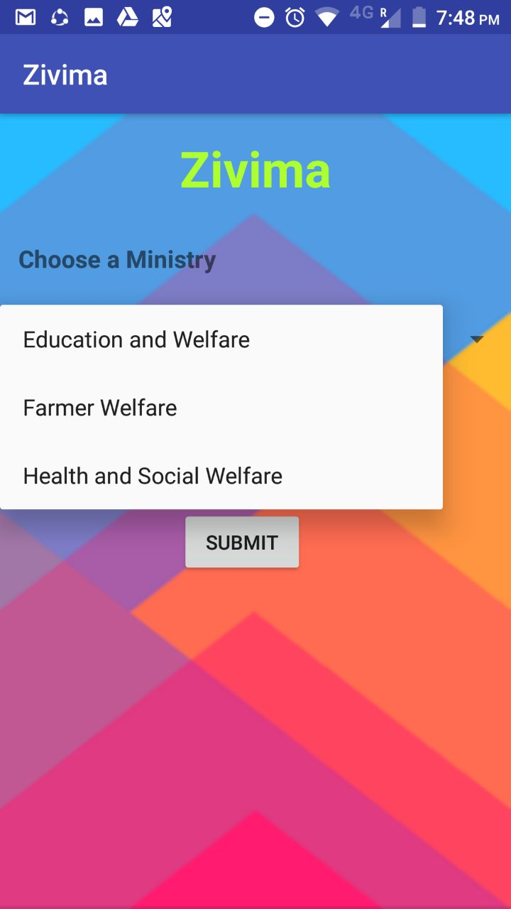
SELECT MINISTRY
After the authentication the ministry for different department module list is displayed where the student can choose the department.

Slide 24
PROBLEM STATEMENT
Once the student select the department of the ministry , they can view several problem statements.
The problem statements are related to the corresponding ministry.
Student can view all the problem statements and choose the one for which they can provide a innovative solution and can create a appropriate working prototype.
Then click attach file button to submit their PDF of the abstract.

Slide 25
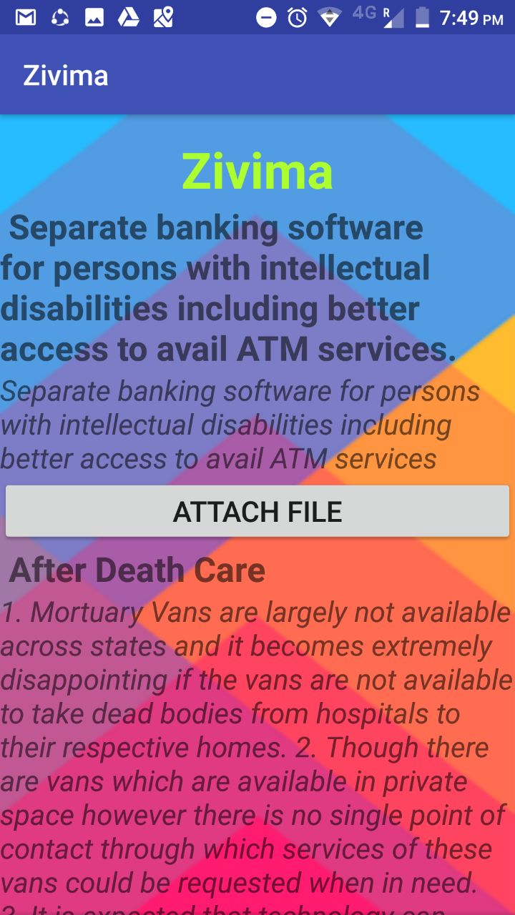
PROBLEM STATEMENT PAGE

Slide 26
UPLOAD PDF
Once the student select their project he/she can upload the abstract of their project .
For uploading ,the abstract file must be in PDF format and the name of the File is entered in text field.
Now click the upload and submit button.
So that the respective details of the student are stored in the database with their abstract.
This file is secured and can be viewed only by the District authority.

Slide 27
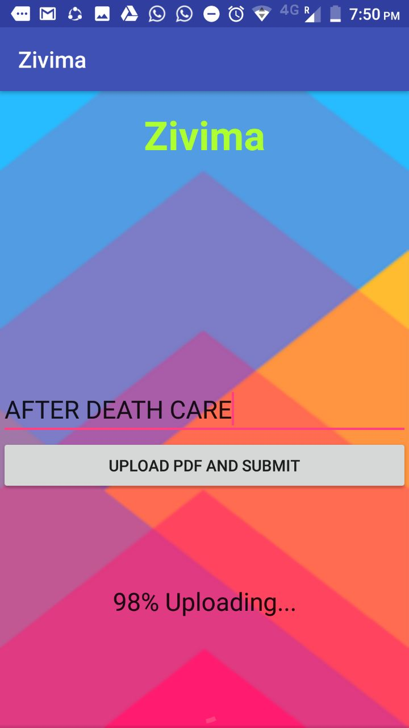
UPLOADING PDF

Slide 28
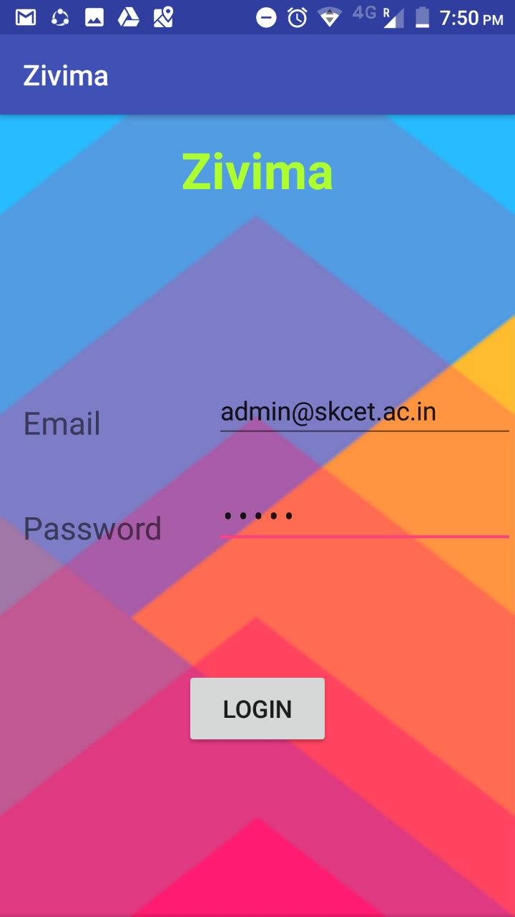
ADMIN LOGIN PAGE
The Admin/district authority should be authenticated
They should have their user id and password individually

Slide 29
ABSTRACT SUBMISSION PAGE
Once the admin/district authority is successfully log in, he/she can view all the abstracts submitted by the student along with their details.
The district authority can verify it by downloading those abstracts.
The following details can be viewed by the district authority.
User name
College
Abstract title
Phone number

Slide 30
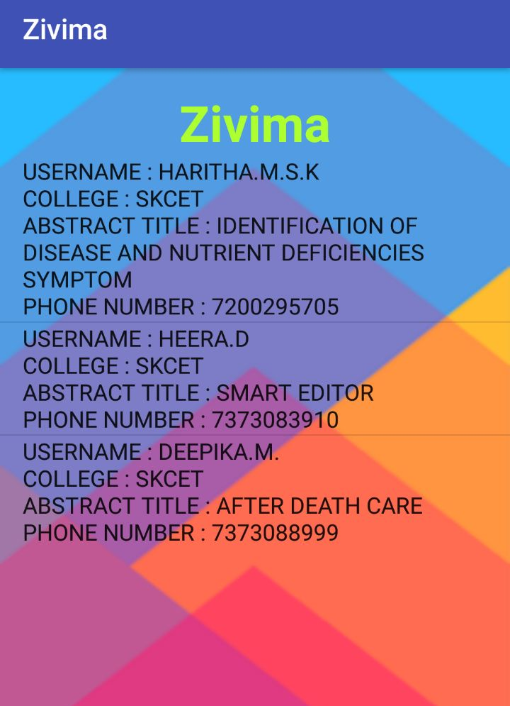
ABSTRACT PAGE

Slide 31
DATA FLOW DIAGRAM

Slide 32


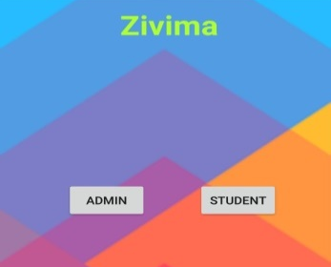
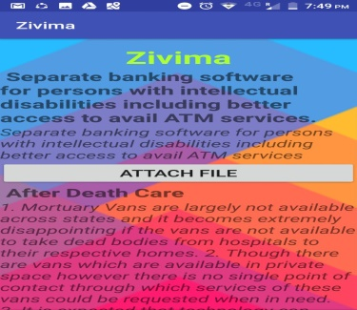
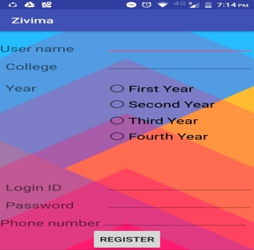


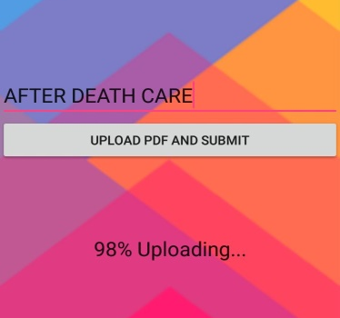
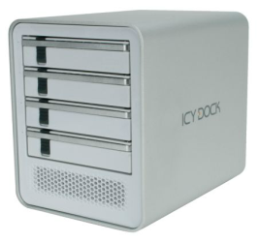

STUDENT’S ARCHITECTURAL DIAGRAM
MINISTRY LIST
LOGIN
PROBLEM STATEMENT
STORAGE
MAIN ACTIVITY
SIGN IN
REAL TIME DATABASE
FIREBASE
UPLOAD PDF

Slide 33


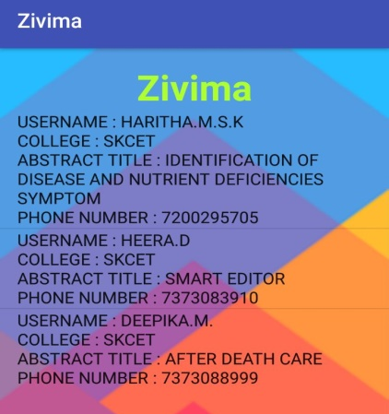
ADMIN ARCHITECTURAL DIAGRAM
ADMIN LOGIN
MAIN ACTIVITY
FIREBASE
ABSTRACT SUBMISSION
REAL TIME DATABASE
DOWNLOAD ABSTRACT

Slide 34
CONCLUSION

Slide 35
CONCLUSION
Thus the proposed system (ZIVIMA) provides a platform to the students from our district with ideas and prototypes, which can be transformed into working products. It is an independent, non-profit entity.
It is a facilitator for people with out-of-box ideas, or innovative working prototypes.
Thus ZIVIMA is a very good platform to contribute your innovative ideas for our country.

Slide 36
FUTURE ENHANCEMENT

Slide 37
FUTURE WORK
Initially it is implemented in District wise.
Further based on Success will expand throughout INDIA by connecting higher authorities of INDIA.
Will send notifications to the student for the authentication of their project.

Slide 38
REFERENCES

Slide 39
WEBSITES:
https://www.tutorialspoint.com/android/android_studio.htm
https://developer.android.com/guide/index.html
https://developer.android.com/training/basics/firstapp/index.html
https://www.simplifiedcoding.net/firebase-storage-example/
https://stackoverflow.com/questions/14399119/attaching-a-file-of-any-type-in-android-application
https://www.lynda.com/Android-Studio-training-tutorials/6597-0.html
https://in.udacity.com/course/new-android-fundamentals--ud851

Slide 40
THANK YOU

