Slide 1


accidents data analysis system
Project Members : Mentor :
Thota Deepika Lakshmi Nageswari Mr.G.Tirupathi
323103211054 Professor
Information Technology
Department of Information Technology

Slide 2
INDEX
1.Abstract
2.Existing System
3.Proposed System
4.Software Requirements
5.Implementation
6.Results
7.Conclusion
8.Future Enhancements
9.References

Slide 3
ABSTRACT
The Traffic Accident Data Analysis System is a data science–based application developed using Python to analyze and visualize road accident data. The system processes accident records to identify patterns related to accident severity, weather conditions, road surface types, lighting conditions, and peak accident hours. An interactive web interface is built using Streamlit, enabling users to explore accident trends through dynamic charts and dashboards. The project helps in understanding critical factors contributing to accidents and supports decision-making for improving road safety and traffic management.

Slide 4
EXISTING SYSTEM
Manual Data Analysis:
Accident data is traditionally analyzed using spreadsheets and static reports, which is time-consuming and error-prone.
Limited Visualization:
Existing systems provide basic charts that lack interactivity and detailed insights.
Example: Monthly accident reports without time-based or weather-based filtering.
No User Interaction:
Users cannot dynamically explore accident patterns or drill down into specific factors such as peak hours or road conditions.

Slide 5
PROPOSED SYSTEM
Interactive Data Analysis:
Uses Python and Streamlit to allow users to interact with accident data dynamically.
Visual Analytics:
Provides pie charts, bar charts, heatmaps, sunburst charts, and area graphs for clear understanding.
Real-Time Insights:
Automatically computes peak accident hours, most affected days, and dominant weather conditions.
User-Friendly Interface:
Sidebar-based navigation allows users to select different analysis modules easily.
Scalability:
Can handle large datasets efficiently using Pandas and optimized data processing.
Applications:
Traffic planning, road safety analysis, policy making, and academic research.

Slide 6
SOFTWARE REQUIREMENTS
Programming Language:
Python 3.x
Libraries:
Pandas – Data manipulation
Plotly – Interactive visualizations
Streamlit – Web application framework
Tools:
NotePad
Command prompt
Dataset:
traffic_accidents.csv

Slide 7
IMPLEMENTATION
Load accident dataset using Pandas.
Perform data cleaning and handling of missing values.
Extract time-based features such as hours and days.
Develop interactive dashboard using Streamlit.
Implement multiple analysis modules:
Drunk Driver Analysis
Weather-Based Analysis
Road and Light Condition Analysis
Weekly and Hourly Accident Trends
Accident peak hours
Display insights using interactive charts and graphs.

Slide 8
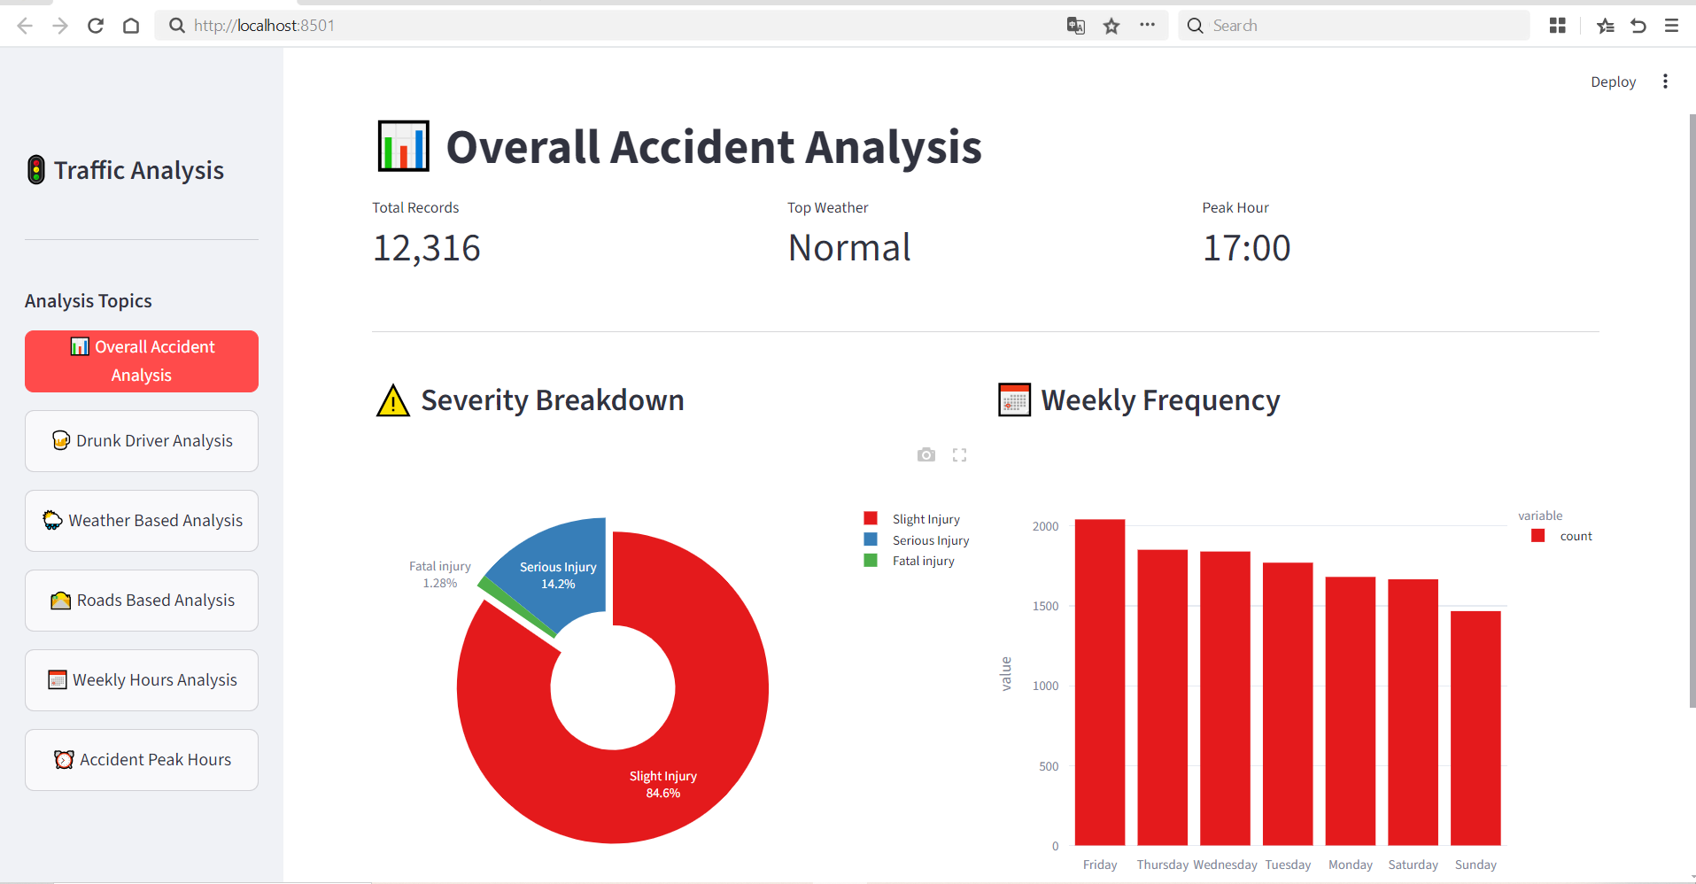
RESULTS

Slide 9
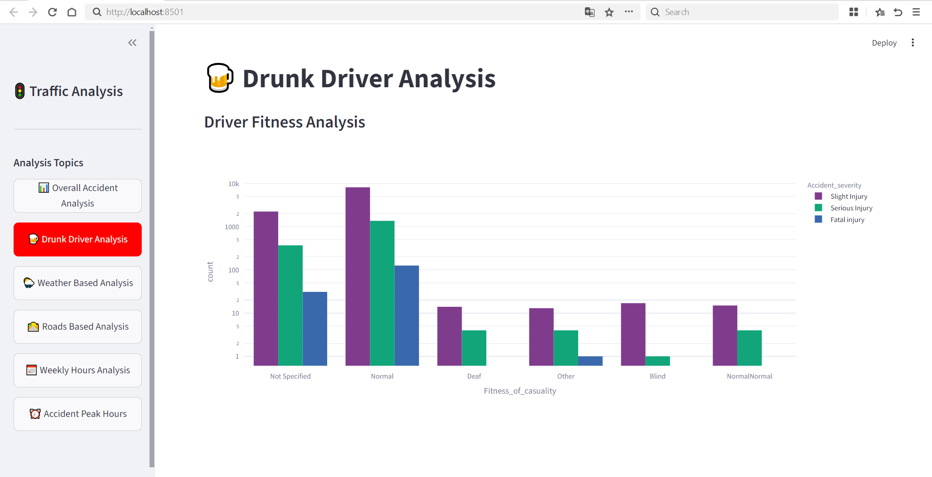

Slide 10
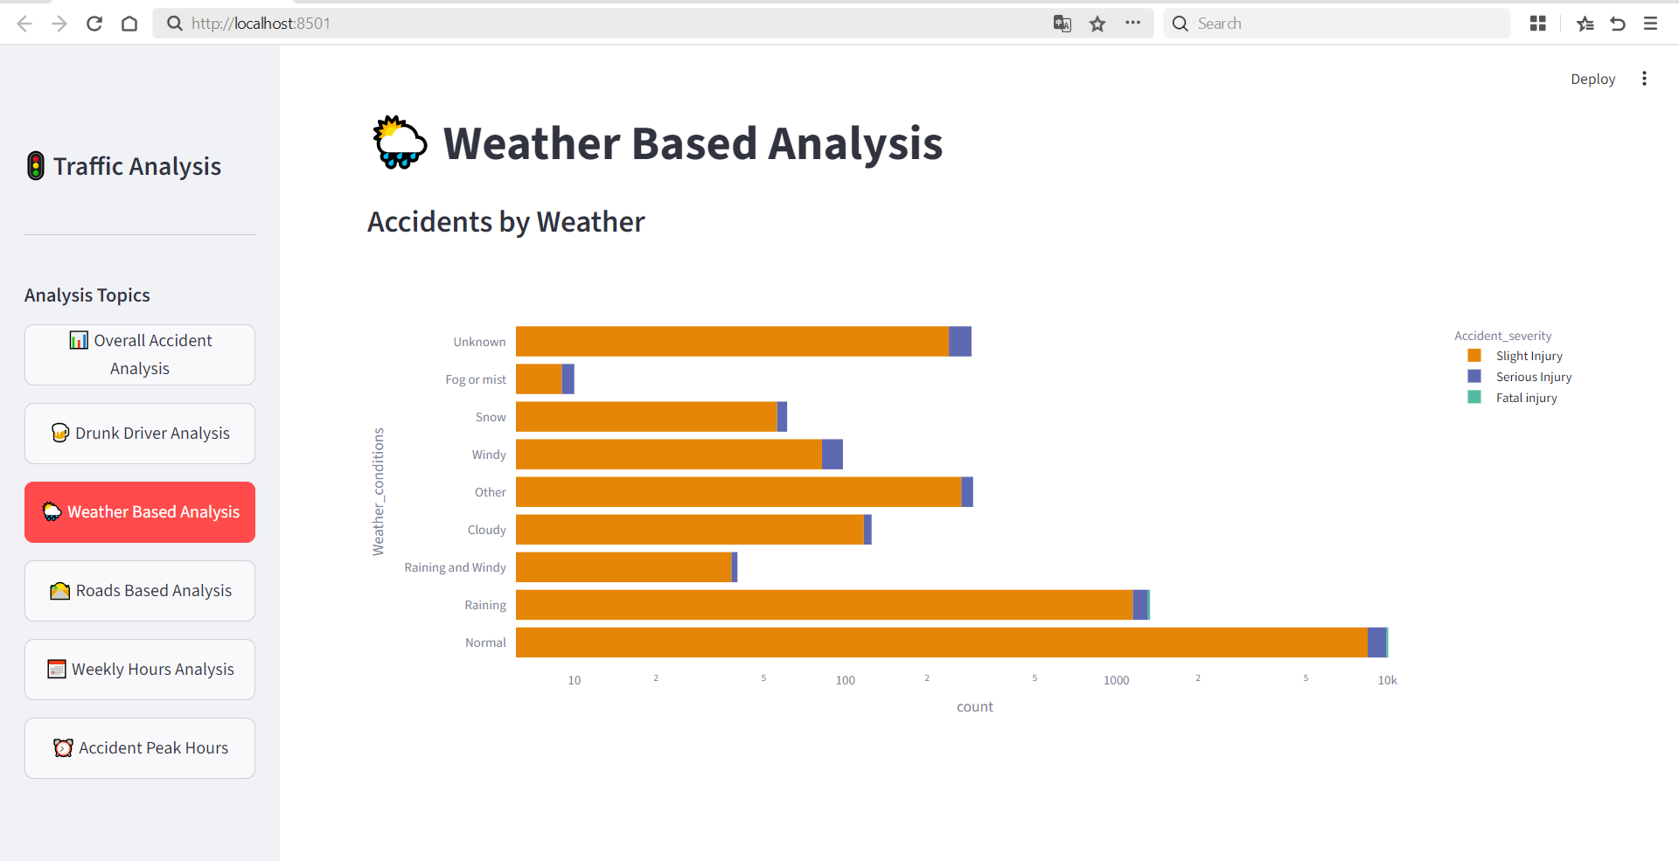

Slide 11
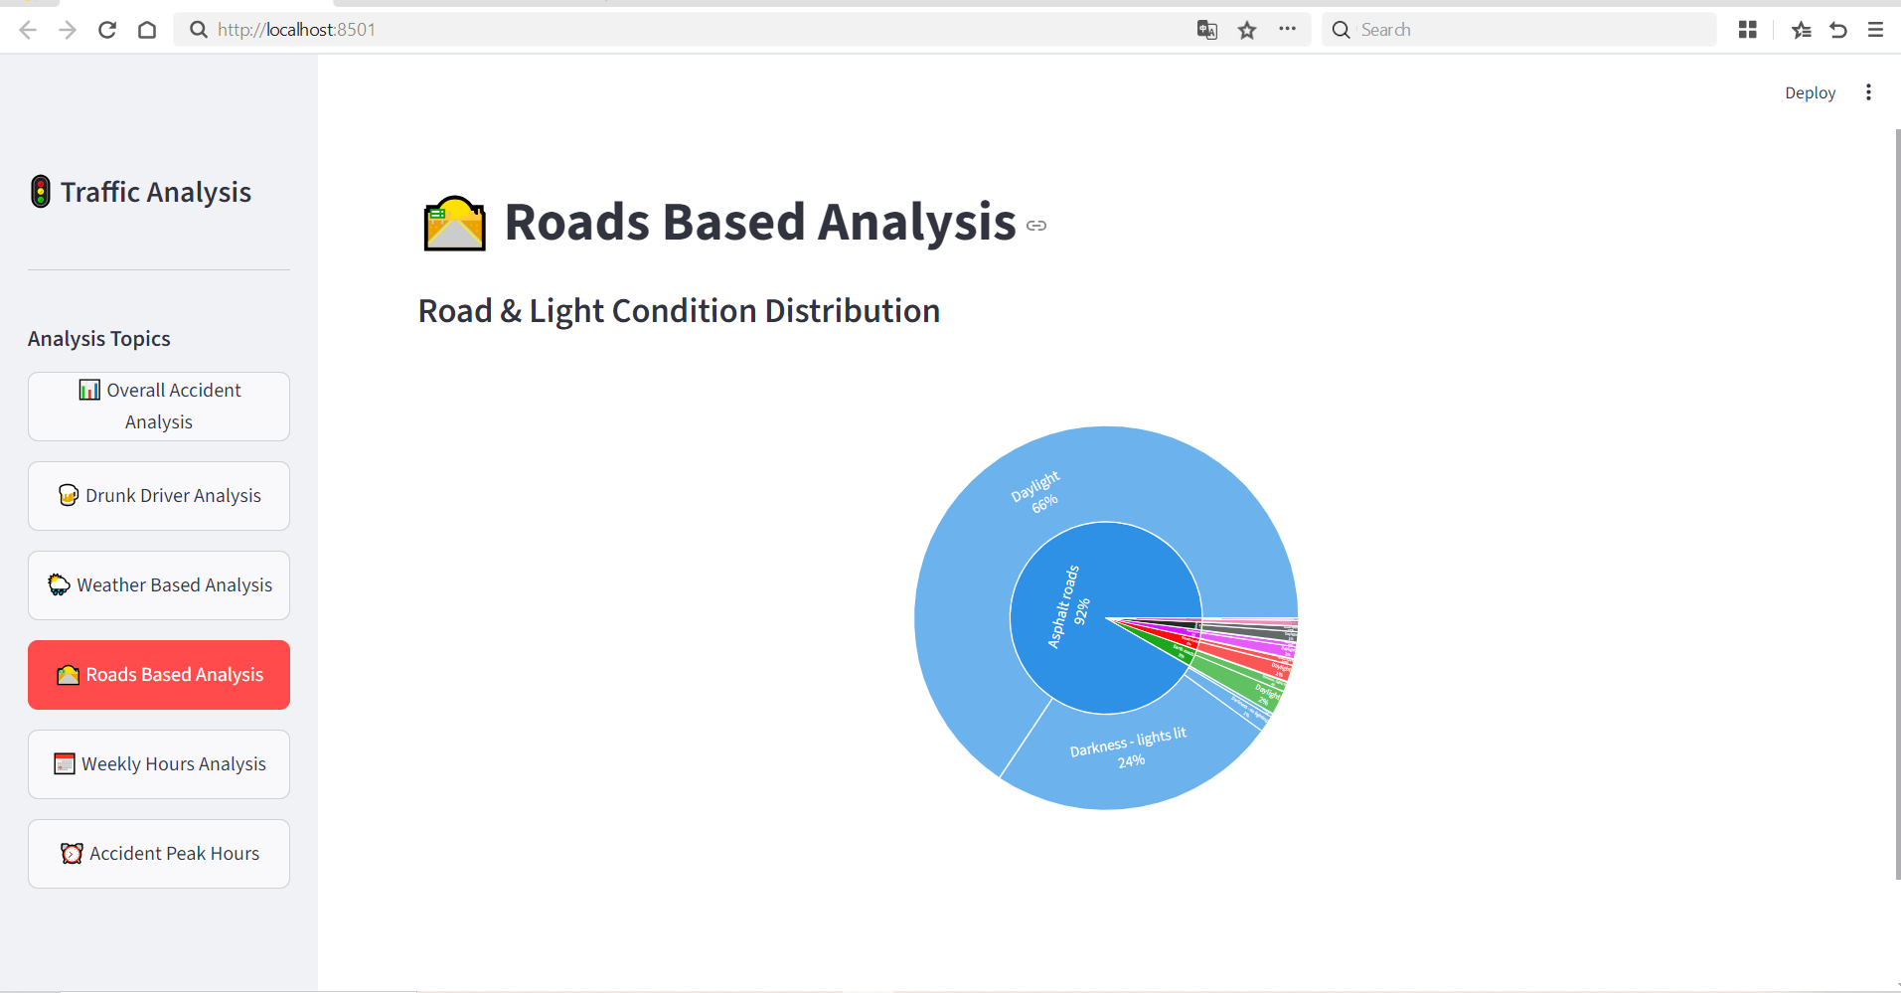

Slide 12
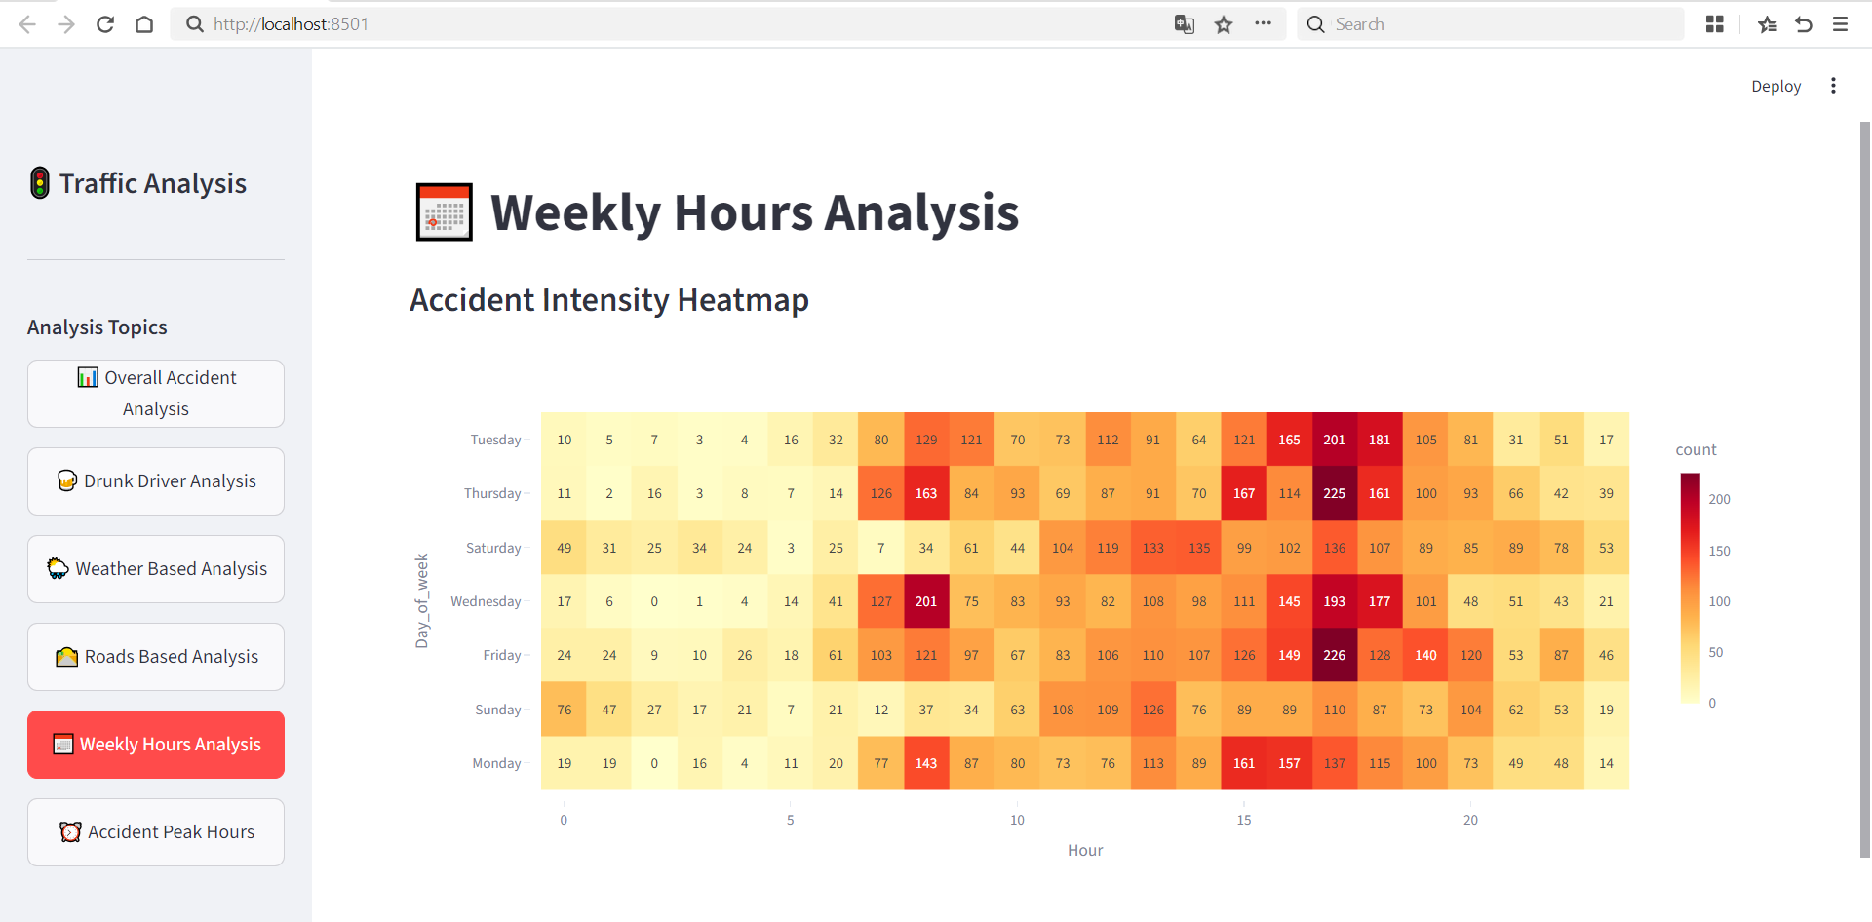

Slide 13
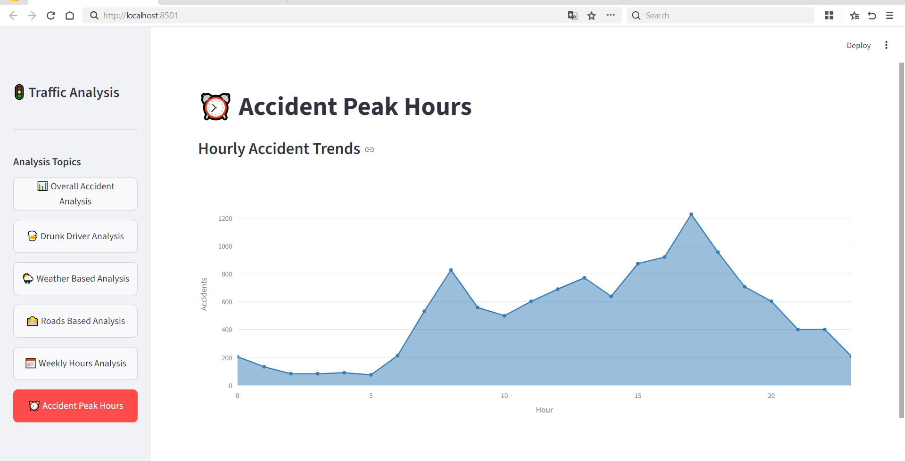

Slide 14
CONCLUSION
The Traffic Accident Data Analysis System demonstrates the effective use of data science techniques for analyzing real-world traffic accident data. By combining Python, Pandas, Plotly, and Streamlit, the project delivers meaningful insights through an interactive and user-friendly interface. The system helps identify critical accident patterns and supports initiatives aimed at reducing road accidents and improving public safety.

Slide 15
FUTURE ENHANCEMENTS
Integration of real-time accident data
Location-based accident analysis using maps
Predictive analysis for accident-prone areas
Integration with government traffic databases
Mobile-friendly dashboard interface

Slide 16
REFERENCES
Python Documentation – https://docs.python.org
Pandas Documentation – https://pandas.pydata.org
Plotly Documentation – https://plotly.com
Streamlit Documentation – https://streamlit.io

Slide 17
THANK YOU

