Slide 1
Building a Mini compiler using Lex and Yacc
Batch -15
23H51A05GA – K.KRISHNADEEP
23H51A05GB – K.DEEPIKA
23H51A05GD – K.PRANAVI

Slide 2
Introduction
With the increasing complexity of programming languages, compilers play an essential role in translating human-readable source code into machine-understandable instructions.
A compiler processes code through multiple stages such as lexical analysis, syntax analysis, and semantic analysis to detect errors and generate structured output.
This project implements a Mini-C Compiler that analyzes a simplified C program using lexical and syntax analysis. The system identifies tokens, validates program structure, and displays symbol table information.

Slide 3
Abstract
The Mini-C Compiler project demonstrates the fundamental stages of compiler construction using lexical analysis and syntax parsing to process a simplified C program.
Using tools like Flex and GNU Bison, the compiler identifies tokens, checks grammar rules, and builds a parse structure.
The system also generates a symbol table and parse tree, helping visualize how compilers analyze the structure of programming languages.

Slide 4
Objectives
To design and implement a Mini-C compiler capable of analyzing a simplified C program.
To understand compiler phases such as lexical analysis, syntax parsing, and token generation.
To learn how automated tools can be used to build compilers efficiently and detect errors in source code.

Slide 5
Tools Used
Flex is used to perform lexical analysis by breaking the input program into tokens like keywords, identifiers, and operators.
GNU Bison is used to define grammar rules and perform syntax analysis to validate the structure of the program.
GCC is used to compile the generated C files and create the executable compiler.

Slide 6
Working Principle
The compiler takes a Mini-C program as input and performs lexical analysis to convert the source code into tokens representing different elements of the language.
Next, syntax analysis checks whether the sequence of tokens follows the grammar rules defined in the parser.
If the program is valid, the compiler generates outputs such as the symbol table and parse tree that represent the structure of the program.

Slide 7
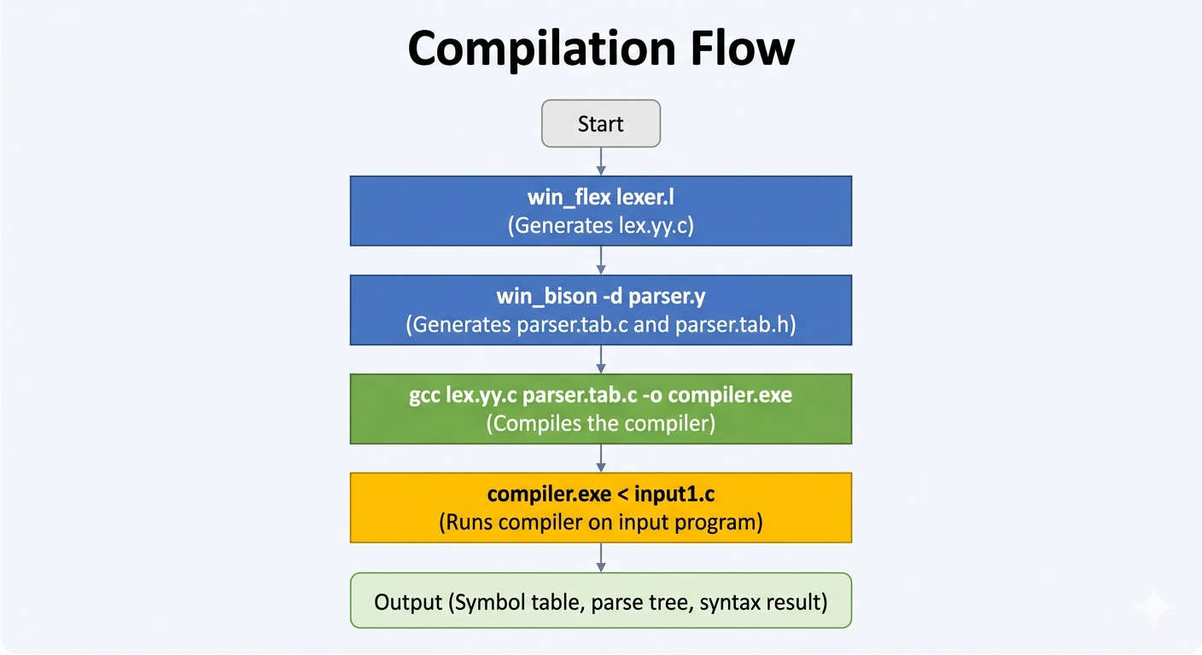
Flow Diagram

Slide 8
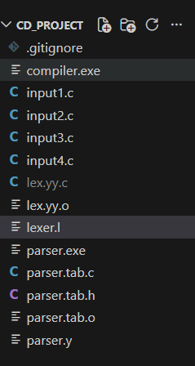
Project Structure and Code
Code : Github Repository - https://github.com/Deepika-909/miniC
Project Structure :

Slide 9
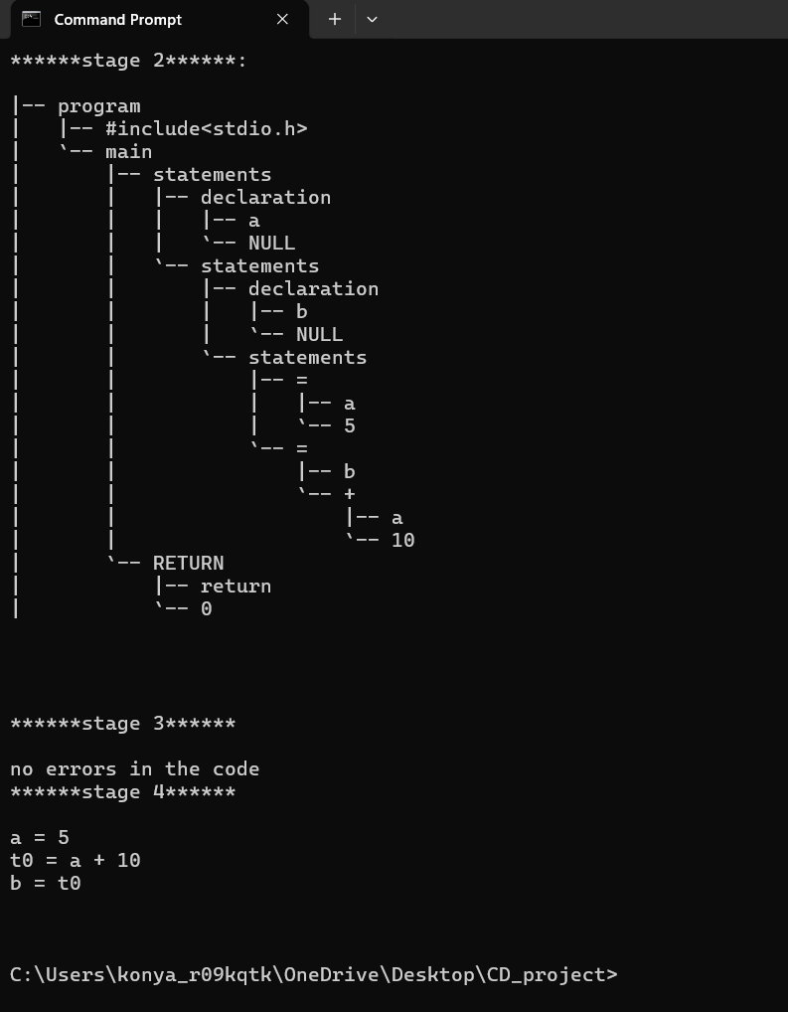
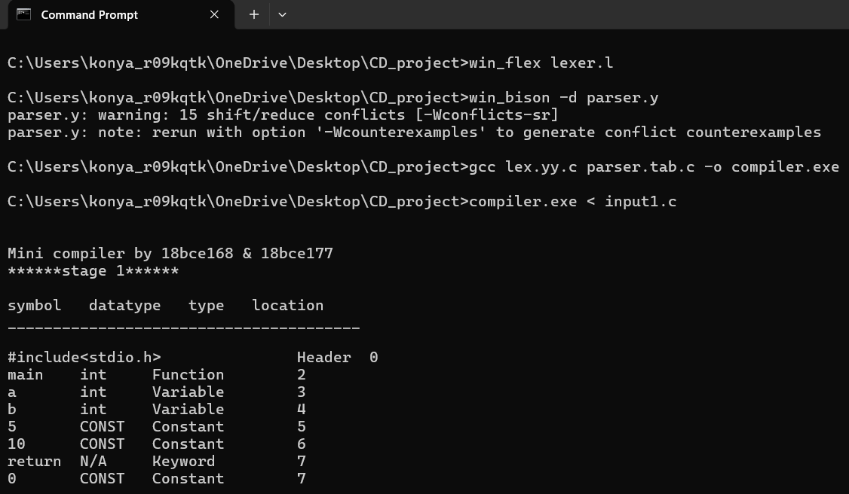
Output

Slide 10
Scope / Applications
The project helps students understand the internal working of compilers and how programming languages are processed by machines.
The concepts used are applied in the development of compilers, interpreters, and programming language processors.
These techniques are also useful in building tools such as code analyzers, debuggers, and automated software development systems.

Slide 11
Conclusion
The Mini-C Compiler project successfully demonstrates the basic stages of compiler construction including lexical analysis and syntax parsing.
It provides hands-on experience with compiler tools and helps understand how source code is analyzed and validated.
The project highlights the importance of compiler technology in modern software development and programming language design.

