Slide 1


VISVESVARAYA TECHNOLOGICAL UNIVERSITY Government Engineering College Raichur-584135 2023-24
INTERSHIP
ON
“PYTHON WITH DJANGO”
Department of Computer science & Engineering
NAME USN
DEEPIKA BIRADAR 3GU20CS011

Slide 2
CONTENTS
About company
Python-Introduction
Introduction to Django overview.
Features of Django
Advantages & disadvantages of Django
MVT Pattern
Steps to create project in Django
Demonstration of Internship project
Conclusion

Slide 3
ABOUT COMPANY
Technosoft is a one of the IT service provider in Karnataka. Incorporated in a year 2019, it has grown from strength to strength. It's guiding principle remains unchanged, providing most suitable product and IT solution service.
Technosoft has build up an extensive network of Customer , Business Partners / Authorized Channel partner with Global technology brands. Our efficient, well-trained and professional store advisors are completely equipped to offer sound and personalized advice for helping a customer receive the best value for money.
In the process of custom application development they also place great value and focus on transferring knowledge to the client's staff so they are able to fully maintain the system once it is in production.

Slide 4
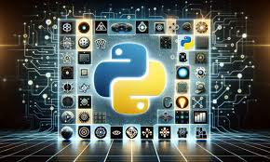
INTRODUCTION
Python is an interpreted, interactive, object-oriented programming language.
Python has a simple syntax similar to the english language. Python has syntax that allows developers to write programs with fewer lines than some other programming languages.
Python runs on an interpreter system, meaning that code can be executed as soon as it is written. This means that prototyping can be very quick.
Python syntax
Syntax in a programming language is a standard way of expressing values
To print a statement- print(“hello world”)
Output: hello world

Slide 5
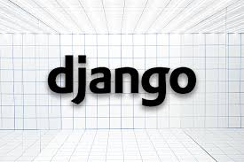
WHAT IS DJANGO?
Django is a high-level Python Web framework that encourages rapid development and clean, pragmatic design. It is a free and open-source web framework, written in Python
Django makes it easier to build better Web apps more quickly and with less code.
The Web framework with perfectionists with deadlines.
It is maintained by the Django Software Foundation (DSF).

Slide 6
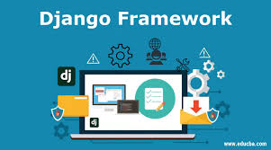
FEATURES OF DJANGO FRAMEWORK
Excellent Documentation
Rapid Development
Enhance Security
Versatile
Open Source
Vast and Supported Community

Slide 7
ADVANTAGES & DISADVANTAGES OF DJANGO
Advantages
Disadvantages
Rapid Development
Security
Built-in Admin Interface
ORM and Database Support
Scalability
Monolithic Structure
Limitations of ORM
Step Learning Curve for Novices
Permormance Overheads
Not Always Appropriate for Small Projects

Slide 8
WHAT IS MVT?
The MVT pattern in Django, or Model-View-Template, is a software design pattern that separates the data, user interface, and application logic into three distinct components. This makes it easier to maintain and update the code, as each component can be changed independently of the others.The Model component is responsible for storing and managing the data. It defines the structure of the data and how it interacts with the database. The View component is responsible for handling user requests and generating responses. It retrieves data from the Model and renders it using the Template component. The Template component is responsible for displaying the data to the user. It is an HTML file with embedded Python code (using Django's template language).

Slide 9
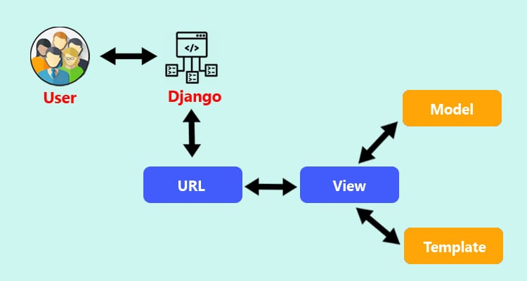
MVT PATTERN

Slide 10
MODELS
Models in Django are the building blocks of your database. They are Python classes that subclass django.db.models.Model. Each model represents a database table, and each attribute of the model represents a field in the table.
When you create a model, Django automatically creates a database table for it. The table will have a column for each field in the model.
For example, the following model represents a blog post:
from django.db import models
class Post(models.Model):
title = models.CharField(max_length=255)
body = models.TextField()
timestamp=models.DateTimeField(auto_now_add=True)

Slide 11
VIEWS
In Django, views are Python functions or classes that take a web request and return a web response. The response can be an HTML page, a JSON object, or any other type of content.There are two types of views in Django: function-based views and class-based views.Function-based views are the simpler of the two types. They are just Python functions that take a web request and return a web response.Class-based views are more complex, but they offer more flexibility and reusability. They are defined as classes that inherit from the View class.To create a view, you first need to define a URL pattern for it. This is done in the urls.py file of your Django project.Once you have defined a URL pattern for your view, you need to create a Python function or class that implements the view.
from django.urls import path
urlpatterns = [
path('', views.index, name='index'),
]

Slide 12
TEMPLATES
Templates are the third and most important part of Django’s MVT Structure.
A Template in Django is basically written in HTML, CSS and JavaScript in a .html
file. Django framework efficiently handles and generates dynamic HTML web pages that are visible to the enduser. Django mainly functions with the backend so, in order to provide a frontend and provide a layout to our website, we use templates.
To use templates in Django, you need to create a template directory in your app directory. The name of the template directory is arbitrary, but it is typically called templates.
Within the template directory, you can create individual template files. Each template file should have a .html extension.

Slide 13

STEPS TO CREATE PROJECT IN DJANGO
DJANGO-ADMIN STARTPROJECT projectname Ex: django-admin startproject gecr
PYTHON MANAGE.py STARTAPP appname Ex:cd gecr Python manage.py startapp student
Go to application folder open apps.py copy the class name and paste it in serverfolder->settings.py->installed_apps(applicationname.apps.classnameConfig)
Copy urls.py from server folder and paste in application folder.
In ursl.py import include method from urls.
Call urls.py(of application) in project urls.py Syntax: path('name/',include('applicationname.urls

Slide 14
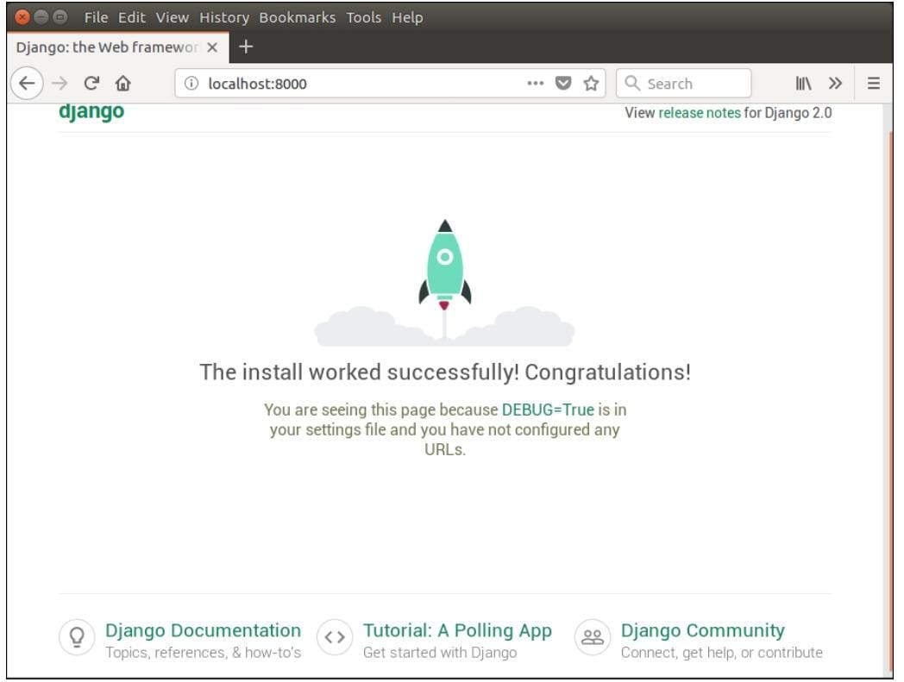
DJANGO-ADMIN STARTPROJECT projectname Ex: DJANGO-ADMIN STARTPROJECT gecr
PYTHON MANAGE.py STARTAPP appname Ex:cd gecr Python manage.py startapp student
Go to application folder open apps.py copy the class name and paste it in serverfolder->settings.py->installed_apps(applicationname.apps.classnameConfig)
Copy urls.py from server folder and paste in application folder.
In ursl.py import include method from urls.
Call urls.py(of application) in project urls.py Syntax: path('name/',include('applicationname.urls

Slide 15

DEMONSTRATION OF INTERNSHIP PROJECT
demo

Slide 16
CONCLUSION
Django is a web application framework built with Python. It allows us to easily create dynamic web apps using Python.
It provides powerful functionalities and concise syntax to help programmers deal with the database.
Python is an interpreted, object-oriented, high-level programming language with dynamic semantics.
It supports modules and packages, which encourages program modularity and code reuse.
I gained experience in using various tools and technologies, such as Sublime text, command prompt and Django.
The project also enabled me to work in a team environment and develop problem-solving skills.

Slide 17


