Slide 1
UNIT-2 SECURITY AT TRANSPORT LAYER
School of CSE
Mrs.Ranjitha U.N
Ranjitha.un@reva.edu.in

Slide 2
WEB SECURITY CONSIDERATIONS
The Internet is two-way →Web is vulnerable to attacks on the Web servers over the Internet
The Web is a key platform for business and information, but server breaches can harm reputations and cause financial loss
Despite their ease of use and setup, Web systems are built on complex software that often contains hidden security flaws, making them vulnerable to attacks—even when properly installed
A compromised Web server can give attackers access to broader corporate systems and data connected to it.
Many Web users lack security training and awareness, making them unable to recognize or counter risks
Notes:
Machine Learning(ML) can be explained as automating and improving the learning process of computers based on their experiences without being actually programmed i.e. without any human assistance. The process starts with feeding good quality data and then training our machines(computers) by building machine learning models using the data and different algorithms. The choice of algorithms depends on what type of data do we have and what kind of task we are trying to automate

Slide 3
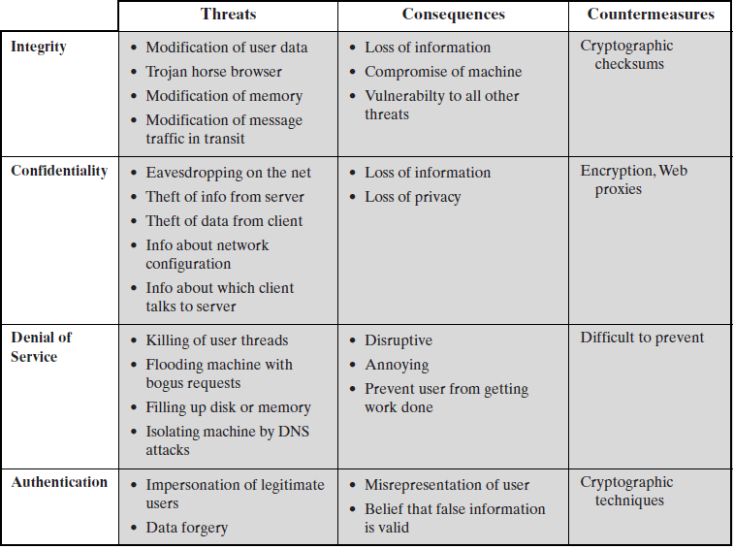
Web Security Threats
One way to group these threats is in terms of passive and active attacks.
Another way to classify Web security threats is in terms of the location of the threat
Notes:
Machine Learning(ML) can be explained as automating and improving the learning process of computers based on their experiences without being actually programmed i.e. without any human assistance. The process starts with feeding good quality data and then training our machines(computers) by building machine learning models using the data and different algorithms. The choice of algorithms depends on what type of data do we have and what kind of task we are trying to automate

Slide 4
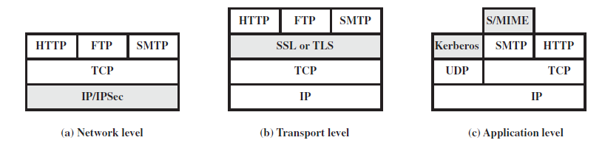
Web Traffic Security Approaches(scope of applicability withIN tcp/ip stack)
SSL and its successor TLS are key security protocols. They can be built into the protocol stack or included in applications like Web browsers(netscape,explorer) and servers
service can be tailored to the specific needs of a given application
transparent
to end users and applications
provides a general-purpose solution.
includes a filtering capability so that only selected traffic need
incur the overhead of IPsec processing.
Notes:
Machine Learning(ML) can be explained as automating and improving the learning process of computers based on their experiences without being actually programmed i.e. without any human assistance. The process starts with feeding good quality data and then training our machines(computers) by building machine learning models using the data and different algorithms. The choice of algorithms depends on what type of data do we have and what kind of task we are trying to automate

Slide 5
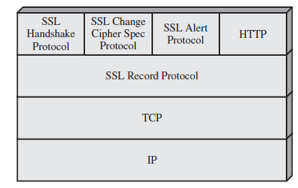
SECURE SOCKET LAYER AND TRANSPORT LAYER SECURITY
Netscape originated SSL. SSL is designed to make use of TCP to provide a reliable end-to-end secure service
SSL Architecture:
SSL is not a single protocol but rather two layers of protocols
SSLspecific
protocols are used in the management of SSL exchanges
provides
the transfer service for Web client/server interaction
provides basic security services to various higher layer
protocols
Notes:
Machine Learning(ML) can be explained as automating and improving the learning process of computers based on their experiences without being actually programmed i.e. without any human assistance. The process starts with feeding good quality data and then training our machines(computers) by building machine learning models using the data and different algorithms. The choice of algorithms depends on what type of data do we have and what kind of task we are trying to automate

Slide 6
SSL Architecture
Two important SSL concepts are the SSL session and the SSL connection → Connection, Session
Connection : A connection is a transport . connections are peer-to-peer relationships. The connections are transient. Every connection is associated with one session.
.
Session: An SSL session is an association between a client and a server. Sessions are created by the Handshake Protocol
Between any pair of parties (applications such as HTTP on client and server),there may be multiple secure connections.
There are a number of states associated with each session.
Once a session is established, there is a current operating state for both read and write
In addition, during the Handshake Protocol, pending read and write states are created
Upon successful conclusion of the Handshake Protocol, the pending states become the current states
Notes:
Machine Learning(ML) can be explained as automating and improving the learning process of computers based on their experiences without being actually programmed i.e. without any human assistance. The process starts with feeding good quality data and then training our machines(computers) by building machine learning models using the data and different algorithms. The choice of algorithms depends on what type of data do we have and what kind of task we are trying to automate

Slide 7
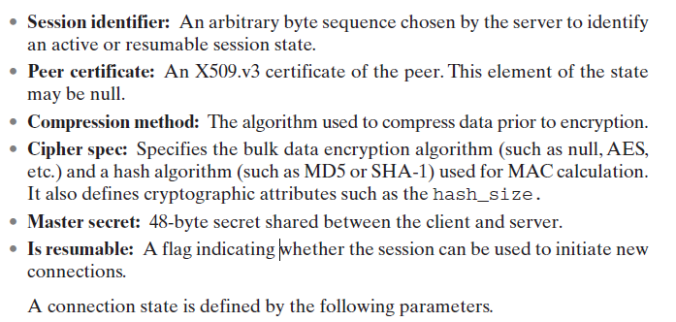
SSL Architecture
A session state is defined by the following parameters.
.
Notes:
Machine Learning(ML) can be explained as automating and improving the learning process of computers based on their experiences without being actually programmed i.e. without any human assistance. The process starts with feeding good quality data and then training our machines(computers) by building machine learning models using the data and different algorithms. The choice of algorithms depends on what type of data do we have and what kind of task we are trying to automate

Slide 8
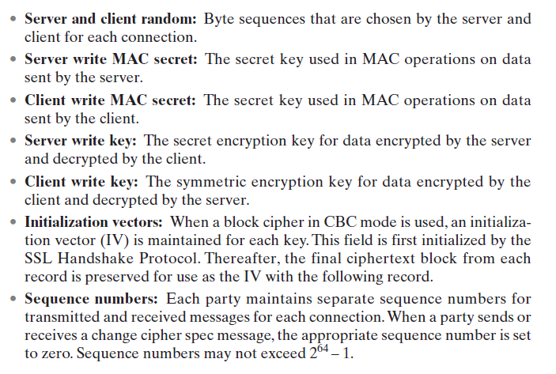
SSL Architecture
A connection state is defined by the following parameters.
.
Notes:
Machine Learning(ML) can be explained as automating and improving the learning process of computers based on their experiences without being actually programmed i.e. without any human assistance. The process starts with feeding good quality data and then training our machines(computers) by building machine learning models using the data and different algorithms. The choice of algorithms depends on what type of data do we have and what kind of task we are trying to automate

Slide 9
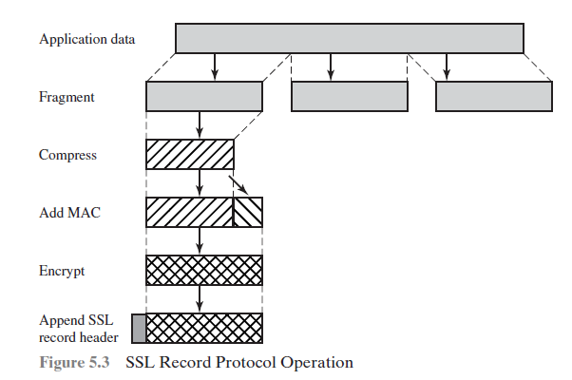
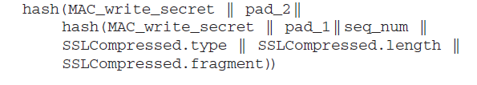
SSL Record Protocol
The SSL Record Protocol provides two services for SSL connections:
• Confidentiality: The Handshake Protocol defines a shared secret key that is used for conventional encryption of SSL payloads.
• Message Integrity: The Handshake Protocol also defines a shared secret key that is used to form a message authentication code (MAC).
.
blocks of 2^14 bytes (16384 bytes) or less
Compression must be lossless
For stream encryption, the compressed message plus the MAC are encrypted(RC4-40 ,RC4128)
For block encryption, padding may be added after the MAC prior to encryption.(AES,IDEA,DES,3DES)
Notes:
Machine Learning(ML) can be explained as automating and improving the learning process of computers based on their experiences without being actually programmed i.e. without any human assistance. The process starts with feeding good quality data and then training our machines(computers) by building machine learning models using the data and different algorithms. The choice of algorithms depends on what type of data do we have and what kind of task we are trying to automate

Slide 10
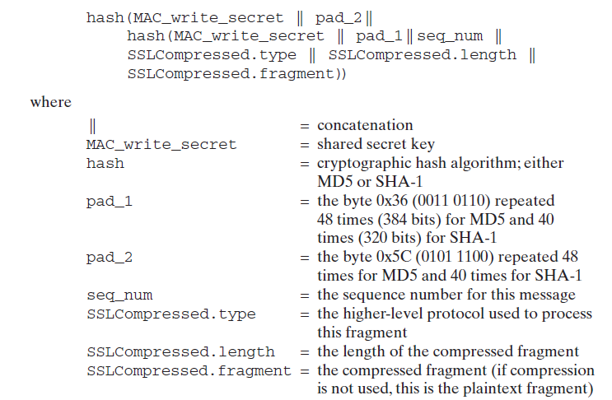
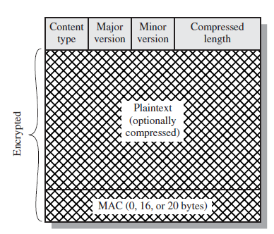
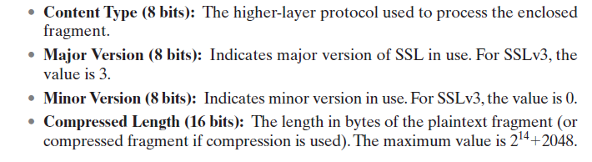
SSL Record Protocol
.
Notes:
Machine Learning(ML) can be explained as automating and improving the learning process of computers based on their experiences without being actually programmed i.e. without any human assistance. The process starts with feeding good quality data and then training our machines(computers) by building machine learning models using the data and different algorithms. The choice of algorithms depends on what type of data do we have and what kind of task we are trying to automate

Slide 11
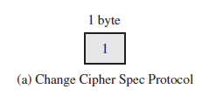
SECURE SOCKET LAYER AND TRANSPORT LAYER SECURITY
.
SSL Record Protocol content types that have been defined are change_cipher_spec, alert,
handshake, and application_data.
Change Cipher Spec Protocol
1.it is the simplest.
2.This protocol consists of a single message ,which consists of a single byte with the value 1.
3.The sole purpose of this message is to cause the pending state to be copied into the current state, which updates the cipher suite to be used on this connection
Notes:
Machine Learning(ML) can be explained as automating and improving the learning process of computers based on their experiences without being actually programmed i.e. without any human assistance. The process starts with feeding good quality data and then training our machines(computers) by building machine learning models using the data and different algorithms. The choice of algorithms depends on what type of data do we have and what kind of task we are trying to automate

Slide 12

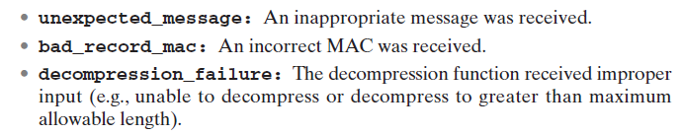
SECURE SOCKET LAYER AND TRANSPORT LAYER SECURITY
Alert Protocol
is used to convey SSL-related alerts to the peer entity.
alert messages are compressed and encrypted, as specified by the current state.
The first byte takes the value warning (1) or fatal (2) to convey the severity of the message.
If fatal, SSL immediately terminates the connection. Other connections on the
same session may continue, but no new connections on this session may be established.
second byte contains a code that indicates the specific alert
Fatal alerts
Notes:
Machine Learning(ML) can be explained as automating and improving the learning process of computers based on their experiences without being actually programmed i.e. without any human assistance. The process starts with feeding good quality data and then training our machines(computers) by building machine learning models using the data and different algorithms. The choice of algorithms depends on what type of data do we have and what kind of task we are trying to automate

Slide 13
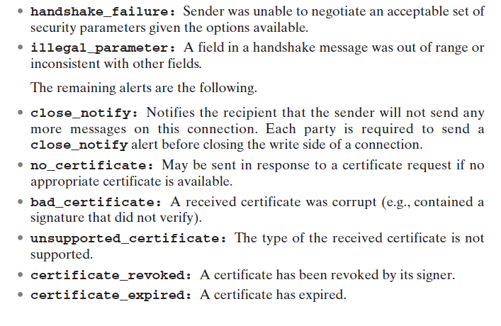
SECURE SOCKET LAYER AND TRANSPORT LAYER SECURITY
Fatal alerts (contd.)
Notes:
Machine Learning(ML) can be explained as automating and improving the learning process of computers based on their experiences without being actually programmed i.e. without any human assistance. The process starts with feeding good quality data and then training our machines(computers) by building machine learning models using the data and different algorithms. The choice of algorithms depends on what type of data do we have and what kind of task we are trying to automate

Slide 14
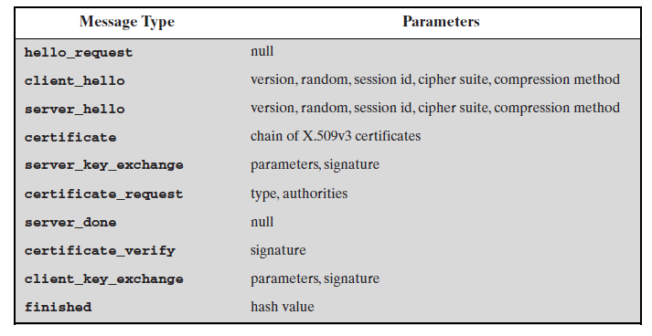
SECURE SOCKET LAYER AND TRANSPORT LAYER SECURITY
Handshake Protocol
It is the most complex part of SSL, is used before any application data is transmitted
The Handshake Protocol consists of a series of messages, Each message has three fields:
• Type (1 byte): Indicates one of 10 messages.
• Length (3 bytes): The length of the message in bytes.
• Content ( bytes): The parameters associated with this message;
Notes:
Machine Learning(ML) can be explained as automating and improving the learning process of computers based on their experiences without being actually programmed i.e. without any human assistance. The process starts with feeding good quality data and then training our machines(computers) by building machine learning models using the data and different algorithms. The choice of algorithms depends on what type of data do we have and what kind of task we are trying to automate

Slide 15
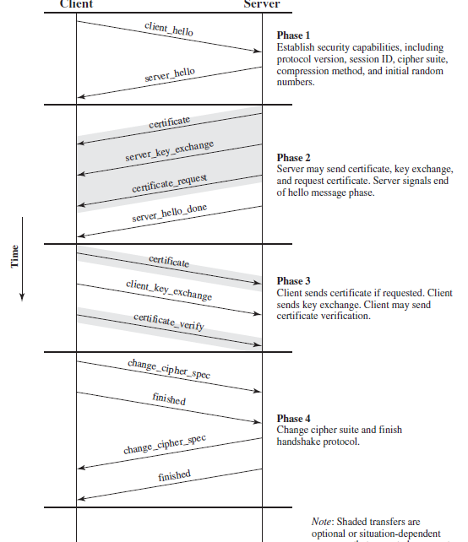
SECURE SOCKET LAYER AND TRANSPORT LAYER SECURITY
Handshake Protocol
PHASE 1. ESTABLISH SECURITY CAPABILITIES
Establish security capabilities, includes
Protocol version - The highest SSL version understood by the client
Random -28 bytes generated by a secure random number generator. These values serve as nonces and are used during key exchange to prevent replay attacks
Session ID: variable-length session identifier ,
A nonzero value indicates that the client wishes to update the parameters of an existing connection ,
zero value indicates that the client wishes to establish a new connection on a new session cipher suite,
Compression method
CipherSuite: This is a list that contains the combinations of cryptographic algorithms supported by the client
Notes:
Machine Learning(ML) can be explained as automating and improving the learning process of computers based on their experiences without being actually programmed i.e. without any human assistance. The process starts with feeding good quality data and then training our machines(computers) by building machine learning models using the data and different algorithms. The choice of algorithms depends on what type of data do we have and what kind of task we are trying to automate

Slide 16
SECURE SOCKET LAYER AND TRANSPORT LAYER SECURITY
Handshake Protocol
PHASE 1. ESTABLISH SECURITY CAPABILITIES (contd.)
Client_hello message, the client waits for the server_hello message, which contains the same parameters as the client_hello message.
For the server_hello message, the following conventions apply.
The Version field →highest supported by the server
Random field is →generated by the server and is independent of the client’s Random field
If the SessionID field of the client→ was nonzero→ the same value is used by the server;
otherwise →the server’s SessionID field contains the value for a new session.
CipherSuite field and compression are selected by the server from the ones proposed by the client
Following the definition of a key exchange method is the CipherSpec, which includes the following fields CipherAlgorithm, MACAlgorithm, CipherType, IsExportable, HashSize, Key Material, IV Size
Notes:
Machine Learning(ML) can be explained as automating and improving the learning process of computers based on their experiences without being actually programmed i.e. without any human assistance. The process starts with feeding good quality data and then training our machines(computers) by building machine learning models using the data and different algorithms. The choice of algorithms depends on what type of data do we have and what kind of task we are trying to automate

Slide 17
SECURE SOCKET LAYER AND TRANSPORT LAYER SECURITY
Handshake Protocol
PHASE 2. SERVER AUTHENTICATION AND KEY EXCHANGE
If authentication is needed then server starts this phase by sending certificate (X.509)
Server_key_exchange message is sent. Its needed for the following protocols Anonymous Diffie-Hellman, Ephemeral Diffie-Hellman, RSA key exchange , Fortezza
Some further details about the signatures are warranted. As usual, a signature is created by taking the hash of a message and encrypting it with the sender’s private key. In this case, the hash is defined as
hash(ClientHello.random || ServerHello.random || ServerParams)
server_done message, sent to indicate the end of the server hello and associated messages. After sending this message, the server will wait for a client response.This message has no parameters.
Notes:
Machine Learning(ML) can be explained as automating and improving the learning process of computers based on their experiences without being actually programmed i.e. without any human assistance. The process starts with feeding good quality data and then training our machines(computers) by building machine learning models using the data and different algorithms. The choice of algorithms depends on what type of data do we have and what kind of task we are trying to automate

Slide 18
SECURE SOCKET LAYER AND TRANSPORT LAYER SECURITY
Handshake Protocol
PHASE 3. CLIENT AUTHENTICATION AND KEY EXCHANGE
If the server has requested a certificate, the client begins this phase by sending a certificate message. If no suitable certificate is available, the client sends a no_certificate alert instead.
In the client_key_exchange message the content of the message depends on the type of key exchange.
Finally the client may send a certificate_verify message to provide explicit verification of a client certificate. This message is only sent following any client certificate that has signing capability
Notes:
Machine Learning(ML) can be explained as automating and improving the learning process of computers based on their experiences without being actually programmed i.e. without any human assistance. The process starts with feeding good quality data and then training our machines(computers) by building machine learning models using the data and different algorithms. The choice of algorithms depends on what type of data do we have and what kind of task we are trying to automate

Slide 19
SECURE SOCKET LAYER AND TRANSPORT LAYER SECURITY
Handshake Protocol
PHASE 3. CLIENT AUTHENTICATION AND KEY EXCHANGE
CertificateVerify.signature.md5_hash=
MD5(master_secret || pad_2 || MD5(handshake_messages ||
master_secret || pad_1));
CertificateVerify.signature.sha_hash=
SHA(master_secret || pad_2 || SHA(handshake_messages ||
master_secret || pad_1));
Notes:
Machine Learning(ML) can be explained as automating and improving the learning process of computers based on their experiences without being actually programmed i.e. without any human assistance. The process starts with feeding good quality data and then training our machines(computers) by building machine learning models using the data and different algorithms. The choice of algorithms depends on what type of data do we have and what kind of task we are trying to automate

Slide 20
SECURE SOCKET LAYER AND TRANSPORT LAYER SECURITY
Handshake Protocol
PHASE 4. FINISH
The client sends a change_cipher_spec message and copies the pending CipherSpec into the current CipherSpec
The client then immediately sends the finished message under the new algorithms, keys, and secrets.
The content of the finished message is the concatenation of two hash values:
MD5(master_secret || pad2 || MD5(handshake_messages ||Sender || master_secret || pad1))
SHA(master_secret || pad2 || SHA(handshake_messages ||
Sender || master_secret || pad1))
Sender → code that identifies that the sender is the client
handshake_messages→ is all of the data from all handshake messages up to but not including this message.
Notes:
Machine Learning(ML) can be explained as automating and improving the learning process of computers based on their experiences without being actually programmed i.e. without any human assistance. The process starts with feeding good quality data and then training our machines(computers) by building machine learning models using the data and different algorithms. The choice of algorithms depends on what type of data do we have and what kind of task we are trying to automate

Slide 21
SECURE SOCKET LAYER AND TRANSPORT LAYER SECURITY
Handshake Protocol
PHASE 4. FINISH (contd.)
In response to these two messages,
The server sends its own change_cipher_spec message, transfers the pending to the current CipherSpec,and sends its finished message. At this point, the handshake is complete and the client and server may begin to exchange application-layer data.
Notes:
Machine Learning(ML) can be explained as automating and improving the learning process of computers based on their experiences without being actually programmed i.e. without any human assistance. The process starts with feeding good quality data and then training our machines(computers) by building machine learning models using the data and different algorithms. The choice of algorithms depends on what type of data do we have and what kind of task we are trying to automate

Slide 22
Thankyou
Notes:
Machine Learning(ML) can be explained as automating and improving the learning process of computers based on their experiences without being actually programmed i.e. without any human assistance. The process starts with feeding good quality data and then training our machines(computers) by building machine learning models using the data and different algorithms. The choice of algorithms depends on what type of data do we have and what kind of task we are trying to automate

