Slide 1


Social Buzz

Slide 2


Today's agenda
Project recap
Problem
The Analytics team
Process
Insights
Summary

Slide 3

Social Buzz, founded in 2010 and headquartered in San Francisco, is a social media platform that prioritizes content over individual users by keeping all users anonymous. The platform allows for over 100 ways to react to content, emphasizing trending content in user feeds. With a rapidly growing user base exceeding 500 million monthly active users, Social Buzz has become a significant player in the social media landscape.
Project Recap
Accenture has begun a 3 month POC focusing on these tasks:
An audit of their big data practice
Recommendations for a successful IPO
An analysis of their content categories that highlights the top 5 categories with the largest aggregate popularity

Slide 4

Problem
Preparation for IPO
Scaling Challenges
Big Data Management

Slide 5




Andrew Fleming Chief Technical Architect
The Analytics team
Marcus Rompton Senior Principle
Deepika J Data Analyst

Slide 6
Process
1
Understanding Data
2
Data Cleaning
3
Data Modelling
4
Data Analysis
5
Interpreting results

Slide 7
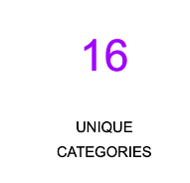

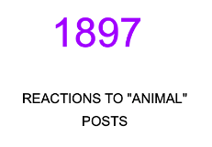
Insights

Slide 8
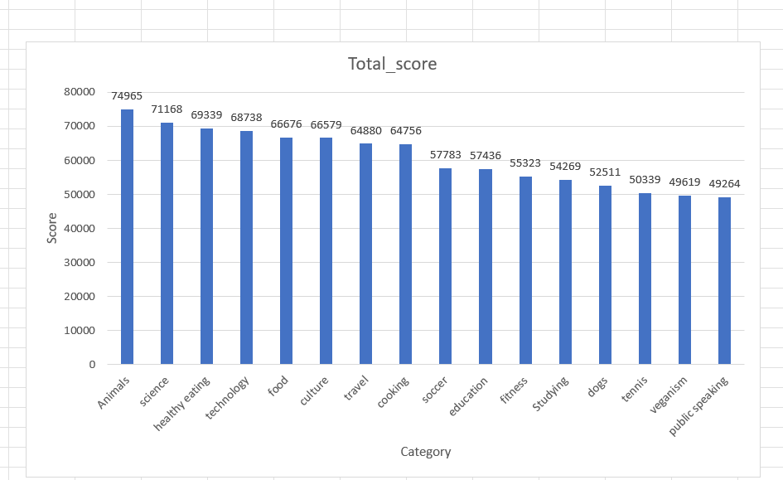

unique categories

Slide 9
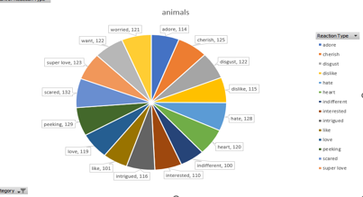

Slide 10
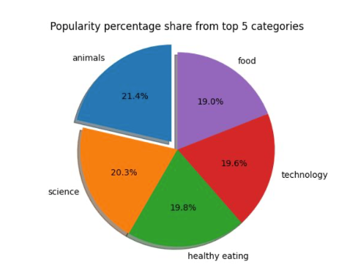

Slide 11

For the Social Buzz project, we conducted a thorough data analysis to address the key questions. We identified the number of unique content categories on the platform, determined the total number of reactions for the most popular category, and pinpointed the month with the highest number of posts. This comprehensive analysis provides valuable insights into user engagement and content trends on Social Buzz.
Summary

Slide 12
Thank you!
ANY QUESTIONS?

