Slide 1

NUMBER SYSTEM
Indian College of Education Belsonda, Mahasamund(C.G.)
Presentation On
Session:-2024-25
Guided By:-
Mr. Murli Chandrakar Sir
Mr. C.L. Nishad Sir
Mrs. R. Banjare Mam
Mr. M.L Barle Sir
Ms. Anju Jain Mam
Mr H.L. Sahu
Part I
Presented By:-
Name:- Deepika Diwan
Class:- B.Ed.(1st Sem)
Subject:-Pedagogy of Mathematics

Slide 2

Objectives
At the end of this lesson, you will be able to :
Define what is number and number system.
Define types of number i.e., Natural, Whole number, Integers, Rational-Irrational Numbers, Real-Complex Numbers.
How number lines can be used to understand operations on Integers.
Find the Decimal Expansion of Real Numbers, and classifying it into rational and irrational numbers.
Represent Real Numbers on the Number line.

Slide 3
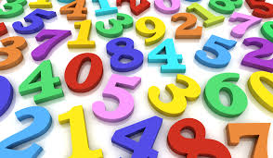
Introduction-
A Number is a mathematical object used in COUNTING and MEASURING. Numbers are often used for LABELS, for ordering serial numbers and for codes like ISBNs.
Here,
A number System is a way to group numbers that are similar with respect to certain properties.
In other words, The number system is a collection of numbers that are grouped into different types each group is defined by certain properties/criteria:-
Natural Numbers
Whole numbers
Integers
Rational Numbers
Irrational Numbers
Real Numbers
Imaginary Numbers
Complex Numbers.
About Numbers
What is Number System?

Slide 4

Types of Numbers
The mysterious world of numbers….

Slide 5
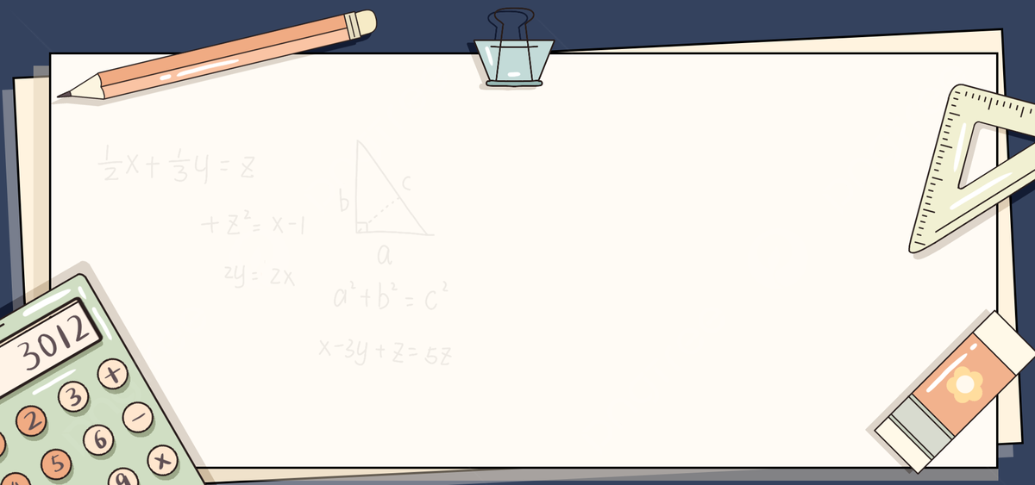
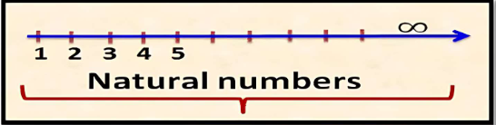
Natural Numbers
All counting numbers are called natural numbers.
It is denoted by “N”.
Example: N= {1, 2, 3, 4, ......}
Natural numbers are represented on the number line as follows.

Slide 6
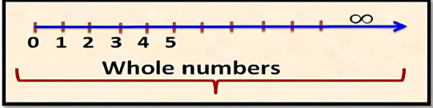
Whole Numbers
The group of natural numbers including ZERO is called whole numbers.
It is denoted by “W”.
All natural numbers are called whole numbers.
0 = Whole numbers – Natural numbers
Example: W = {0, 1, 2, 3, 4, ......}
Whole numbers are represented on number line as follows

Slide 7
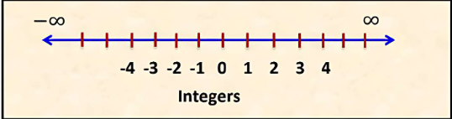
Integers
The collection of all whole numbers and negatives of all natural numbers or counting numbers are called integers.
They are denoted by “Z” or “I”.
All whole numbers are integers, but all integers are not whole numbers.
Negative Integers = Intergers – Whole Numbers.
Example: Z = {......-3,-2,-1, 0, 1, 2, 3 ......}
Integers are represented on number line as follows:-

Slide 8
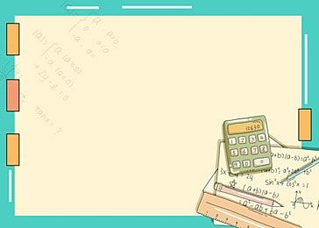
Rational Numbers
A number that can be represented in the form of p/q where p and q are integers and q is non zero,
is called a rational number.
The collection of rational numbers is denoted by the symbol “Q”.
Rational numbers include natural number, whole numbers, integers and all the (negative and positive) fractions
Example: 1/2, -4/5, 26/8, etc.
12 = 12/1 = p/q ; where p=12, q=1
0 = 0/1 =p/q; where p=0, q=1
-25 = -25/1 and so on......
Equivalent Rational Numbers
The rational numbers that have same value but are represented differently.
i.e., If a/b is equivalent to c/d and a/b = X,
then c/d = X
Also, if a/b = c/d, then a x d = b x c.
Example:- 5/2 =15/6

Slide 9
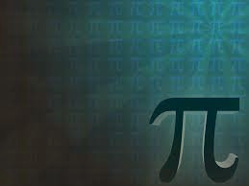
Irrational Numbers
A number that cannot be written in the form of p/q (where p and q are integers and q is non zero), is called and irrational number.
We denote and irrational number by “S”.
Example:√2, √3, √5, √6, √11, ∏, 0.10110111011110......... Are not rational numbers, so they are irrational numbers.
Irrational numbers have endless non-repeating decimal digits and cannot ne expressed as fractions.
But they do exist on number line.
Notes:
Sq root of all prime numbers are irrationals.
Sq root of all non perfect square positve integers are irrational.
🙄

Slide 10
Properties of Irrational Numbers
The sum or difference of the two irrationals need not to be irrational.
√2 + √2 = 2√2 (Irrational ) √2 - √2 = 0 (Rational )
2. The product or quotient of the two irrationals need not to be irrational.
√3 x √3 = 3 (Rational ) √2 x √3 = √6 (Irrational )
√8/ √2 = 2 (Rational) √6/ √3 = √2 (Irrational
3. The sum or difference of a rational number with an irrational number is Irrational.
4. The product or quotient of a non-zero rational number with an irrational number is Irrational.

Slide 11
NUMBER SYSTEM
Indian College of Education Belsonda, Mahasamund(C.G.)
Presentation On
Session:-2024-25
Guided By:-
Mr. Murli Chandrakar Sir
Mr. C.L. Nishad Sir
Mrs. R. Banjare Mam
Mr. M.L Barle Sir
Ms. Anju Jain Mam
Mr H.L. Sahu
Part II
Presented By:-
Name:- Deepika Diwan
Class:- B.Ed.(1st Sem)
Subject:-Pedagogy of Mathematics

Slide 12


We have studied ∏ = 22/7 and if ∏ is an irratinal number then what about 22/7 is it rational or irratinal?
Pi (∏) is an irrational number (3.1415926538979...) while
22/7 is a rational number (3.142857142357..),
Showing that they are the same up to two decimal places. So just for simplification we have assumed that ∏=22/7.

Slide 13
Real Numbers
The collection of rational and irrational numbers together make up a collection of real numbers.
The collection of real numbers is denoted by “R”.
Natural, whole numbers, integers, rational, irrational numbers are subsets of real numbers.
Some properties of Real numbers:-
Every real number is either rational or irrational.
Between any two real number, there exist an infinite numbers of real numbers.
Each point on the number line corresponds to a unique real number.
The square of a real number is always non-negative (≥0).
The real numbers include all of the measuring numbers.

Slide 14
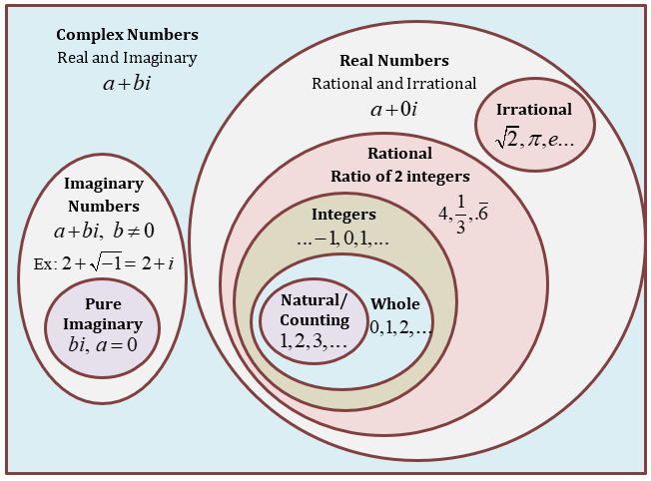
Complex Numbers
Moving to a greater level of abstraction, the real numbers can be extended to the complex numbers.
This set of numbers arose historically, from trying to find closed formulas for the roots of cubic and quadratic polynomials.
This led to expression involving the square root of negative numbers, eventually to the defination of new number: The Square root of negative one denoted by “i”.
The complex numbers consists of all numberrsof the form (a + ib); where a and b are real numbers.

Slide 15
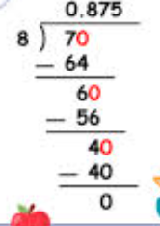
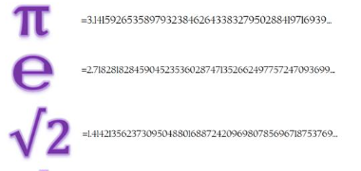

Decimal Expansion of a Real Number
A decimal expansion of a number can be either:-
Terminating Decimal
Non terminating, recurring
Non terminating non recurring
A decimal expansion in which the remainder becomes zero.
For example,
7÷8 = 0.875
In which remainder never become zero, instead the number of the quotient start repeating themselves.
Such numbers are classified as rational numbers. It can be written as p/q
Eg. 1÷3 =1.333…. =1.3
When we divide a number by another, remainder never becomes zero and also the number does not repeat themselves in any specific pattern.
Such numbers are classified as irrational numbers. Eg.
Terminating decimal is always a rational number. It can be written as p/q.

Slide 16
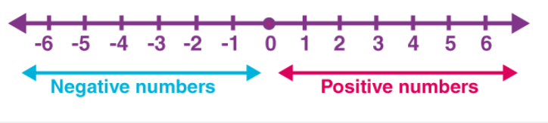
What is number line ?
A number line is a pictorial representation of numbers on a straight line.
It’s a reference for comparing and ordering numbers. It can be used to represent any real number that includes every whole number and natural number.
Arithmetic operations of numbers can be better explained on a number line. To begin with, one must know to locate numbers on a number line. Zero is the middle point of a number line.
All positive numbers occupy the right side of the zero whereas negative numbers occupy the left side of zero on the number line.
As we move on to the left side value of a number decreases. For example, 1 is greater than -2.
In a number line, integers, fractions, and decimals can also be represented easily.

Slide 17
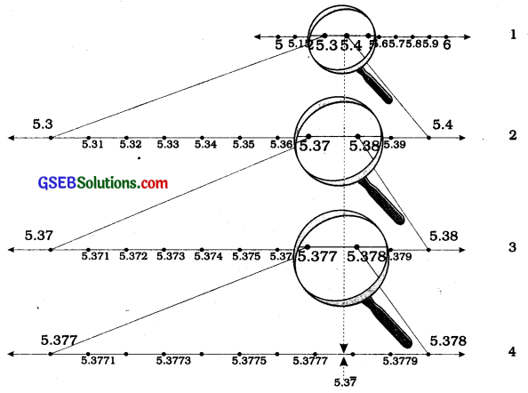
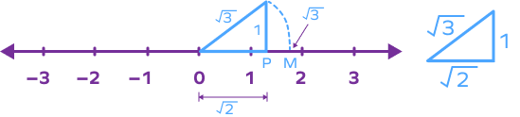
Successive Magnification Method,
to locate any real number on Number lines
On the number line, there are infinite smaller numbers lying b/w any two numbers. These smaller numbers can be of two, three or more decimal places.
To see or mark such numbers clearly, we use the process called successive magnification of the number line.
Here we use a imaginary magnifying glass to enlarge the smaller divisions on the number line.
This procedure can be used to visualize with a non-terminating non-recurring decimal expansion on the number line.
Irrational number on number line
Representation of irrational numbers on number line can be done with the help of Pythagoras theorem.

Slide 18

Summary…
All counting numbers are called natural numbers which starts from 1.
All natural numbers their negatives along with 0 is called Integers.
A number line is called a rational number, if it can be written in p/q form. Where p and q are integers and q ≠ 0.
A number is called an irrational numbers, it it cannot be written in p/q form. Where p and q are integers and q ≠ 0.
The decimal expansion of a rational number is either terminating or non-terminating recurring.
The decimal expansion of an irrational number is non terminating non-recurring.
The real numbers are the collection of all rational and irrational numbers.

Slide 19
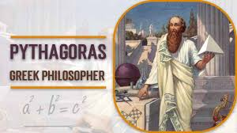
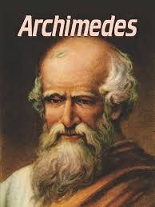
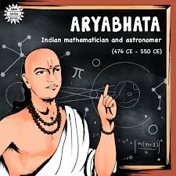
Did you Know ?
The Pythagoreans in Greece, followers of the famous mathematician and philosopher Pythagoras, were the first to discover the numbers which were not rationals, around 400 BC. These numbers are called Irrational numbers
The Greek genius Archimedes was the first to compute digits in the decimal expansion of ∏. He showed 3.140845 < ∏ < 3.142857.
Aryabhatta, the great Indian Mathematician and astronomer, found the value of ∏ correct to four decimal places (3.1416).
Using high speed computers and advanced algorithms, ∏ has been computed to over
1.24 trillion decimal places!!

Slide 20
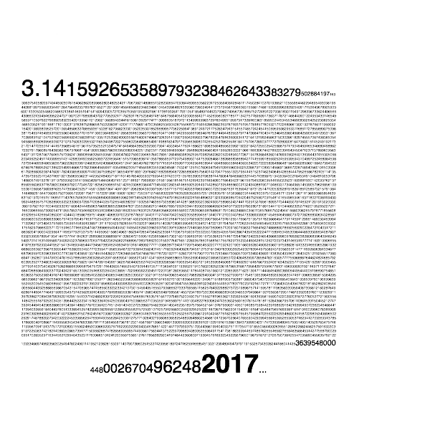

Thanks For Watching🙋‍♀️

