Slide 1
PariVrtan
“Agriculture with new Perspective”

Slide 2
THE CHALLENGE:
Agricultural marketing MUST BECOME MORE EFFICIENT AND SUBSTAINABLE of it is to provide enough food for a growing world population, but the major problem faced is lack of proper agriculture marketing and inadequate storage facilities

Slide 3
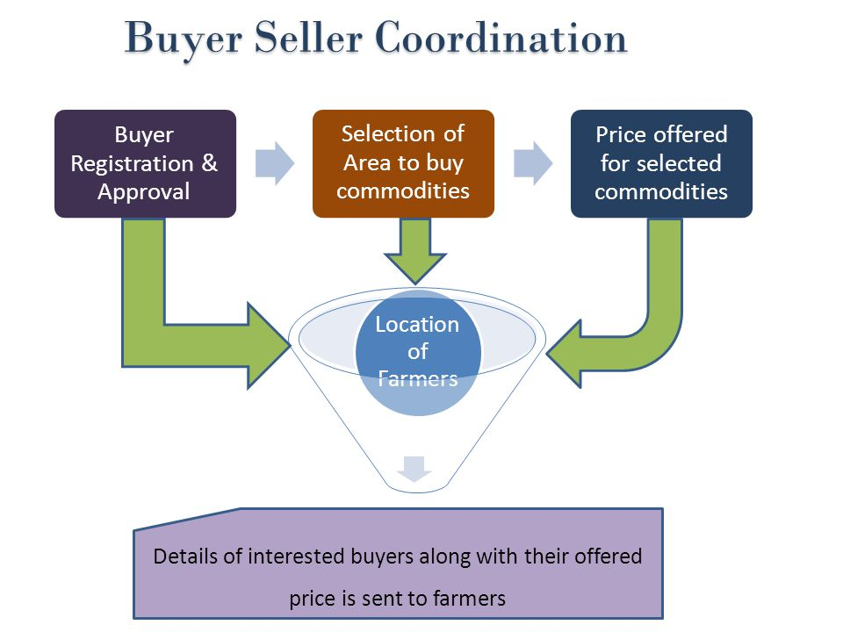
PROBLEM TITLE An innovative platform to sell the produce at a better rate.

Slide 4


Elevator Pitch
MISSION:-
We ignite the opportunity for farmers a better price for their produce.
VISION:
A system that provides an interface to sell their produce and connect with the buyers all over india.

Slide 5
solution: why Parivrtan ?
A cloud based application that will help connect large number of small holder farmers with multiple buyers leading to mimimize the middleman’s margins and farmers transaction costs.
Our System provides Segmented size of the operation (Gross Farm Income or based on number of acres farmed)
Direct Funding Broadcast for farmers to sell their goods directly without having the interface of dealers , vendors, retailers which is major beneficial where they can introduce their own rate.
Support farmers by providing Multi-Lingual Languages for their easy access through the sections.
System that produces details to farmers on weather patterns that could impact the crop, possible pest attacks, weather warnings.
Steps for producing high yield that are specific for a farmer based on the local regional terrain ,weather scenario,rather than generic guidance

Slide 6
solution DEVELOPMENTS
Provide farmers aroung the world with vital information on which to base their work decisions
Steps for producing high yield that are specific for a farmer based on the local regional terrain ,weather scenario,rather than generic guidance
Better Farmer Financial Inclusions for planning out loans, intrest and managing his costs
Registration for farmers onto our website to receive information via mobile.
Better crop produce and farmers have better income with perspective guidance.
Ask a question interface and options to search for the information.

Slide 7
TECHNOLOGY
A digital technology to transform agriculture to double farmers income: of mobile applications to disseminate valuable information regarding farming, sending crop related advisories through SMS and online portals
Big Data Analytics: By giving real-time insights. Help farmers identify their techniques are working,are their inputs correct and what do they need do prepare for in case of weather changes.
Launching an online trading platform,improve/create scientific storage capacity.
Introduce soil heath card schemed and providing subsidies
E-Commerce
Payment methods

Slide 8
MARKETING APPROACH & STARTEGIES FOR OUR BUISNESS
Gather & analyze reliable Market data:
Provide personal & demographic information
Analyze crop type & Rotation Pattern
Relationship with other growers
Distinction between acres owned vs. operated vs. owned and operated
Grain bin count & capacity
Acreage & Geospatial imagery of the operation.

Slide 9
MARKET Opportunity: market size and customer base
Identifying the farmers ideal markets
Integrate marketing channels to increase and enhance our website promotion.
Growing the overall market share among the current ideal buyer personas
Increasing the wallet share among the current customers, either with new products driven in the market or through upselling.
Expanding the foot print of farmers into new markets and segments of farmers, whether that be geographically or demographically (ex-age,gender etc)
Measure results and analyze to improve future campaigns( i.e impression and conversion can be tracked through mail,social media or programmatic adverstising.

Slide 10

Team
Deepa RM
3rd Year,CSE
Sapthagiri College of Engineering
Team Leader

Slide 11
THANKYOU

