Slide 1

Test Automation –Ecommerce Site
User Guide and Design Document
Created By,
Deepikadevi Thiyagarajan

Slide 2
Code base and Jenkins Details
Git Repository
https://github.com/Deepika-TestAutomationUser/ECommerce-SpecFlowAutomation-Project/tree/master
Branch : Master
UserName:deepikadevi.testautomation@gmail.com
Password:March%2022
Cloud based Jenkins Job
ECommerce-SpecflowAutomationProject [Jenkins]
User Name:TestAutomationUser
Password:March%2022
Automation Mail Id to check Jenkins autogenerated mail:
UserName:deepikadevi.testautomation@gmail.com
Password:March%2022
Software requirement to run in local
.Net Core
Visual Studio 2022 - Professional
Cloud EC2 Setup :
UserName:TestAutomationUser
Password:March%2022
https://930065949252.signin.aws.amazon.com/console
Reported Defect:
https://testautomationproject.atlassian.net/browse/QQAUT-2

Slide 3
Test Automation (Spec flow) framework
This framework supports Web testing through BDD approach also has rest sharp API testing feature which can be extended for API testing
Behavior Driven Development (BDD) is an agile software development practice that encourages collaboration between everyone involved in developing software: developers, testers, and business representatives such as product owners or business analysts.
API testing is performed with help of rest sharp API library in C#.
Page object model design pattern has been followed to handle locators and its methods
Selenium webdriver is used for performing web tests using

Slide 4
Test Automation framework component
Test Automation Framework
Support Classes
UI Tests
Selenium wrapper
Page Objects

Slide 5
Support Classes
It has helper classes for handling API calls, Authentication, logs, driver ,browser and random data generator,etc
API call methods & authentication handler
Logs Generator
AppSetting reader
Data Helper
Unity container library class,etc
Reusable helper class

Slide 6
Page Objects
Page Object model is the most is a design pattern on which each web page (or significant ones) considered as a different class. Each page object represents the page of the web page or application. It is a layer between the test scripts and UI and encapsulates the features of the page
Login Page
My Account Page
Check Page
Reusable Page class

Slide 7
Selenium Wrapper
Selenium wrapper has helper classes for handling web elements like button,textbox,drop down ,etc
ActionClass_Handler
Alert_Handler
Browser_And_Navigation_Handler
Button_Link_RadioButton_Handler
CheckBox_Handler
DropDown_Handler
Label_Handler
Frame_Handler_Wrapperr
TextBox_Handler
Window_Handler
Driver,Browser classes
Selenium wrapper class

Slide 8
UI Tests
UI Test module has the application specific Feature files , step definition files and AppConfig file
Test
Feature files
Step definition files
Feature file – Used by Spec flow to specify acceptance criteria for features (use cases or user stories) in your application are defined using Gherkin syntax
Step definition file- Step definitions provide the connection between the free-text specification steps and the application interfaces. Step definitions are .NET methods that match to certain scenario steps. The classic way of providing the match rules is to annotate the method with regular expressions.

Slide 9










Design flow
API Models(Not included in project )
Support Classes
API Tests
API Call Helper class
JSON/XML Request / Response Models
Feature files
Web browser Helper Class(.Net)
Step definition files
Page Objects
Selenium wrapper
Page classes with reusable application specific methods
Reusable methods to handle elements in web pages

Slide 10
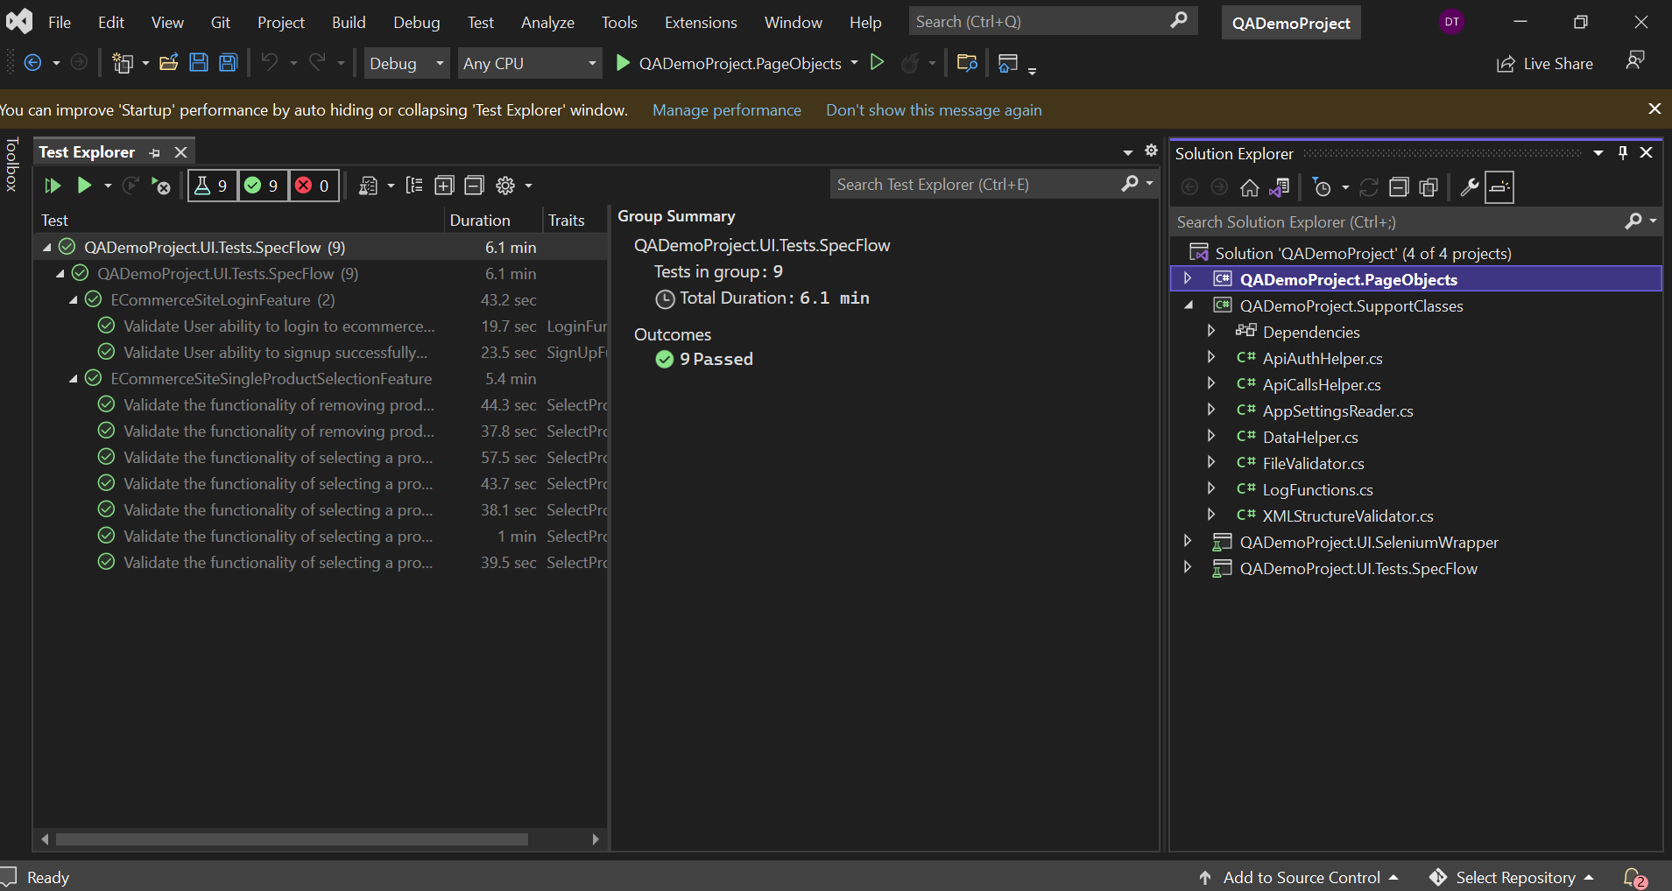
Test Explorer Execution - Goto Test ->Test Explorer-> Build->Run desired tests

Slide 11
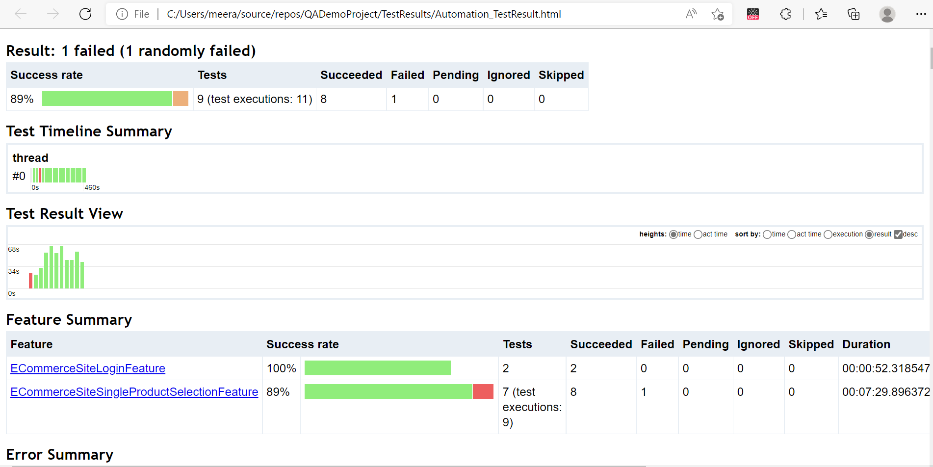
Spec Runner result
Double click on the icon

Slide 12
BDD Flow :
Effective collaboration – BDD increases and improves collaboration. It enables everyone involved in the project to easily engage in the product development cycle.
Documentation - By using plain language(gherkin), all are able to write behavior scenarios. High visibility.
Test-Driven - BDD is an evolution of TDD. Writing scenarios from the beginning enforces quality-first and test-first mindsets. BDD automation can run scenarios to fail until the feature is implemented and causes tests to pass.
Code Reuse - Given-When-Then steps can be reused between scenarios. The underlying implementation for each step does not change. Automation code becomes very modular.
Adaptability - BDD scenarios are easy to update as the product changes. Plain language is easy to edit. Modular design makes changes to automation code safer. Scenarios can also be filtered by tag name to decide what runs and what doesn’t.

Slide 13
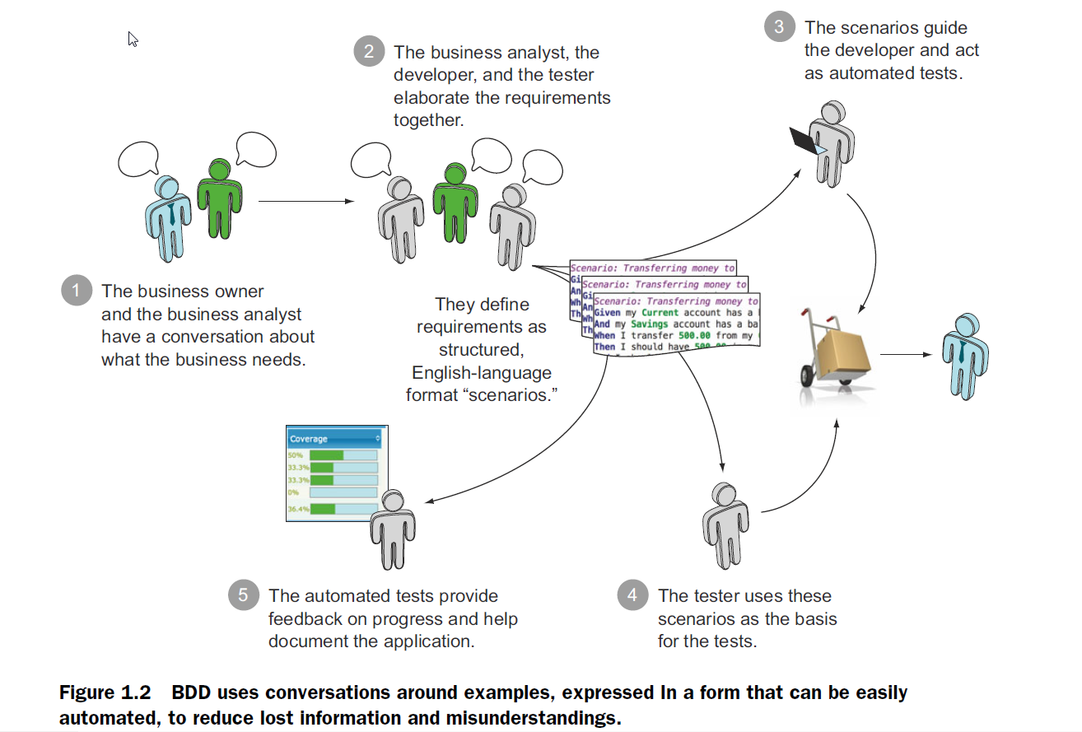
BDD Practice

Slide 14
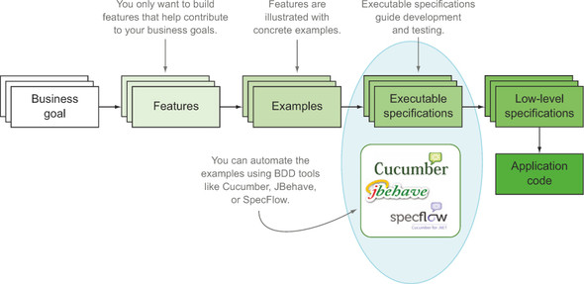
BDD FLOW

Slide 15
Disadvantages
BDD requires high business engagement and collaboration
BDD works best in an Agile or iterative context
Poorly written tests can lead to higher test-maintenance costs

Slide 16


