Slide 1
Product Investment Analysis
Understanding category dominance and future investment focus

Slide 2
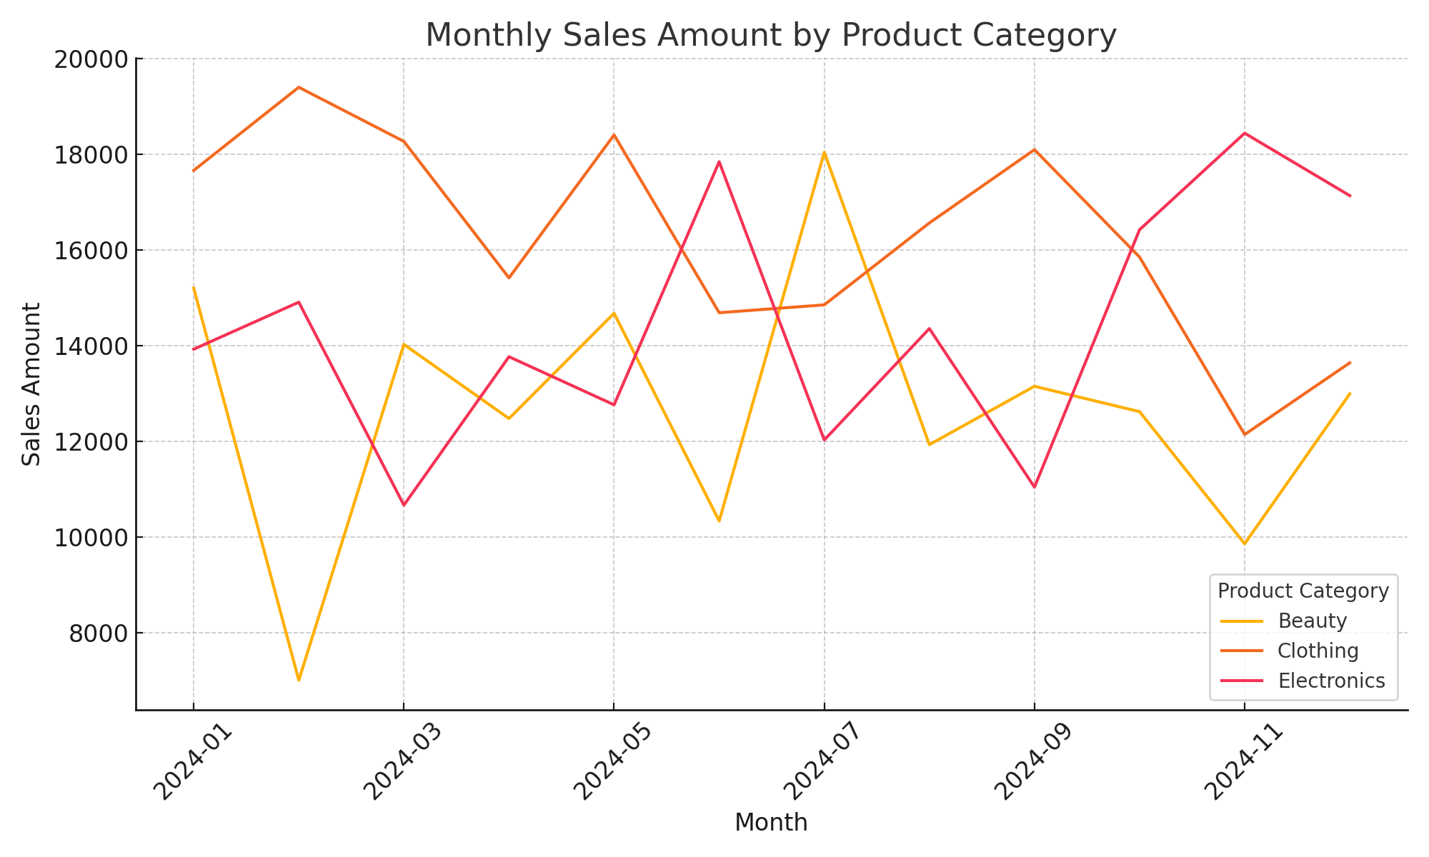
Monthly Sales Trend

Slide 3
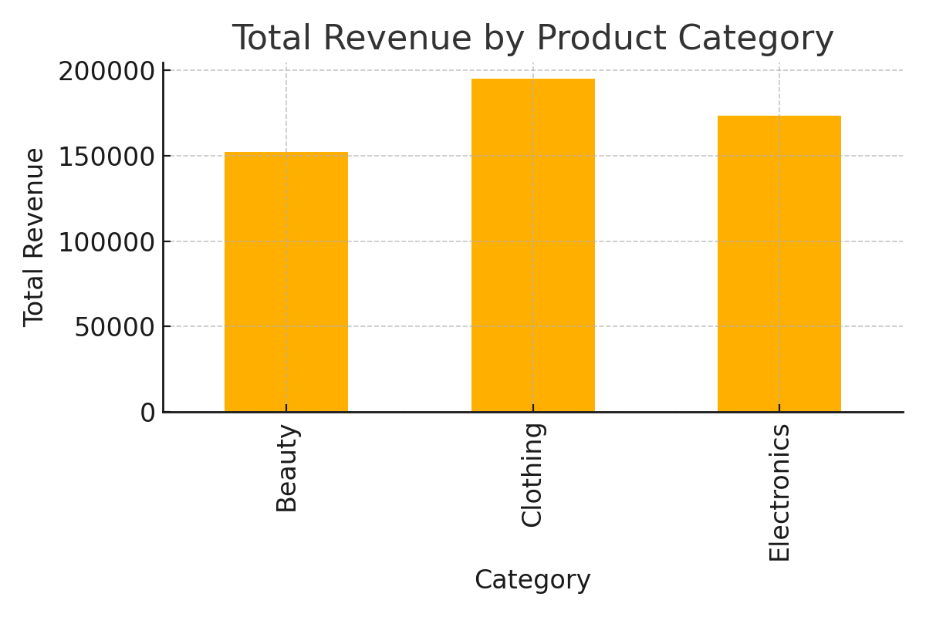
Total Revenue by Product Category

Slide 4
Recommendation Summary
Primary Investment: Clothing (high consistency and strong demand)
Secondary Opportunity: Electronics (high promotional responsiveness)
Maintain but do not prioritize Beauty (higher volatility)

