Slide 1
Product Investment Analysis
Understanding category dominance and future investment focus
Notes:
This presentation analyzes product category performance to determine the strongest investment opportunity.
We compare total revenue, monthly trends, customer demographics, and price sensitivity.
Conclusion: Clothing is the most stable and scalable investment, Electronics is strong for promotional boosts, Beauty is volatile.

Slide 2
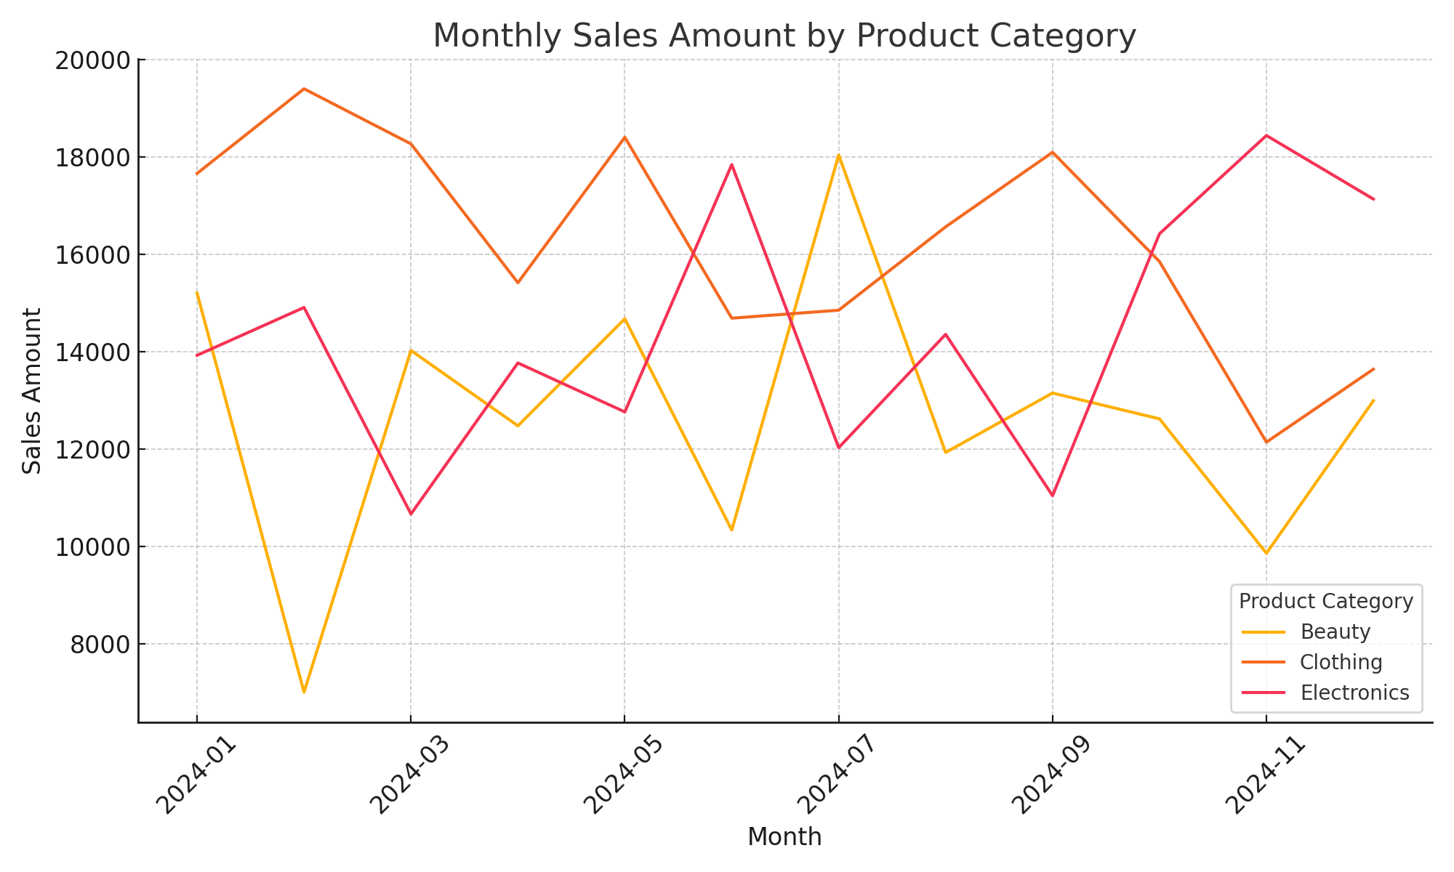
Monthly Sales Trend
Notes:
This chart shows monthly sales trends for each product category.
Clothing remains consistently strong across all months, showing stable demand.
Electronics shows peaks that align with seasonal or promotional periods.
Beauty fluctuates, indicating trend-based or emotional purchasing patterns.

Slide 3
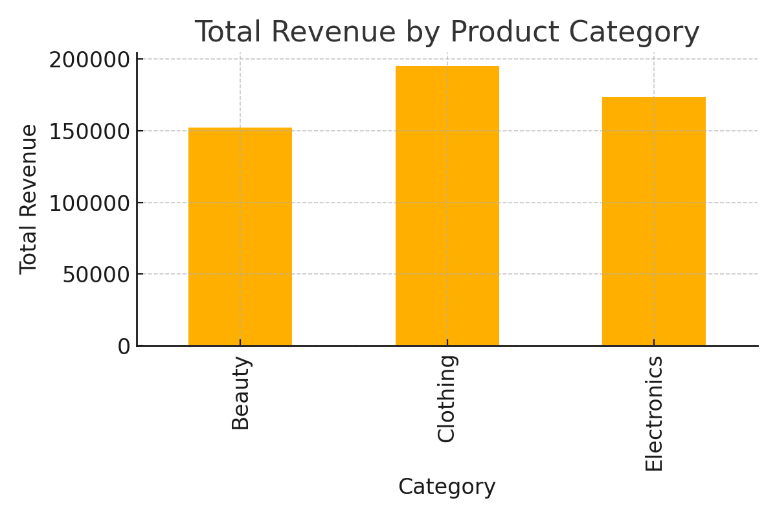
Total Revenue by Product Category
Notes:
This bar chart compares total revenue by category.
Clothing contributes the highest total revenue overall, making it the strongest base for investment.
Electronics performs well but is less stable month-to-month.
Beauty generates revenue but with lower consistency and predictability.

Slide 4
Recommendation Summary
Primary Investment: Clothing (high consistency and strong demand)
Secondary Opportunity: Electronics (high promotional responsiveness)
Maintain but do not prioritize Beauty (higher volatility)
Notes:
Recommendation Summary:
Primary Investment → Clothing: Stable demand across demographics, supports predictable growth.
Secondary Investment → Electronics: High return during promotional cycles, useful for growth pushes.
Monitor → Beauty: Demand is volatile; best for trend-based and targeted campaigns.

