Slide 1


Diagnostic Performance of Artificial Intelligence Model For Pneumonia From CXR (chest x-ray)
-Ramya Krishna Gadiparthi
-Deepika Linga
-Sushma Nagubandi

Slide 2


INTRODUCTION
The chest X-ray (CXR) is the most readily available and common imaging modality for the assessment of pneumonia. However, detecting pneumonia from chest radiography is a challenging task, even for experienced radiologists. An artificial intelligence (AI) model might help to diagnose pneumonia from CXR more quickly and accurately. We aim to develop an AI model for pneumonia from CXR images and to evaluate diagnostic performance with external dataset.
To train the pneumonia model, a total of 157,016 CXR images from the National Institutes of Health (NIH) and the Korean National Tuberculosis Association (KNTA) were used (normal vs. pneumonia = 120,722 vs.36,294). An ensemble model of two neural networks with DenseNet classifies each CXR image into pneumonia or not. To test the accuracy of the models, a separate external dataset of pneumonia CXR images (n = 212) from a tertiary university hospital (Gachon University Gil Medical Center GUGMC, Incheon, South Korea) was used; the diagnosis of pneumonia was based on both the chest CT findings and clinical information, and the performance evaluated using the area under the receiver operating characteristic curve (AUC). Moreover, we tested the change of the AI probability score for pneumonia using the follow-up CXR images (7 days after the diagnosis of pneumonia, n = 100)

Slide 3
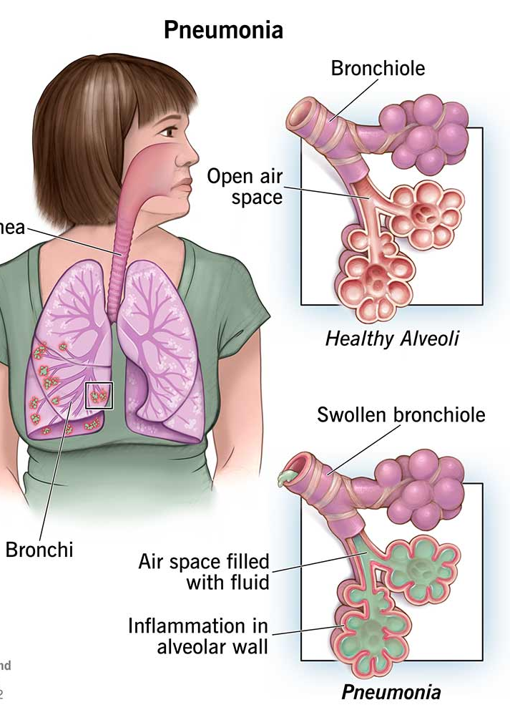
WHAT'S PNEUMONIA?
Pneumonia is an infection that inflames the air sacs in one or both lungs. The air sacs may fill with fluid or pus (purulent material), causing cough with phlegm or pus, fever, chills, and difficulty breathing. A variety of organisms, including bacteria, viruses and fungi, can cause pneumonia.

Slide 4
The goal of this project is to develop an artificial intelligence (AI) model for the detection of pneumonia from chest radiography images. The project will involve the use of CNN (Convolution Neural Network) algorithms to train and test the model on a dataset of chest X-ray images.
The model will be evaluated using various metrics to assess its accuracy and efficiency in detecting pneumonia.
To achieve this goal, an AI model might help to diagnose Pneumonia disease from the chest x- rays more quickly and accurately.
The project will ultimately aim to develop a highly accurate and efficient AI model for pneumonia detection. This model has the potential to significantly improve patient outcomes and reduce the burden on healthcare systems worldwide.
PROJECT STATEMENT

Slide 5
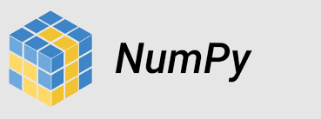

Packages used in the project
Python libraries such as NumPy, Pandas, Matplotlib
TensorFlow and Keras for building and training deep learning models, particularly Convolutional Neural Networks (CNNs).

Slide 6


