Slide 1
DEEPIKA S
813821104025
Final Project

Slide 2

PROJECT TITLE PROJECT TITLE FACE RECOGNITION

Slide 3


AGENDA 1.Project statement 2.Problem statement 3.Project overview 4.Who are the end user 5.Your solution and its value proposition 6.The wow in your solution 7.Modelling 8.Result
3/21/2024 Annual Review

Slide 4

PROBLEM STATEMENT To design and implement a facial recognition system leveraging Convolutional Neural Networks (CNNs) to accurately identify individuals from images or video streams. The system should effectively extract discriminative features from facial images, enabling robust recognition performance in varying conditions such as different lighting, facial expressions, occlusions, and pose variations.

Slide 5

PROJECT OVERVIEW Objective: Create a face recognition application that can identify faces in a given image. Prepare Environment and Data: Set up your project directory with training and validation data directories.Load Training Data and Train Model: Use face detection and recognition techniques to train a new model. Recognize Unlabeled Faces: Detect faces in an image and label them. Display Results: Draw bounding boxes around recognized faces and display their names. Applications: Security, personalized services, social media tagging.Source Code

Slide 6

WHO ARE THE END USERS? 1.Individuals: This can include people using smartphones or computers for Unlocking devices: Face recognition can be used for secure access to phones, laptops, and tablets. Social media applications: Some social media platforms use facial recognition to suggest photo tags or create filters. Payment authentication: Facial recognition can be used for contactless payments. 2.Organizations: These can include businesses and government agencies that utilize face recognition for Security and access control: Organizations can use facial recognition to restrict access to buildings or sensitive areas. Law enforcement :Facial recognition can be used for criminal identification or suspect tracking in public places. Customer identification and verification : Applications include age verification or identity checks for banking or other services.

Slide 7

YOUR SOLUTION AND ITS VALUE PROPOSITION Solution: 1. Data Loading: The LFW dataset is loaded using fetch_lfw_people from sklearn.datas ets. 2. Data Preprocessing : Faces with at least 100 images are selected. The data is preprocessed by normalizing pixel values and reshaping the images. 3.Data Splitting : The dataset is split into training and testing sets using train_test_split from sklearn.model_selection. Value Proposition: 1. Accuracy : CNNs are well-suited for image recognition tasks like face recognition due to their ability to automatically learn features from data. 2.Efficiency:CNNs are computationally efficient, especially when dealing with large datasets like images. 3. Scalability: The system can scale to accommodate a larger dataset or additional classes of faces with minimal adjustments.

Slide 8

THE WOW IN YOUR SOLUTION For a face recognition project, implementing state-of-the-art solutions involves utilizing deep learning architectures like Convolutional Neural Networks (CNNs) with techniques such as transfer learning to achieve high accuracy. Employing pre-trained models like VGG-Face, FaceNet, or OpenFace can streamline the development process and enhance performance. Integration of attention mechanisms and ensemble learning can further refine the recognition system, enabling robustness against variations in lighting conditions, poses, and occlusions. Leveraging advanced algorithms for facial landmark detection and feature extraction enhances the system's ability to capture intricate facial details accurately.
3/21/2024 Annual Review

Slide 9
MODELLING 1.Data Loading and Preprocessing: - The LFW dataset is loaded using fetch_lfw_people from sklearn.datasets. - Only faces with a minimum number of occurrences per person (100 faces) are considered. - Data is preprocessed by normalizing pixel values to a range of [0, 1]. 2. Data Splitting: - The preprocessed data is split into training and testing sets using train_test_split from sklearn.model_selection. - The split is done with an 80-20 ratio, where 80% of the data is used for training and 20% for testing. 3. Model Definition: - A Sequential model is created using tensorflow.keras.models.Sequential. - The model consists of three Conv2D layers with max-pooling layers in between, followed by a Flatten layer and two Dense layers. - ReLU activation is used for the Conv2D layers, and softmax activation is used for the output layer since it's a multi-class classification problem. - The model is compiled with the Adam optimizer, categorical cross-entropy loss function, and accuracy metrics. 4.Training the Model: - The model is trained using the fit method on the training data with validation data provided. - Training is done for 20 epochs with a batch size of 25.5.

Slide 10
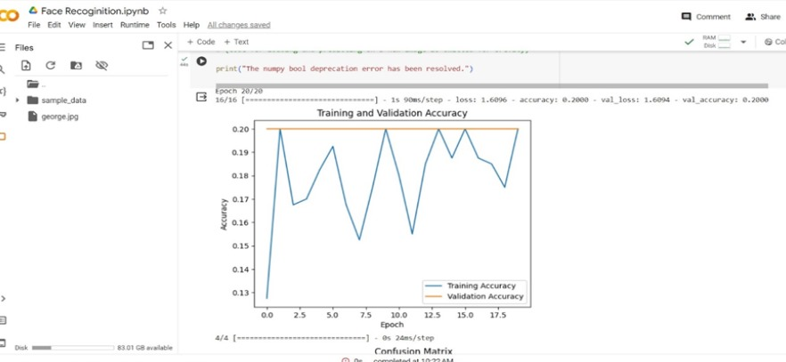
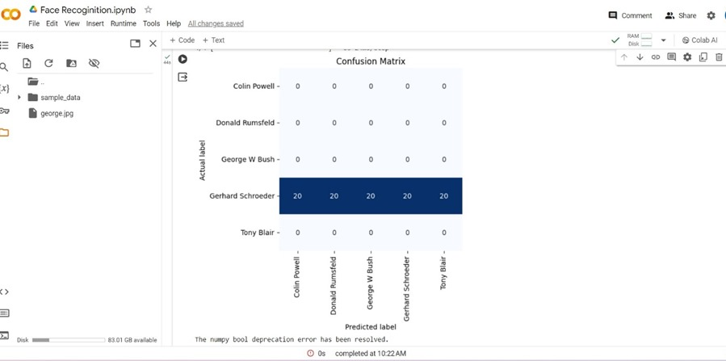
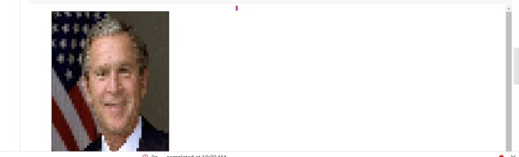
RESULTS

