Slide 1
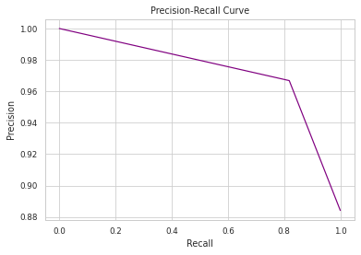
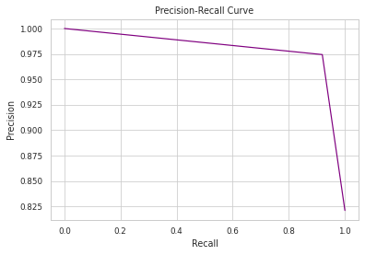
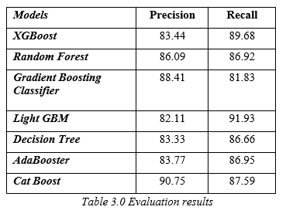
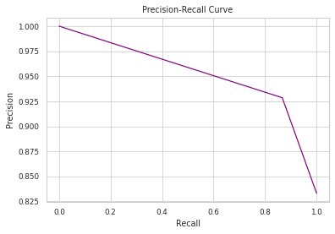
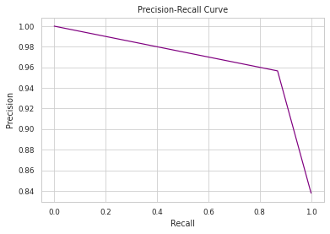
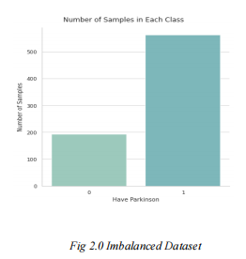
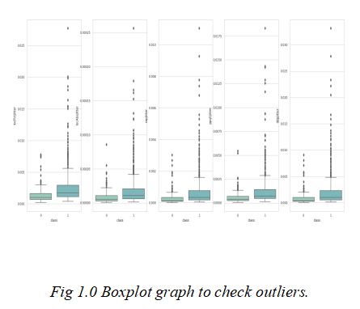
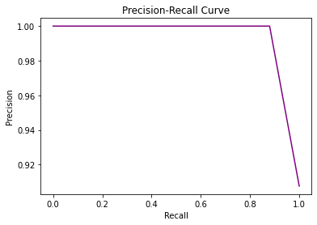
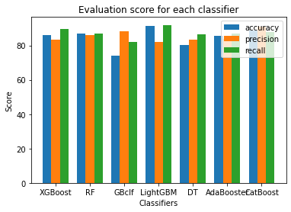
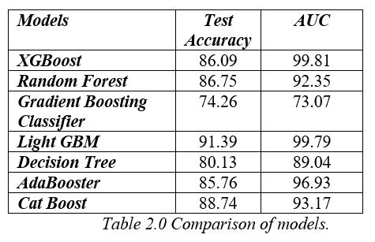
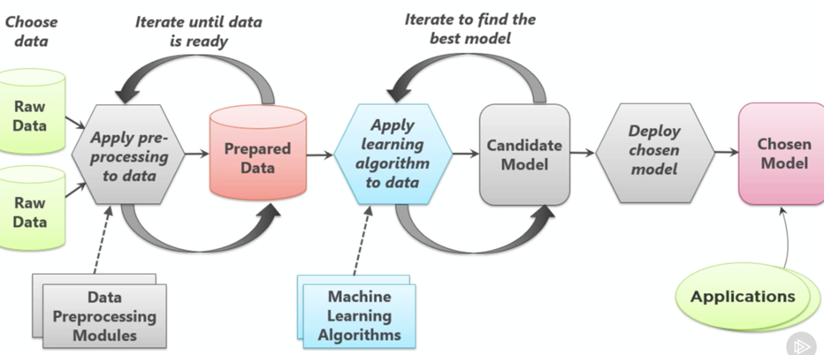
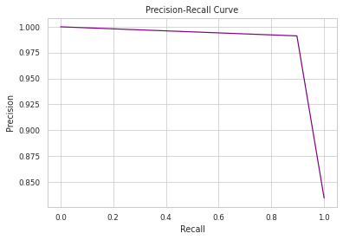
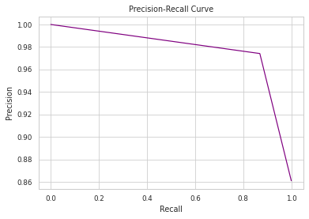
COMPARISON OF VARIOUS ML CLASSIFIERS TO DETECT PARKINSONS DISEASE
Harshith Savanth K, Kaushik RM, Sagar Shaw, Tharun Deepika M
School of CSE, REVA University, Bangalore, India
ABSTRACT AND INTRODUCTION
IDENTIFICATION OF THE DATASET
The dataset is taken from the UCI repository. The information in the dataset is obtained from 188 patients with Parkinson’s disease which contains 107 men and 82 women in it with ages ranging from 33- 87, phonation of the vowel-a was collected from each person with a repetition of 3 times. This dataset contains 754 attributes, the attributes of jitter and shimmer. The dataset has many attributes which record different forms of frequencies, intensities and means. It also contains information about GNE and SNR which are Glottal to noise excitation ratio and Signal to noise ratio respectively.
DATA PRE-PROCESSING
The dataset is pre-processed in google collab using Python as a programming language by importing essential libraries. Outliers have been addressed to understand the dataset efficiently by plotting a boxplot graph for variability or perturbation (deviation) of the fundamental frequency. People who are suffering from PD tend to have a higher jitter percentage. The variation of the fundamental frequency is of low range for people who are normal. Duplicate and null values in the dataset have been removed efficiently. Label encoding is performed on 3 the dataset for converting categorial features to continuous features and then the dataset is divided into train and test sets and fit into the algorithms to predict the accuracy.
EXPLORATORY DATA ANALYSIS
EDA is the most significant step for any data-driven project, for analyzing and taking decisions from discovered insights for accurate predictions. During EDA, it has been discovered that the data is imbalanced. The graph above shows the imbalance in the dataset The dataset is highly imbalanced i.e., there are around 200 positive cases against 500 negative cases.
Out of the 7 different algorithms, 3 algorithms that provide the highest accuracy are Light GBM (91.39%), Cat Boost (88.74%), and Random Forest (86.75%).
The comparison of all the algorithms’ precision-recall curves is put into a table which can be referred to in the below-given table. All the algorithms are run in the same runtime environment.
The table gives information on the precision and recall of all the algorithms.
3. Gradient Boosting Classifier 4. . Light GBM
5. Decision Tree 6. . Ada Booster
7.CatBoost
ABSTRACT:
Parkinson's Disease (PD) is a progressive neurological disorder that affects movement. Early detection of PD is crucial for timely treatment and management of the disease.
Machine learning (ML) classifiers have shown promising results in the diagnosis of PD using various data sources. However, there is a lack of consensus on which ML classifier performs best for PD detection.
In this study, we compare the performance of various ML classifiers, including XGBoost , Gradient Boosting classifier , Light GBM , Ada Booster , Cat Boost , Decision Trees (DTs) and Random Forests (RFs) to detect PD using multiple data sources.
We evaluate the accuracy, efficiency, and interpretability of these classifiers using a large and diverse dataset.
This study provides valuable insights into the most effective approach for PD detection using ML classifiers, which can improve the early detection and management of PD.
INTRODUCTTION:
Parkinson's Disease (PD) is a progressive neurological disorder that affects millions of people worldwide. It is characterized by the degeneration of dopaminergic neurons in the substantia nigra region of the brain.
The symptoms include: Tremors in hands, arms, legs, jaw, or head. Muscle stiffness, where muscle remains contracted for a long time. The slowness of movement. Impaired balance and coordination, sometimes leading to falls.
The accurate and early detection of PD is crucial for timely treatment and management of the disease.
Machine learning (ML) classifiers have shown promising results in the diagnosis of PD using various clinical and non-clinical data sources. However, there is a need to compare and evaluate different ML classifiers to identify the most accurate and efficient approach for PD detection
PROBLEM STATEMENT, AIM AND OBJECTIVES
COMPARISON OF EVALUATION METRICS
Accuracy, precision, and Recall have been noted down for the 7 models and a Bar graph has been plotted which helps in the comparison of the evaluation metrics of each model. In fig 14.0, we can observe that the LightGBM model has the highest Accuracy and Recall and Precision is the highest in the CatBoost model.
CONCLUSIONS
PROBLEM STATEMENT Starting stage of Parkinson's disease possess many problems with regard to detection.
Since PD can have a subtle onset before an actual diagnosis is made, people often attribute symptoms to other causes.
So detection of disease in early stages plays a crucial role to prevent advancement of the disease and deal with it.
AIM:
The aim of this work we are doing it to compare the results of the 7 different classification algorithm and check which classification algorithm works best with our Parkinson's disease dataset.
What does our objective answer?
Detecting of the disease as early as possible so that it makes the work for the practitioner easy and can stop the advancement of the disease to the higher levels
OBJECTIVES:
Parkinson's disease is one in which the symptoms are barely noticeable, so people suffering from this disease will never get to know until it advances to higher levels.
The key purpose of the Personalized Parkinson Project is to contribute to the understanding of the differences in etiology, pathophysiology, phenotypic diversity, and disease progression among individual PD patients.
The objective of our project to use machine learning algorithm to our best knowledge to detect the disease as early as possible.
In our project, we have summarized the research on the 7 different machine-learning algorithms and compared their accuracy to find out which algorithm will provide us with the best accuracy to predict Parkinson’s disease as early as possible so that one can diagnose it and take the required treatment.
After the dataset is pre-processed with the required Python code it is fed into 7 different algorithms named as Random Forest, Decision Tree, ADA Boost, Cat Boost, Gradient Boosting Classifier, Light GBM, Random Forest, and XGBOOST algorithm. When we compared the accuracy of the test dataset of all the algorithms it was observed that Light GBM has the highest accuracy of 91.30% and a recall score of 0.91 followed by XGBoost which is in second place in terms of recall and also has good accuracy. So, we conclude that Light GBM and XGBoost are the two algorithms that we can use for the early prediction of this disease.
COMPARISON OF RESULTS OF DIFFERENT MODELS
Seven models such as Random Forest, Decision tree, ADA Boost, Cat Boost, Gradient Boosting Classifier, Light GBM, Random Forest, and XGBOOST algorithm. Every algorithm that has been named above uses different attributes of the dataset to get the accuracy which is later compared.
The selected dataset is divided into the training part and the testing part and applied to different algorithms and their accuracy score is recorded which is shown in table below.
REFERENCES
[1]K. Khanna, S. Gambhir and M. Gambhir, "Identification and Assessment of Pre-processing Techniques for Parkinson's Diagnosis," 2022 IEEE Delhi Section Conference (DELCON), New Delhi, India, 2022, pp. 1-4, doi: 10.1109/DELCON54057.2022.9753324.
[2]M. S. Roobini, Y. R. K. Reddy, U. S. G. Royal, A. K. Singh and K. Babu, "Parkinson's Disease Detection Using Machine Learning," 2022 International Conference on Communication, Computing and Internet of Things (IC3IoT), Chennai, India, 2022, pp. 1-6, doi: 10.1109/IC3IOT53935.2022.9768002.
[3]S. Harlina, A. Rizaldy, Usman, Magfirah, Asran and M. O. Kadang, "Comparison of Feature Selection in The Classification Of Patients With Parkinson's Disease," 2021 3rd International Conference on Cybernetics and Intelligent System (ICORIS), Makasar, Indonesia, 2021, pp. 1-4, doi: 10.1109/ICORIS52787.2021.9649502.
[4]Global, regional, and national burden of Parkinson’s disease, 1990–2016: a systematic analysis for the Global Burden of Disease Study 2016.
[5]Sachin Shetty ,Dr. Y. S. Rao, SVM Based Machine Learning Approach to Identify Parkinson’s Disease Using Gait analysis .
[6]Sandhya Joshi ,Deepa Shenoy, Vibhudendra simha G G,P L Rrashmi , K R Venugopal ,L M Patnaik ,2010 Second International Conference on Machine Learning and Computing.
[7]udil Hussain ,Dr. Amit Sharma ,Machine Learning Techniques for Voice-based Early Detection of Parkinson’s Disease ,2022 2nd International Conference on Advance Computing and Innovative Technologies in Engineering (ICACITE) | 978-1-6654-3789-9/22/$31.00 ©2022 IEEE | DOI: 10.1109/ICACITE53722.2022.9823467.
[8]Gábor Kiss, Artúr Bendegúz Takács, Dávid Sztahó, Klára Vicsi ,Detection Possibilities of Depression and Parkinson’s disease Based on the Ratio of Transient Parts of the Speech ,9th IEEE International Conference on Cognitive Infocommunications (CogInfoCom 2018) ,August 22-44, 2018,Budapest, Hungary.
METHODOLOGY
EXPERIMENTAL RESULTS
PRECISION RECALL CURVE
The recall scores are shown on the x-axis of these curves, while the precision scores are shown on the y-axis.
The level of precision indicates how well-built the data analysis model is. Recall serves as a measurement of how much of a model is being used to analyze the data.
Understanding how the model interprets historical patterns is made easier by the precision-recall curve. The precision-recall curve of all the algorithms are noted below.
1. XGBoost 2.Random Forest
The above diagram explains the methodology used in machine-learning algorithms in general.

