Slide 1

DEPARTMENT OF COMPUTER SCIENCE & ENGINEERING
Title:Vision-Driven Intrusion & Intent Detection for Restricted Zones via Behavioural and Emotional Analysis
BATCH ID : 23MPCS-B1
S. No | Roll. No | Student Name
1 | 23881A05A7 | P.Vishnu
2 | 23881A05B9 | S.Deepak
3 | 23881A05C6 | V.Deepika
Guide Details
K.Shalini
Assistant Professor
Department of CSE

Slide 2
Mini Project Review-4 Outlines
Main idea of the Project
Existing System Vs Proposed
Proposed Project Objectives
Proposed Project Outcomes
Software and Hardware Requirements
Process Model
Design Phase
Architectural Diagram [Modified]
[UML Diagrams or Data Flow Diagrams] and ER-Diagrams
Proposed Methods and Algorithms
Results
Conclusion

Slide 3

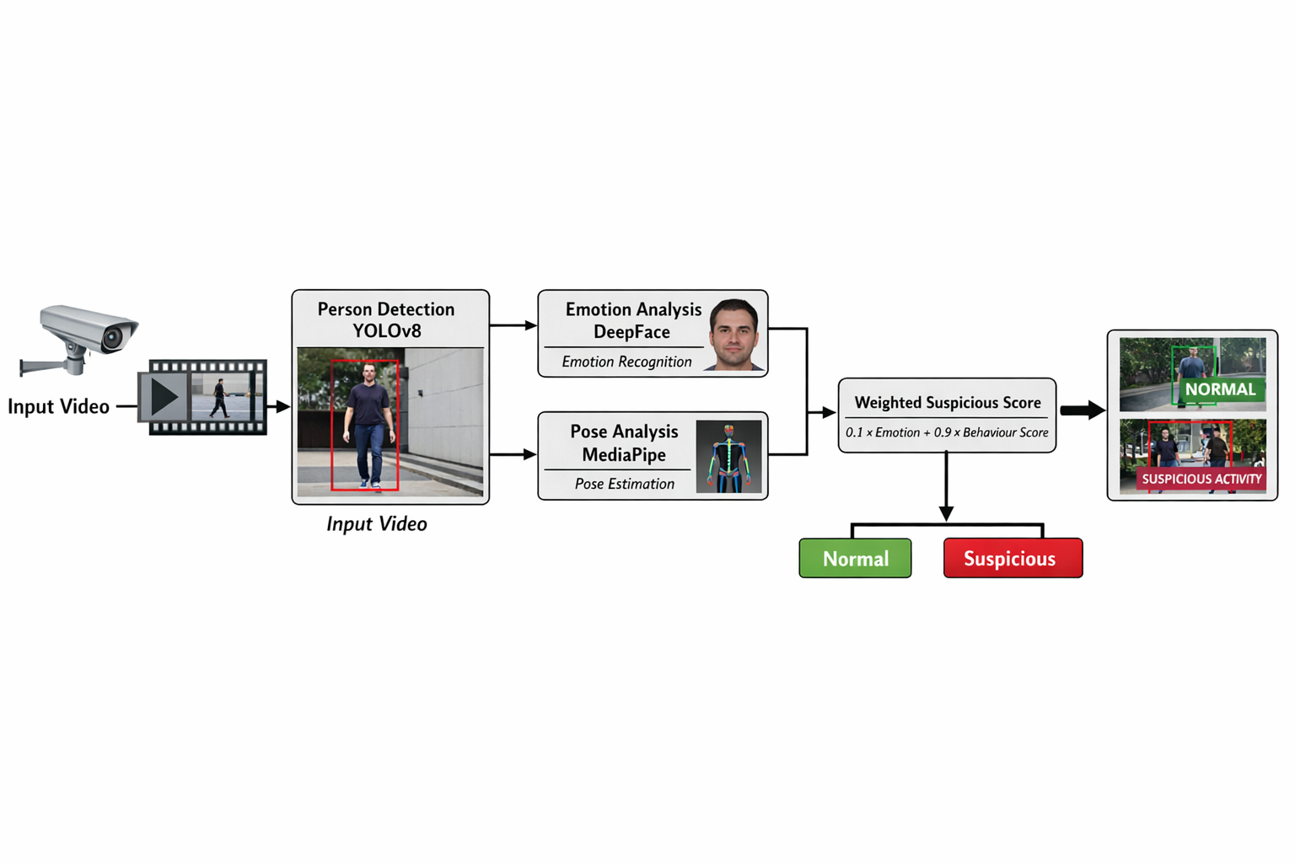
Main idea of the Project
The project aims to develop an intelligent surveillance system capable of automatically detecting suspicious human activities from video data. The system integrates computer vision and deep learning techniques to analyze both facial emotions and human behavioral patterns. By combining these two aspects using a weighted scoring mechanism, the system identifies whether a person’s activity is normal or suspicious. The main idea is to reduce dependency on manual monitoring and improve early detection of potential threats.

Slide 4

Existing System Vs Proposed
Existing System
Uses YOLOv8 for human detection
Uses DeepFace for emotion recognition
Basic fusion of emotion and behavior
Lower accuracy due to equal weighting
Limited focus on behavioral importance
Proposed System
Uses YOLOv8, DeepFace, and MediaPipe Pose
Introduces weighted scoring mechanism
Behavior given higher importance (0.9)
Emotion used as supporting factor (0.1)
Improved detection performance (83% best accuracy)
DEPARTMENT OF CSE MINI PROJECT REVIEW

Slide 5
Proposed Project Objectives
Detect suspicious human activities automatically
Analyze both emotion and behavior from video
Improve detection accuracy using weighted scoring
Reduce human effort in surveillance monitoring
Enable future real-time implementation

Slide 6
Proposed Project Outcomes
Automated suspicious activity detection system
Integration of multiple AI models
Weighted scoring mechanism for better decisions
Achieved 83% best accuracy
Provides foundation for smart surveillance systems

Slide 7
Software and Hardware Requirements
Software
Python
OpenCV
YOLOv8 (Ultralytics)
DeepFace
MediaPipe
Google Colab / VS Code
Hardware
System with minimum 8GB RAM
GPU (optional but recommended)
Webcam / Video dataset

Slide 8
Process Model
1.Input Video
2.Frame Extraction
3.Human Detection
4.Emotion Analysis
5.Behavior Analysis
6.Score Calculation
7.Classification Output

Slide 9
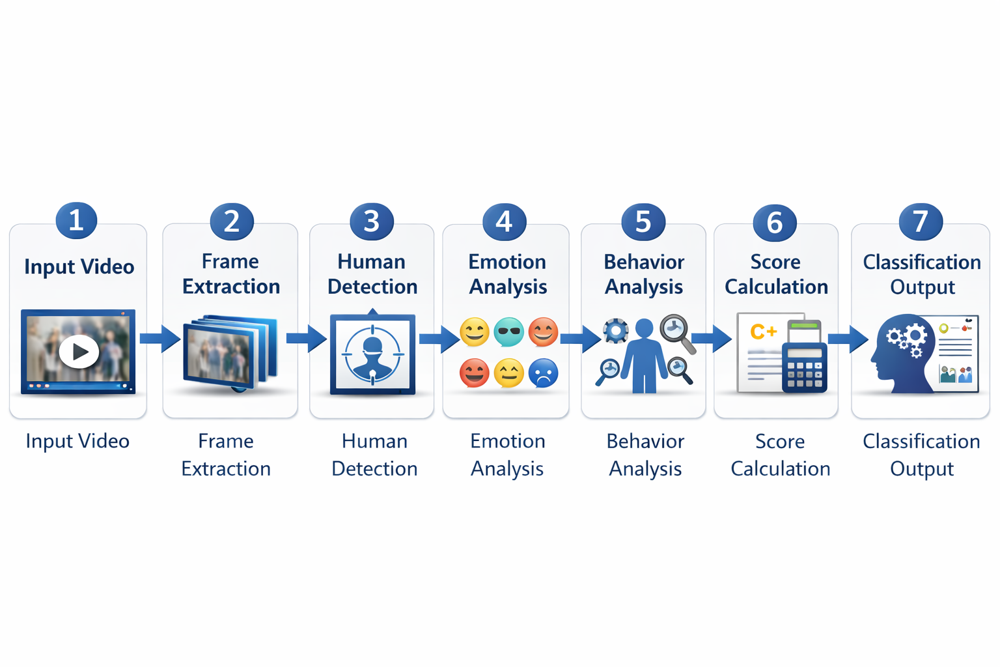
PROCESS MODEL

Slide 10
Architectural Diagram
Input video enters system
YOLOv8 detects humans
DeepFace extracts emotion
MediaPipe extracts pose
Scores are combined
Final decision: Normal
/ Suspicious

Slide 11
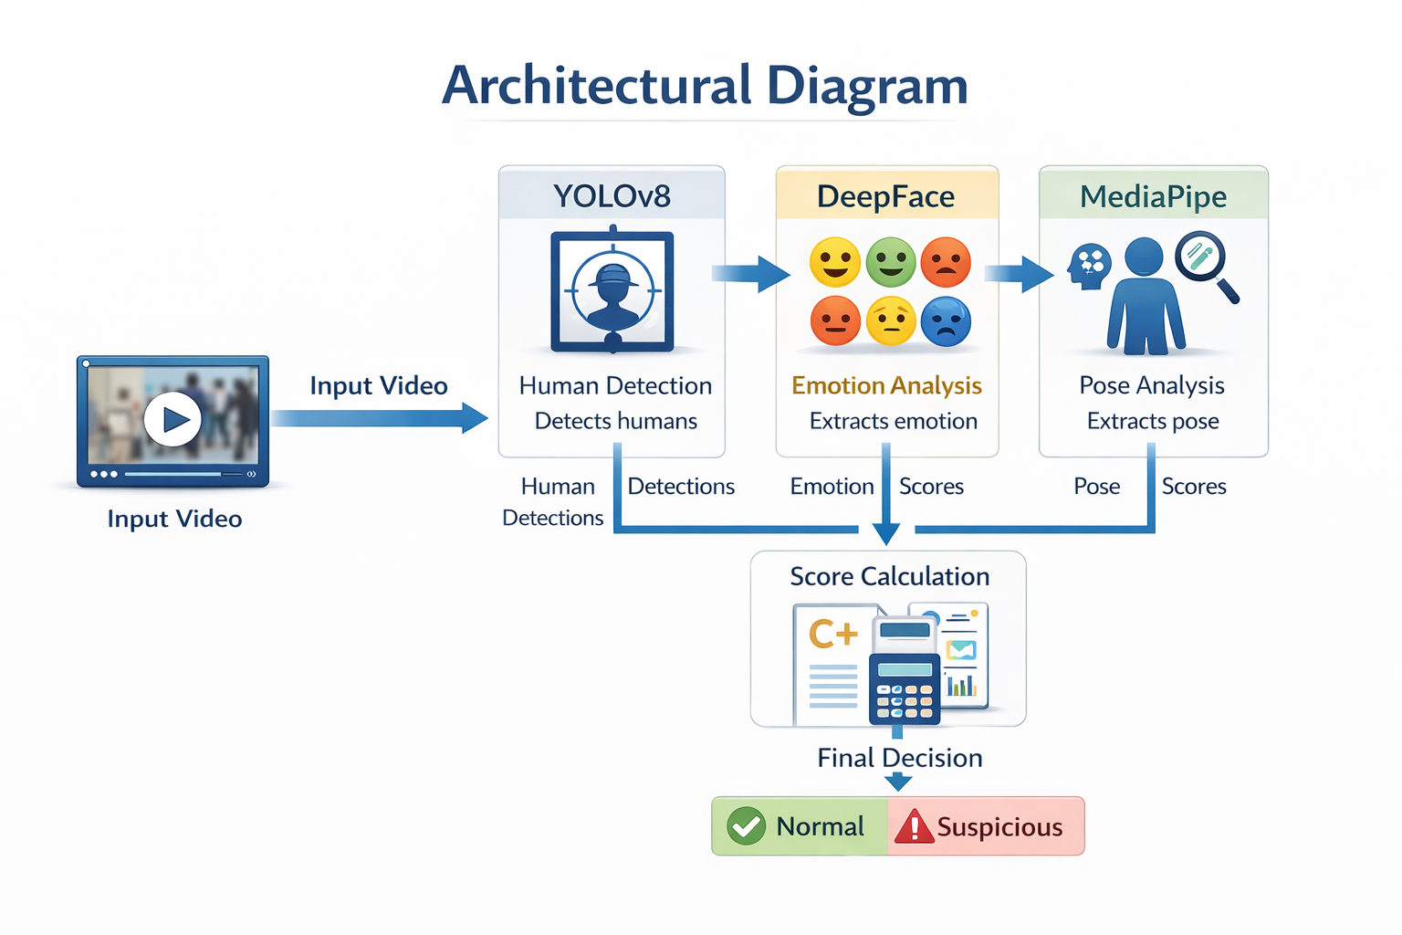

Slide 12
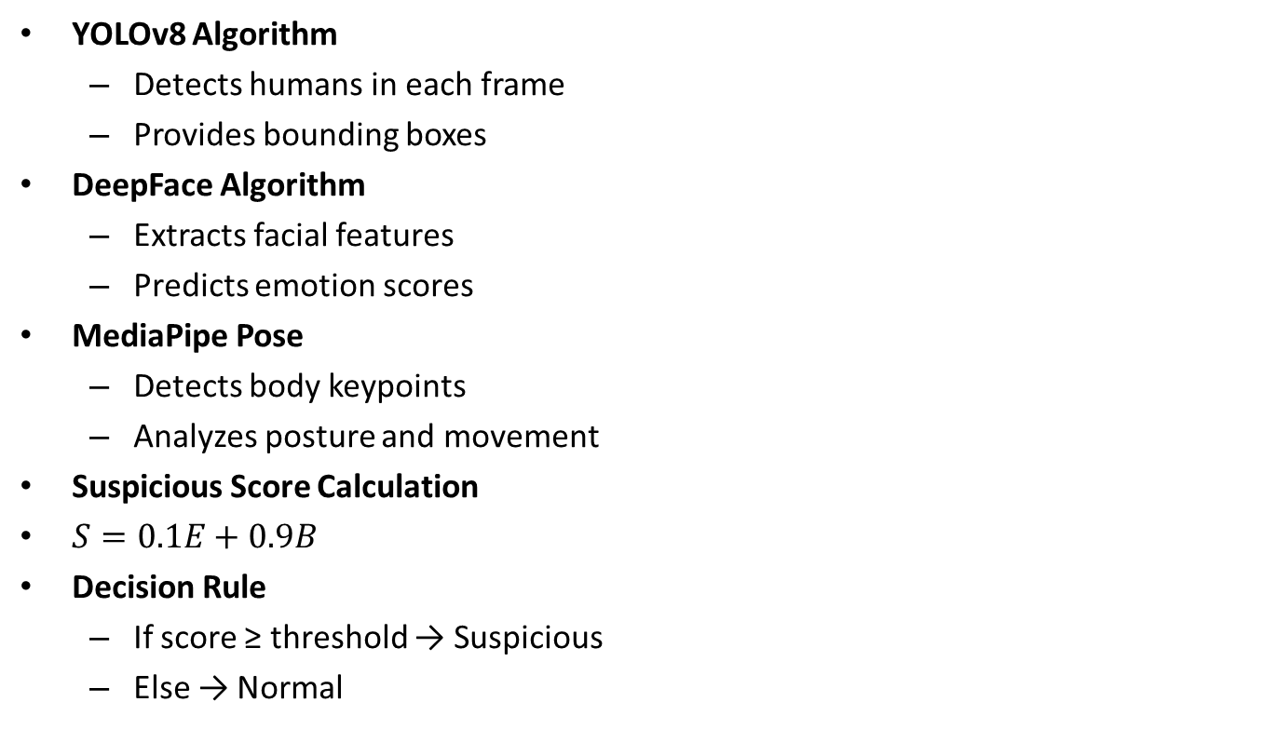
PROPOSED METHOD AND ALGORITHMS
YOLOv8 Algorithm
Detects humans in each frame
Provides bounding boxes
DeepFace Algorithm
Extracts facial features
Predicts emotion scores
MediaPipe Pose
Detects body keypoints
Analyzes posture and movement
Suspicious Score Calculation
$S=0.1E+0.9B$
Decision Rule
If score ≥ threshold → Suspicious
Else → Normal

Slide 13
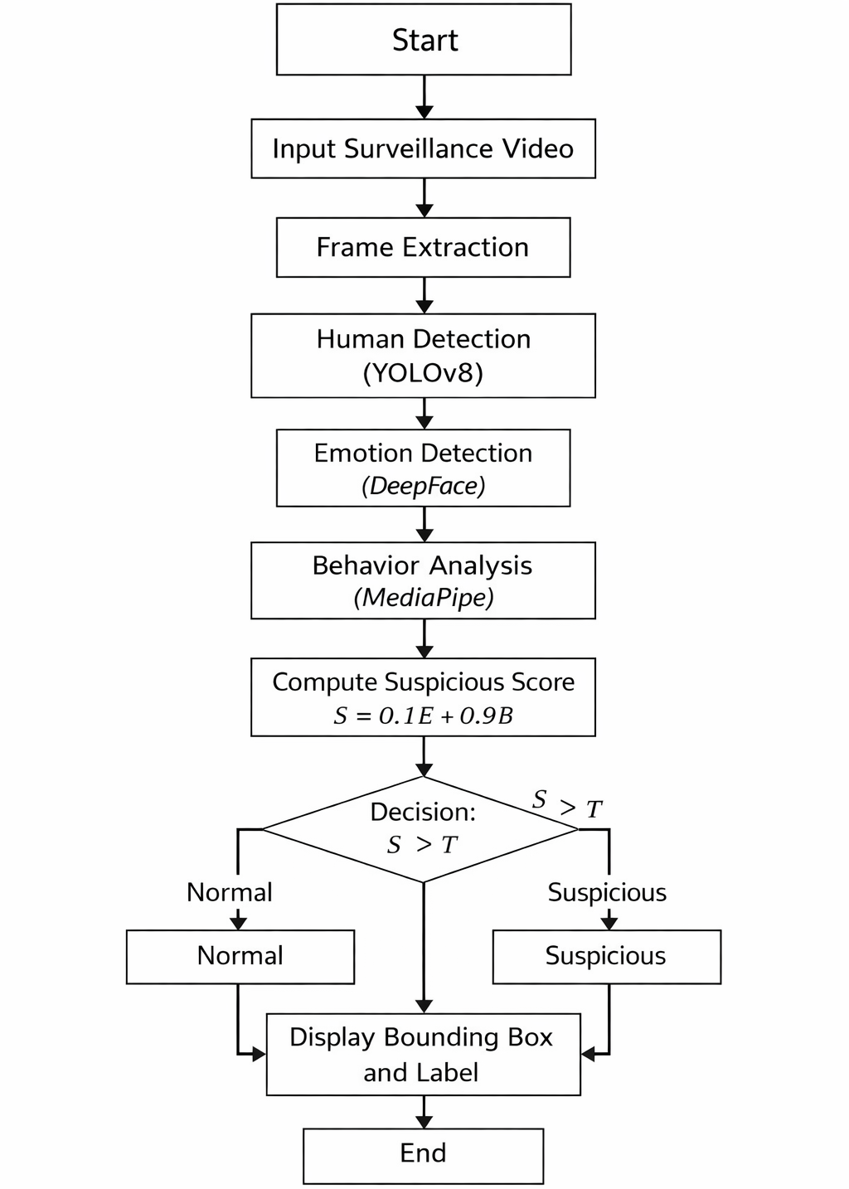
PROPOSED METHOD AND ALGORITHMS

Slide 14
Results
Model evaluated on surveillance videos
Achieved best accuracy of 83%
Improved performance over base model
Behavioral weighting improved detection
System successfully distinguishes activity types.

Slide 15
Conclusion
The project successfully demonstrates an AI-based surveillance system capable of detecting suspicious activities by combining emotional and behavioral analysis. The proposed weighted scoring mechanism improves detection performance by prioritizing behavioral cues. The system provides a practical approach toward intelligent automated surveillance and can be further extended for real-time applications.

Slide 16
Thank You

