Slide 1
NOVA 30-Day Job Preparation Strategy
NOVA AI Preparation Resource
26 October 2026

Slide 2
Goal
Prepare for entry-level software developer roles through Python, SQL, DSA, projects, and mock interviews.

Slide 3
Week 1: Fundamentals
Days 1-3: Revise Python basics.
Days 4-5: Practice SQL queries.
Days 6-7: Solve beginner coding problems.

Slide 4
Week 2: Problem Solving
Practice arrays, strings, dictionaries, and basic data structures.

Slide 5
Week 3: Projects and Interviews
Revise your projects, practice explaining your code, and complete mock interviews.

Slide 6
Week 4: Applications and Revision
Improve your resume, apply to suitable jobs, revise weak topics, and practice interviews daily.

Slide 7
Schedule / Data
Week | Focus | Target
Week 1 | Python and SQL | Revise fundamentals
Week 2 | DSA | Solve practice problems
Week 3 | Projects | Prepare project explanations
Week 4 | Revision | Apply and practise interviews

Slide 8
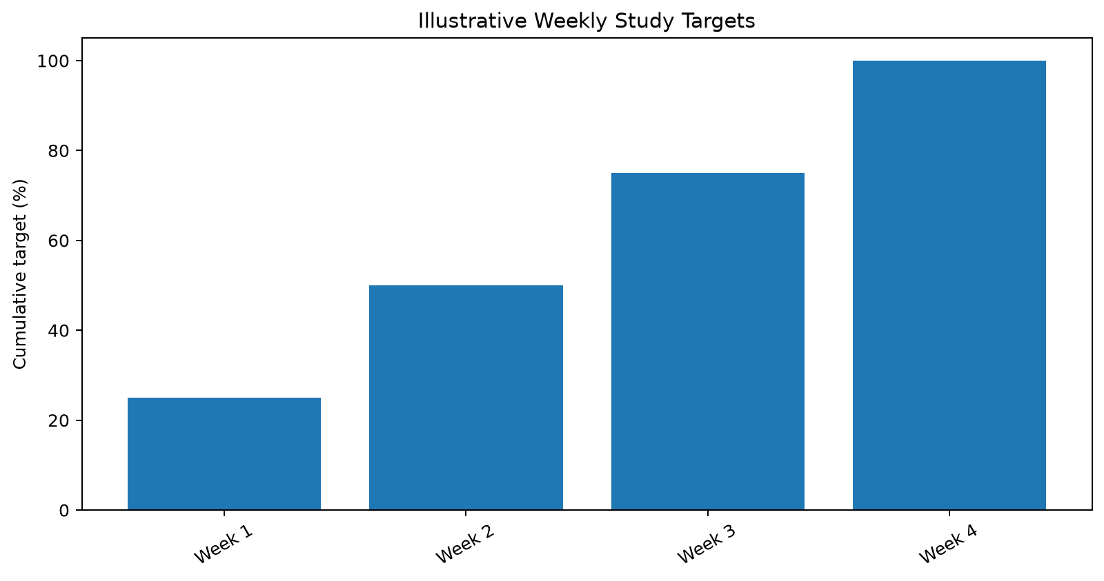
Illustrative Weekly Study Targets

