Slide 1
Unstructured Demo
Document Parsing for RAG
Dates | Modules
2 November 2025
9 November 2025
16 November 2025
23 November 2025
30 November 2025
7 December 2025 | Module 4: Document Parsers + Module 5 (Part 1): LlamaIndex Fundamentals
14 December 2025 | Module 5 (Part 2): LlamaIndex (Document Handling, Indexing, Querying, Hybrid Search)

Slide 2
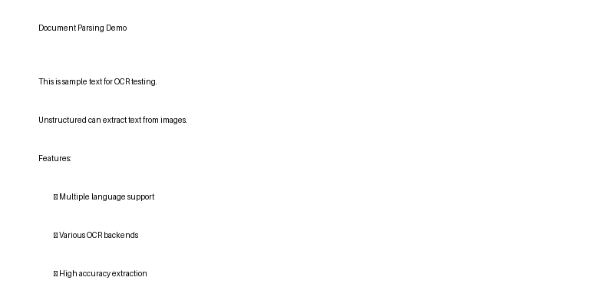
Key Features
Multiple file formats supported
OCR for scanned documents
Table extraction

