Slide 1
Distracted Driver Detection
Deepika Dasaroju
Student Id : 888078129

Slide 2

Agenda
Objective
Datasets
Data Exploration
Data Partitioning
Modeling
Results
Summary
References

Slide 3
Objective
Develop deep learning models to accurately identify various forms of distracted driving, including texting, eating, talking on the phone, and other activities.
Tasks:
Dataset Description
Utilize a comprehensive dataset provided by State Farm, consisting of 22,424 images categorized into
ten classes representing different driver behaviors.
Models used
Base Model Greyscale
Base Model Greyscale with Early stopping
Base Model RGB
RGB Model with Batch Normalization
Reset 152
VGG 16
Model Performance Evaluation

Slide 4
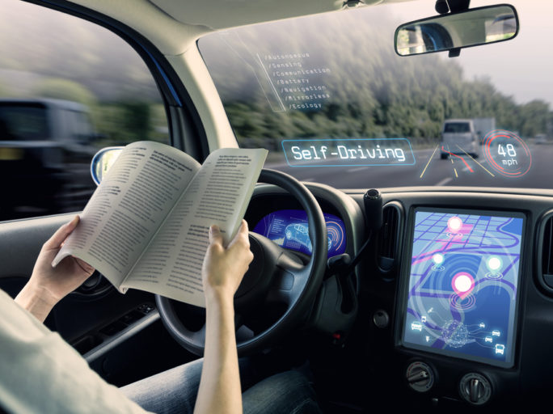
Overview of the dataset provided by State Farm:
Data Exploration
The dataset provided by State Farm comprises 22,424 images capturing drivers in various states of attention and distraction.
Images are initially in RGB format with a resolution of 480x640 pixels.
They are resized to 120x160 pixels for standardization and computational efficiency.
Images are categorized into ten classes, representing different driver behaviors and facilitating classification tasks.
This Photo by Unknown Author is licensed under CC BY-SA-NC

Slide 5
Data Exploration
Distribution of images across the ten classes of driver behaviors:
c0 (safe driving): 2,489 images
c1 (texting - right): 2,267 images
c2 (talking on the phone - right): 2,317 images
c3 (texting - left): 2,346 images
c4 (talking on the phone - left): 2,326 images
c5 (operating the radio): 2,312 images
c6 (drinking): 2,325 images
c7 (reaching behind): 2,002 images
c8 (hair and makeup): 1,911 images
c9 (talking to passenger): 2,129 images

Slide 6
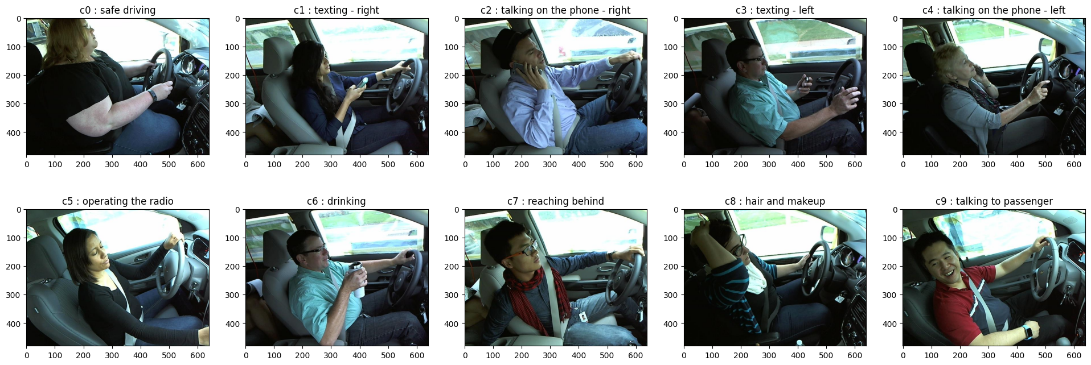
Data Exploration (Cont’d)
Display of sample images representing each class for visual understanding

Slide 7
Dataset Partitioning
Splitting the data:
Training Set (60%): This set consists of 13,454 samples utilized to train machine learning models. This larger portion ensures that models have sufficient data to learn patterns and relationships within the dataset effectively.
Validation Set (20%): This set contains 4,485 samples and serves as a validation resource for tuning hyperparameters and monitoring model performance. By providing a separate dataset for model evaluation during training, the validation set helps prevent overfitting.
Test Set (20%): This independent dataset comprises 4,485 samples reserved for final model evaluation. It assesses the model's generalization performance on unseen data, ensuring its effectiveness in real-world applications.

Slide 8
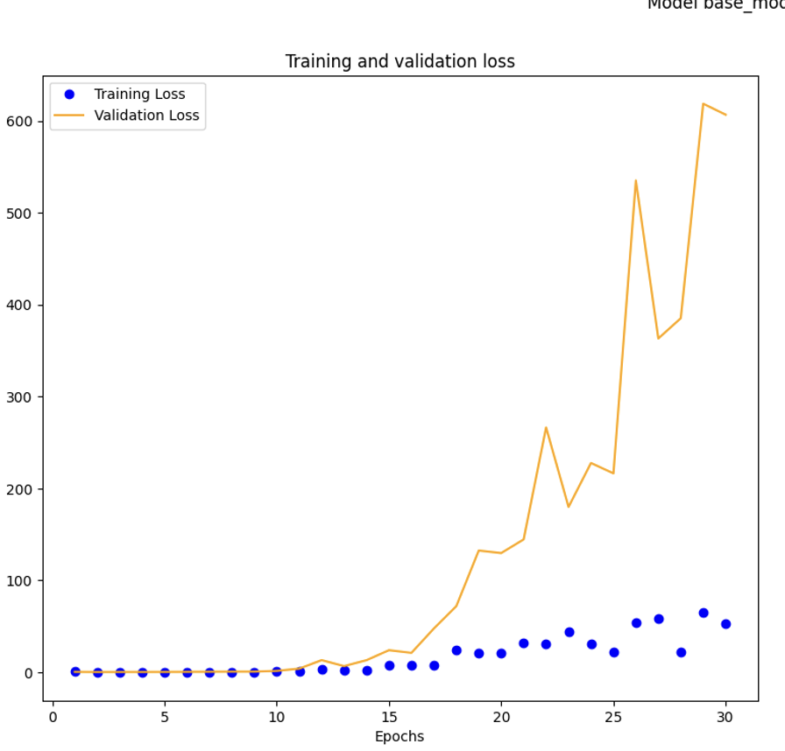
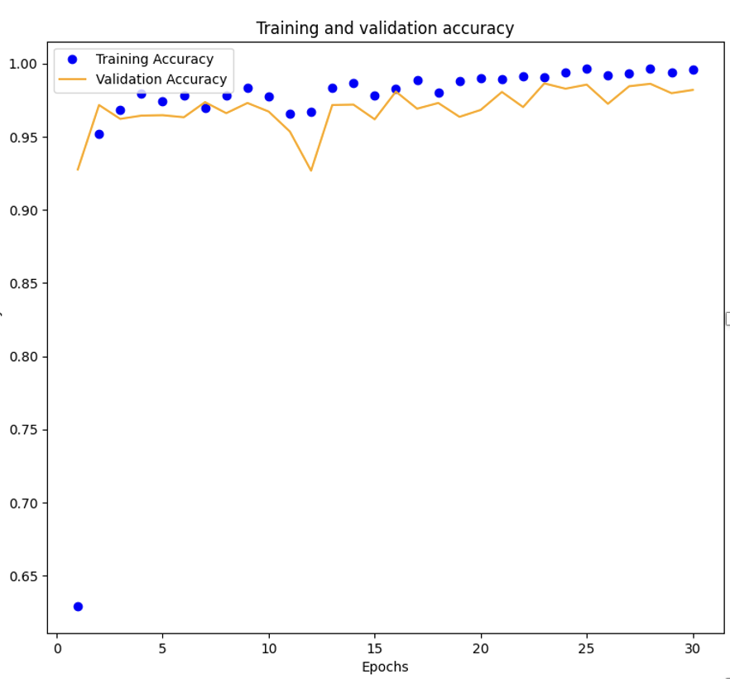
Base Model Grey Scale
Model Overview:
Convolutional Neural Network (CNN) for identifying distracted driver behaviors from greyscale images.
Input shape: (120, 160, 1)
Architecture:
Three convolutional layers with max pooling.
A flattened layer is followed by two dense layers and an output layer.
Total trainable parameters: 3,933,034.
Training Procedure:
Optimizer: Adam
Loss Function: Sparse categorical cross-entropy
Evaluation Metric: Accuracy
Image data normalized to [0, 1].

Slide 9
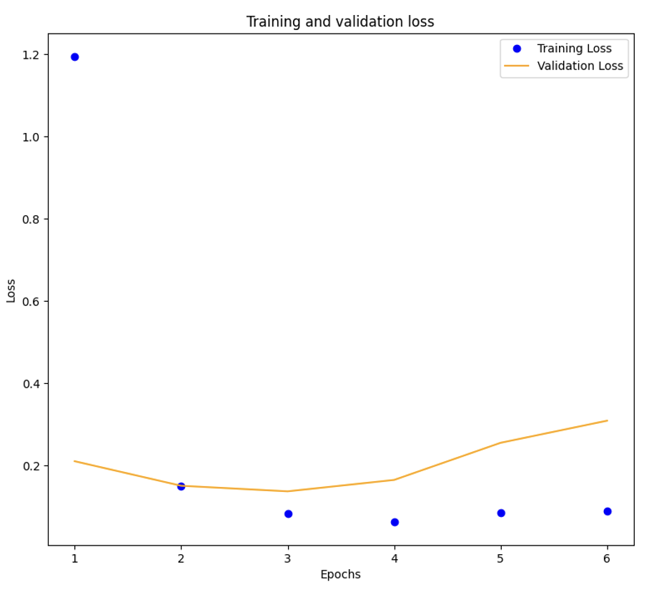
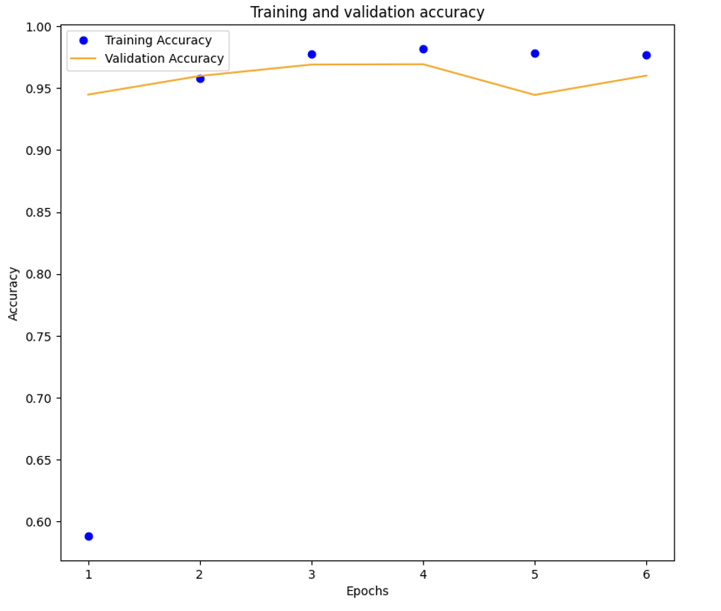
Base Model Grey Scale With Early Stopping
Model Overview:
A convolutional Neural Network (CNN) is designed to detect distracted driver behavior from greyscale images.
Incorporates an early stopping mechanism to prevent overfitting and enhance generalization.
The input architecture and trainable parameters are the same as the base models.
Early Stopping Mechanism:
Monitors validation loss, halting training if there is no improvement in validation loss for a specified number of epochs.
Patience is set to 3 epochs; the restore_best_weights option is enabled.
Training Procedure:
Optimizer: Adam
Loss Function: Sparse categorical cross-entropy
Metric: Accuracy
Input images normalized to [0, 1].
Training halted at the 6th epoch due to a lack of improvement in validation loss.

Slide 10
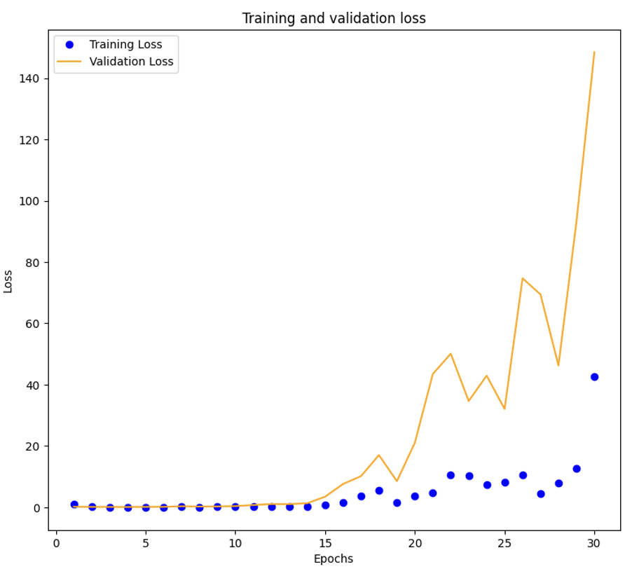
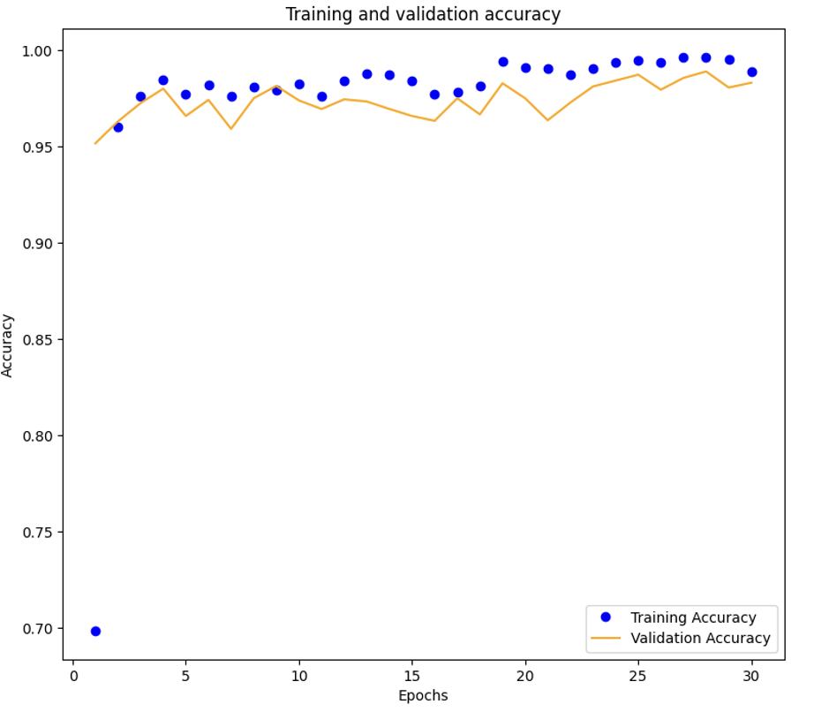
Base Model RGB
Model Overview:
Convolutional Neural Network (CNN) optimized for processing RGB images.
Designed to utilize full-color spectrum information for detecting and classifying distracted driver behaviors.
Input shape: (120, 160, 3)
Architecture:
Convolutional layers followed by max pooling for feature extraction.
Flattening layer to prepare data for dense layers.
Dense layers for classification.
Total trainable parameters: 3,935,338.
Training Procedure:
Optimizer: Adam
Loss Function: Sparse categorical cross-entropy
Metric: Accuracy
Image data normalized to [0, 1]
Training completed over 30 epochs with a batch size of 100.

Slide 11
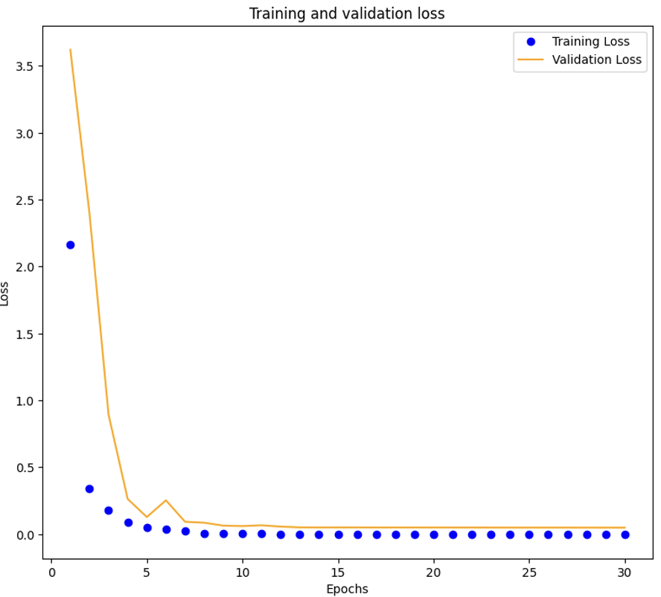
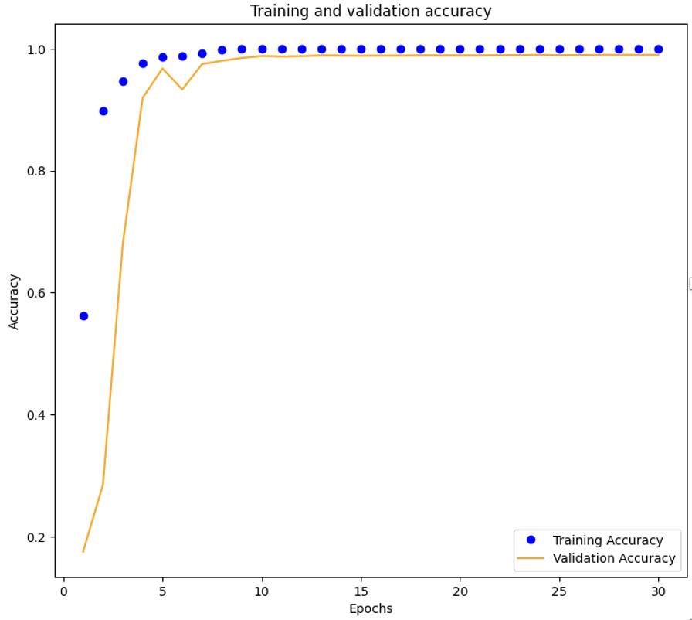
RGB Model With Batch Normalization
Model Overview:
Convolutional Neural Network (CNN) enhanced with batch normalization for processing RGB images.
Designed to improve training efficiency and model generalization.
Input shape: (120, 160, 3)
Architecture:
Convolutional layers followed by batch normalization and max pooling.
Flattening layer to prepare data for dense layers.
Dense layers for classification.
Total trainable parameters: 747,698.
Batch Normalization:
Applied after each convolutional layer to standardize activations, improving training stability and convergence.
Training Procedure:
Optimizer: Adam
Loss Function: Sparse categorical cross-entropy
Metric: Accuracy
Image data normalized to [0, 1]
Training completed over 30 epochs with a batch size of 100.

Slide 12
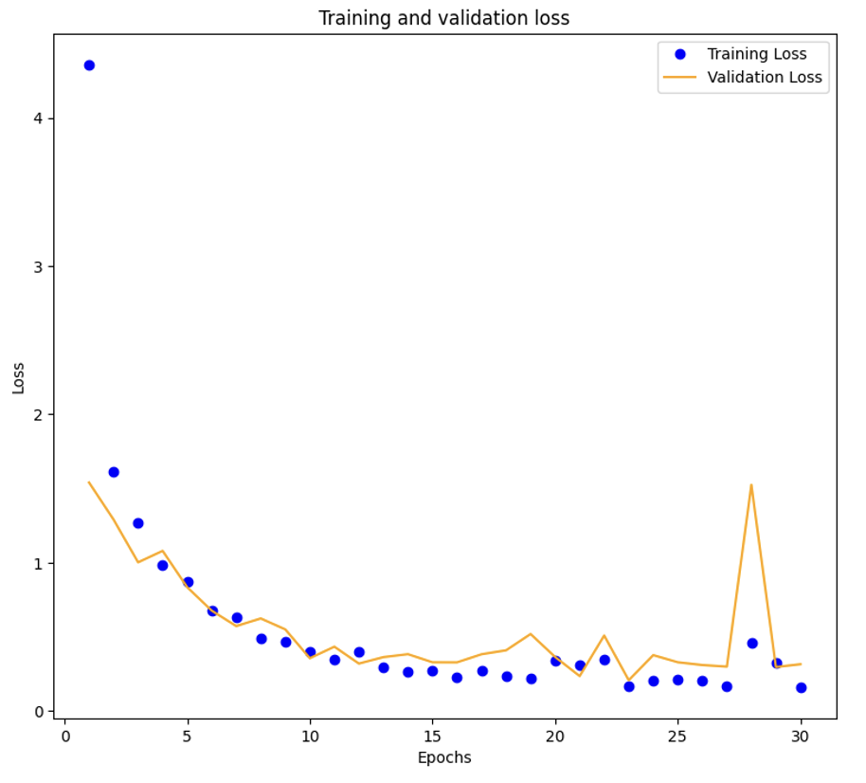
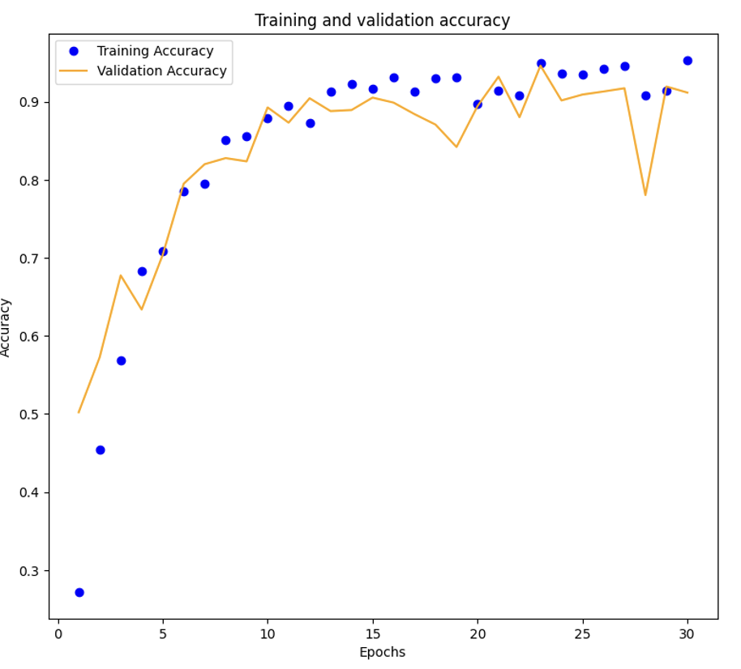
ResNet 152
Model Overview:
Utilizes pre-trained ResNet152 architecture for transfer learning in distracted driver detection.
Pre-trained base loaded with ImageNet weights.
Customized Top layers for specific classification tasks.
Input shape: (120, 160, 3)
Pre-Trained Base:
ResNet152 base configured with top layers excluded and input shape set for RGB images.
All pre-trained base layers are frozen to preserve learned features.
Custom Top Layers:
Flattening layer to convert 2D feature maps into a single vector.
Dense layers for feature interpretation and classification.
Total trainable parameters in custom layers: 40,971,010.
Training Procedure:
Optimizer: Adam
Loss Function: Sparse categorical cross-entropy
Metric: Accuracy
Training over 30 epochs with a batch size of 100.

Slide 13
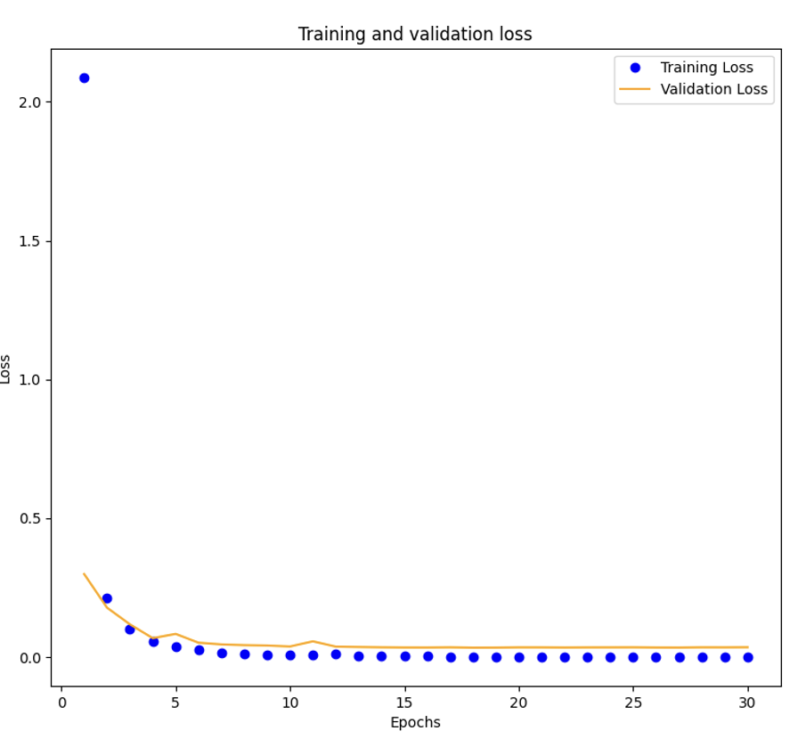
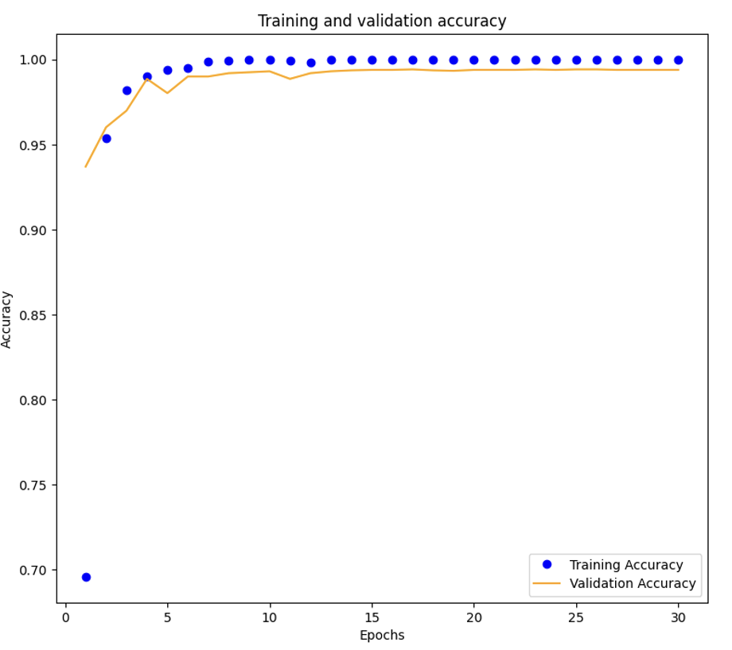
VGG 16
Model Overview:
Utilizes pre-trained VGG16 architecture for transfer learning in distracted driver behavior classification.
VGG16 base initialized with ImageNet weights and top classification layers excluded.
Input shape: (120, 160, 3)
Pre-Trained Base:
The VGG16 base is configured to retain pre-trained feature representations.
All base layers are frozen to prevent changes during training.
Custom Top Layers:
Flatten layer converts the output of the Pre-trained base into a 1D tensor.
Dense layers for feature interpretation and classification.
Total trainable parameters in custom layers: 7,691,010.
Training Procedure:
Optimizer: Adam
Loss Function: Sparse categorical cross-entropy
Metric: Accuracy
Training over 30 epochs with a batch size of 100.

Slide 14
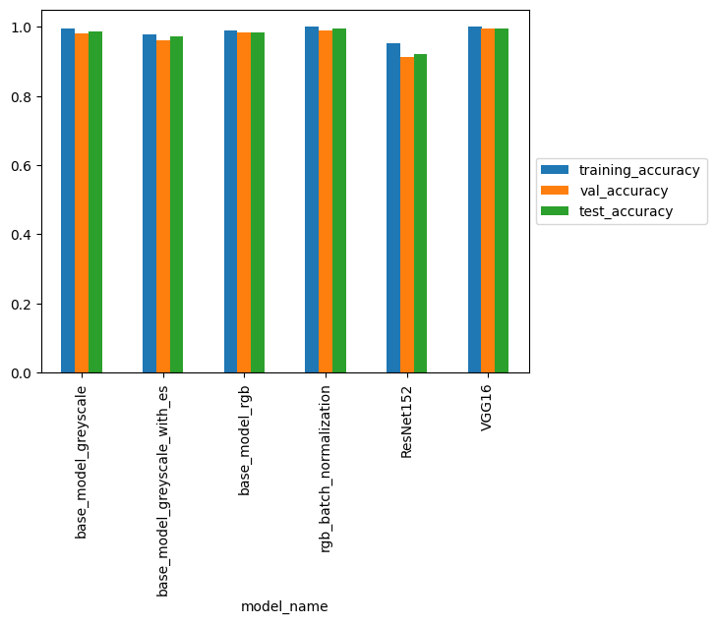
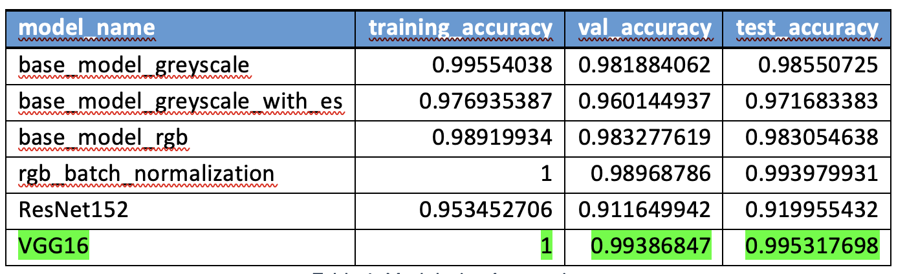
RESULTS
Model Performance Metrics:
Accuracy, precision, recall, and F1-score were evaluated on the test dataset.
Provides insights into correct predictions, false positives, and false negatives.
Accuracy:
VGG16 and RGB Batch Normalization models achieved high
test accuracies.
ResNet model showed a notable difference between training
and validation accuracies.
Model Wise Accuracies:

Slide 15
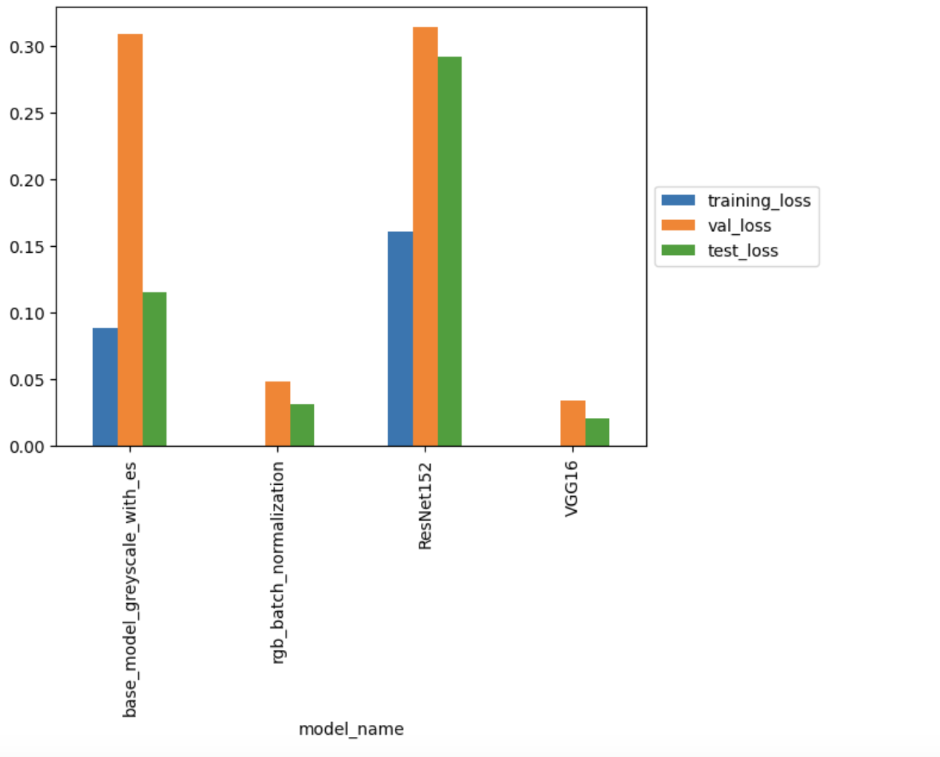
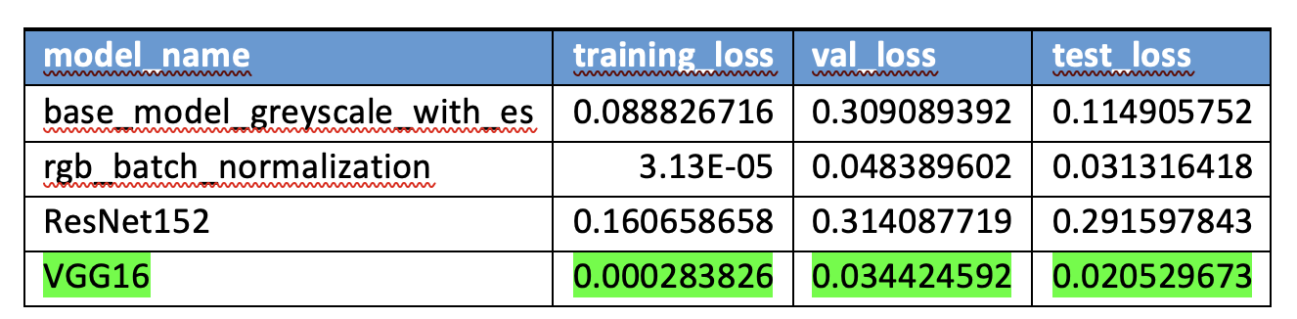
RESULTS
Loss:
VGG16 exhibited the lowest test loss, indicating efficient classification.
RGB Batch Normalization also showed low test loss.
Model Wise Losses:

Slide 16
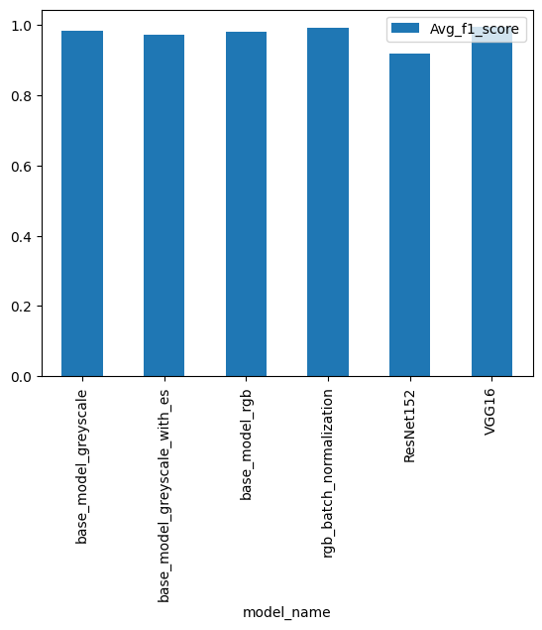
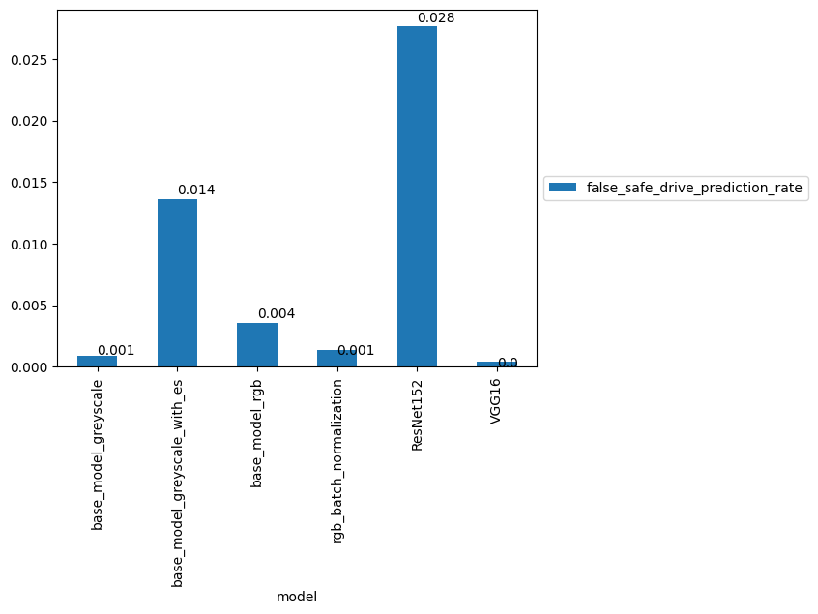
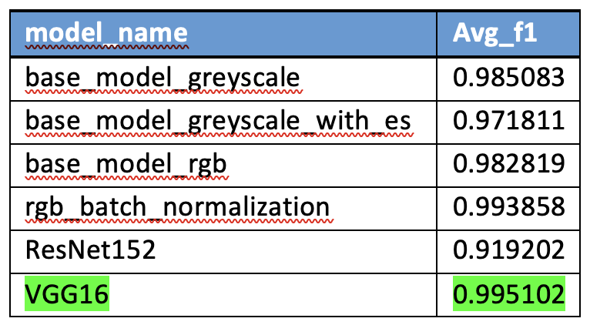
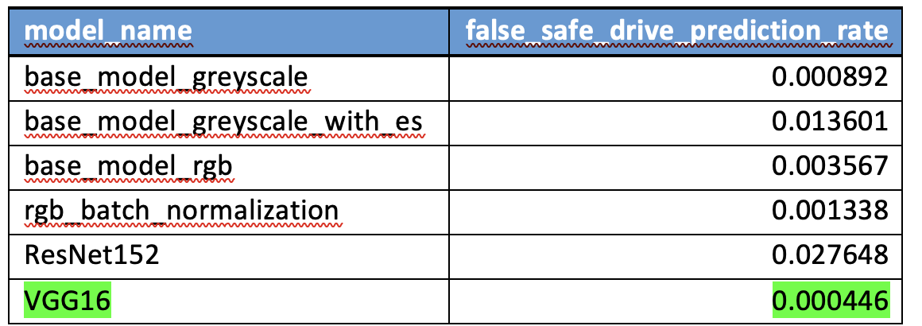
RESULTS
Class-Specific Metrics:
VGG16 excelled across multiple classes, demonstrating high accuracy, specificity, and F1 scores.
Notable performance in detecting various distracted driving behaviors.
Average F1 Score:
VGG16 achieved the highest average F1 score, indicating overall strong performance across all classes.
RGB Batch Normalization followed closely in performance.
False Safe Driving Prediction Rate:
VGG16 exhibited the lowest false safe driving prediction rate, indicating fewer false predictions of safe driving when drivers are distracted.

Slide 17

Summary & Insights
Leveraging pre-trained networks, particularly VGG16, resulted in the highest overall test accuracy and lowest test loss.
RGB Batch Normalization model also showed superior performance.
Base Model Greyscale with Early Stopping demonstrated faster training but lower accuracy than other models.
Adjustments in model architecture and utilization of pre-trained models were crucial.
Accurately detecting distracted driving behaviors can lead to proactive interventions and accident prevention.
Further fine-tuning of top layers or exploration of different architectures could enhance accuracy.

Slide 18
References
Kaggle State Farm distracted driver detection.
World Health Organization (2020). Road traffic injuries.
The Daily Star. (2020). 21 died on roads every day.
Hesham M. Eraqi, Yehya Abouelnaga, Mohamed H. Saad, Mohamed N. Moustafa, "Driver Distraction Identification with an Ensemble of Convolutional Neural Networks”
Dash, A.K. (.2019). Vgg16 architecture.
Machine Learning Mastery - CNN
Transfer Learning Art of fine tuning a pretrained model
RestNet Architecture

Slide 19
Thank You

