Slide 1
IMAGE COLORIZATION USING GAN
PRESENTED BY:DEEPIKA D
REGISTER NO:813821104024
DEPARTMENT:COMPUTER SCIENCE AND ENGINEERING
3/21/2024 Annual Review

Slide 2
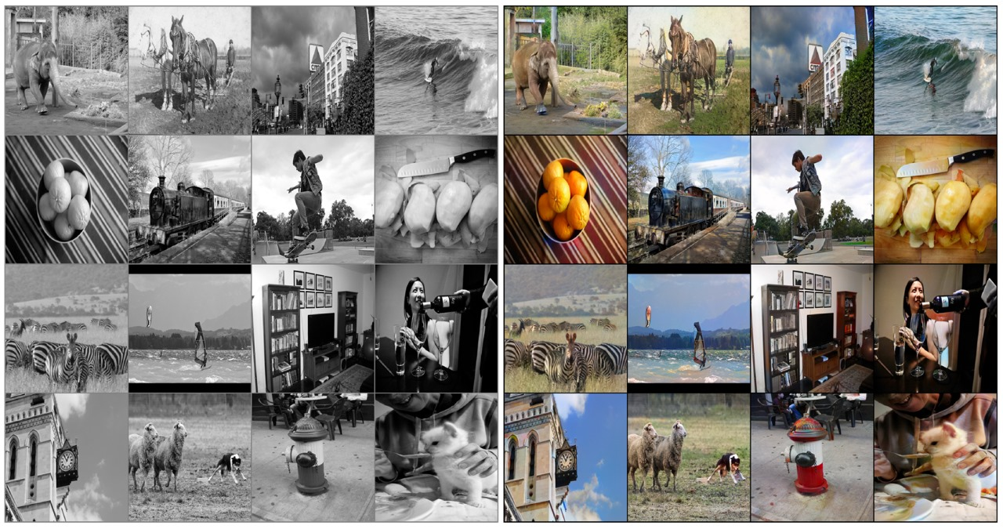
IMAGE COLARIZATION USING GAN
PROJECT TITLE
3/21/2024 Annual Review

Slide 3
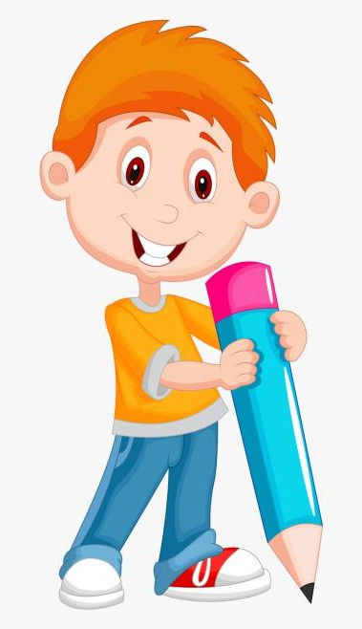

AGENDA
Problem Statement
Project Overview
The Solution and Its Value Proposition
The WOW in the Solution
Modelling
Results
3/21/2024 Annual Review

Slide 4

PROBLEM STATEMENT
Image colorization is the process of adding color to grayscale images, which can be a time-consuming and labor-intensive task when done manually. Traditional methods often rely on hand-crafted features or complex algorithms, making them susceptible to inaccuracies and inconsistencies. To address this challenge, there is a growing interest in utilizing deep learning techniques, particularly Generative Adversarial Networks (GANs), to automate the colorization process.The primary objective of this project is to develop an efficient and accurate image colorization system using GANs.
Specifically, the project aims to:
Train a GAN architecture suitable for image colorization
Evaluate and refine the colorization model

Slide 5
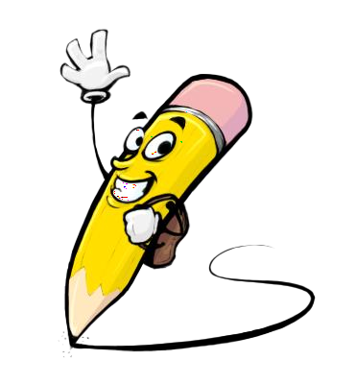
PROJECT OVERVIEW
Overview:
Imagine adding colour to an old black and white snapshot to create a vivid scene that is brimming with life.
This is the magic that GAN-based image colorization is capable of.
Colorization is one area where GANs, a kind of deep learning model, have completely changed picture manipulation tasks.
Objectives:
Learning Color Distribution: The model should learn the statistical distribution of colors in natural scenes. This allows it to generate colors that are probable and realistic within the context of the image (e.g., a human face wouldn't be colored bright green).
Leveraging Context Clues: Train the model to utilize contextual information within the image, such as shadows and highlights, to infer the appropriate colors for different regions.
Adherence to Color Palettes: If the training data includes images from specific styles or time periods (e.g., historical photos), the model should learn to generate colors that are consistent with those palettes.

Slide 6
PROJECT OVERVIEW(CONTD..)
Goals:
Realistic Colorization: The primary goal is to generate colorized images that are visually realistic and indistinguishable from natural color photographs. GANs are well-suited for this task as they can capture complex patterns and textures in images, allowing for more accurate colorization.
Preservation of Semantics: Ensure that the colorized images maintain the semantic meaning and context of the original grayscale images. Colors should be applied appropriately to objects, scenes, and textures, preserving the underlying structure and content.
Generalization Across Diverse Images: Develop a colorization model that can generalize well across different types of grayscale images, including various scenes, objects, and textures. The goal is to create a versatile system that can handle a wide range of inputs without sacrificing colorization quality.

Slide 7
PROJECT OVERVIEW(CONTD..)
How It Works?
Dataset Preparation: Collect grayscale images paired with their corresponding color images for training.
GAN Architecture Selection: Choose a suitable GAN architecture like cGANs or Pix2Pix for image-to-image translation.
Generator Network: Develop a generator network to produce colorized versions of grayscale images.
Discriminator Network: Create a discriminator to distinguish between real and fake color images.
Adversarial Training: Train the generator and discriminator simultaneously to optimize their performance.
Loss Functions: Utilize adversarial loss to ensure realism and perceptual loss to capture visual details.
Training Optimization: Use gradient descent methods to update the networks iteratively.
Evaluation and Fine-Tuning: Assess the model's performance and make adjustments as necessary.
Inference: Employ the trained generator for colorizing new grayscale images.
Post-processing: Optionally refine colorized images through adjustments like color balance or contrast

Slide 8

THE SOLUTION AND ITS VALUE PROPOSITION
SOLUTION:
Generative Adversarial Networks (GANs) offer a powerful solution for image colorization. These deep learning models are trained on a vast collection of grayscale images paired with their corresponding color versions. Through an ingenious training process, GANs learn to map grayscale information to realistic color channels, effectively colorizing black and white photos.
VALUE PROPOSITION:
Breathe life into history: Restore faded black and white photos.
Empower artistic expression: Explore color variations in grayscale images.
Boost visual appeal: Automatically colorize images for greater engagement.
Save time and resources: Automate large-scale grayscale image colorization.
Unmatched realism: Generate incredibly realistic and natural-looking colors.
Preserve image details: Maintain image integrity during colorization.
Adaptable to styles: Colorize images following specific aesthetics.

Slide 9

THE WOW IN THE SOLUTION
Our solution is truly remarkable. By harnessing the power of advanced regression algorithms and a rich dataset including crucial features like airline, date of journey, and destination, we've developed a model that accurately predicts flight prices. Travelers can now plan their trips with confidence, knowing they have reliable cost estimates at their fingertips. Airlines and travel agencies also benefit, as our solution provides them with the insights needed to optimize pricing strategies and enhance customer satisfaction.
The WOW factors are:
Precision and Accuracy
Transparent Insights
Continuous Improvement
3/21/2024 Annual Review

Slide 10
MODELLING
Network Architecture:
A typical GAN architecture for image colorization involves two main components.
Generator (G): This network acts like the colorization artist. It takes a grayscale image (typically one channel) as input and aims to produce a colorized image (usually three channels for RGB). The architecture of G can be based on convolutional neural networks (CNNs), often employing U-Net like structures with skip connections to preserve spatial information.
Discriminator (D): This network acts as the art critic. It receives both real color images and the colorized images generated by G. Its task is to distinguish between the real and fake images. The discriminator also utilizes CNNs, often with a simpler architecture compared to the generator.

Slide 11
MODELLING
Data Preparation:
A large dataset of paired grayscale and color images is required. Preprocessing steps like image resizing and normalization might be necessary.
Generator Update: During each training iteration, a grayscale image is fed into the generator. The generated color image is then sent to the discriminator alongside a real color image. Based on the discriminator's feedback (through the adversarial loss), the generator updates its weights to improve its colorization capabilities
Discriminator Update: Independently, the discriminator receives both real and fake color images. It uses this information to refine its ability to distinguish between them, updating its own weights in the process.
Iterative Refinement: This process of updating the generator and discriminator continues for numerous iterations, allowing both models to learn and improve their performance. The content loss (if used) is also factored into the generator's update process.

Slide 12
MODELLING
Loss Functions
Loss Functions: Adversarial Loss: This loss function guides the training process. It encourages the generator (G) to create colorized images that can fool the discriminator (D) into believing they are real. Conversely, it pushes the discriminator (D) to improve its ability to detect fake images generated by G.
Content Loss (Optional): This loss function helps the generator (G) produce colorized images that are not only realistic but also retain the content and structure of the original grayscale image. Common metrics used here include L1 or L2 loss between the generated color image and the real color image (if available for training).
Additional Considerations
Hyperparameter Tuning: Finding the optimal settings for various hyperparameters (learning rates, network size) is crucial for achieving good colorization results.
Training Hardware: Training GANs can be computationally expensive. Utilizing GPUs or specialized deep learning accelerators is often recommended.

Slide 13
MODELLING
Data Preparation for Unseen Dataset:
Another dataset is loaded for prediction using the trained model.
Similar preprocessing steps are applied to the unseen dataset as with the training dataset.
Prediction using the Trained Model:
The trained Random Forest Regressor model is used to predict flight prices on the unseen dataset.
R-squared value and normalized RMSE are calculated to evaluate the model's performance on the unseen data.
Hyperparameter Tuning with RandomizedSearchCV:
Hyperparameter tuning is performed on the Random Forest Regressor using RandomizedSearchCV to find the optimal hyperparameters.
The best parameters are identified, and the model's performance is evaluated again.
3/21/2024 Annual Review

Slide 14
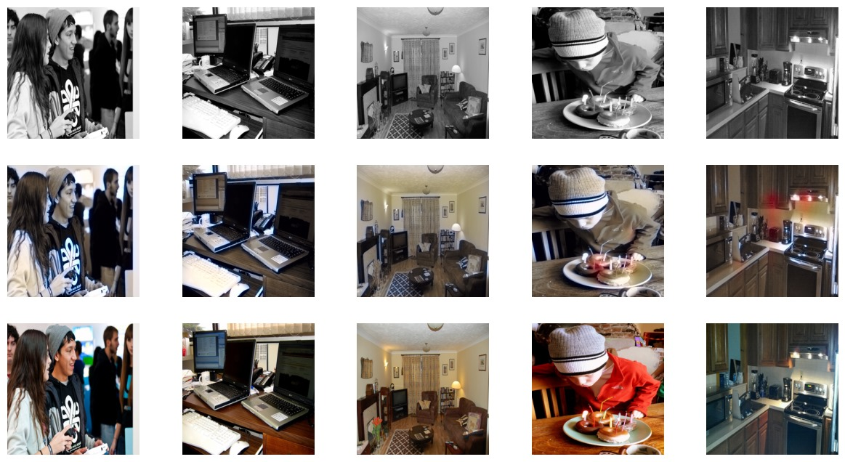
RESULTS
3/21/2024 Annual Review

Slide 15
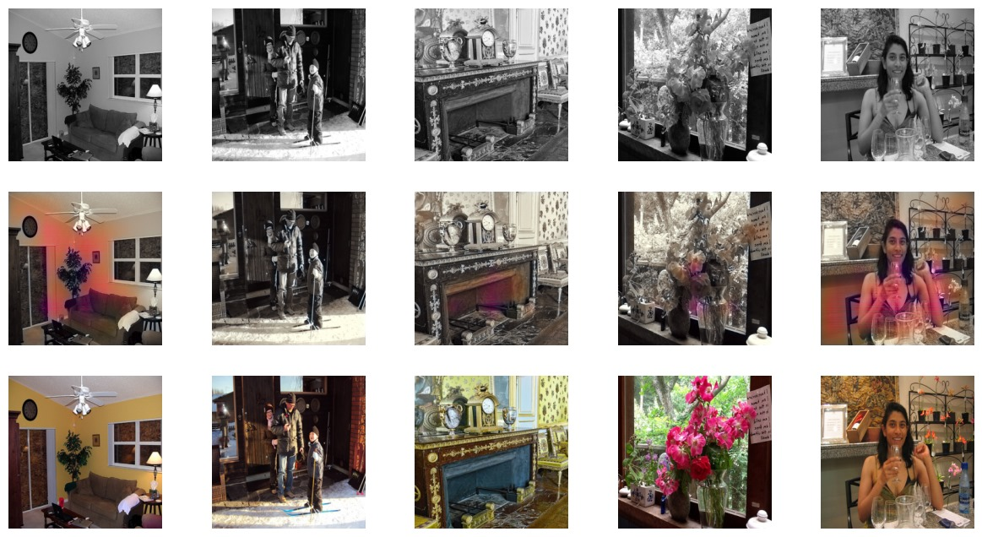
RESULTS
3/21/2024 Annual Review

Slide 16
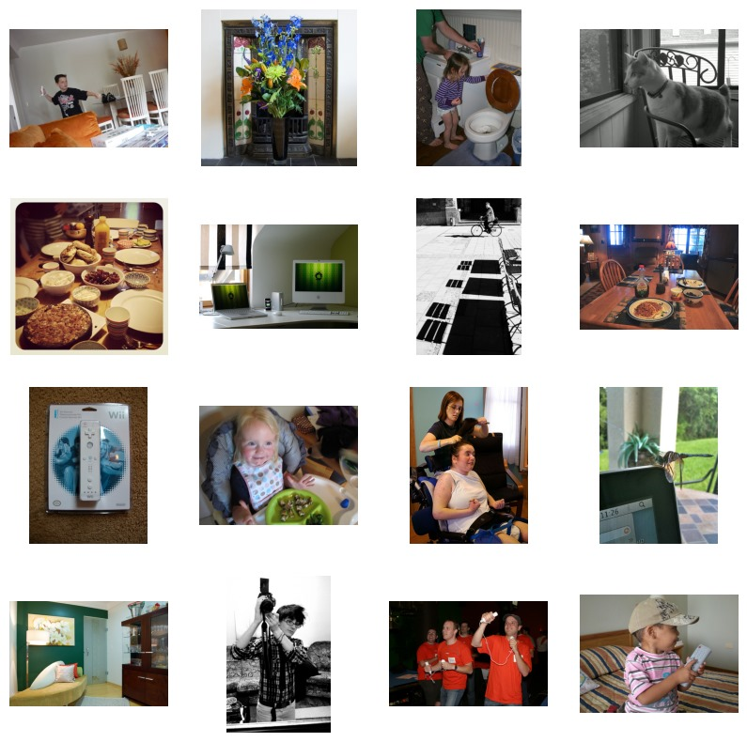
RESULTS
GitHub Link

