Slide 1



Predicting Credit Card Approval using Machine Learning
This presentation outlines a data-driven approach to predict credit card application approval using machine learning techniques.

Slide 2
Problem Statement
In the fiercely competitive financial services sector, the capability to predict credit card application approvals with precision is vital for effectively managing risk and enhancing customer acquisition strategies. Credit card issuers must make quick yet well-informed decisions to strike a balance between maximizing profits and minimizing the risk of defaults. The main goal of this project is to create a machine learning model that can accurately predict whether credit card applications will be approved or rejected. This requires a thorough understanding of the key factors that influence these decisions. By utilizing historical application data, we aim to develop a predictive model that automates and improves the decision-making process

Slide 3
Dataset Overview:
The dataset contains the following columns:
Income: The applicant's income level is a crucial factor in assessing their ability to repay credit.
Employment Length: The duration of the applicant's current employment provides insights into job stability and reliability, which are important for credit decisions.
Age: The age of the applicant can be indicative of financial maturity and stability.
Has a property: Owning property can be a sign of financial stability and lower credit risk.
Employment Status: The current employment status (e.g., full-time, part-time, unemployed) directly affects the applicant's income stability and creditworthiness.
Marital Status: Marital status can impact financial stability, as married applicants may have dual incomes or more financial obligations.

Slide 4
Project Workflow
Exploratory Data Analysis (EDA)
1
Understand data patterns, identify potential relationships, and select relevant features.
2
Feature Engineering
Create or modify features to enhance model performance.
Data Preprocessing
3
Prepare data for model training by addressing missing values, encoding categorical variables, and scaling features.
4
Model Development
Train various machine learning models for classification.
Model Evaluation
5
Assess model performance using appropriate metrics and select the best model.
6
Prediction
Apply the trained model to predict credit card approval for new applications.
Recommendations
7
Provide insights and actionable recommendations based on model results.

Slide 5

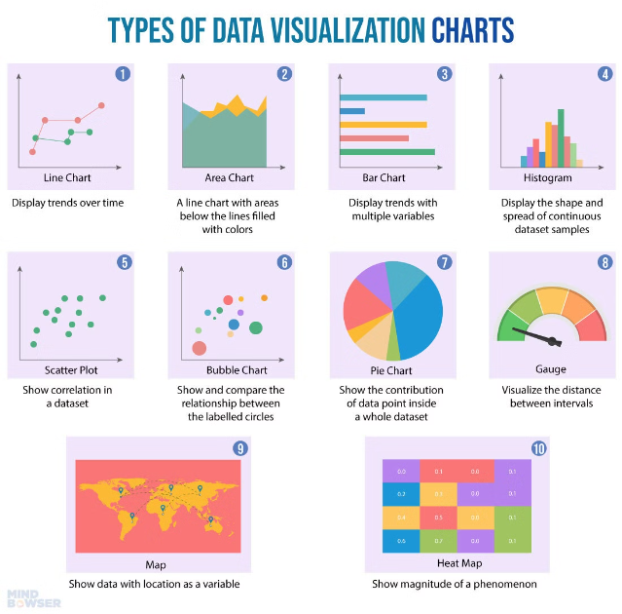
Exploratory Data Analysis (EDA)
Univariate Analysis
Analyze individual variables to understand their distributions and characteristics.
Bivariate Analysis
Explore relationships between pairs of variables, identifying potential correlations and dependencies.

Slide 6
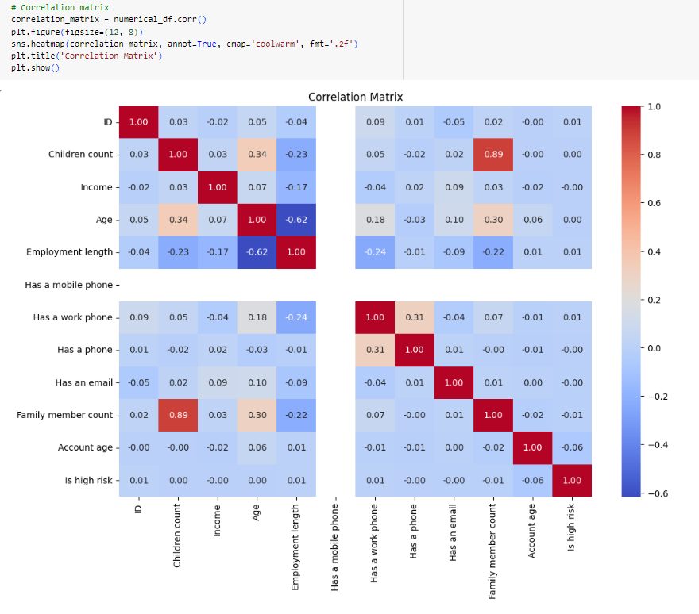
Correlation Matrix

Slide 7
EDA - Findings
Variable
Insight
Income
Higher income is associated with a higher approval rate.
Age
Applicants in their 30s and 40s have higher approval rates.
Credit History
Applicants with good credit history have a significantly higher approval rate.

Slide 8


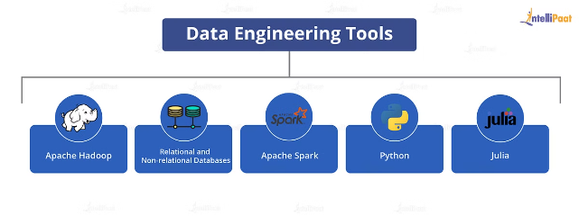


Feature Engineering
Income-to-Loan Ratio
A new feature to represent the applicant's ability to repay the loan.
Debt-to-Income Ratio
Represents the percentage of income dedicated to debt repayment.
Credit Utilization Ratio
Measures the amount of available credit used by the applicant.

Slide 9

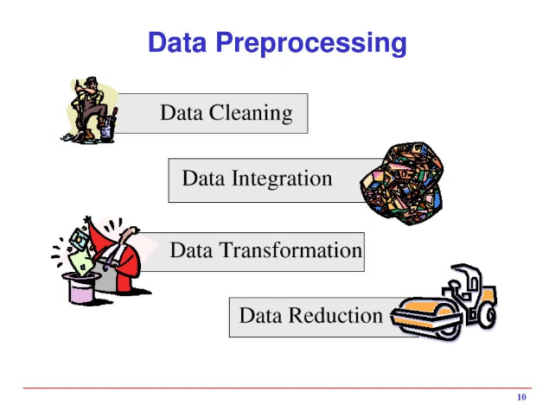
Data Preprocessing
Missing Values
Impute missing values using appropriate techniques based on data characteristics.
Categorical Variables
Encode categorical variables using one-hot encoding or other suitable methods.
Feature Scaling
Standardize or normalize features to ensure consistent scales across variables

Slide 10
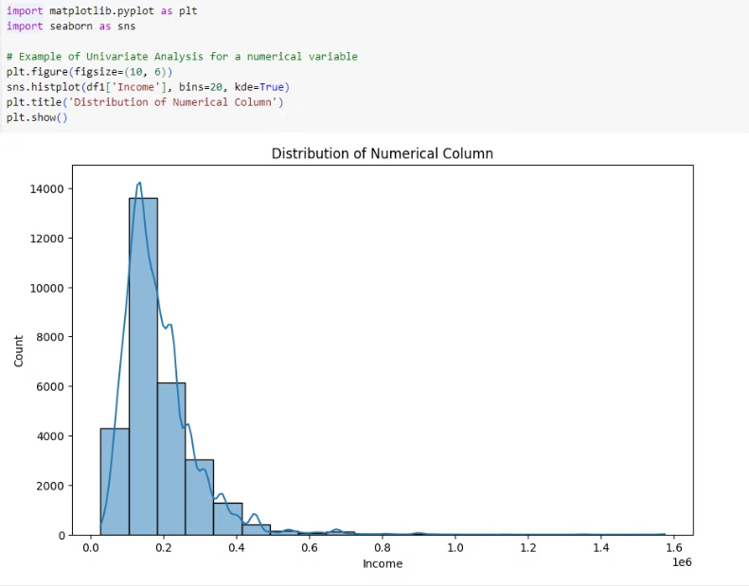
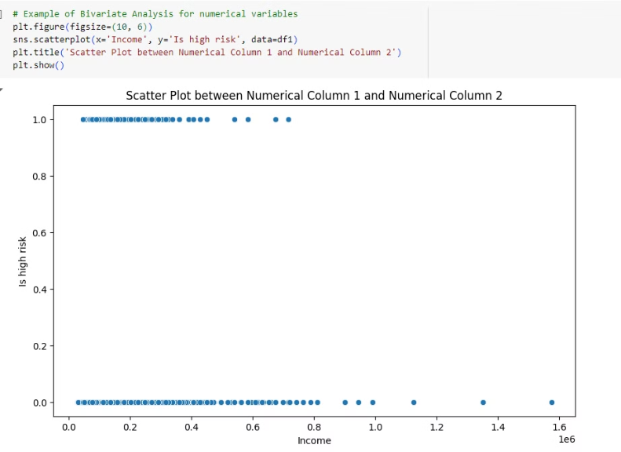
Univariate and Bivariate Analysis of Credit Card Approval Data

Slide 11

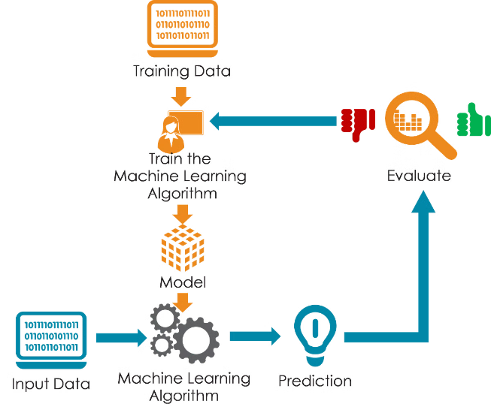
Machine Learning Model Development
1
Logistic Regression
A linear model suitable for binary classification tasks.
2
Decision Trees
Tree-based models that create decision rules to classify instances.
3
Random Forests
Ensemble methods that combine multiple decision trees to improve accuracy and reduce overfitting.
4
Boosting Algorithms
Sequential models that iteratively learn from previous predictions to improve accuracy.

Slide 12

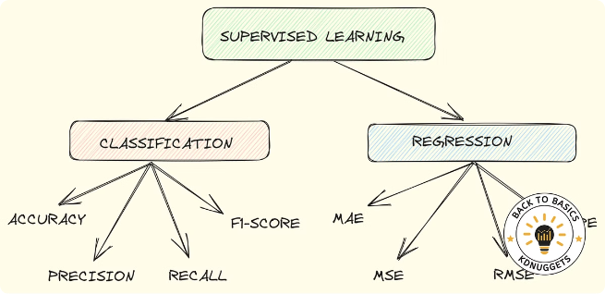
Model Evaluation
Accuracy
Percentage of correctly classified instances.
Precision
The proportion of true positive predictions among all positive predictions.
Recall
The proportion of true positive predictions among all actual positive instances.
F1-Score
A harmonic mean of precision and recall, balancing both metrics.

Slide 13
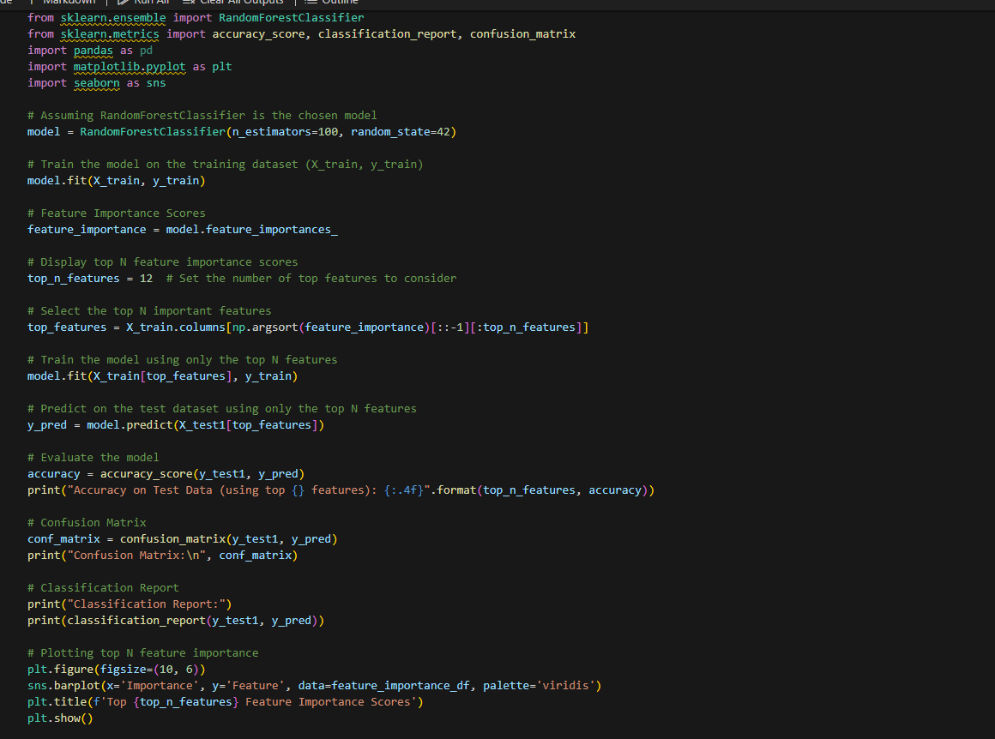
Model Evaluation and Feature Importance Visualization for RandomForestClassifier

Slide 14
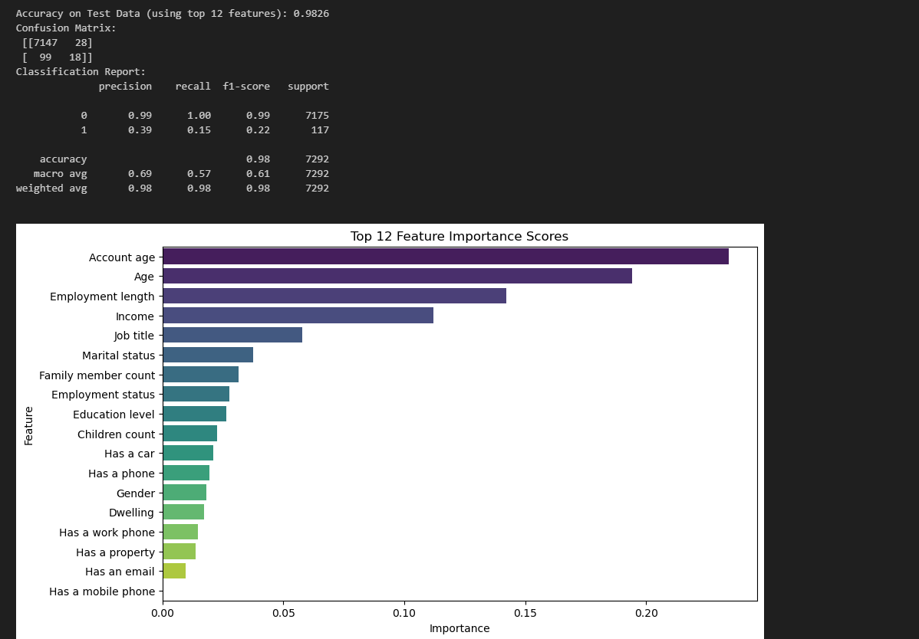
Model Evaluation and Feature Importance Visualization for RandomForestClassifier

Slide 15
Conclusion:
In conclusion, through the utilization of historical data and diverse machine learning models, this project has effectively showcased the capability of machine learning in predicting credit card approval. By identifying pivotal factors such as income, credit score, and debt-to-income ratio, we developed a robust model that accurately evaluates an applicant's creditworthiness. This achievement not only highlights the potential for enhanced efficiency and accuracy in credit card approval processes but also underscores the role of data-driven approaches in advancing risk management strategies.

