Slide 1

Resilience to Overfitting: AdaBoost's Approach
Overfitting is a major challenge in machine learning, where models become too complex and perform poorly on unseen data. AdaBoost, an ensemble learning algorithm, offers a powerful solution to this problem by combining multiple weak learners, each with limited complexity, to achieve resilience to overfitting.

Slide 2
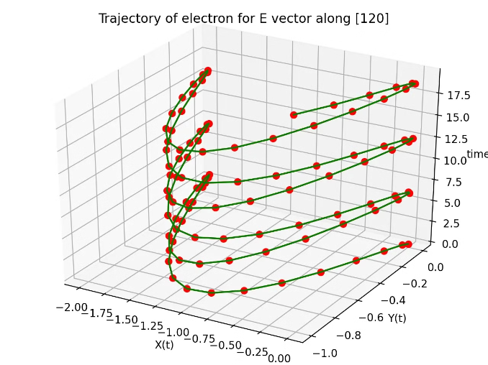
Overfitting: A Common Challenge
Overfitting occurs when a model learns the training data too well, capturing noise and outliers instead of the underlying patterns. This results in poor generalization to new data.
1
High Variance
2
Poor Generalization
3
Unreliable Predictions
Overfitting is often characterized by high variance, meaning the model is highly sensitive to small changes in the training data.
Models that overfit perform well on the training data but struggle to predict accurately on unseen data.
Overfitting leads to unreliable predictions for new instances, rendering the model ineffective for real-world applications.

Slide 3
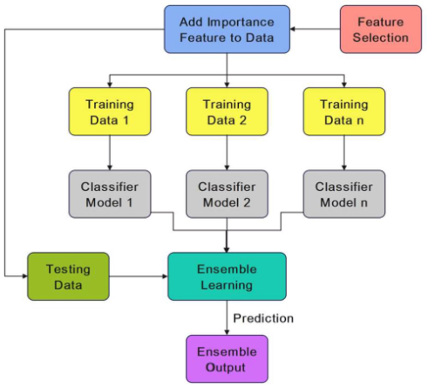
Resilience to Overfitting: A Key Property
Effective models possess resilience to overfitting, ensuring they generalize well to unseen data. This property is crucial for reliable predictions and real-world application.
1
Robust Performance
2
Reliable Predictions
3
Reduced Variance
Resilient models exhibit lower variance, demonstrating stability across different datasets.
Resilient models maintain high performance even with variations in the training data.
Models that generalize well provide accurate predictions for new data points.

Slide 4

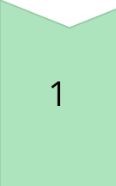
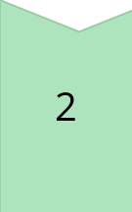
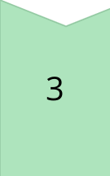
AdaBoost: An Ensemble Learning Algorithm
AdaBoost, short for Adaptive Boosting, is a powerful ensemble learning algorithm that combines multiple weak learners to create a strong, robust model. Its adaptive nature allows it to focus on difficult examples, improving performance over time.
Weak Learners
Individual models with limited complexity, each capable of making slightly better-than-chance predictions.
Adaptive Weighting
Sample weights are adjusted based on the performance of previous learners, giving more weight to misclassified examples.
Ensemble
The final prediction is a weighted combination of the predictions of all weak learners, leading to improved accuracy.

Slide 5
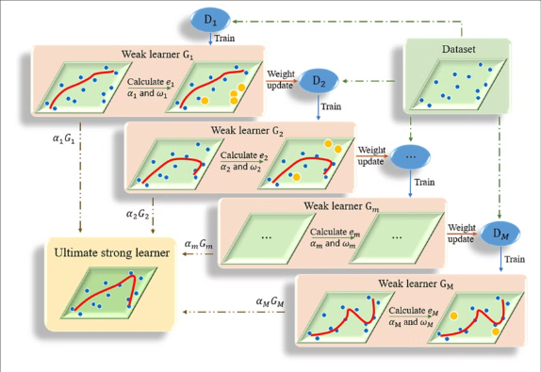
Weak Learners: The Building Blocks of AdaBoost
Weak learners are simple models that are only slightly better than random guessing. They often have limited complexity, such as decision stumps or shallow decision trees, and are prone to errors.
1
Decision Stumps
Simple decision trees with only one split, used to classify data based on a single feature.
2
Shallow Decision Trees
Decision trees with limited depth, capable of capturing basic patterns in the data.
3
Linear Models
Simple models that use a linear combination of features to make predictions

Slide 6
Adaptive Adjustment of Sample Weights
AdaBoost adaptively adjusts the weights of training samples based on the performance of previous learners. Misclassified examples receive higher weights, forcing subsequent learners to focus on them.
Weighted Combination
Initial Weights
The final prediction is a weighted combination of predictions from all learners, with more weight given to learners that performed well.
Training samples are assigned equal weights at the beginning of the boosting process.
1
2
3
Weight Adjustment
Samples misclassified by a learner are assigned higher weights, forcing subsequent learners to focus on them.

Slide 7
Limited Complexity of Weak Learners
Weak learners in AdaBoost have limited complexity, preventing them from overfitting the training data. This simplicity allows them to focus on capturing general patterns rather than memorizing noise.
High Complexity
Overfitting
Poor Generalization
Limited Complexity
Resilience to Overfitting
Good Generalization

Slide 8



Combination of Multiple Weak Learners
AdaBoost combines the predictions of multiple weak learners to create a strong, robust model. By averaging the predictions, the ensemble model is less likely to be influenced by the limitations of any single weak learner.
Diversity
Averaging
Error Reduction
Weak learners often make different types of errors, resulting in a diverse ensemble that is less prone to overfitting.
The final prediction is an average of the predictions from all weak learners, reducing the impact of individual errors.
The combination of multiple weak learners leads to a significant reduction in overall error, improving model accuracy.

