Slide 1

BullyBlock AI – AI-Based Cyberbullying Detector and Reporter
TEAM DETAILS
NAME: ABINAYA S/ 211423104005 DEEPIKA J / 211423104110
BATCH NUMBER : A18
DOMAIN: CYBERSECURITY AND MACHINE LEARNING
DATE : 29/10/2025
COORDINATOR NAME & DESIGNATION
DR.KAVITHA SUBRAMANIAM PROFESSOR

Slide 2
AGENDA
Introduction to Cyberbullying
Overview of the growing issue and its psychological and academic impacts on students and young people.
Limitations of Existing Systems
Discussion of current AI tools that only detect harmful content without automated response or severity evaluation.
Proposed System – BullyBlock AI
Introduction of an end-to-end AI-powered solution for detection, severity analysis, and automated reporting.
Methodology and Technologies Used
Implementation using NLP techniques, BERT transformer model, spaCy framework, and custom classifiers.
Severity Classification and Alert Mechanism
Categorization of abuse levels (Low, Medium, High) and real-time alerting via SMTP for severe or repeated cases.
Sentiment Analysis and Data Visualization
Monitoring communication trends through sentiment tracking and interactive dashboards for actionable insights.
Evaluation and Performance
Use of diverse datasets, cross-validation for fairness, continuous fine-tuning, and achieving 88% overall accuracy.

Slide 3
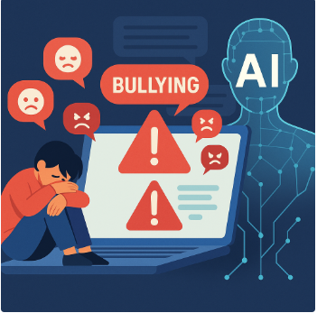
ABSTRACT
Cyberbullying is rising, and current AI tools only detect harmful messages without taking further action. Victims still need to report abuse manually, which delays justice.
Our project, BullyBlock AI, goes beyond detection. It uses NLP to analyze the tone and history of messages, assigns a severity level (Low, Medium, High), and if serious or repeated abuse is found, it automatically reports the case to authorities using SMTP and Webhook APIs.
This ensures faster response, reduces manual effort, and supports a safer digital space.
Technology Utilized:
Libraries: Scikit-learn, TensorFlow, Keras , NLTK, BERT
NLP Tools: spaCy , HuggingFace Transformers
Dataset: Kaggle Cyberbullying Dataset, Twitter Hate Speech Dataset

Slide 4
INTRODUCTION
Cyberbullying is a major concern in the digital era, especially among youth.
It causes emotional distress, anxiety, depression, and poor academic performance.
Increasing use of social media has led to higher cases of online harassment.
Manual reporting of abuse often delays intervention and support.
BullyBlock AI offers a complete AI-based solution for early detection and prevention.
Uses Natural Language Processing (NLP) and Machine Learning for message analysis.
Incorporates BERT and spaCy for understanding text and linguistic patterns.
Classifies abuse into severity levels — Low, Medium, High.
Automatically alerts authorities through SMTP email system in severe cases.
Provides sentiment analysis and interactive dashboards to track user behavior.
Aims to create safe digital communities through proactive monitoring.

Slide 5
OBJECTIVE
To design and develop an AI-powered system for real-time detection of cyberbullying and cyberhate.
To identify and analyze abusive or harmful text using Natural Language Processing (NLP).
To utilize pre-trained transformer models (BERT) for contextual text understanding.
To automate the reporting and alerting process using SMTP-based notifications.
To reduce manual intervention by providing end-to-end detection and response.
To perform sentiment analysis for evaluating user communication tone and emotion.
To offer interactive dashboards for visualizing bullying trends and patterns.
To ensure accuracy, reliability, and fairness through balanced dataset preprocessing.
To build a modular, scalable system deployable on both web and mobile platforms.
To promote safe digital communication through early detection and quick intervention.

Slide 6
LITERATURE REVIEW
Author(s) & Year | Key Contribution / Summary
Kaur & Saini (2023) | Developed AI model detecting cyberbullying across social media using deep learning.
Ambareen (2023) | Surveyed AI techniques for cyberbullying detection, highlighting challenges and limitations.
Usmaan Ali (2024) | Applied SVM and Random Forest with feature extraction to detect cyberbullying patterns.
Balakrishnan & Kiaty (2023) | Reviewed ML approaches, highlighting hybrid models for improved detection accuracy.
Jamalpur et al. (2023) | Classified subtle harassment using ML with preprocessing and feature selection.
Milosevic et al. (2023) | Evaluated AI moderation tools from users’ perspective, stressing fairness and trust.
Verma et al. (2023) | Studied transparency and reliability of AI moderation systems on online platforms.
Lahby et al. (2024) | Explored AI for content moderation, emphasizing human oversight for online safety.

Slide 7
LITERATURE REVIEW
Author(s) & Year | Key Contribution / Summary
Nlerum & Brisibe (2024) | Proposed hybrid deep learning + NLP model for nuanced cyberbullying detection.
Prama et al. (2025) | Developed explainable AI for detecting severity of cyberbullying with interpretable results.
Hamim et al. (2024) | Used deep learning for multilingual, large-scale cyberbullying detection.
Perera & Fernando (2024) | Integrated detection + prevention model for safer online interactions.
Al-Harigy et al. (2022) | Compared ML algorithms for automated cyberbullying detection pipelines.
Saharan (2022) | Created adaptable ML framework for real-time cyberbullying detection.

Slide 8

PROBLEM STATEMENT
Cyberbullying and cyberhate are widespread issues, especially affecting students, causing anxiety, depression, and social withdrawal.
Over 37% of Indian students and 1 in 3 youth globally have faced cyberbullying, which harms their mental health and academics.
Existing AI tools mostly detect harmful content but lack real-time, automated reporting and action.
Manual reporting of abusive content is slow, unreliable, and often ignored, allowing abuse to continue and worsen
There is an urgent need for an automated system that detects, assesses severity, and reports cyberbullying quickly and reliably to create a safer digital environment.

Slide 9
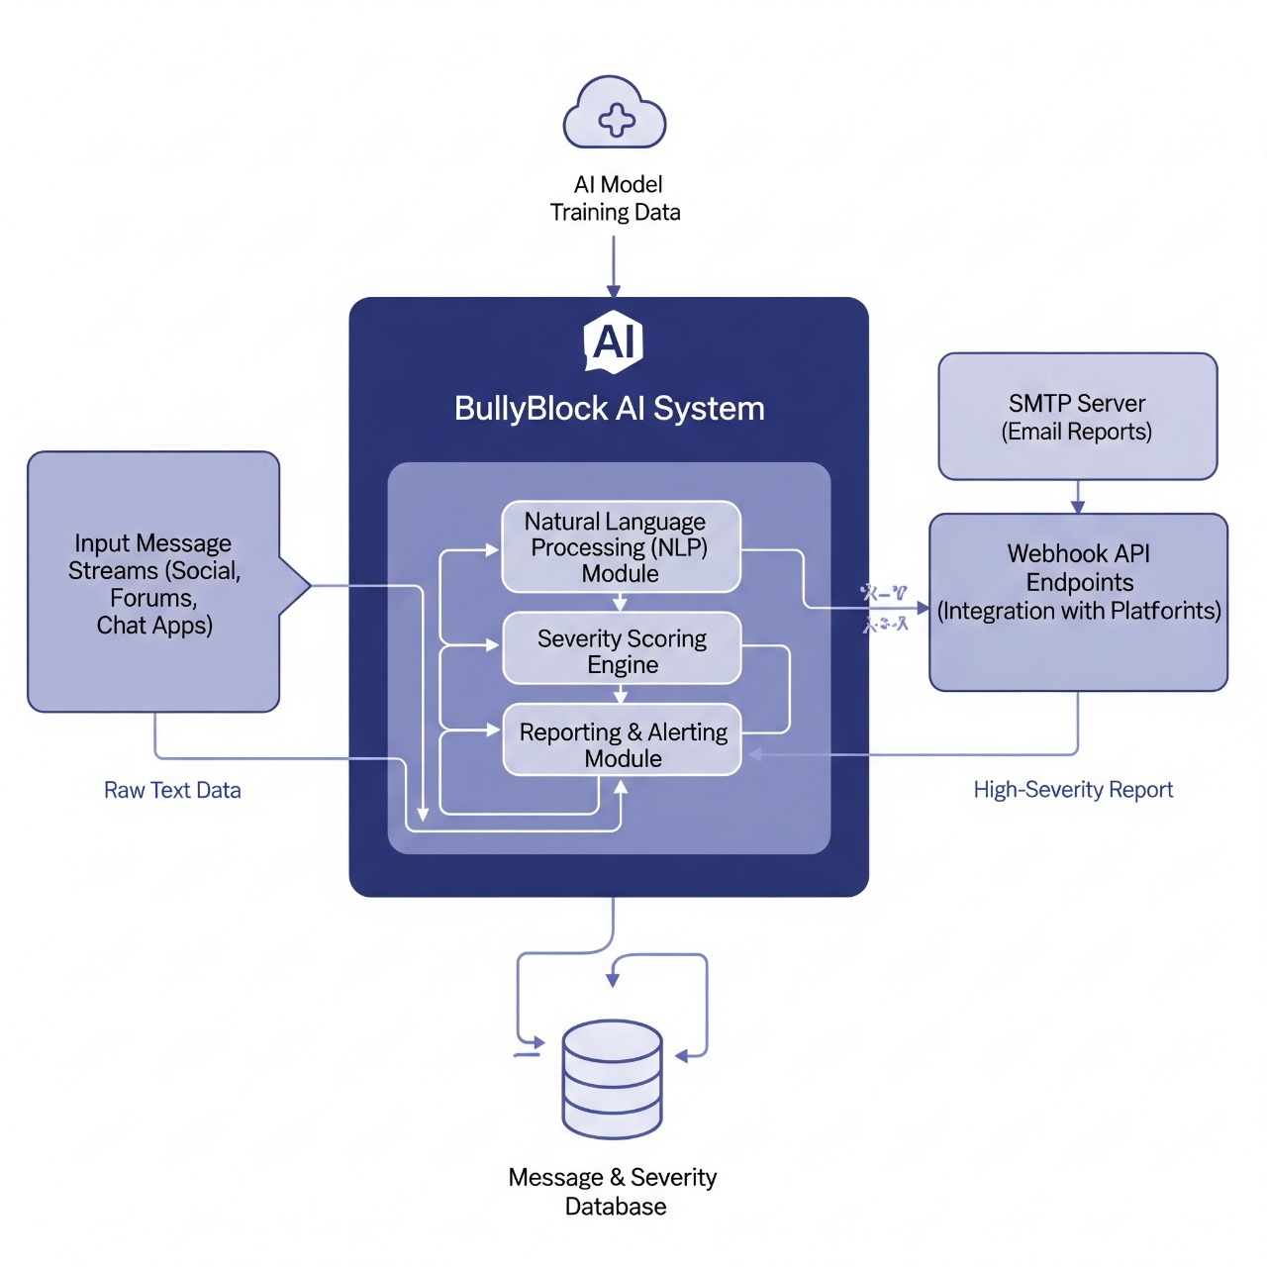
ARCHITECTURE DIAGRAM

Slide 10
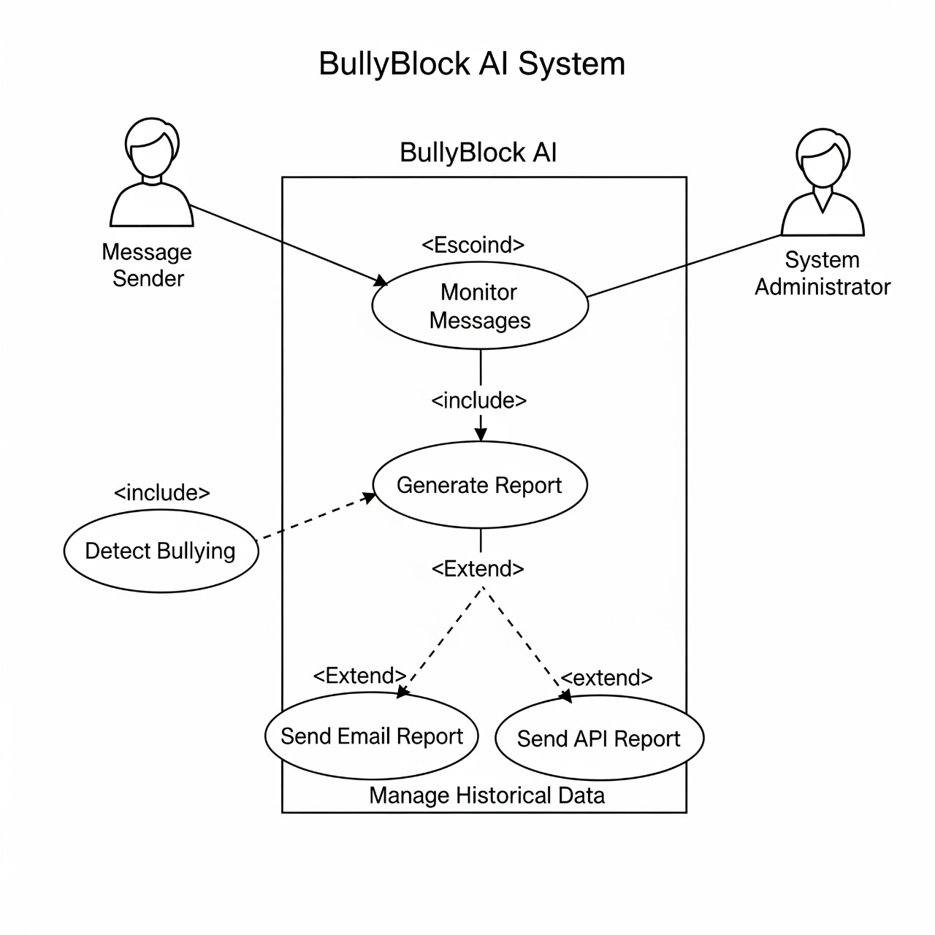
Usecase Diagram

Slide 11
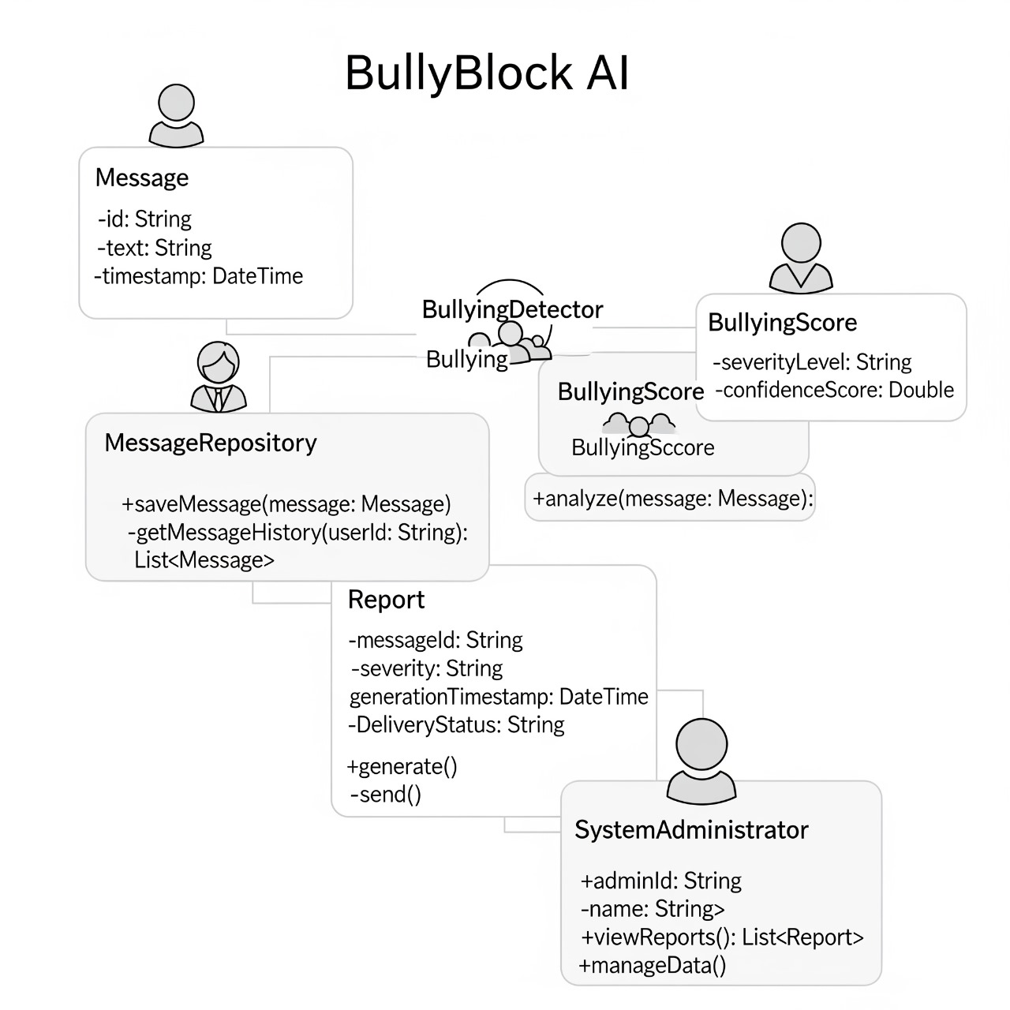
Class Diagram

Slide 12
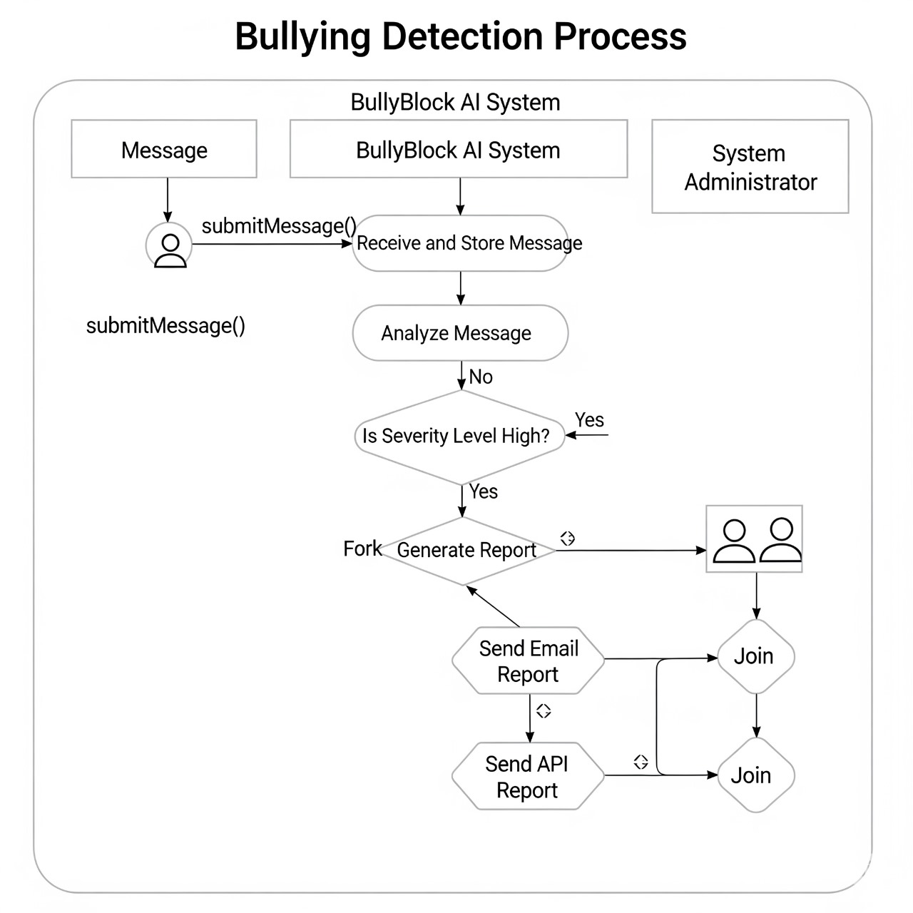
Activity DIAGRAM

Slide 13
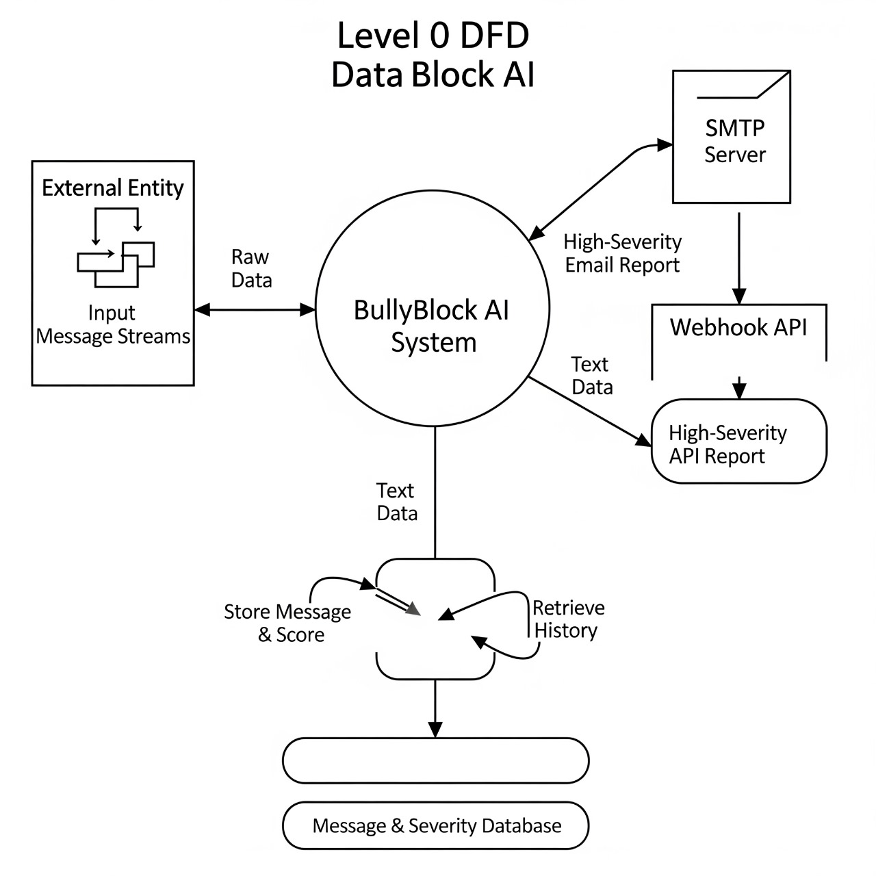
DATA FLOW DIAGRAM

Slide 14
MODULES
User Input: The user sends a message through a platform.
Detection: The message is checked using AI and NLP tools (like BERT, spaCy) to find bullying or abusive words.
Severity Check: The system checks how serious the message is – Low, Medium, or High.
Reporting: If the message is very serious or happens again and again, it sends a report to authorities using email or webhook.
Notification: If it's not serious, the system warns the user or logs the message.
Data Handling: All messages and results are saved for future checking and to improve the system.
Live Dashboard: A dashboard shows health of the platform – number of bullying cases, who reported, and alert status.
SOS Alert: For serious cases, an alert is sent immediately to help teams for quick action.

Slide 15
METHODOLOGY
Data Collection
Collect messages in real-time from online platforms (social media, chat apps, forums).
Use APIs or direct platform feeds to obtain messages.
Abusive Content Detection
Use pre-trained NLP models (BERT, spaCy) to automatically detect harmful or abusive language.
Classify messages as Cyberbullying or Non-Cyberbullying.
Severity Assessment
Classify detected cyberbullying messages into Low, Medium, or High severity.
Consider repeated low-severity messages as potentially serious.
Automated Alert System
Trigger automatic email notifications for:
High-severity messages
Recurring low-severity messages
Alerts sent to parents, school administrators, or platform moderators via SMTP.
Visualization & Monitoring
Use interactive dashboards to show:
Severity trends over time
Frequency of cyberbullying incidents
Sentiment distribution of messages

Slide 16
TESTING
Checked if messages are correctly detected as cyberbullying or non-cyberbullying.
Verified severity classification: Low, Medium, High.
Alert System Testing
Tested automatic email notifications for high-severity and recurring low-severity messages.
Ensured alerts reach parents, admins, or moderators.
Dashboard & Visualization Testing
Verified real-time display of severity trends, message counts, and sentiment distribution.
Platform & Language Testing
Tested system on multiple platforms (chat apps, social media) and different languages (if supported).
Performance Testing
Checked response time for detection and alert generation.

Slide 17
TEST CASES
Test Case | Input | Expected Output | Result
TC1 | Message: “You are useless” | Detected as Cyberbullying, Severity: Medium | Pass
TC2 | Message: “I hate you, leave me alone” | Detected as Cyberbullying, Severity: High | Pass
TC3 | Message: “Good job on your project!” | Detected as Non-Cyberbullying | Pass
TC4 | Multiple low-severity messages | Trigger recurring alert | Pass
TC5 | High-severity message | Automatic email sent to parent/admin | Pass

Slide 18
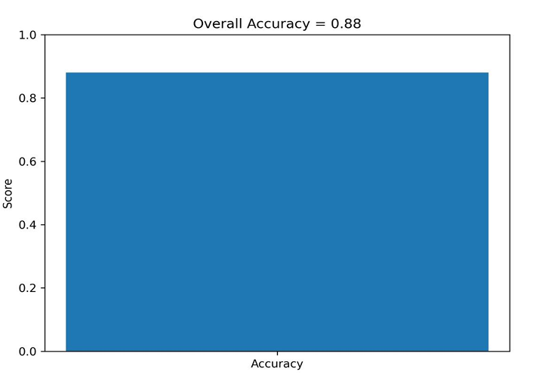
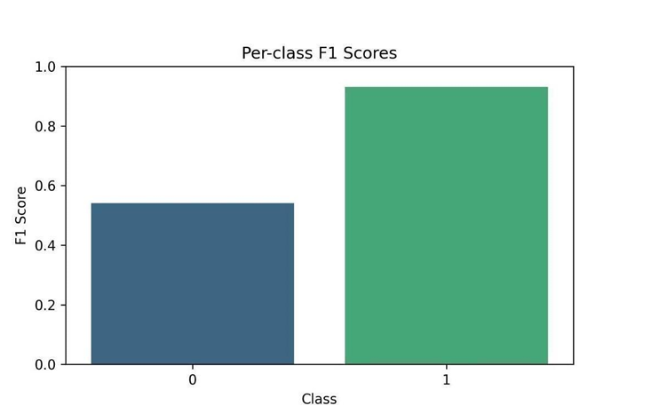
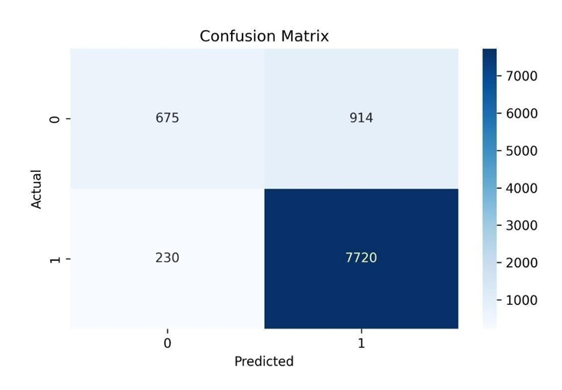
PERFORMANCE ANALYSIS

Slide 19
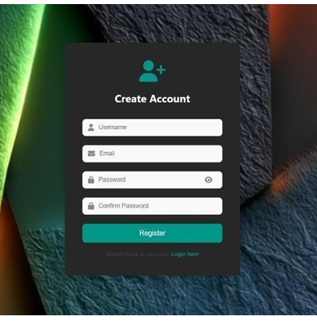
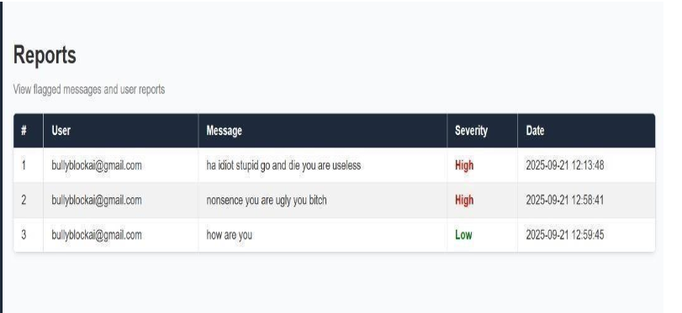
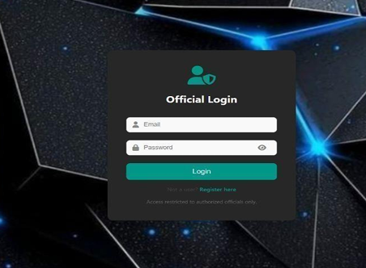
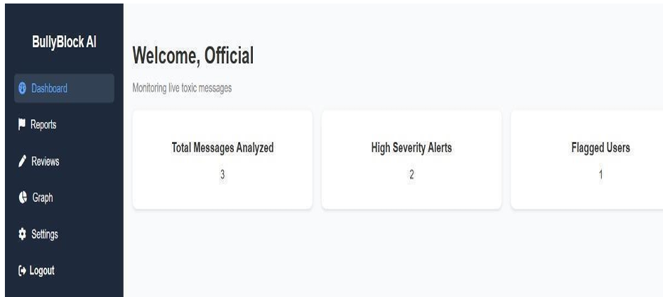
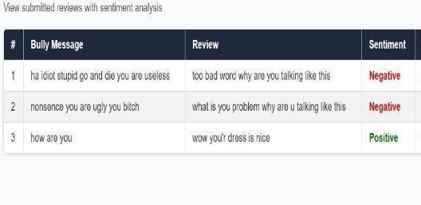
SCREENSHOTS

Slide 20
CONCLUSION
Effective Detection: The system accurately identifies cyberbullying and hate speech in real time using advanced NLP models such as BERT and spaCy.
Severity Classification: Messages are categorized as Low, Medium, or High, enabling appropriate and timely responses.
Automated Reporting: High-severity incidents trigger instant email alerts to designated authorities, ensuring rapid intervention and victim support.
User-Friendly Dashboard: Interactive graphs and sentiment analysis provide clear insight into trends and the overall communication climate.
Social Impact: The solution promotes safer digital spaces and aligns with UN SDG 16 (Peace, Justice and Strong Institutions) and SDG 3 (Good Health and Well-Being).
Scalability and Growth: Built with open-source tools and cloud deployment, the platform can easily expand to multilingual content and larger social-media datasets.

Slide 21
FUTURE WORK
Multilingual Support: Expand the system to detect cyberbullying in multiple languages, allowing it to work across
different regions and cultures effectively.
Advanced Detection: Enhance the model to analyze not only text but also videos, voice messages, and memes for
more accurate detection of harmful content.
Mobile Application: Develop a user-friendly mobile app so that users can report, detect, and receive real-time alerts
about cyberbullying anytime, anywhere.
Feedback & Learning: Implement a feedback system where users can mark false detections, enabling the AI to
learn and improve continuously over time.
Collaboration: Partner with schools, social platforms, and mental health organizations to test the system in real-world
scenarios and gather valuable insights.

Slide 22
REFERENCES
Kaur, M., & Saini, M. (2023). Role of Artificial Intelligence in Cyberbullying and Cyberhate Detection. IEEE Access.
2 . Ambareen, K. (2023). A Survey of Cyberbullying Detection and Performance: Its Impact in Social Media Using Artificial Intelligence.
3. Usmaan Ali, M. (2024). Detection of Cyberbullying on Social Media Platforms Using Machine Learning.
4. Dave, P., Yuan, X., Siddidu, M., & Roy, K. (2024). Detection of Cyberbullying in GIF Using AI.
5. Balakrishnan, V., & Kiaty, M. (2023). Cyberbullying Detection and Machine Learning: A Systematic Literature Review.
6. Fortuna, P., & Nunes, S. (2018). A survey on automatic detection of hate speech in text. ACM Computing Surveys (CSUR), 51(4), Article 85.
7. Al-Garadi, M. A., Varathan, K. D., & Ravana, S. D. (2016). Cybercrime detection in online communications: The experimental case of cyberbullying detection in Twitter. Computers in Human Behavior, 63, 433–443.
8. Rosa, H., Pereira, N., Ribeiro, R., Ferreira, P. C., Carvalho, J. P., Oliveira, S., & Coheur, L. (2019). Automatic cyberbullying detection: A systematic review. Computers in Human Behavior Reports, 1, 100008.
9. Chatzakou, D., Kourtellis, N., Blackburn, J., De Cristofaro, E., Stringhini, G., & Vakali, A. (2019). Detecting cyberbullying and cyberaggression in social media. ACM Transactions on the Web (TWEB), 13(3), 1–51.

Slide 23
REFERENCES
10. Dinakar, K., Reichart, R., & Lieberman, H. (2011). Modeling the detection of textual cyberbullying. In Proceedings of the 5th International AAAI Conference on Weblogs and Social Media (ICWSM).
11. Zhang, Z., Robinson, D., & Tepper, J. (2018). Detecting hate speech on Twitter using a convolution-GRU based deep neural network. In European Semantic Web Conference.
12. MacAvaney, S., Yao, H., Yang, E., Russell, K., Goharian, N., & Frieder, O. (2019). Hate speech detection: Challenges and solutions. PLOS ONE.
13. Rajadesingan, A., & Ruths, D. (2019). Learning what we don’t know: Cyberbullying detection with weak supervision. In Proceedings of the AAAI Conference on Artificial Intelligence.
14. Kwok, I., & Wang, Y. (2013). Locate the hate: Detecting tweets against Blacks. In Proceedings of the 27th AAAI Conference on Artificial Intelligence.
15. Davidson, T., Warmsley, D., Macy, M., & Weber, I. (2017). Automated hate speech detection and the problem of offensive language. In Proceedings of the 11th International AAAI Conference on Web and Social Media.
16. Wulczyn, E., Thain, N., & Dixon, L. (2017). Ex Machina: Personal attacks seen at scale. In Proceedings of the 26th International World Wide Web Conference (WWW).
17. Zhou, X., & Zafarani, R. (2020). A survey of fake news detection using natural language processing. ACM Computing Surveys (CSUR), 53(5), Article 109.

Slide 24
THANK YOU

