Slide 1
AIR CANVAS Project

Slide 2
Ever wanted to draw your imagination by waiving your finger in the air?
Guess what! It is now possible using the Air Canvas.
It will draw anything on it by detecting the motion of your finger and noticing the landmarks of your knuckles.
Here, hand landmarks and tracking is used in order to achieve the objective.

Slide 3
Why Air Canvas?
The project focuses on developing a motion-to-text converter that can potentially serve as software for intelligent wearable devices for writing from the air.
Writing in air, one of the most challenging research areas, contributes immensely to the advancement of an automation process and can improve the interface between man and machine in numerous applications.
The invention of faster computers, availability of inexpensive and good quality video cameras and demands of automated video analysis has given popularity to object tracking techniques.

Slide 4
AIM
1
To build an air canvas that draws whatever you draw using your finger in the air, on the canvas

Slide 5
TOOLS & LIBRARIES
2
Python
Numpy
OpenCV
MediaPipe

Slide 6
Features:
Hand Gesture Recognition : Utilizes the MediaPipe library to detect and track hand landmarks in real-time.
Drawing Interface : Offers a dynamic drawing interface where hand gestures translate into drawing actions.
Multi-color Drawing : Supports multiple colors for drawing, with the ability to switch colors on-the-fly using hand gestures.
Canvas Controls : Includes controls for clearing the canvas and selecting different drawing colors through specific hand gestures

Slide 7
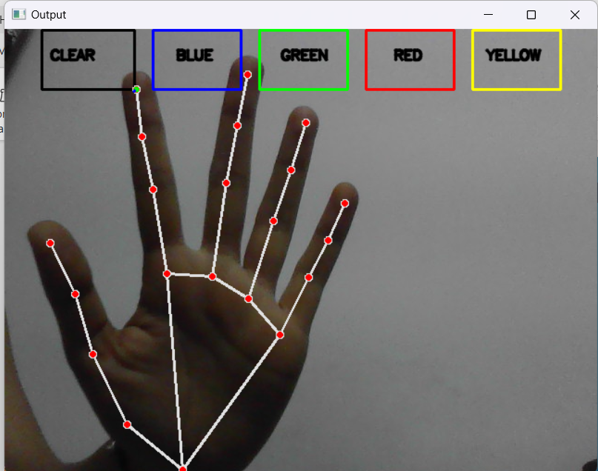
Working application

Slide 8
How it works:
Hand Tracking : Utilizes the MediaPipe Hands module to detect hand landmarks from the webcam feed.
Gesture-based Drawing : Interprets specific hand movements to initiate drawing actions, switch colors, and control the canvas.
Real-time Visualization : Displays both the live webcam feed and the canvas in separate windows, showing the drawing process in real-time.

Slide 9
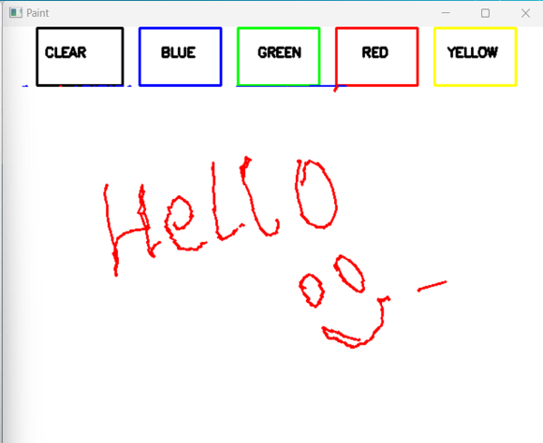
Canvas

Slide 10
ROADMAP
Start reading the frames and convert the captured frames vertically to RGB color space which is easy for color detection.
Adjust the values of the mediapipe intialization to detect one hand only.
Detect the landmarks, find the forefinger coordinates and keep storing them in the array for successive frames.
1
3
5
2
4
6
Prepare the canvas frame and put the respective ink buttons on it
Detect the landmarks by passing the RGB frame to the mediapipe hand detector.
Finally draw the points stored in array on the frames and canvas.

Slide 11
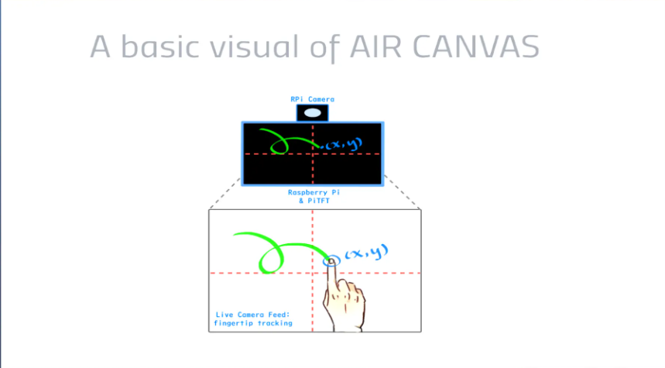

Slide 12
How does it make a change?
It will be a powerful means of communication for the people with hearing or speaking impairment.
It is an effective communication method that reduces mobile and laptop usage by eliminating the need to write.
It has the potential to challenge traditional writing methods.
Educational Tools: Air canvas can be used in education to teach subjects like geometry, physics, and art in a more engaging and interactive way. Students can visualize and manipulate complex concepts in three dimensions

Slide 13
Healthcare and Therapy: Development of therapeutic applications for physical and mental health, such as virtual rehabilitation exercises and stress-relief painting.

Slide 14
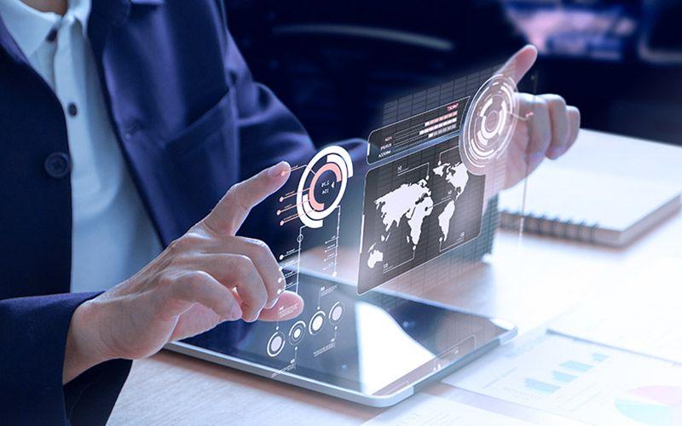
FUTURE SCOPE
Air touch panels
No need to keep a contact with your gadget. You can do all the work by waiving in the air.

Slide 15
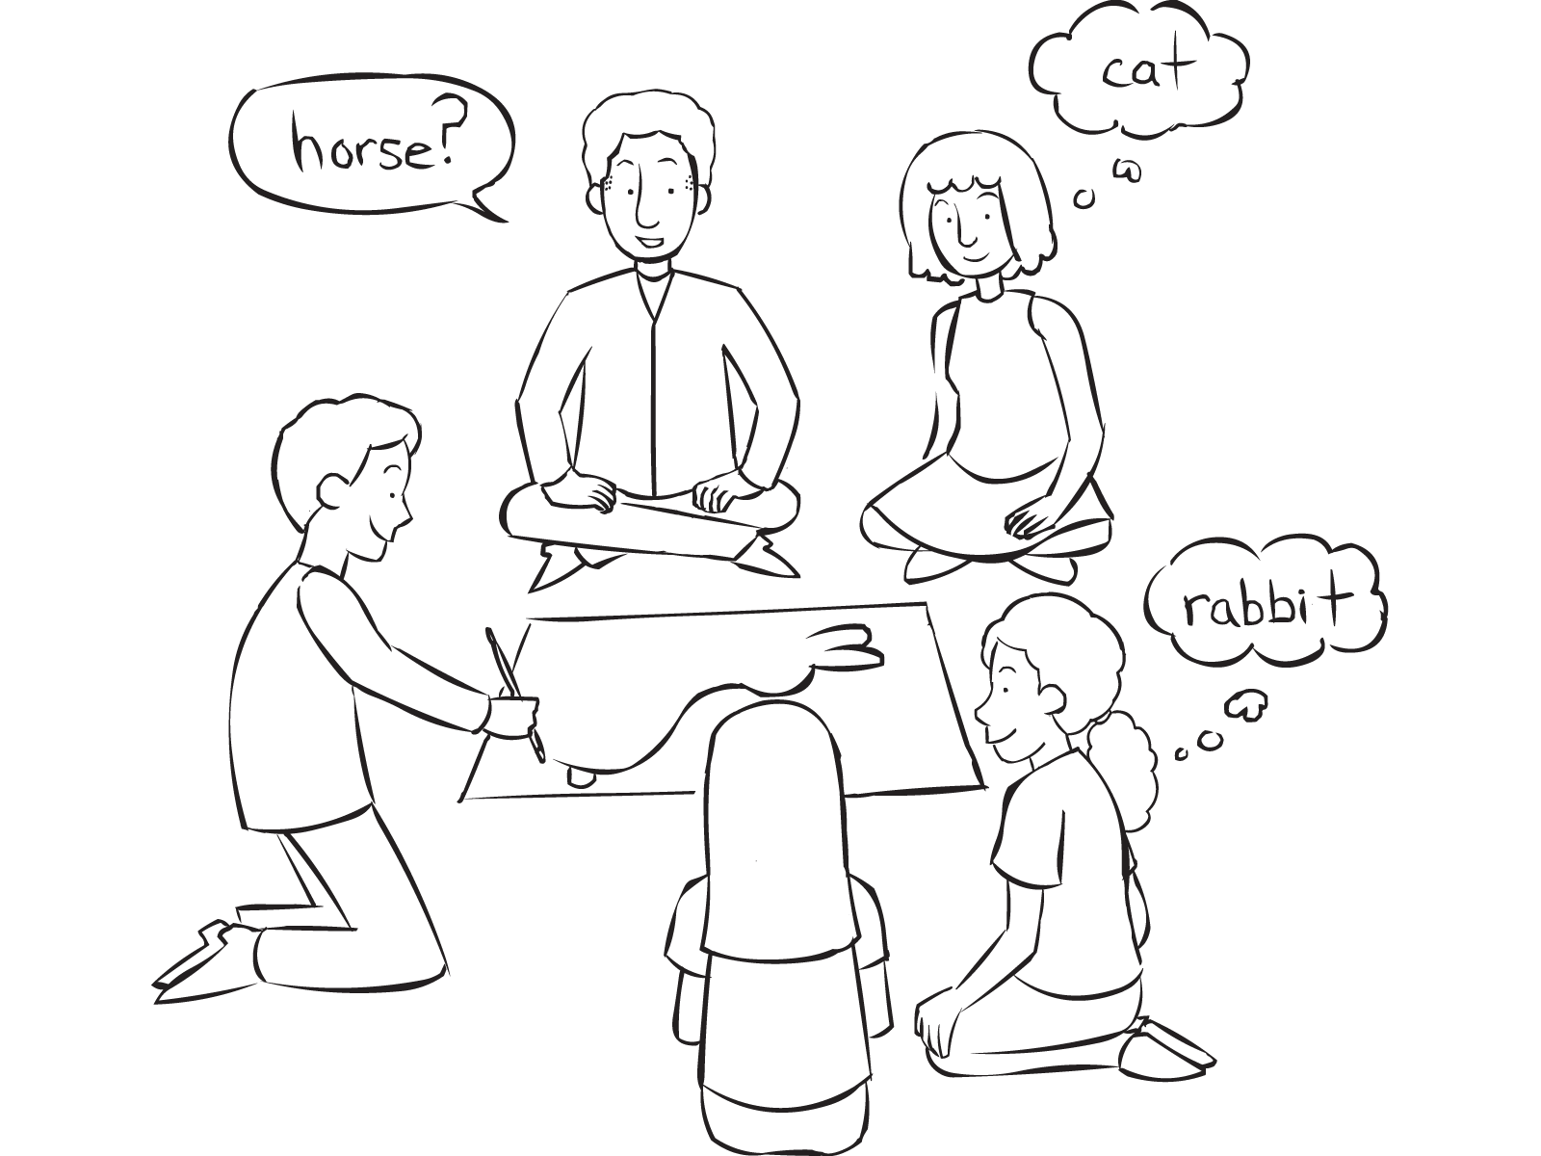
FUTURE SCOPE
Pictionary
You can now play this game with your friends without pen / paper!

Slide 16
Thank You!

