Slide 1
The TESLA Broadcast Authentication Protocol
Deepika M M
1PI14S014

Slide 2
Timed Eﬃcient Stream Loss-tolerant Authentication
What is it?

Slide 3
Why broadcast??

Slide 4
How good it is compared to other protocols?

Slide 5
Idea behind the protocol!!

Slide 6
Background &Assumption!

Slide 7
1.one way chain

Slide 8
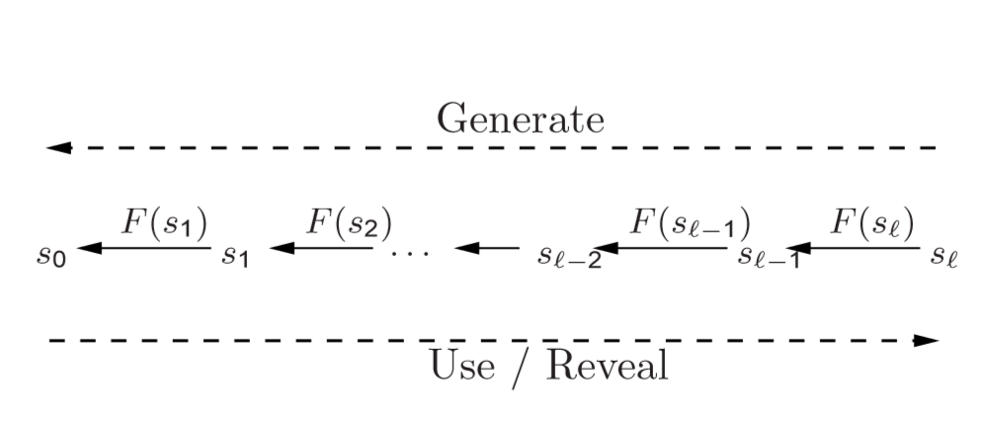

Slide 9
2.Time Synchronization

Slide 10
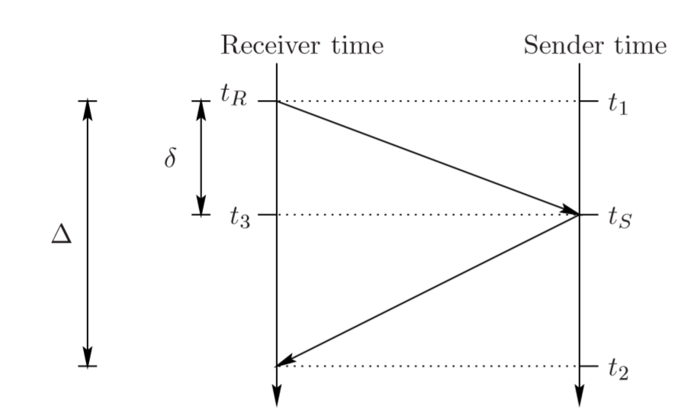

Slide 11
Requirements!

Slide 12
How does it work?

Slide 13
TESLA protocol
Seder setup
Bootstrapping Receivers
Broadcasting Authenticated Messages
Authentication at Receiver
TESLA Security Considerations

Slide 14
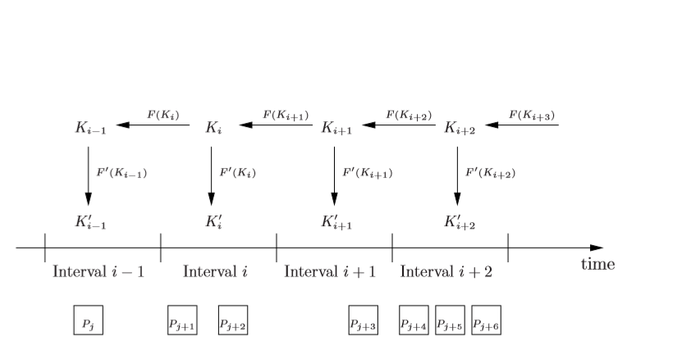

Slide 15
TESLA Security Considerations
The receiver’s clock is time synchronized up to a maximum error of ∆.
The functions F,F are secure PRFs, and the function F furthermore provides weak collision resistance.

Slide 16
THANK YOU!!

