Slide 1

An efficient algorithm for data security in cloud storage
Ali AZOUGAGHE, Zaid KARTIT, Mustapha HEDABOU, Mostafa BELKASMI,
Mohamed EL MARRAKI
Under the guidence of: Deepika M M
Dr.Mamatha H R 1PI14IS014
Dept. of Info.Science.

Slide 2

Abstract
Cloud computing has now become a major trend, it is a new data hosting technology that is Very popular in recent years.

Slide 3

Introduction to cloud computing
As a virtual space that connects users from all over the globe, the Internet is like a cloud, sharing information by way of satellite networks Cloud computing, in turn, refers to sharing resources, software, and information via a network, in this case the Internet.

Slide 4

Advantages
It is basically meant to give maximum with the minimum resources.
The user end is having the minimum hardware requirement but is using the maximum capability of computing.
Cloud Computing provides IT services as on-demand services, accessible from anywhere, anytime and by authorized user.

Slide 5
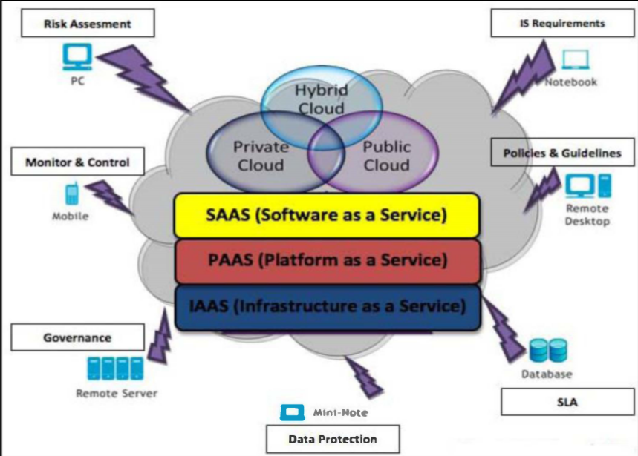

Slide 6

Security Issues
Abuse and Nefarious Use of cloud computing
Malicious Insiders
Data Loss or Leakage
Account or Service Hijacking
Insecure Interfaces and API’s
Shared Technology Issues

Slide 7

Security in cloud computing
Security in cloud computing involves concepts such as network security, equipment and control strategies deployed to protect data, applications and infrastructure associated with cloud computing.

Slide 8
Security in cloud computing
Security allows the confidentiality, integrity, authenticity and availability of information

Slide 9

Security in cloud computing
Asymmetric Encryption
Asymmetric cryptography is a class of cryptographic algorithm.
a) Elgamal encryption
Conceptually, EI Gamal supports homomorphic multiplication operations on encrypted data.

Slide 10

Algorithm : EIGamal Encryption
Output: public key kpub and private key kpr
1. function KeyGen
2. Choose a large prime p
3. Choose a primitive element alpha belongs to z^* base p
4. Choose an integer a belongs {0,. . .p-2}
5. beta =alpha^a
6. Return kpub= (p , alpha,beta), k pr = a
7. End function
Input: public key kpub =(p, alpha,beta) and message m
Output: ciphertext c
l. Function ENCRYPT(m)
2. Choose k belongs {2,. . .p-2}
3. x =alpha^k mod p
4. Y = beta^k * m mod p
5. Return c = (x, y)
6. End function
Input: private key kpr = a and ciphertext c = (x, y)
Output: message m
l. function DECRYPT(c)
2. Calculate m = x^-a y mod p
4. return m
5. end function

Slide 11

Security in cloud computing
Symmetric Encryption
1) AES Algorithm
AES which has a fixed block size of 128 bits, and a key size of 128, 192, or 256 bits. The key size used for an AES cipher specifies the number of repetitions of transformations rounds.

Slide 12
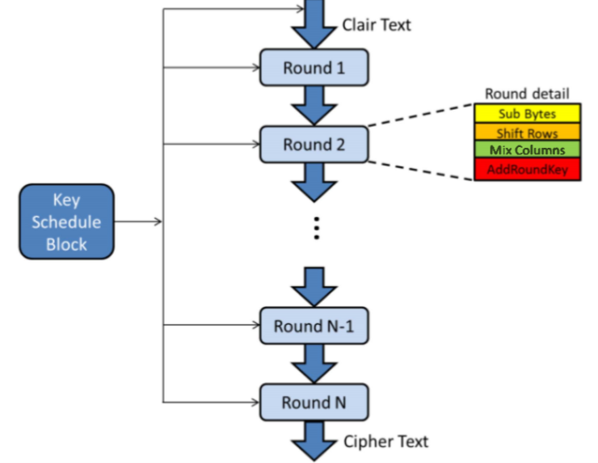
Illustration of the AES Algorithm

Slide 13

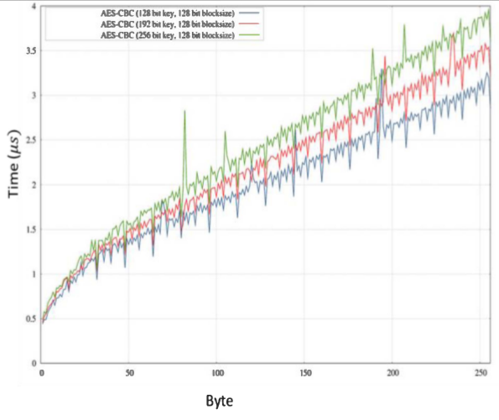
AES speed at 128, 192 and 256-bit key sizes

Slide 14
Security in cloud computing
Advantages of AES Algorithm
AES is not susceptible to any attack but Brute Force attack
AES performs well on a wide variety of hardware
AES is also much faster than the traditional algorithms

Slide 15
PROPOSED ALGORITHM
A. File Upload
This algorithm got two phases; In the first phase, the algorithm encrypts Clair text with AES Algorithm. In the second phase, we encrypt AES key using EIGamal algorithm.

Slide 16
Algorithm 2
Encrypt_File (F)
{
for B<- 1 to numberOfBlock(F) do
{
B'=ENC_AES(B,K)
}
send_to_cloud(F')
for k<- 1 to SizeOf(K) do
{
k'=ENC_Elgamal(k)
}
Save_in_server(K')
}

Slide 17
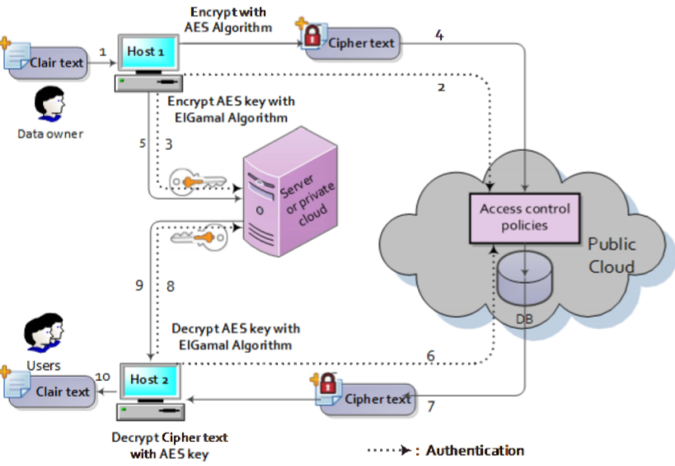
model proposed of data storage in cloud computing

Slide 18
PROPOSED ALGORITHM
B. File Download
This algorithm got also two phases; in the first phase, the algorithm decrypts AES key using EIGamal Algorithm. In the second phase, decrypts cipher text using AES key retrieved from the server.

Slide 19
Agorithm 3
1. Decrypt_File (F')
{
for k‘<- 1 to SizeOf(K') do
{
k=DEC_Elgamal(k')
}
retum(K)
for B‘<-to numberOfBlock(F‘) do
{
B=DEC_AES(B',K)
}
retum(F)
}

Slide 20
Comparative Results of RSA and Elamal algorithms
PC hp Compaq dc 5800 with the following specifications: Intel (R) Core (TM) 2 Duo CPU E6550 @ 2.33GHz (2 CPUs), with 3072MB of RAM.

Slide 21
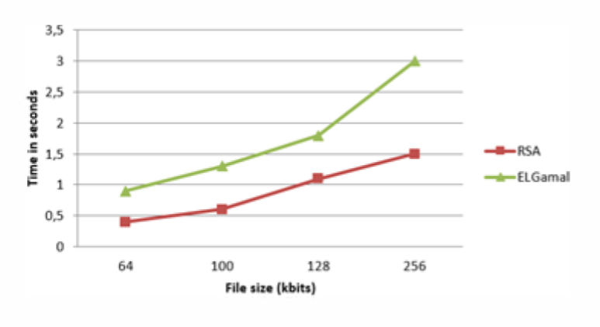

Slide 22
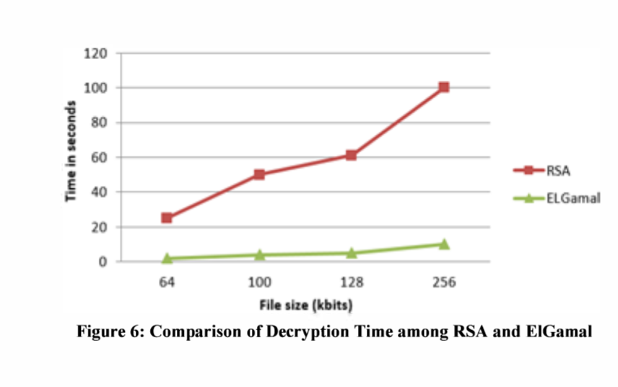

Slide 23
Implement results and analysis
The implementation of results highlights the time of execution in upload and in download of files with different sizes.
The download time is greater than the upload time.

Slide 24
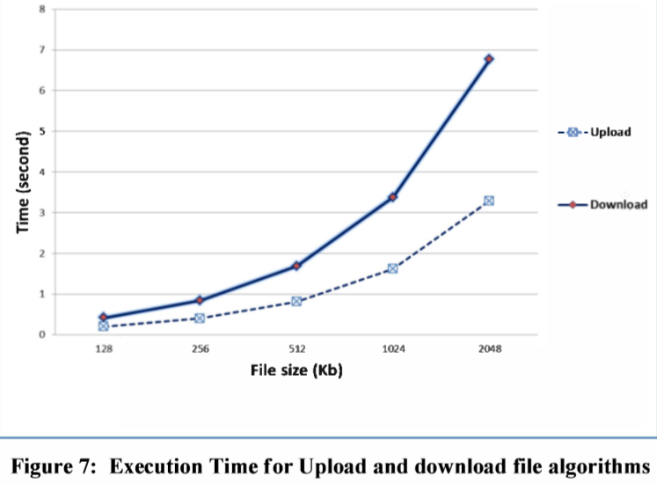

Slide 25
Advantages
Ability to change the symmetric key frequently to enhance security
The AES key used for encryption of the data is encrypted by Elgamal algorithm .
The decryption of data requires double authentication, the user must have access rights to the company's server and cloud storage.

Slide 26

CONCLUSION AND FUTURE WORK
Although Cloud storage has many advantages; there are still many actual problems concerning security that need to be solved. If we can eliminate or master this weakness of security, the future is going to be Cloud storage solutions for large as well as small companies.

Slide 27
REFERENCES
KOLODNER, Elliot K., TAL, Sivan, KYRIAZIS, Dimosthenis, et al. A cloud environment for data-intensive storage services. In : Cloud Computing Technology and Science (CloudCom), 2011 IEEE Third International Conference on. IEEE, 2011. p. 357-366.
P. Arora, R. C. Wadhawan, and E. S. P. Ahuja, « Cloud Computing Security Issues in Infrastructure as a Service », into J. Adv. Res. Comput. Sci. Softw. Eng., vol. 2, n° 1, 2012.
A Platform Computing Whitepaper. -Enterprise Cloud Computing: Transforming IT. Platform Computing, pp6, 2010
Cloud Security Alliance 'Top Threats to Cloud Computing" Version 1.0 (20 10).
Taher EIGamal. A public key cryptosystem and a signature scheme based on discrete logarithms. IEEE Transactions on Information Theory, 469-472, 1985

Slide 28

THANK YOU

