Slide 1
Nesting Depth
1)fun sort(inputFile, outputFile) =
let
2) val a = array(11,0);
3) fun readArray(inputFile) = •••
4) • • • a • • • ;
5) fun exchanged,j) =
... a ... ;
7) fun quicksort(m,n) =
Let
8) val v = • • • ;
9) fun partition(y,z) =
10) • • • a • • • v • •• exchange • • •
in
11) ••• a ••• v ••• partition ••• quicksort
End
in
12 • • • a • • • readArray • • • quicksort • • •
end;

Slide 2
Access Links
A direct implementation of the normal static scope rule for nested functions is obtained by adding a pointer called the access link to each activation record.
If procedure p is nested immediately within procedure q in the source code, then the access link in any activation of p points to the most recent activation of q.
Note that the nesting depth of q must be exactly one less than the nesting depth of p.

Slide 3
Access Links
Access links form a chain from the activation record at the top of the stack to a sequence of activations at progressively lower nesting depths.
Along this chain are all the activations whose data and procedures are accessible to the currently executing procedure

Slide 4
Access Links
Suppose that the procedure p at the top of the stack is at nesting depth np, and p needs to access x, which is an element defined within some procedure q that surrounds p and has nesting depth nq.
Note that nq < np, with equality only if p and q are the same procedure. To find x, we start at the activation record for p at the top of the stack and follow the access link np — nq times, from activation record to activation record.
Finally, we wind up at an activation record for q, and it will always be the most recent (highest) activation record for q that currently appears on the stack.

Slide 5
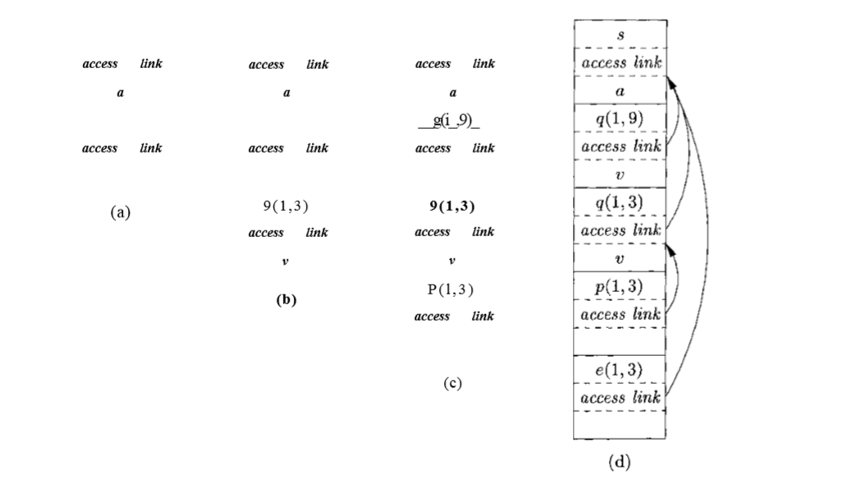
Access Links

Slide 6
Manipulating Access Links
Procedure p is at a higher nesting depth than q.
Then p must be defined immediately within q, or the call by q would not be at a position that is within the scope of the procedure name p.
Thus, the nesting depth of p is exactly one greater than that of q, and the access link from p must lead to q.
It is a simple matter for the calling sequence to include a step that places in the access link for p a pointer to the activation record of q.

Slide 7
Manipulating Access Links
The call is recursive, that is, p — q? Then the access link for the new acti- vation record is the same as that of the activation record below it.

Slide 8
Manipulating Access Links
The nesting depth np of p is less than the nesting depth nq of q.
In order for the call within q to be in the scope of name p, procedure q must be nested within some procedure r, while p is a procedure defined immediately within r.
The top activation record for r can therefore be found by following the chain of access links, starting in the activation record for q, for nq — np + 1 hops. Then, the access link for p must go to this activation of r.

