Slide 1
WProfile
Requirements

Slide 2
Requirements R0 - What is the application?
Web Application to maintain Information about People.
Basic Requirements (R0-1,2,3,4) => Add, Search, Edit, Delete.
Additional Requirements -> Coming Soon

Slide 3
Requirements R1 – Functional Requirements
R1-0 Wprofile is hosted on a web server and available at any time.
R1-1 Wprofile should be reachable via any reasonably modern web browser.
R1-2 On navigating to the web page, the application should list the basic information (Defined in “Profile Requirements”) about People that are already stored.
R1-3 The application must provide a search bar to find people based on information in the Profile of any person (Defined in “Profile Requirements”).
R1-4 The application should allow for editing or deleting the information of the People it has displayed on the page.

Slide 4
Requirements R2 – Profile Requirements
Profile is a set of information of a Person
Profile has the following data considered as “basic information”:
Name
Picture
Contact Information
Profile also has the following data:
Professional Information – Education, Work Experience, Resume/Portfolio Link.
Personal Information – Short Biography, Interests and Hobbies like Movie preference, food preference, Art, Games, etc.
[Advanced] Uploaded Information – Poems, articles, Expanded Portfolio, etc.

Slide 5
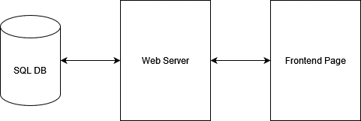
Requirements R3 – Implementation Requirements
Frontend should be implemented in HTML, and CSS. Javascript maybe used.
Backend should be implemented in Python 3.
Database should be sqlite3.

