Slide 1
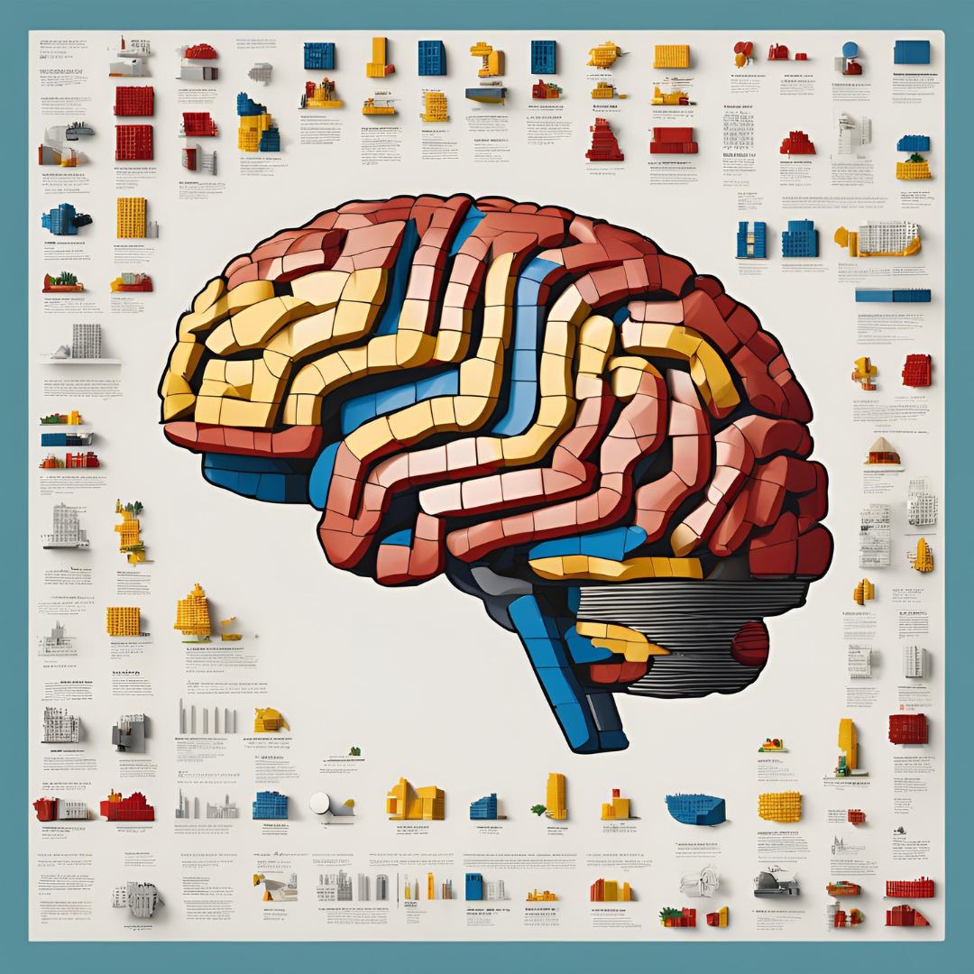
Brickspiration
Endless LEGO Creations

Slide 2
Team
Name | GitHub Handle | LinkedIn Handles
Deepika | github.com/DeepikaMobileDeveloper | linkedin.com/in/deepikakhammampati/
Nidhi | github.com/Nidhi-Pai | linkedin.com/nidhi-pai
Meera | github.com/MeeraTresa | linkedin.com/in/meera-tresa-sebastian/

Slide 3
What problem did we solve and why?
Challenge:
Repurpose LEGO sets for different builds
Goal:
Develop an AI system to suggest creative and compatible alternative builds from existing LEGO sets.
Data:
Rebrickable database (13M+ parts, 30K+ sets)
Depth-First Search to merge the dataset into the required sets+parts format

Slide 4
What is our solution?
AI-powered system analyzes your existing LEGO parts
Provides personalized build ideas and guides
Helps foster creativity, problem-solving skills in kids

Slide 5
Solution Tech Stack
Vector Database: Milvus on Zilliz Clusters
LLM: GROQ
Embeddings: Sentence Transformers (all-MiniLM-L6-v2)
Interface: Gradio
Data: Rebrickable dataset

Slide 6
Monetization Strategy
Freemium Model:
Offer free access with limited features or usage.
In-App Purchases:
Allow users to purchase additional features like premium tutorials, or designs.
Lego Partnerships:
Partner with Lego or other toy companies to feature branded content
User-Generated Content:
Allow users to upload and share their own Lego designs

Slide 7
Next Steps
Implement image generation functionality for the repurposed build
Address roadblock of lacking the image dataset for LEGO parts
Expand dataset coverage and system capabilities
Find ways to scan existing lego parts and propose builds

Slide 8
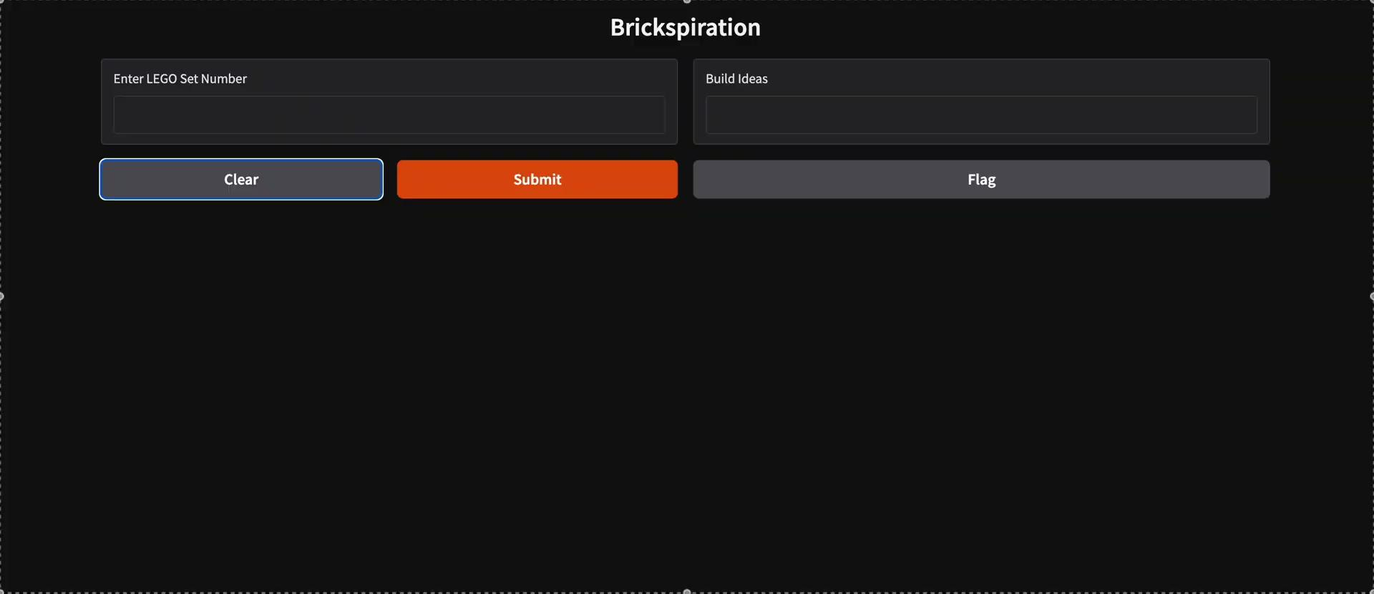
Demo

