Slide 1
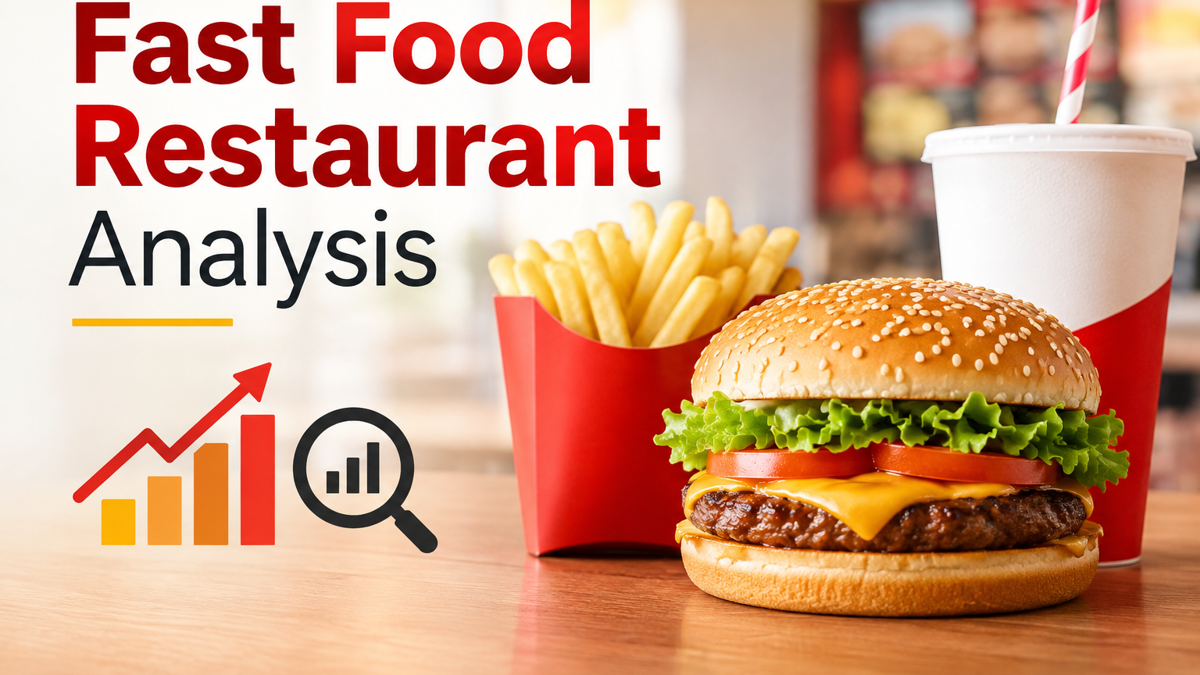
Name: Deepika Mudireddy
Course: Data Science
Notes:
Start simple: Germany has almost 42,000 fast food places. I wanted to see where they are and why some places have more than others. Remember to put your name and course on this slide.

Slide 2
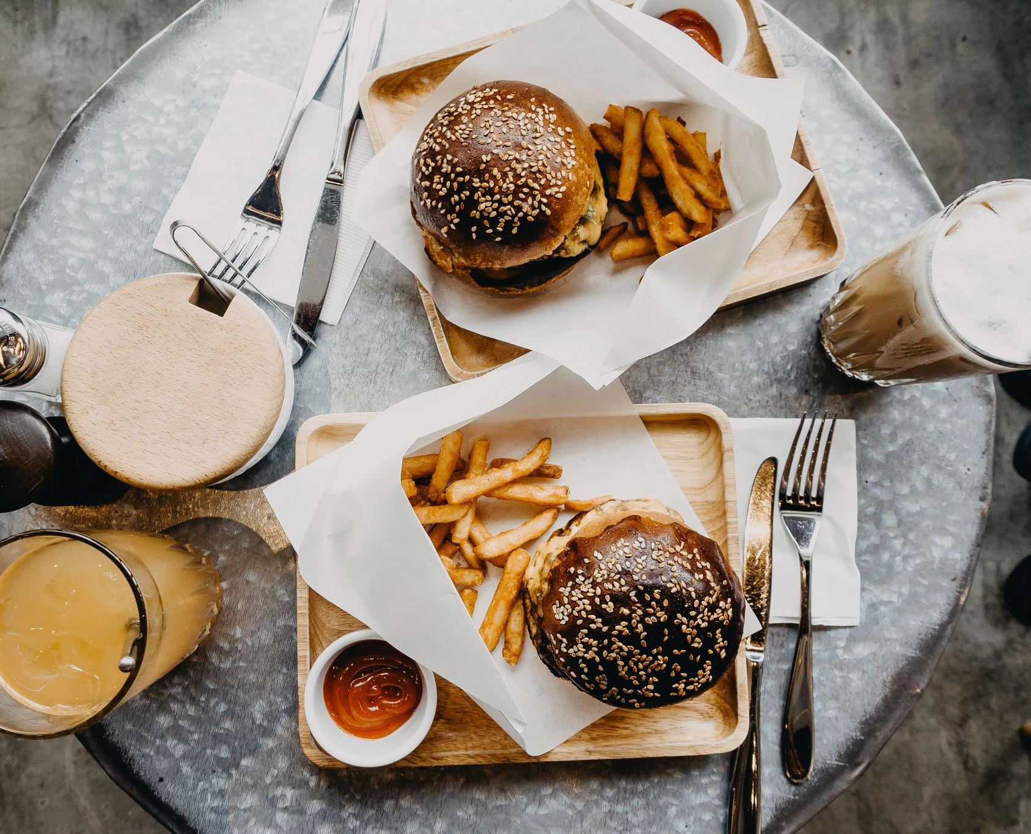
INTRODUCTION
Germany has around 42,000 fast-food restaurants, so they are quite common across the country.
In this project, I wanted to see where these restaurants are mainly located.
I looked at different cities, states, and fast-food chains.
I also used population data to make the comparisons between places more meaningful.
The data was taken from OpenStreetMap and analysed using Power BI.
In simple terms, my main goal was to understand where fast-food restaurants are located in Germany and what patterns we can see in the data
Notes:
Read the five questions out loud. Then explain in one line why dividing by population matters: a big city will always have more of everything, so counts alone are not a fair comparison.

Slide 3
Where my data comes from
41,952
4,689
16
restaurants
towns and cities
states
What I did with it
1
Cleaned the data: fixed city names, matched postcodes to the right state, marked chains and independents
2
Added the population of each state and of the 81 biggest cities
3
Built the charts and measures in Power BI
Sources: OpenStreetMap (amenity = fast_food) and Destatis population tables.
Notes:
Mention that I only have population numbers for the 81 biggest cities. The small towns are in the data but they have no population to divide by.

Slide 4
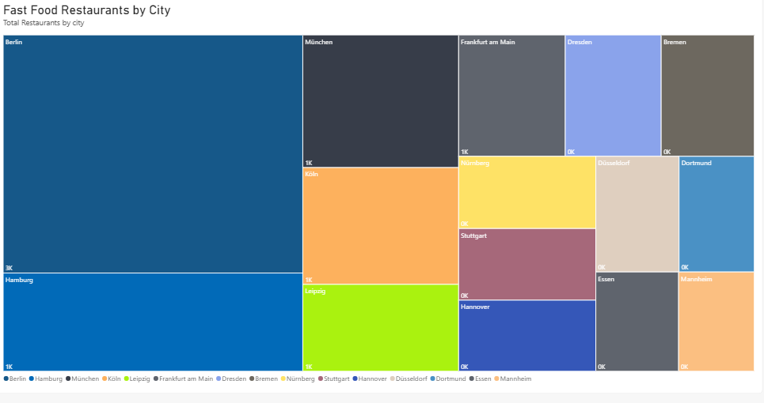
Cities which have the most restaurants
Berlin has the most restaurants, with 2,807.
Hamburg comes next with 1,157, followed by München with 813.
The top 10 cities account for around 20% of all fast-food restaurants in Germany.
However, these are also some of Germany’s biggest cities, so the results are closely linked to city size.
Power BI chart: "Fast Food Restaurants by City".
Notes:
Point at the big Berlin box. Then say the important part: this chart mostly tells us where a lot of people live, not where fast food is popular. That is why the next charts use population.

Slide 5
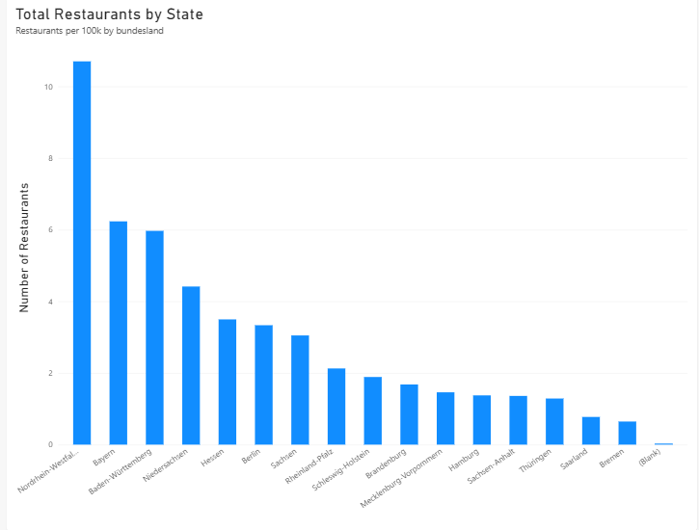
Fast Food Distribution Across German States
North Rhine-Westphalia has the most, with 9,011 restaurants.
Bavaria comes next with 5,249, followed by Baden-Württemberg with 5,026.
Lower Saxony has 3,717 restaurants, while Bremen has the fewest with 543.
Bremen has fewer restaurants partly because it is the smallest state.
There are also 25 restaurants with no state information, so these should be removed from the analysis.
Power BI chart: "Total Restaurants by State". Title changed, but the numbers are still the broken measure — see slide 10.
Notes:
Be honest here. The chart is titled per 100,000 people but the order is the same as the population order of the states, which is a warning sign. I explain the reason on slide 10.

Slide 6
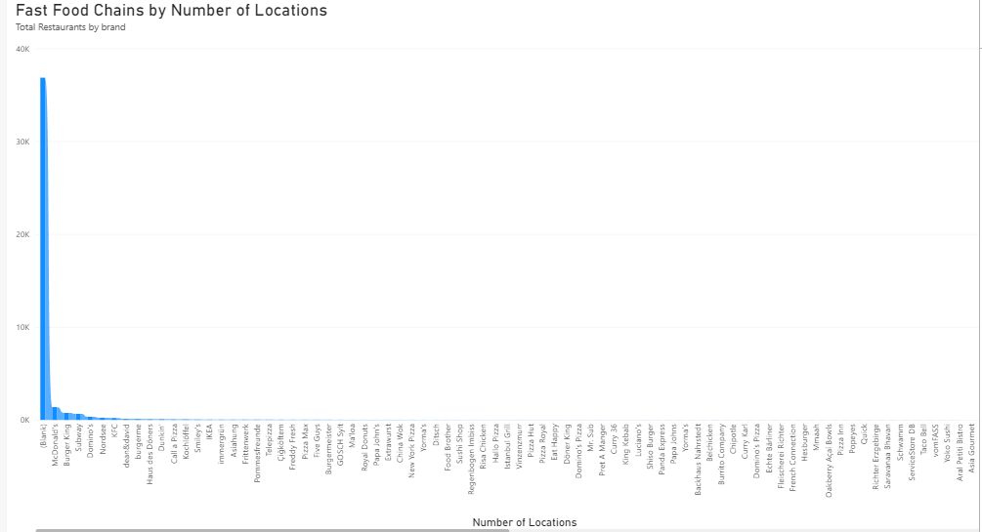
Fast Food Chains in Germany
McDonald's is the biggest chain with 1,380 locations.
Burger King has 760 and Subway has 656.
After the top three the numbers drop fast. No other chain reaches 350.
The tall bar on the left marked (Blank) is all the restaurants with no chain name.
Power BI chart: "Fast Food Chains by Number of Locations". Still includes every small brand plus (Blank) — worth filtering to the top 8.
Notes:
That (Blank) point on the left is almost 37,000 restaurants. It looks like an error but it is not. The next slide explains what it actually is.

Slide 7
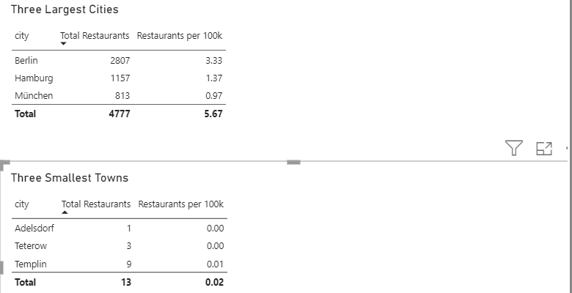
Big cities v/s small towns
Big cities clearly have more restaurants overall.
The per-person result may be inaccurate because the population data needs to be mapped correctly, so I did not use it as a final result.
Power BI tables: "Three Largest Cities" and "Three Smallest Towns". Per 100k column still not correct — see slide 10.
Notes:
The surprise here is that big cities are not more fast food heavy per person. They just have more people. Say that a result of no difference is still a real result.

Slide 8
Most German fast food is not a chain
Only 5,104 of the 41,952 restaurants belong to a chain. The other 36,848 are small independent shops. That is the big (Blank) bar from the last chart.
88%
21%
11%
are independent shops
of all places sell kebab
sell burgers
Kebab is the most common type of fast food in Germany, almost twice as common as burgers. So the typical German fast food place is not a McDonald's. It is a döner shop on the corner.
Notes:
This is the best finding in the project and it was not even one of my questions. Say it simply: the chain ranking is interesting, but chains are only a small slice of the market.

Slide 9
CONCLUTION
Big cities have more restaurants overall.
Restaurant numbers are different from city to city.
City size seems to have an impact on restaurant availability.
The per-person results need better population mapping before we can rely on them.
Overall, the data gives us a clear picture of restaurant distribution across cities.

Slide 10


