Slide 1
Data Analytics 60 - Final Project Presentation
The University of Europe for Applied Sciences (UE)
Potsdam campus
Analysing the impact of social media usage on mental health using data analytics
A data analytics study using survey-based behavioural and well-being indicators
Beyond screen time : understanding behavioural drivers of mental well-being
Research Team : Deepika Mudireddy | Srividhya | Ganesh Acharya | Vrinda Suni

Slide 2

Analysing the impact of social media usage on mental health using data analytics
TEAM
Team Roles and Project Contributions
A clear division of responsibilities supports data handling ,analysis, interpretation and delivery
Vrinda Suni
Role: Team Lead, Presentation & Project Coordination
Coordinated overall project planning and execution Designed and the presentation slides Managed GitHub repository and final submission process
Ganesh
Role: Data Cleaning & Preprocessing
Performed data cleaning by handling missing and duplicate values Standardized dataset formats for uniform analysis Prepared refined data for statistical evaluation
Deepika
Role: Data Analysis &Visualization
Conducted statistical and exploratory data analysis
Developed charts and visual representations for insights Identified key patterns and trends in the dataset
Srividhya
Role: Data Collection & Dataset Management
Collected datasets from verified and relevant sources. Organized and structured raw data for analysis. Ensured data quality, completeness, and consistency
02 / 14

Slide 3
Analysing the impact of social media usage on mental health using data analytics
RESEARCH MOTIVATION
Problem Context and Research Motivation
Behavioral patterns matter – not only screen time.
Social media is embedded in communication, learning and daily routines nut the mental health signal depends on how people engage
Social media has reshaped communication, information sharing, learning, and everyday social interaction.
Growing concerns include anxiety, depressed mood, sleep disruption, and attention difficulties.
Prior discussion often over-focuses on total exposure time rather than behavioral mechanisms.
project examines whether comparison, validation seeking, distraction, and platform use reveal stronger signals.
The goal is a descriptive, data-grounded view of digital well-being for young adults.
03 / 14

Slide 4
Analysing the impact of social media usage on mental health using data analytics
OBJECTIVES
Research Objectives and Questions
01
02
Usage intensity
Platform differences
Assess how daily hours relate to worry, depressed mood, sleep issue and concentration difficulty
Compare descriptive mental-health profiles across commonly used platforms in the survey sample.
03
04
Behavioral drivers
Functioning and sleep
Examine social comparison and validation seeking as mechanisms behind pooper well-being indicators.
Explore how sleep problems and concentration difficulty co-occur with emotional outcomes.
04 / 14

Slide 5
Analysing the impact of social media usage on mental health using data analytics
DATA FOUNDATION
Dataset Overview
The survey spans demographics, platform behavior and ordinal mental-health indicators.
379
Respondents
Clean survey records used for descriptive analysis.
22.2 years
Average age
Sample centered on young adults in their early twenties.
73%
Students
University students dominate the occupation profile.
58%
Female
Female respondents form the largest gender group.
Calculation
Students: 397 × 73% = 289.81 ≈ 290
Female: 397 × 58% = 230.26 ≈ 230
Male: 397 − 230 = 167
Key Highlights
Majority of the respondents are students, making the dataset relevant for analysing social media usage among young adults.
The average participant age is 22.2 years, representing the young adult population.
The dataset has a slightly higher proportion of female respondents (58%) than males.
05 / 14

Slide 6
Analysing the impact of social media usage on mental health using data analytics
METHODOLOGY
Analytical Workflow and Methodology
A structured descriptive-analytics pipeline connects the cleaned survey to interpretable findings.
01
02
03
04
05
06
Collection
Cleaning
EDA
Behavioral analysis
Platform comparison
Correlation & findings
Survey responses covering demographics, platform use, behaviors, and well-being outcomes.
Standardized fields, checking completeness, and prepared ordinal variables for analysis.
Profiled responded demographics and baseline score distributions.
Compared outcomes by usage intensity, comparison and validation seeking.
Benchmarked platform groups using average mental-health indicators.
Visualized relationships and summarized descriptive academic cautions.
Analytical stance : descriptive and exploratory, associations are interpreted cautiously and not presented as causal effects.
06 / 14

Slide 7
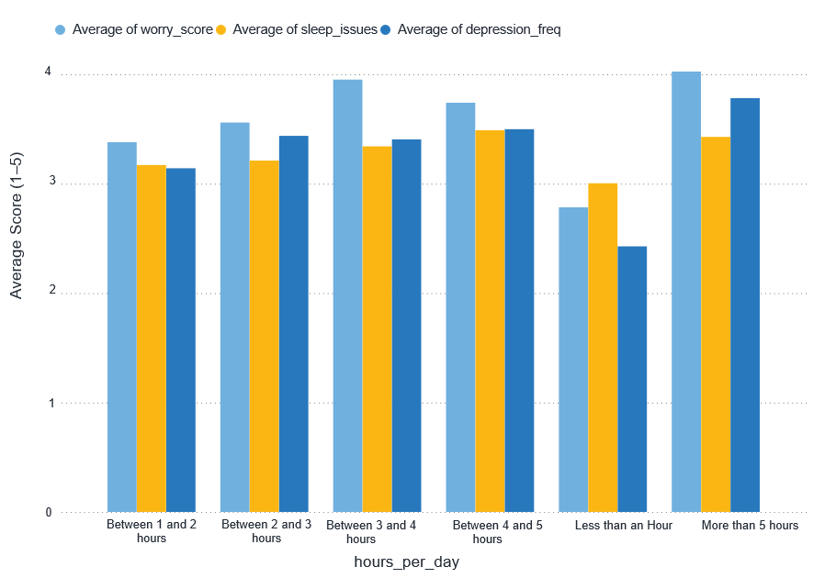
Analysing the impact of social media usage on mental health using data analytics
KEY VISUALIZATION 1
Mental Health Scores vs Daily Social Media Usage
Higher Usage
Mental health scores increase with daily social media usage.
High-Risk Users
Users spending more than 5 hours/day report higher depression and worry.
Sleep Impact
Longer screen time is associated with increased sleep issues.
Overall Finding
Lower daily usage is linked with better mental well-being.
07 / 14
1
0

Slide 8
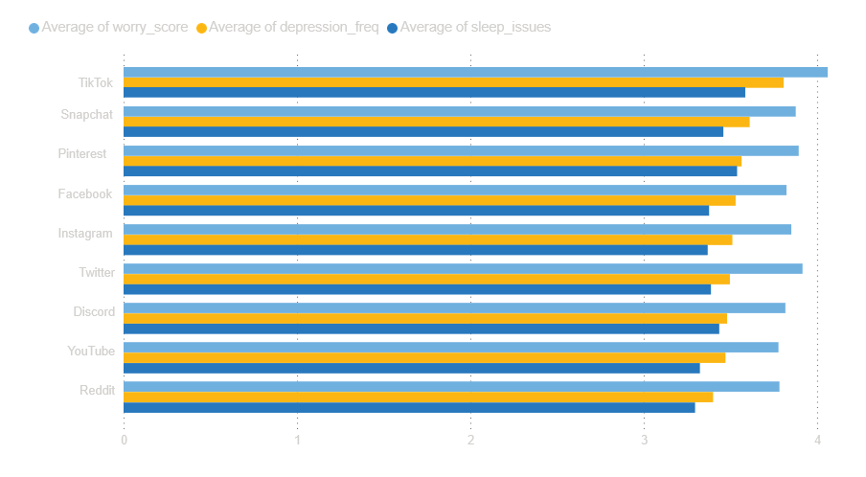
Analysing the impact of social media usage on mental health using data analytics
KEY VISUALIZATION 2
Mental Health by Social Media Platform
Highest Score
TikTok
Lowest Score
Reddit
YouTube
Observation
Platform choice
Influences outcomes
🟦 Highest Score : TikTok users reported the highest depression and worry scores.🟦 Lower Score: Reddit and YouTube users showed comparatively lower scores.🟦 Platform Effect: Mental health outcomes vary across social media platforms.🟦Overall Finding: Platform choice may influence emotional well-being.
08 / 14

Slide 9
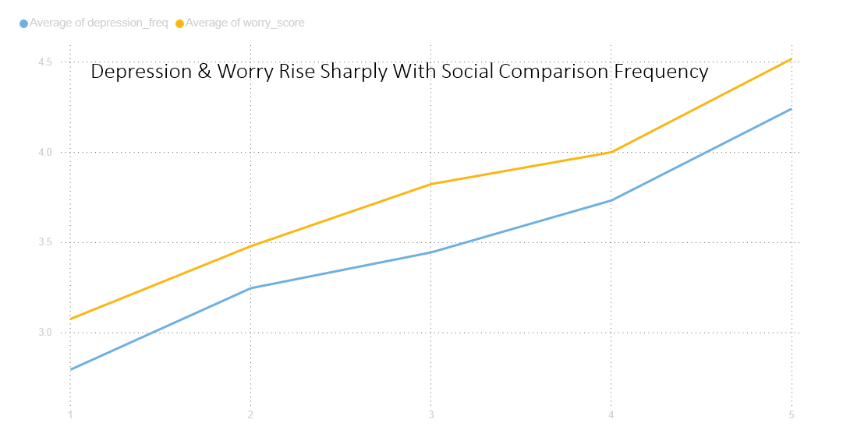
Analysing the impact of social media usage on mental health using data analytics
KEY VISUALIZATION 3
Depression & Worry Rise with Social Comparison Frequency
Social Comparison
Key Finding
Higher Worry
🟦 Social Comparison: Frequent comparison increases depression levels.🟦 Worry: scores rise as comparison frequency increases.
🟦 Behaviour :Comparing with others negatively affects mental health.🟦 Overall Finding : Social comparison is a major behavioural risk factor.
09 / 14

Slide 10
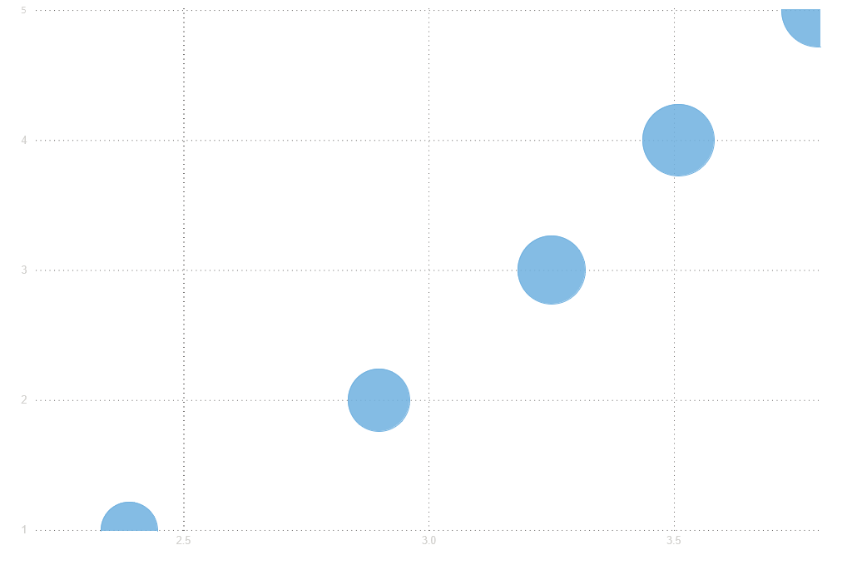
KEY VISUALIZATION 4
Poor Sleep and Difficulty Concentrating Rise Together
🟦 Sleep Quality
Reduced sleep quality is linked to increased mental health concerns.
🟦 Overall Impact
Maintaining healthy sleep patterns contributes to better emotional well-being.
🟦 Concentration
Sleep disturbances significantly affect focus and daily performance.
10 / 14

Slide 11
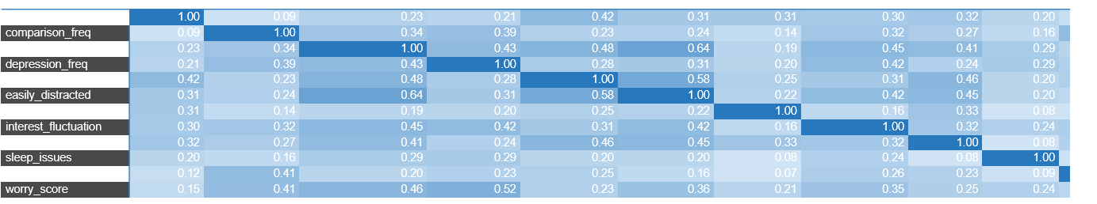
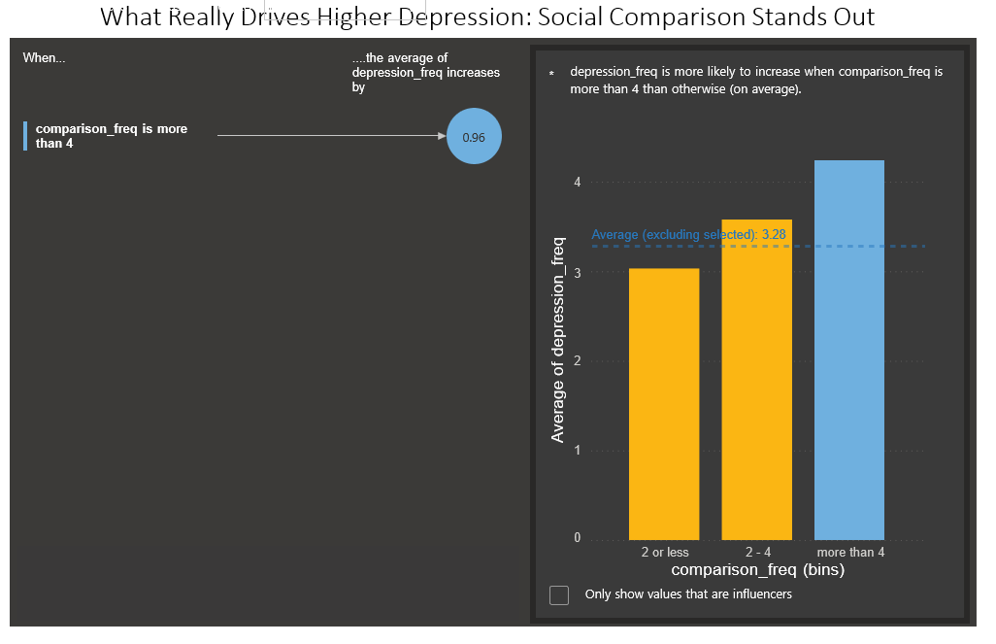
Analysing the impact of social media usage on mental health using data analytics
KEY VISUALIZATION 5
Key Influencer Analysis & Correlation Heatmap
Correlation Heatmap – Social Media Use & Mental Health Indicators
Strongest Driver : Social comparison is the strongest factor influencing depression.
Correlation: Depression and worry show a strong positive relationship.
Overall Finding: Mental health indicators are closely interconnected.
The Key Influencer Analysis identifiedsocial comparison as the strongest factor contributing to higher depression levels. The correlation heatmap further highlights strong positive relationships among major mental health indicators, particularly depression and worry
11 / 14

Slide 12
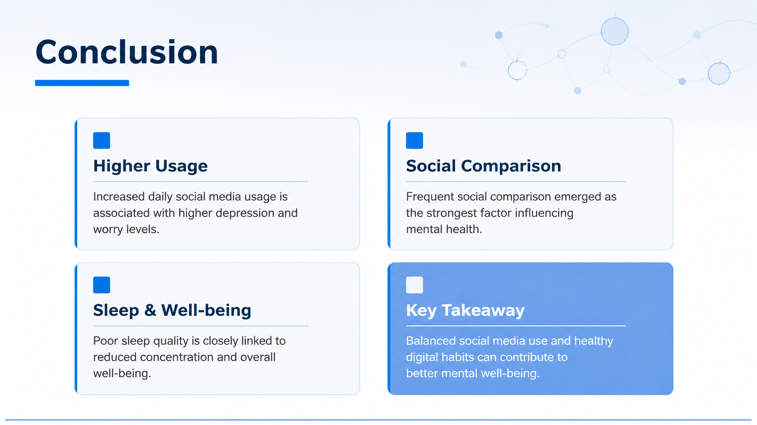
Analysing the impact of social media usage on mental health using data analytics
Conclusion
12 / 14
13 / 14

Slide 13
THANK YOU
Any Questions?
GROUP MEMBERS
Deepika Mudireddy | Ganesh Acharya | Vrinda Suni
Analysing the impact of social media usage on mental health using data analytics
14 / 14

