Slide 1








2022-179
Escort – University Students Guidance System based on NLP
1

Slide 2
Research Team
Student Name | Registration Number
Deepika. S | IT19148632
Abarna. U | IT19116952
Parathan. T | IT19125176
Shanghavi. R | IT19155708
Supervisor: Ms. Archchana Kugathasan
Co-Supervisor: Mr. Dharshana Kasthurirathna
1

Slide 3


Research Problem
University students and administration facing issues while communicating because, lack of time and language difference
University students are unable to receive easy solution for psychological
issues because of unawareness and communication issues
Students want to prepare themselves for industry experience and to develop their skills in their field of interest
University students are required to analyze their performance to determine their weaknesses
1

Slide 4
Research Objectives
Main Objectives
This research recommends a proper system for university students where they can communicate using chat-bot, related to administrative and personal issues and get an accurate solution.
Also, from this system students can get a better career guidance and suitable solution for students’ weakness according to their grades.
Sub Objectives
Sub Objective 1: Give solutions for the doubts/ issues or clarifications related to university administration.
Sub Objective 2: Recommend exercises and activities in preferred language for psychological issues.
Sub Objective 3: Recommends mentors, courses & certifications for students based on their preference
Sub Objective 4: Predicts student performance and recommends suitable learning materials.
1

Slide 5
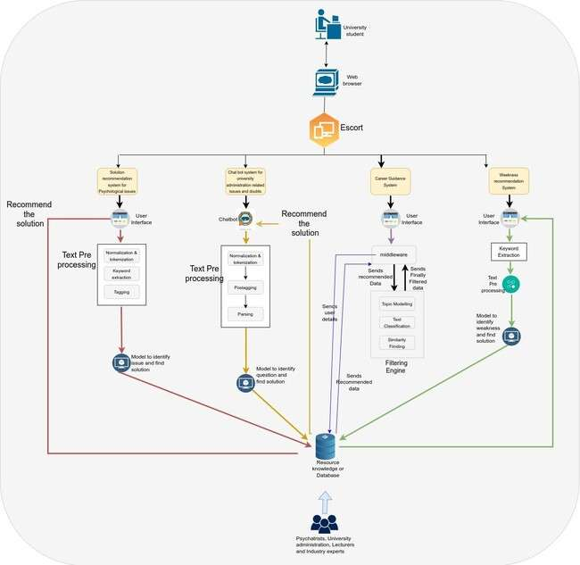
Overall Solution as a System Diagram
1

Slide 6
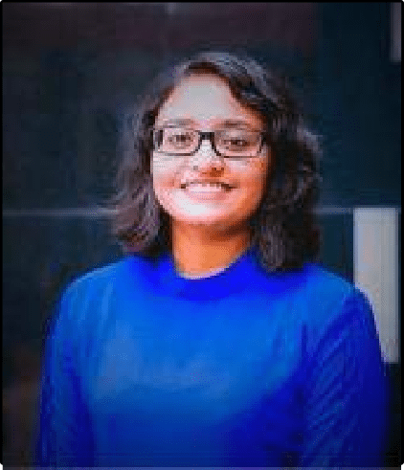
Student Must add a professional photo to this cage
IT19148632 | DEEPIKA. S
Software Engineering
IT19148632 |
Deepika. S | 2022-179
6

Slide 7




RESEARCH QUESTION
Requirement gathering about how the students are getting response for administration and the language problem they are facing.
Most of the students do not get a proper solution as an answer for their question
Students are having communication issues because of language, which lead to wrong information passing
IT19148632 |
Deepika. S | 2022-179
6

Slide 8
SPECIFIC & SUB OBJECTIVES
Our research aims to minimize the interaction between university administration and students, which normally cost a lot of time. Providing a chat bot where students can find solution via a chat-bot by asking the questions in their preferred language.
Sub Objectives
Identify the main categories of administration where students are having more issues/doubts or clarifications.
Get proper data set which will give accurate solutions.
Implement chat-bot with multiple input language support (English, Tamil, English-Tamil code-mix) 4.Implement a website which can be accessed by all technical devices.
IT19148632 |
Deepika. S | 2022-179
6

Slide 9
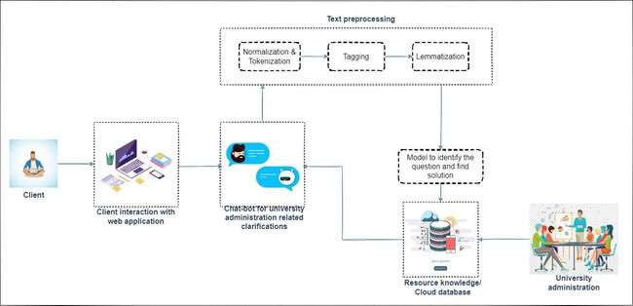

Methodology – System Diagram
11/7/2022
9

Slide 10
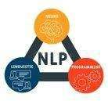

Steps | Technologies Required | Rules & Algorithms | Tools
Gather administration related questions and find solutions | Questionnaire | - | Google form WhatsApp
Pre-process requirements | Natural Language Processing (NLP) | NLTK, Keras | Visual Studio Code, Flask
Train the model | NLTK, Keras, Pandas | Tokenization Tagging Lemmatization | Visual Studio Code, Flask, NLTK, Matplotlib
Give answers to questions | Natural Language Processing (NLP), Numpy | Lemmatization | Python libraries
Front end development | JavaScript framework – React JS HTML, CSS | Material UI | Visual Studio Code
IT19148632 | Deepika. S | 2022-179
11/7/2022 10

Slide 11
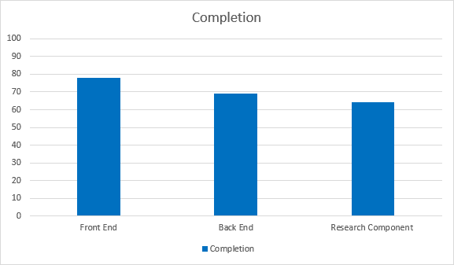
Completion of the project
IT19148632 | Deepika. S | 2022-179
11/7/2022
11

Slide 12
Work to be completed
50% Progress
Create model for English language.
Complete the Tamil and Tamil- Codemix model.
Trained model for English language.
Improve the UI of administrative
chatbot and complete frontend.
Create model for Tamil Language.
Completed the frontend for Administrative chatbot
11/7/2022
12

Slide 13
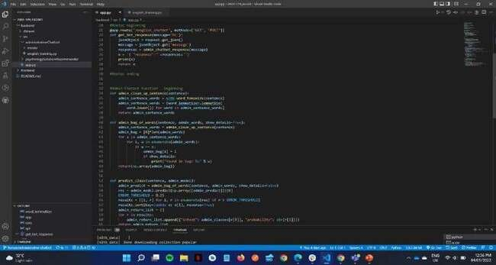
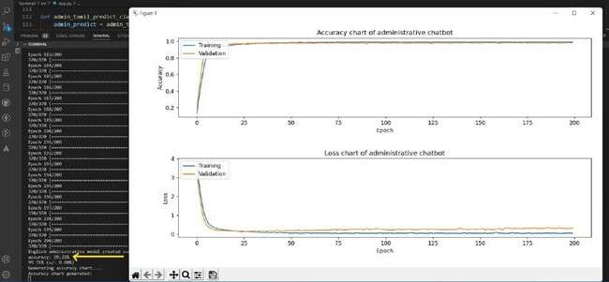
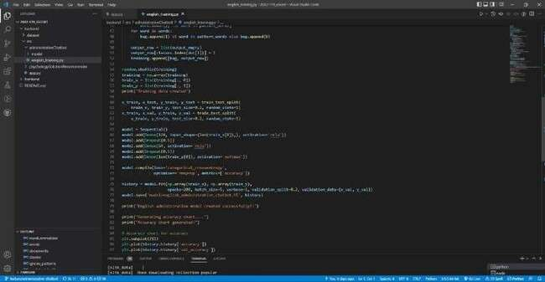
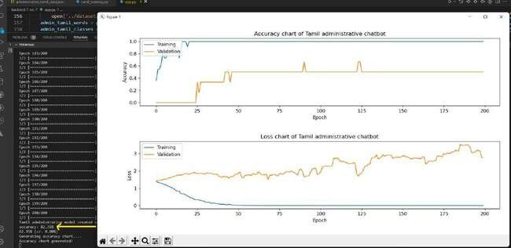
Evidence
Chatbot accuracy
Back End
IT19148632 | Deepika. S | 2022-179
11/7/2022
13

Slide 14

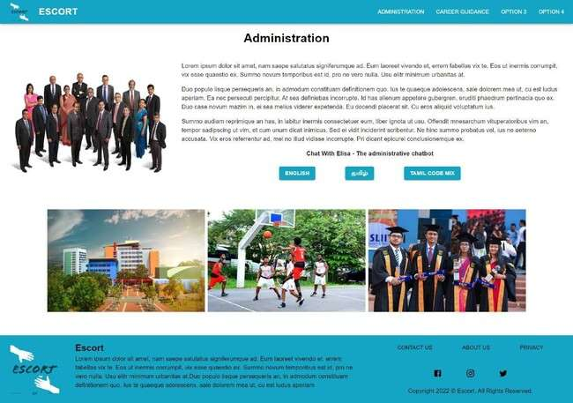
Frontend

Slide 15


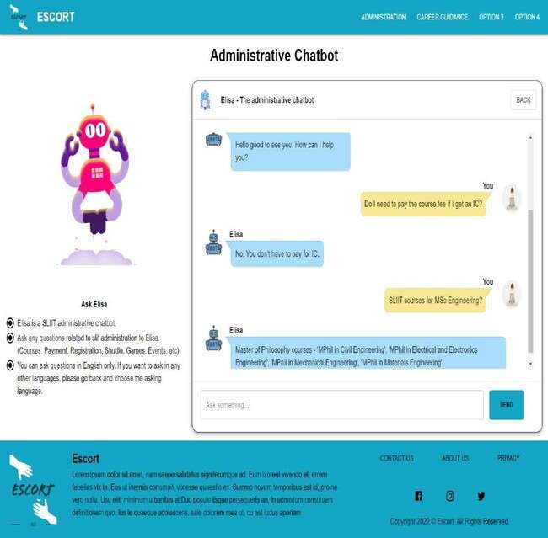
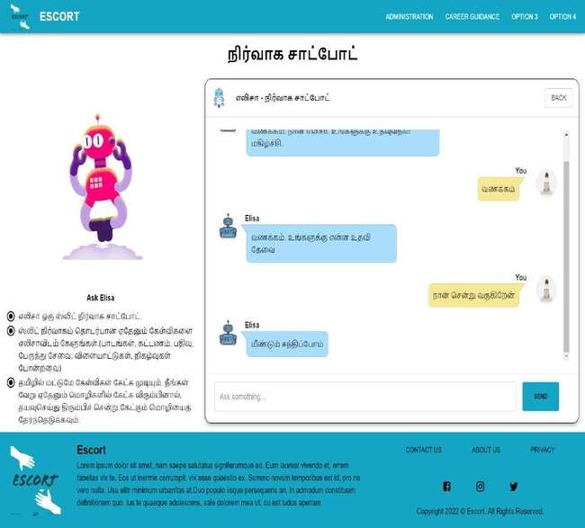

Slide 16
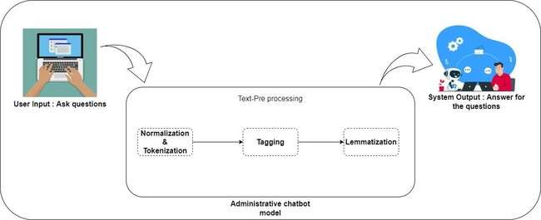
Summary of the component
IT19148632 | Deepika. S | 2022-179
11/7/2022
16

Slide 17
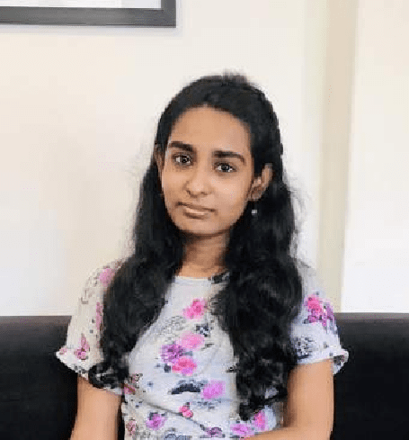
Student Must add a professional photo to this cage
IT19116952 | ABARNA. U
Software Engineering
IT19116952 |
Abarna. U | 2022-179

Slide 18
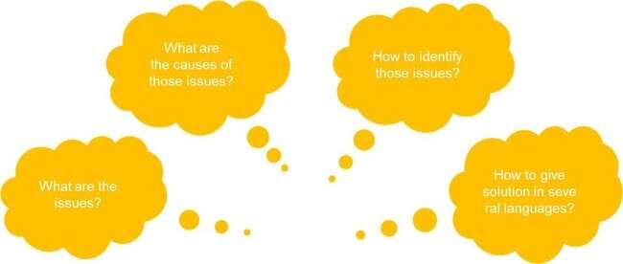

Research Question
IT19116952 |
Abarna. U | 2022-179

Slide 19

Specific and sub-objectives
Objective
Main Objective is to provide a better solution for the issues in psychology, to the university students in preferred language.
Sub Objectives
Implement website only for university students
Identify main psychological issues and causes
Train a model to find solution for psychological issues
Provide multi language system to recommend solution
IT19116952 |
Abarna. U | 2022-179

Slide 20

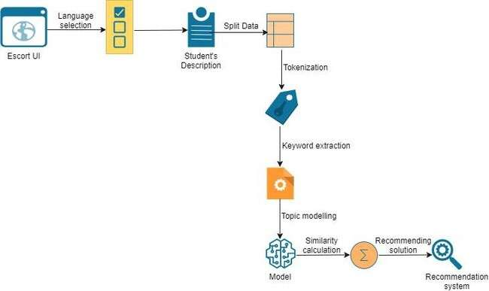
Methodology
System diagram
IT19116952 |
Abarna. U | 2022-179

Slide 21
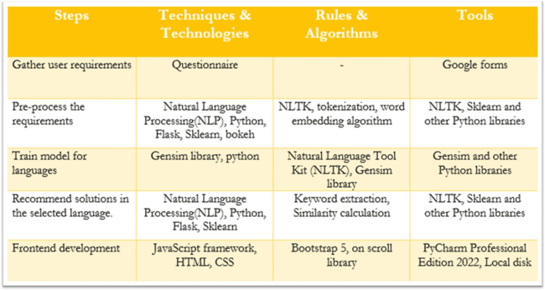
IT19116952 |
Abarna. U | 2022-179

Slide 22
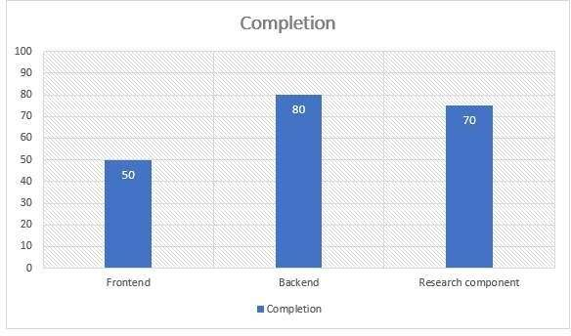
Completion of the project
IT19116952 |
Abarna. U | 2022-179

Slide 23
Completion of the project
Completed work
Work to be completed
Recommendation system for English
Backend development and
train model for Tamil
Basic frontend development
Develop Word Embedding
Recommendation system for
Sinhala
Add more data for Tamil model
Finalized frontend
development
IT19116952 |
Abarna. U | 2022-179

Slide 24
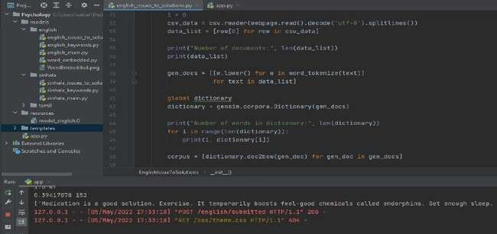
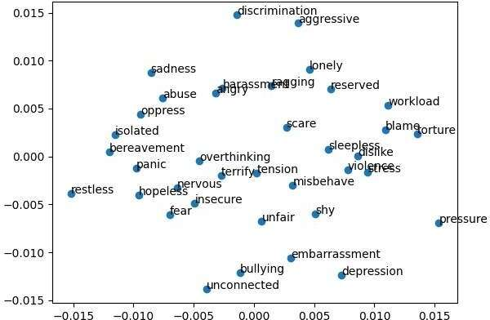
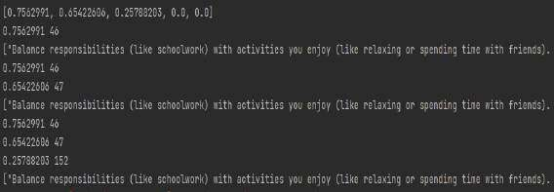
Evidence
Back End
IT19116952 |
Abarna. U | 2022-179

Slide 25
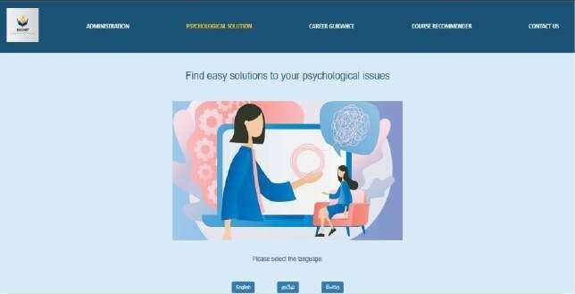
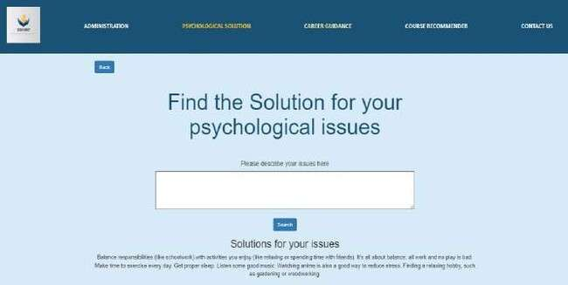
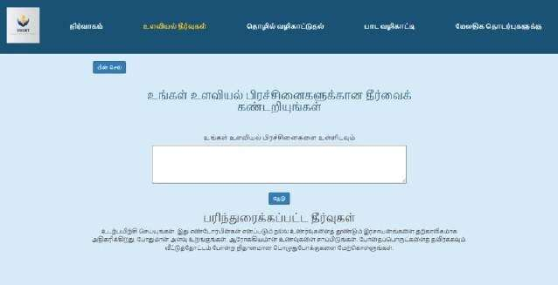
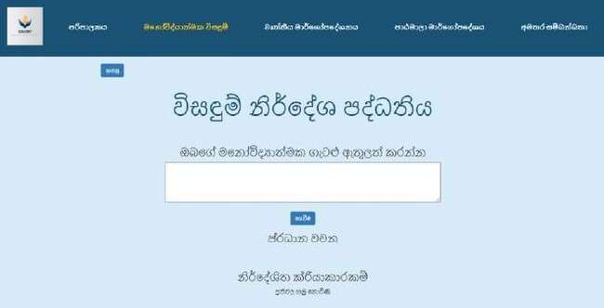
Front end
IT19116952 |
Abarna. U | 2022-179

Slide 26



Summary of the component
Solution Recommendation System for Psychological issues
Input: Description of psychological issues
Output: Simple solutions
Split data
Accuracy checking
Tokenization
Similarity
calculation
Keyword extraction
Topic modelling
IT19116952 |
Abarna. U | 2022-179

Slide 27
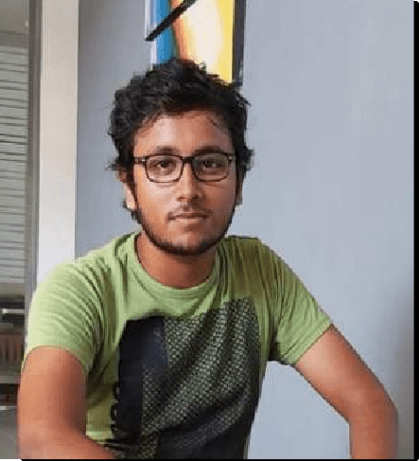
Student Must add a professional photo to this cage
IT19125176 | PARATHAN T.
Software Engineering
IT19125176 | Parathan T. | 2022-179

Slide 28

Research Question
Most of the student needs a career guidance during their
undergraduate studies
They should need to know the courses, certifications and available mentors who can guide during their undergraduate studies
This Photo by Unknown author is licensed under CC BY-SA-NC.
An interactive chat-bot that could help students to clear their career related doubts
IT19125176 | Parathan T. | 2022-179

Slide 29

Specific and sub objectives
Specific Objective
To help IT students during their undergraduate studies, with sharing suitable
courses, certifications and mentor guidance through a chat-bot.
Students able to query the chat-bot with doubts in the fields they are interested
Sub-Objective
Build an easy usable dashboard to feed data for the chatbot
Build model to classify the type of queries to answer
Build custom Named Entity recognition model
Build front-end webapp that enables users to have a chat and get answers for their queries
This Photo by Unknown author is licensed under CC BY-SA-NC.
IT19125176 | Parathan T. | 2022-179

Slide 30
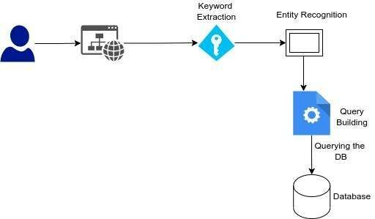
Methodology
System diagram
IT19125176 | Parathan T. | 2022-179

Slide 31
Steps | Technologies Required | Rules & Algorithms | Tools
Gather Courses, Mentors, Certification related data | Questionnaire/ Creating Dashboard to manage data | - | Google Forms / React based front-end UI
Pre-process requirements | Natural Language Processing (NLP) |  | NLTK, Matplotlib
Create Custom Entity Recognition | Natural Language Processing (NLP) |  | Spacy
Front end development | JavaScript framework – React JS HTML, CSS | Material UI | Visual Studio Code
IT19125176 | Parathan T. | 2022-179

Slide 32
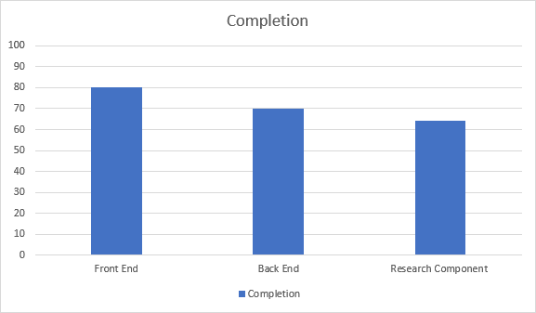
IT19125176 | Parathan T. | 2022-179
11/7/2022
32

Slide 33

Completion of the project
Completed Work
Work to be Completed
Front-end design & implementation for chat- bot
Back-end design & implementation
Custom Text-Classification model to choose among the options
Custom Named Entity Recognition model to differentiate entities using Spacy
Front-end conditional rendering of chat-bot screen needs to be implemented
Back-end API's conditions needs to be enhanced
Adding more data to Custom Entity Recognition and build model
This Photo by Unknown author is licensed under CC BY.
IT19125176 | Parathan T. | 2022-179

Slide 34
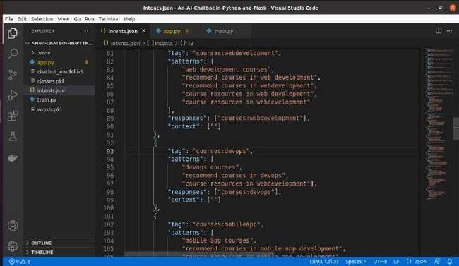
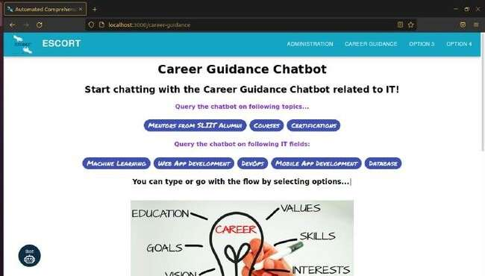
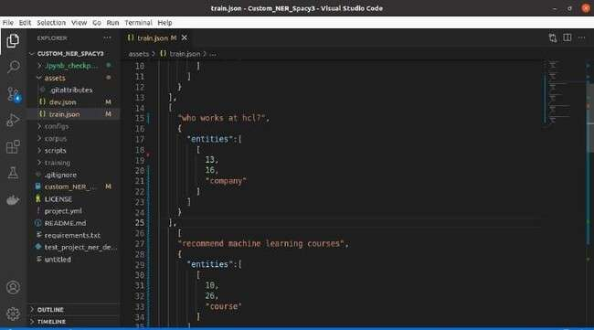
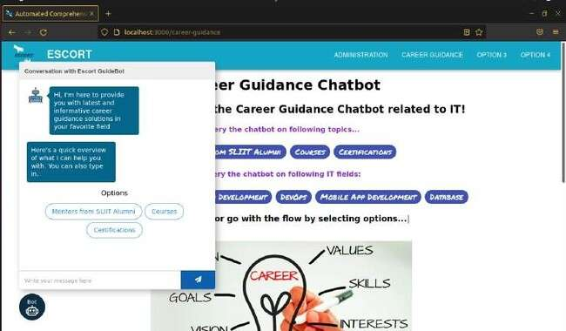
Evidence
Back-end
Front-end
IT19125176 | Parathan T. | 2022-179

Slide 35
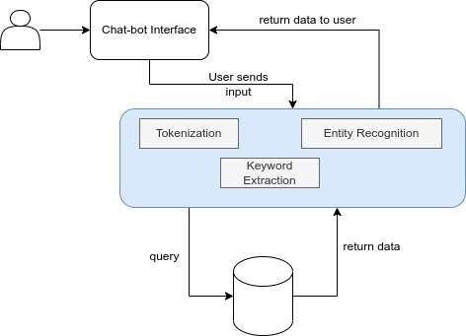
Summary of the Component
IT19125176 | Parathan T. | 2022-179

Slide 36
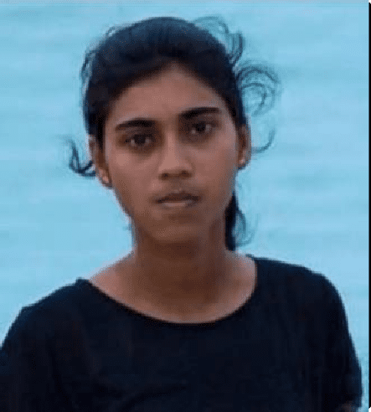
Student Must add a professional photo to this cage
IT19155708| SHANGHAVI. R
Software Engineering
IT19155708| Shanghavi. R | 2022-179

Slide 37

Recommend suitable Learning resources to the students based on their performance
IT19155708| Shanghavi. R | 2022-179

Slide 38

Research Questions
What are the attributes we can use to predict students' academic performance more efficiently ?
How to recommend learning resources based on student performance?
Is it important for a student to identify their weaknesses?
How reliable is the system for predicting performance?
IT19155708| Shanghavi. R | 2022-179

Slide 39




Specific and Sub Objectives
Specific Objective
Identifying and analyzing students performance based on their marks and recommending suitable learning resources.
Analyze student’s marks.
Predicting performance level in a subject.
Sub Objectives
Recommending Learning materials.
Help to identify weaknesses.
IT19155708| Shanghavi. R | 2022-179

Slide 40
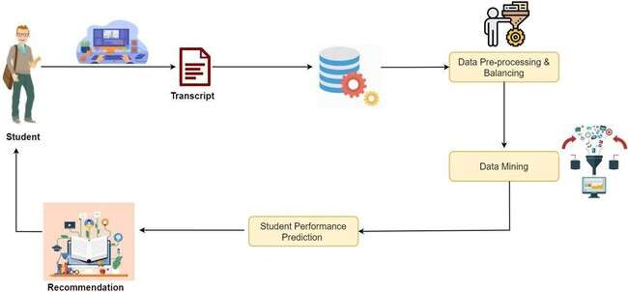
RESEARCH METHODOLOGY
IT19155708| Shanghavi. R | 2022-179

Slide 41
Completion of the project
Completed work
Backend development for
Performance prediction
Work to be completed
Frontend Implementation
Backend development for
recommendation
IT19155708| Shanghavi. R | 2022-179

Slide 42
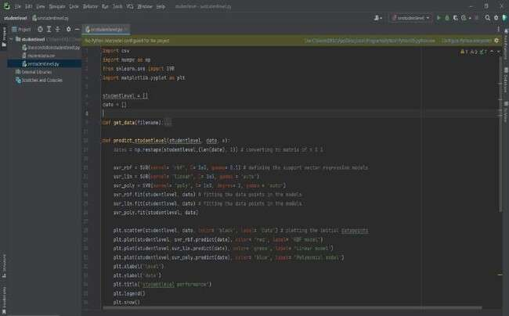
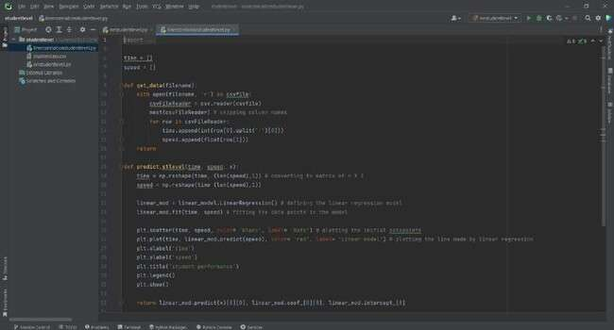
Evidence
IT19155708| Shanghavi. R | 2022-179

Slide 43


Summary of the component
System
Input – Students Marks & Subject
Output- Predicting performance and learning resources recommendation
Data pre-processing & balancing
Data mining
IT19155708| Shanghavi. R | 2022-179

Slide 44
References
Guruswami Hiremath, Aishwarya Hajare, Priyanka Bhosale, Rasika Nanaware, Dr. K. S. Wagh “Chatbot for Education System”, 2018.
Fabio Clarizia, Francesco Colace, Marco Lombardi, Francesco Pascale, Domenico Santaniello “Chatbot: An Education Support System for
Student”, 2018.
Aziliz Le Glaz1 , MD; Yannis Haralambous2 , PhD; Deok-Hee Kim-Dufor1 , PhD; Philippe Lenca2 , PhD; Romain Billot2 , PhD; Taylor C Ryan3 , MS; Jonathan Marsh4 , MA; Jordan DeVylder4 , MD, PhD; Michel Walter1,5 , MD, PhD; Sofian Berrouiguet1,2,5,6 , MD; Christophe Lemey 1,2,5 , MD, Machine Learning and Natural Language Processing in Mental Health: Systematic Review, 2021
Jessica Sharp, Stephen Theiler, A Review of Psychological Distress Among University Students: Pervasiveness, Implications and Potential Points of Intervention, 2018.
Amer Al-Badarenah , Jamal Alsakran Computer Information Systems Department Jordan University of Science and Technology Irbid 22110, Jordan, Computer Science Department University of Jordan Amman 11942, Jordan, "An Automated Recommender System for Course Selection", 2016.
JinjiaoLin, HaitaoPu, YibinLib, Jianlian, "Intelligent Recommendation System for Course Selection in Smart Education" 2017 International Conference on Identification, Information, and Knowledge in the Internet of Things
J. Shana, and T. Venkatacalam, “A framework for dynamic Faculty Support System to analyse student course data”, International Journal of
Emerging Technology and Advanced Engineering, Vol. 2, No. 7, 2012, pp.478-482.
M. SRRICHARAN, M. SANKEPALLY, M. K. SAI, M. LAKKIREDDY and M. M. KUMAR, "STUDENT PERFORMANCE ANALYSER USING SUPERVISED LEARNING ALGORITHMS," 7 June 2021.
Y. Baashar, G. Alkawsi, N. Ali, H. Alhussian and H. T. Bahbouh, "Predicting student’s performance using machine learning methods: A systematic literature review," 15 July 2021.
Sangeeta Kumari, Zaid Naikwadi, Akshay Akole, and Purushottam Darshankar. “Enhancing College Chat Bot Assistant with the Help of Richer Human Computer Interaction and Speech Recognition”, International Conference on Electronics and Sustainable Communication System (ICESC), pp.427-433. IEEE, 2020.

Slide 45
Risk Mitigation
Risks | Mitigation
Chatbots has high error rate | Trained the model with a lot of data to increase the accuracy and reduced the error rate.
Get users personal details for identifying psychological issues | Users will be anonymous, and their personal details won’t be saved.
Getting personal details of the mentors (email) | The details will be published after getting approval from the mentors.
Recommending the correct tutorial for students’ weakness module | Categorize students marks and recommend suitable tutorials for that range and module.

Slide 46


Commercialization
Identifying the target audiences.
Create social media and flyer marketing plan in universities.
Advertise on LMS.
Develop a pricing strategy after a year of product release.
Send e-mail to university students about the website.

Slide 47


