Slide 1
Flood Prediction Using R
Deepika S

Slide 2
Problem Statement
Flood occurrence depends on multiple environmental factors such as rainfall, temperature, humidity, and river water level.
Due to complex interrelations, it’s difficult to manually predict flood chances.
The problem is to develop a predictive model that estimates the probability of flood occurrence based on given parameters.
This probability helps in early warning and disaster preparedness.

Slide 3
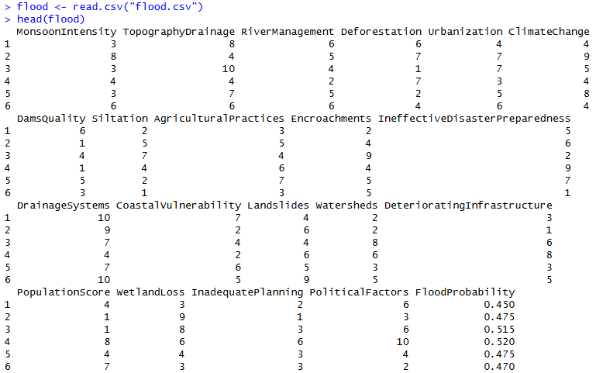
Loading Dataset

Slide 4
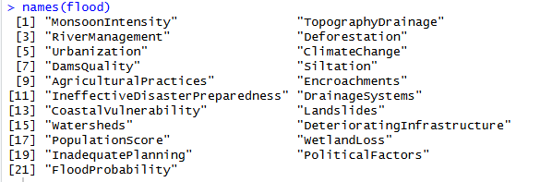

Anatomy of our Dataset
Dimensions of Dataset | Features of Dataset
The Dataset consists of “50000” rows and “21” columns/features. The data source is Kaggle dataset repository.

Slide 5
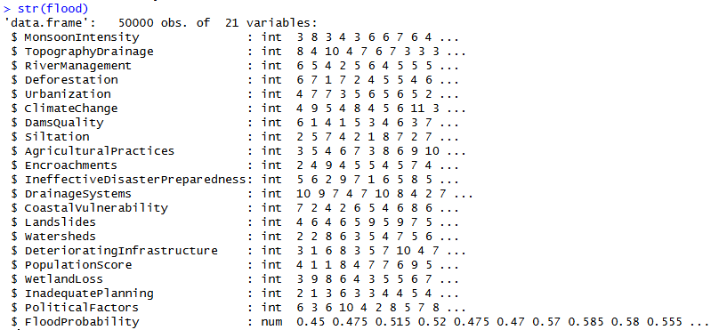
Structure of the Dataset

Slide 6
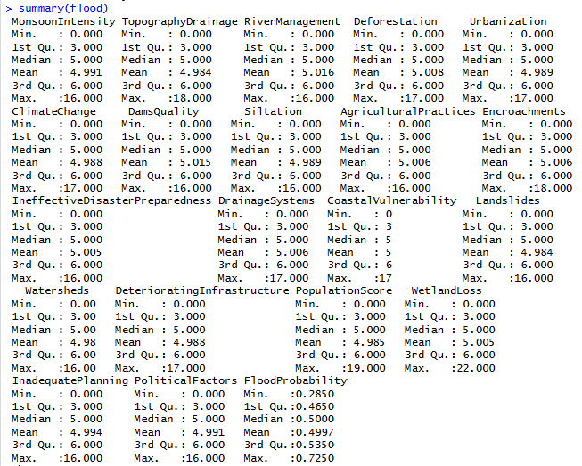
Summary of the Dataset

Slide 7
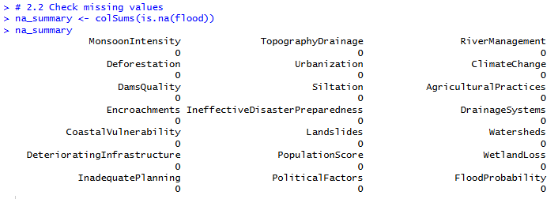
Stage – 1: Data Cleaning
Checking Missing Values

Slide 8

Stage – 1: Data Cleaning
Checking Duplicate Values Count

Slide 9

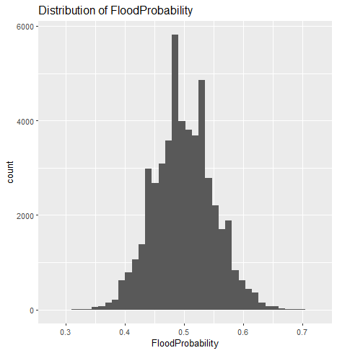
Stage -2 : Data Visualization

Slide 10
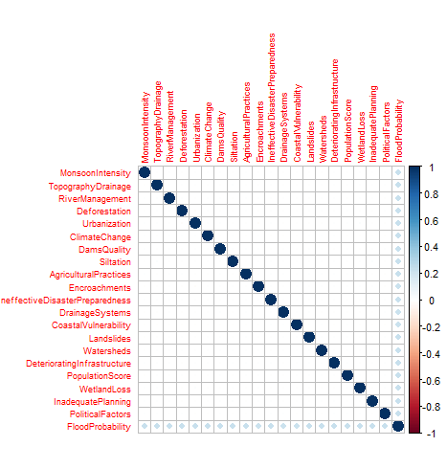
Stage -2 : Data Visualization
Correlation matrix for numeric features
> num_vars <- df[,sapply(df, is.numeric)]
> cor_mat <- cor(num_vars, use = "pairwise.complete.obs")
> corrplot(cor_mat, tl.cex = 0.6)

Slide 11
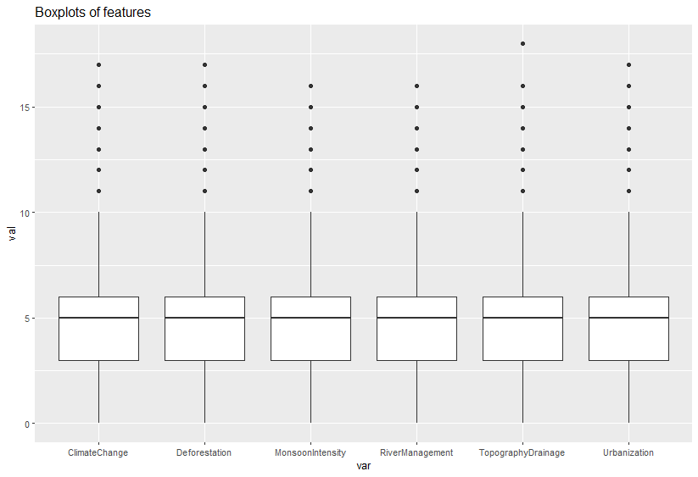
Stage -2 : Data Visualization
Boxplots for checking outliers

Slide 12

Stage – 4 : Data Splitting
80 % of the dataset is used for training and 20 % for testing

Slide 13
Stage – 5 : ML model Training
Machine Learning Models used
Linear Regression
Random Forest Regression
Generalized Linear Model : Logistic Regression

Slide 14
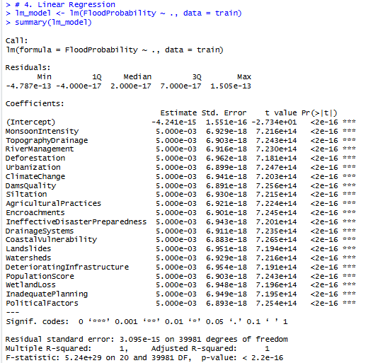
Linear Regression

Slide 15

Prediction and Evaluation

Slide 16
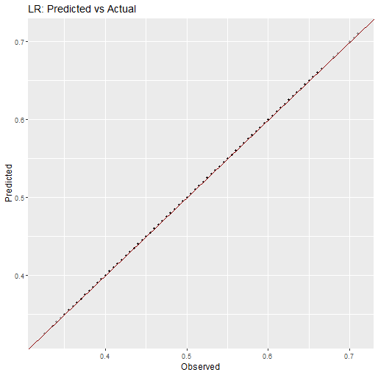
Linear Regression : Actual vs Predicted

Slide 17

Random Forest Regression

Slide 18
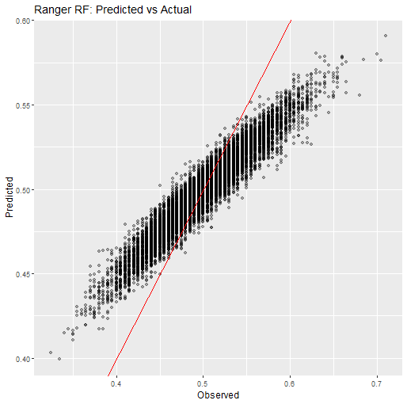
Random Forest Regression : Actual vs Predicted

Slide 19
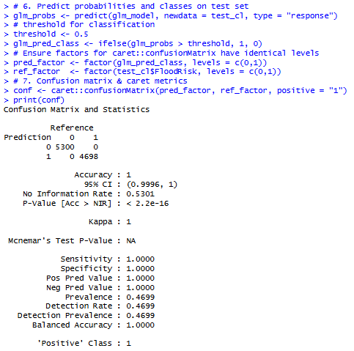
Generalized Linear Model: Logistic Regression

Slide 20
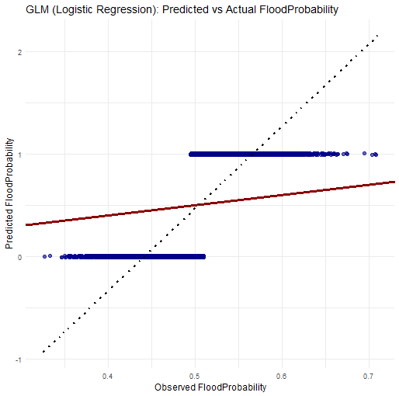
Generalized Linear Model: Logistic Regression : Actual vs Predicted

Slide 21
Comparison of Models
Model | Type | R² / Accuracy | RMSE | Comments
Linear Regression | Regression | 1.000 | — | Perfect fit but possibly overfitted
Random Forest | Regression | 0.9159 | 0.0265 | Realistic and robust generalization
Logistic Regression | Classification | 1.000 | — | Perfect accuracy; may indicate overfitting

Slide 22
Results and Discussion
Considering both interpretability and realistic performance, the Random Forest model is the most reliable for this dataset.
Achieved a high R² (0.916) with a low RMSE (0.0265), indicating strong predictive ability while maintaining generalization on unseen data.
Linear and Logistic models show perfect or near-perfect scores, but these results are suspiciously ideal, suggesting overfitting or data bias.

Slide 23
Project Reference
GitHub : https://github.com/DeepikaSundaravadivel

Slide 24
THANK YOU!!!

