Slide 1


Post Graduate program in Data Science and engineering Online – January 2022
GROUP-2
Airline Passenger Satisfaction Analysis using
Machine Learning Techniques
GROUP MEMBERS:
Deepika Varshney
Poorvi Khilwani
P.K. Parasu Ramudu
Venkatesh
Varadharajan R
MENTORED BY
P. V. SUBRAMANIAN

Slide 2
Business Objective and Understanding
Problem Statement
Why it is important
Value Addition
We aim to build a classification model to determine customer satisfaction and identify areas of improvement.
It will help the airline industry or airline company to perform very well in their business by knowing the key areas for improvement.
Airline companies can prioritize their expenditure which will help them in developing their business.
Future Scope
Solution
When our model goes into production, it will help the Airline companies to identify areas to improve.
Model will help the airline to retain loyal customers and improve chances so that new customers also prefer the airline.

Slide 3
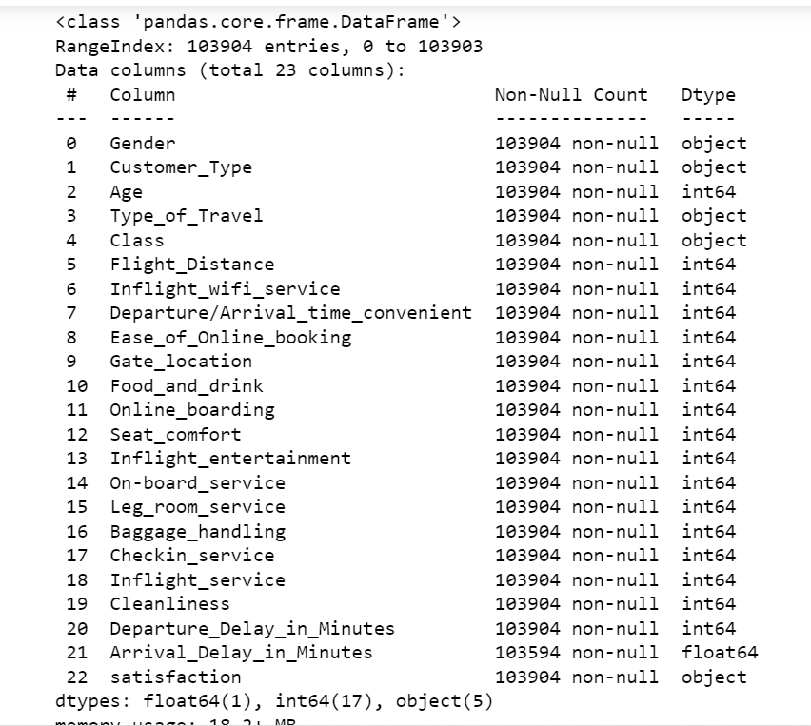
BASIC PROPERTY OF DATASET
Variable categorization :
Independent variables:
Numerical column: 18
Categorical column: 4
Column with Null values : 1
Target variable:
Categorical - 1
Shape of the dataset:
103904 rows and 23 columns

Slide 4
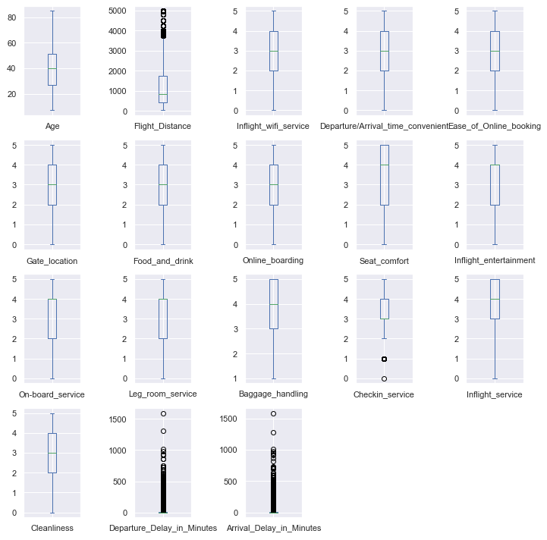
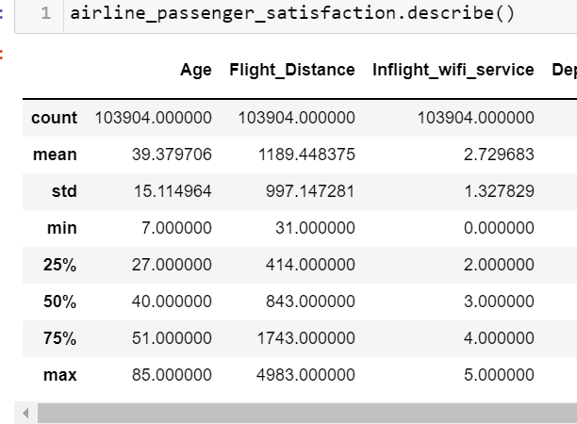
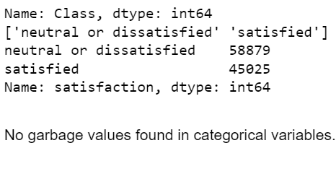
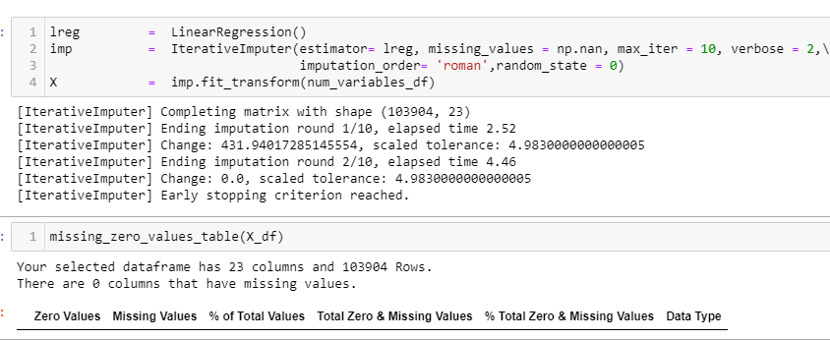
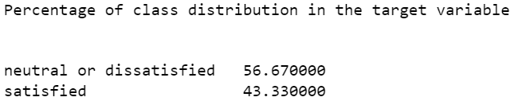
Data Processing
Data Description
Outlier Treatment
We check outliers on all variables and treat on four continuous numerical with IQR.
Handling Missing Values
Class Imbalance
We have no missing values in our dataset. We used IterativeImputer to treat missing values found in 1 column.

Slide 5
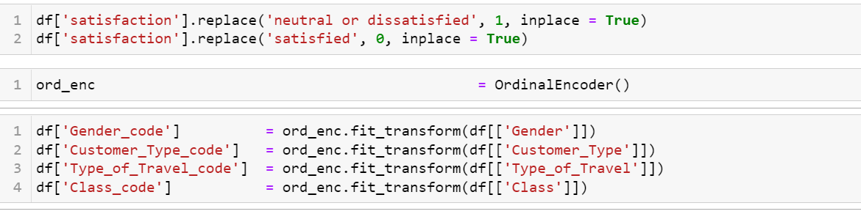

Feature Engineering
Overview: used columns:
Gender code, Customer Type code, Type of Travel code, Class code
Encoding
Used OrdinalEncoding (Refer fig: 5.1)
Normality Test: All the four continuous numerical variables are not normally distributed based on the Shapiro test and its skewness and kurtosis value. (Refer fig: 5.2)
Normalization: used log transformation and value of skewness and kurtosis has gone down significantly but still data is not normally distributed.
Fig 5.1
Column Name | SKEWNESS | Kurtosis | Shapiro Test p <= alpha( = 0.05) : reject H0, not normal. p > alpha( = 0.05) : fail to reject H0, normal.
Age | -0.004516 ,not normally distributed has more weight in the right tail of the distribution. | -0.719591 ,not normally distributed and platykurtic. | Statistics = 0.988, p = 0.000 Age Sample does not look Gaussian (reject H0)
Flight Distance | 1.109450 , not normally distributed and has more weight in the left tail of the distribution. | 0.268465 ,not normally distributed and platykurtic. | Statistics = 0.864, p = 0.000 Sample does not look Gaussian (reject H0)
Departure Delay in Min | 6.733882 ,not normally distributed and has more weight in the left tail of the distribution | 100.262123 ,not normally distributed and leptokurtic. It signifies that it tries to produce more outliers rather than the normal distribution. | Statistics = 0.423, p = 0.000 Sample does not look Gaussian (reject H0)
Arrival Delay in Min | 6.564658 ,not normally distributed and has more weight in the left tail of the distribution | 93.505029 ,not normally distributed and leptokurtic. It signifies that it tries to produce more outliers rather than the normal distribution. | Statistics = 0.429, p = 0.000 Sample does not look Gaussian (reject H0)
Fig 5.2
Fig 5.3

Slide 6
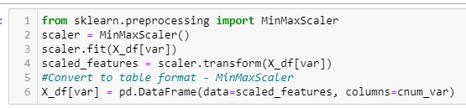
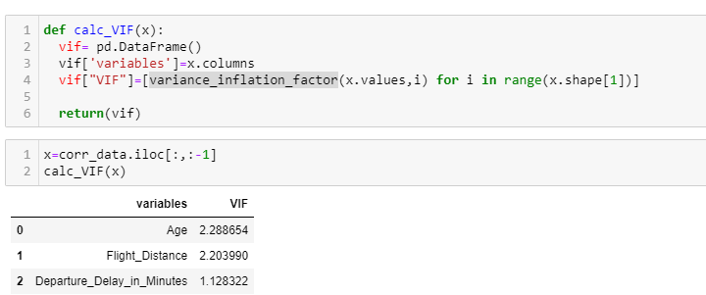
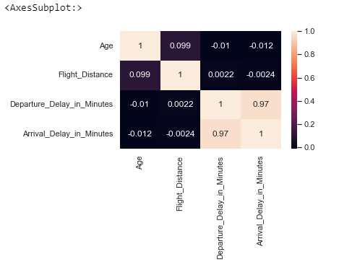
Feature Scaling: we use min max scaler instead of standard scalar. This can help in improve performance of Logistic Regression, SVM etc. (Refer fig: 6.1)
Multicollinearity Detection
Using correlation matrix and variance_inflation_factor.
VIF is less than for 5 for continuous numerical variables, hence it is evident that multicollinearity is absent in them. (Refer fig: 6.2, 6.3)
Fig 6.1
Fig 6.3
Fig 6.2

Slide 7
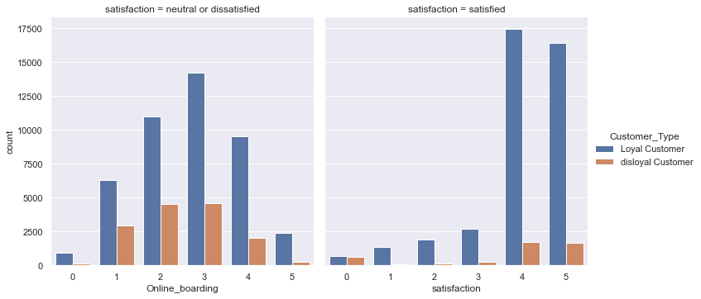
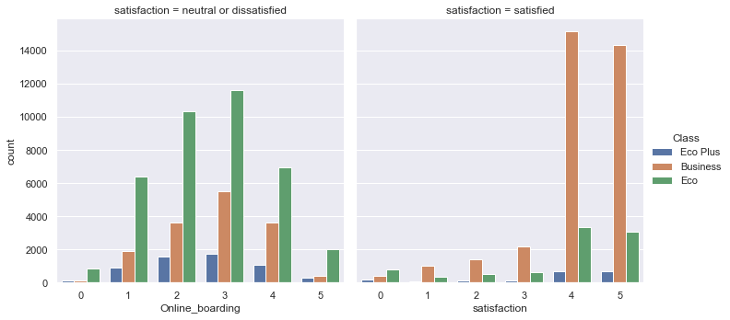
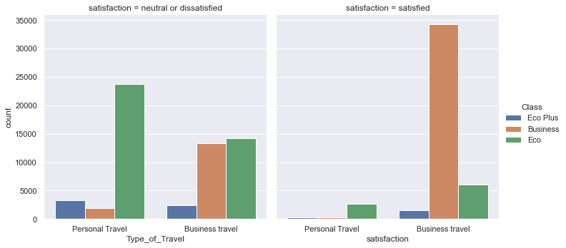
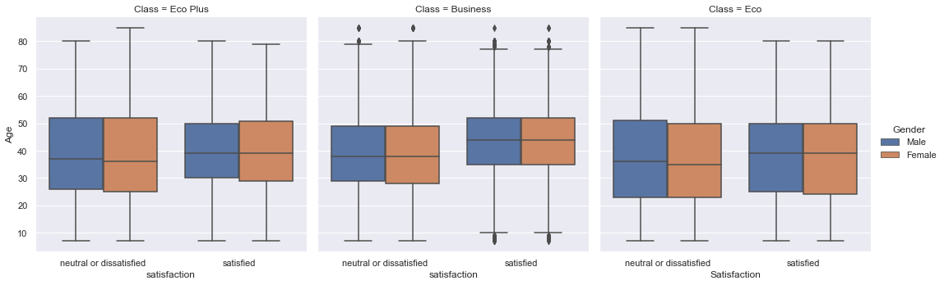
Validating Inferences Using Visualizations
 | Frequent flyers are more likely to be loyal customers.
 | Customer Prefer Business class more than other Class types.
 | Business Class customers travelling for Business purpose are more satisfied than then those travelling for personal use.
 | Economy and business class passengers are more dissatisfied for both gender. Also there are outliers present in the satisfaction and dissatisfaction column for the business class.

Slide 8
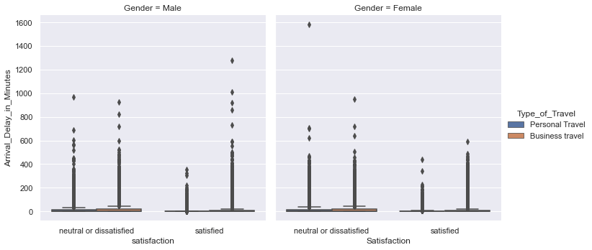
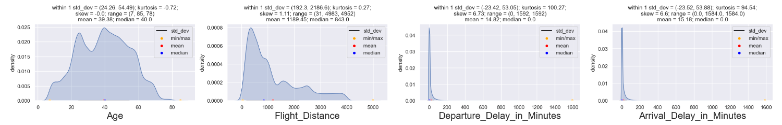
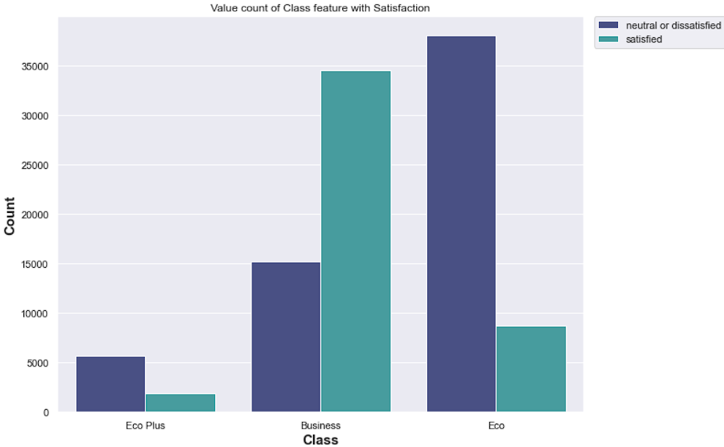
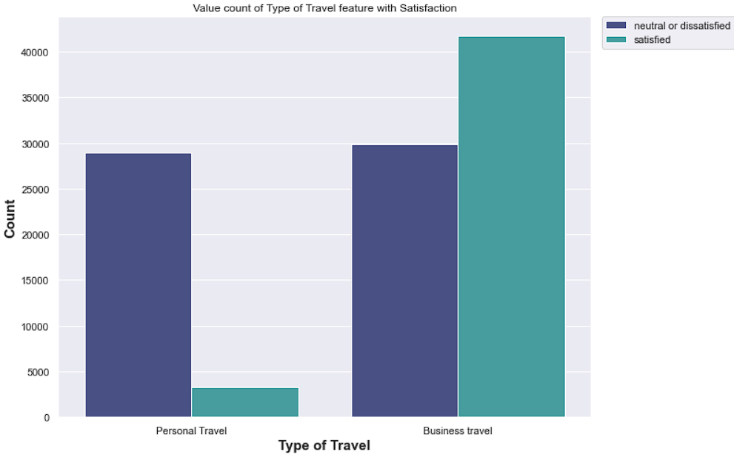
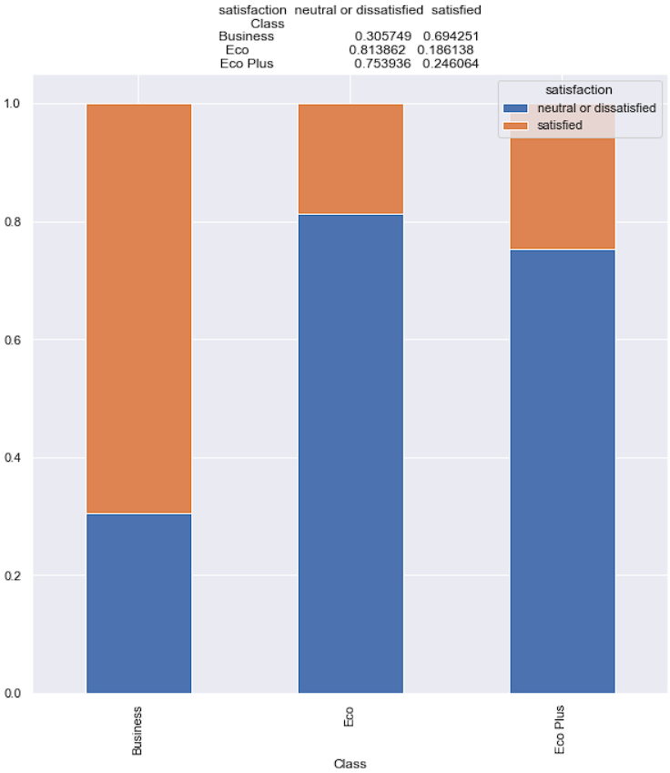
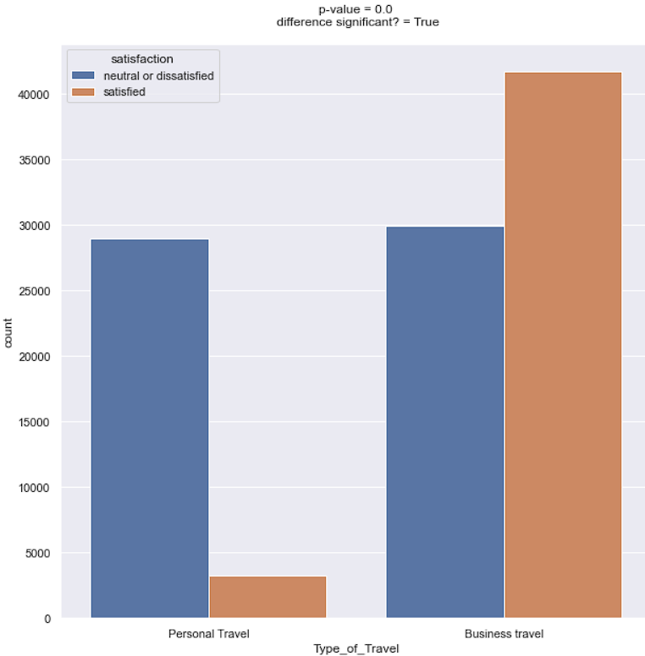
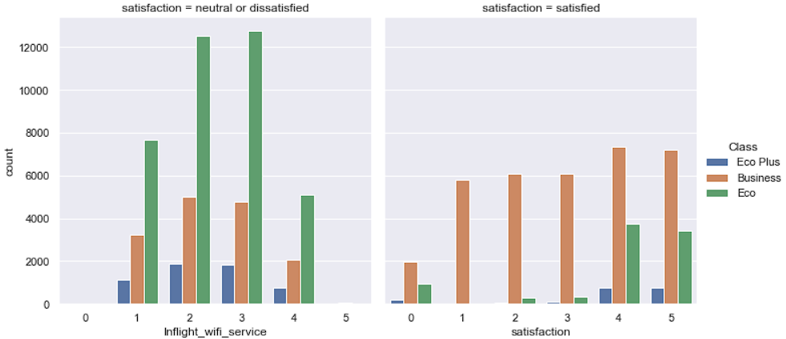
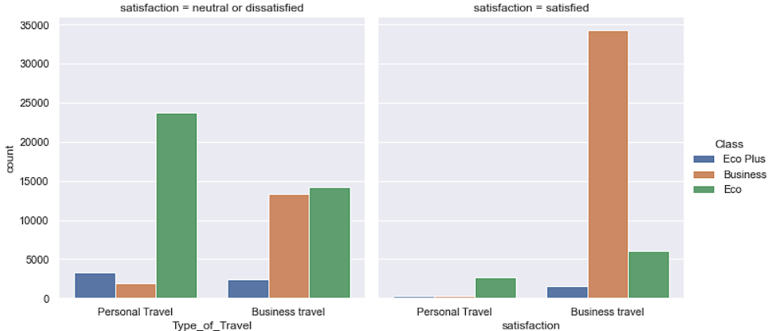
 | Two graphs show the relation of the target variable with Departure and Arrival of flights that how the target variable gets effected by these two variables.
 | Univariate Analysis Avg age is 40 years and passengers are between 20 and 60 yrs. Avg flight dis is 1190km Avg delay in departure is 14min Avg delay in arrival is 15min
 | Bivariate Analysis These graphs shows relation between Type of travel and class of the travel w.r to target variable. Statistical analysis is done here. (Chi-Square test).
 | Multivaraiate Analysis These graphs shows relation between Type of travel and class of the travel w.r to target variable.

Slide 9
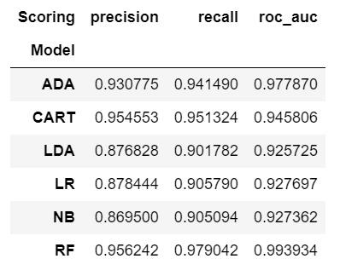
BASE MODEL BUILDING:
Dataset has target variable as categorical hence we can compared all models and do spot check on their performances basis roc_auc, precision and recall.
Logistic Regression
Decision Tree Classifier
Gaussian NB
Random Forest Classifier
AdaBoost
Linear Discriminant Analysis
When model doesn’t give better results then ensemble methods like Random Forest, Boosting
methods can be implemented to get better results
Metrics to evaluate the model
AUC score
Accuracy score
We observe that both Decision Tree and Random Forest models have recall score above 95%. However, Logistic Regression model which has excellent explanatory power gives a good performance measure (0.9058). So, we check if the assumptions of Logistic Regression model are satisfied before using them.

Slide 10
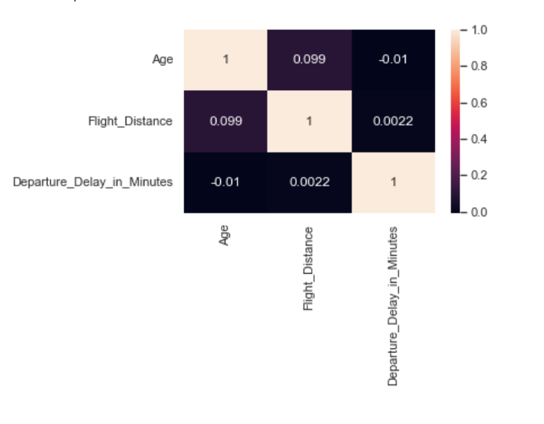
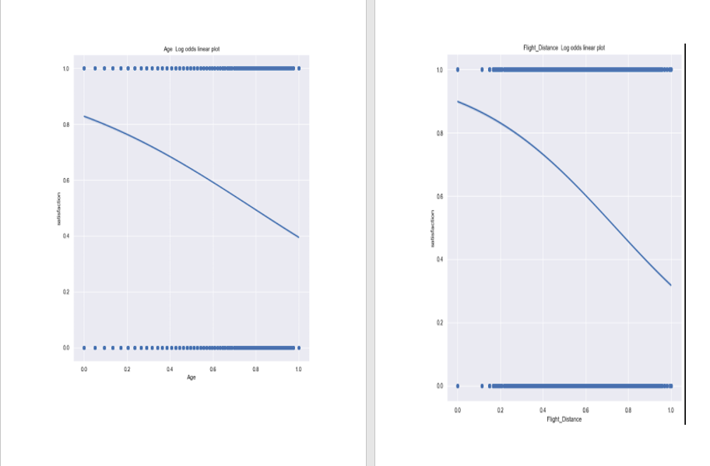
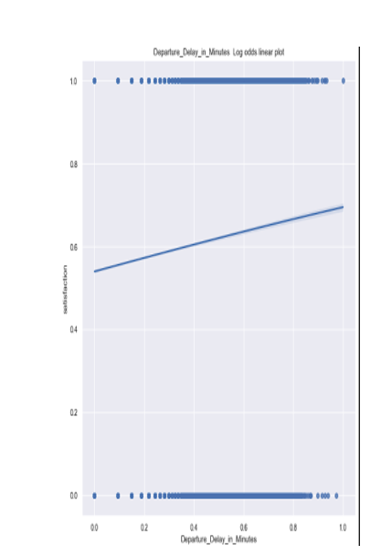
Checking the assumptions:
1) Binary logistic regression requires the target / dependent variable to be binary.
For a binary regression, the factor level 1 of the dependent variable should
represent the desired outcome. In our case it is class 1 - Dissatisfied customers
2) Only the meaningful variables should be included.
We have ensured that there are no unwanted variables selected for model building.
3) The predictor variables should not be correlated to each other.
To check this assumption, we use correlation coefficient among the independent
variables. (Refer fig 10.1)
4) The independent variables are linearly related to the log odds
plot the independent variables in question and look for an S-shaped curve. (Refer fig 10.2)
5) Logistic regression requires quite a large number of observations.
We have 103904 rows and 23 columns; so, we have approximately 4518 observations per variable.
So, all the assumptions are satisfied.
Fig 10.1
Fig 10.2

Slide 11
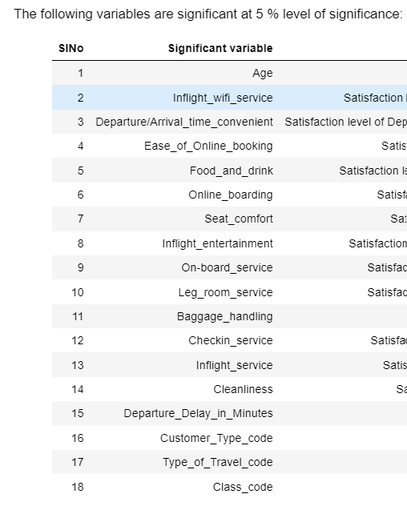
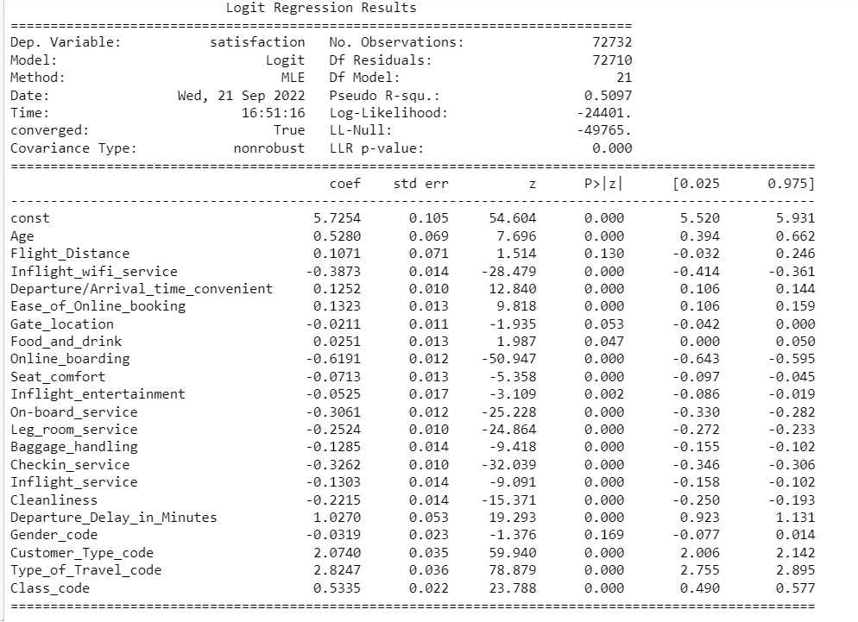
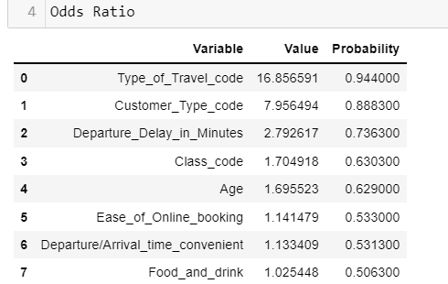
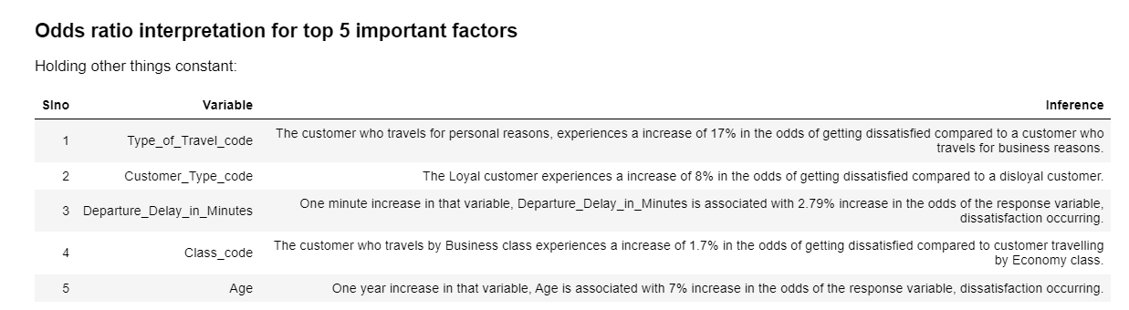
Results of Logistic Regression

Slide 12
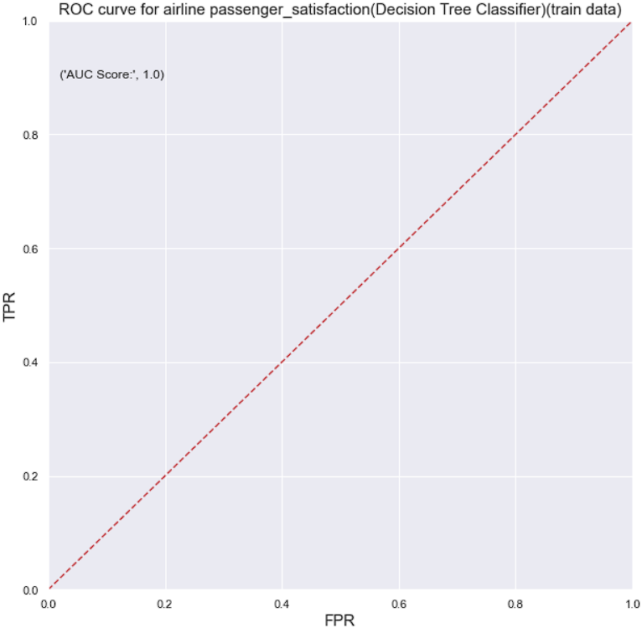
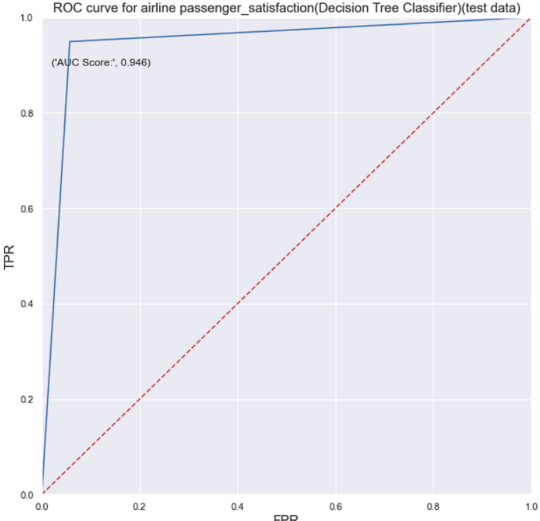
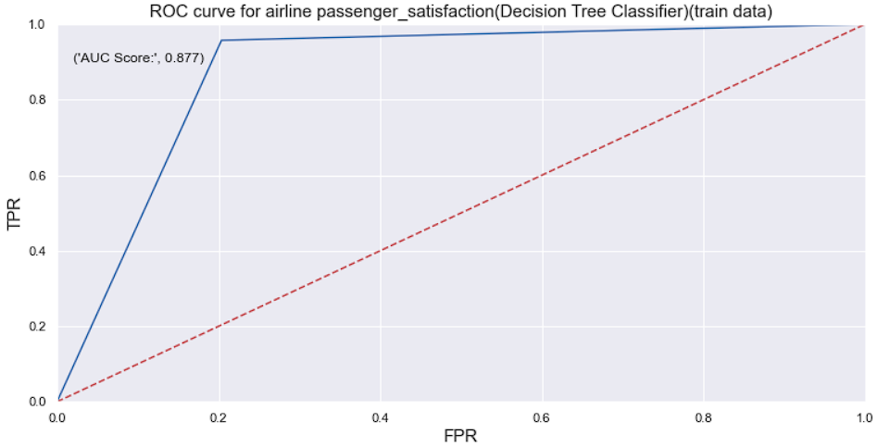
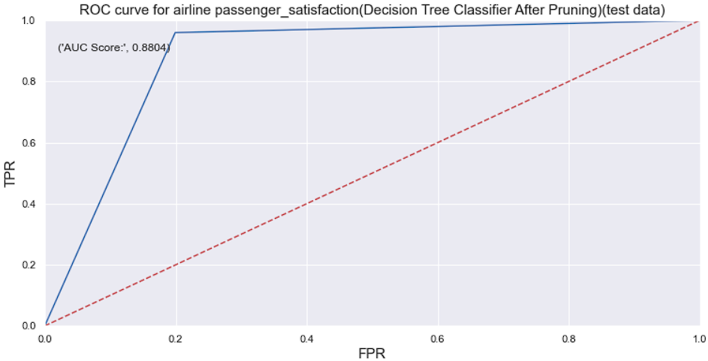
Decision Tree
Observations:
Area under Roc curve signifies how well model is able to discriminate between the two classes As our score is above 0.90 it can be considered to be very good i.e the model is able to predict the correct class very well. We can also see that training roc auc score and testing roc auc score are not that similar hence their is chance of overfitting. We know that DT are highly prone to overfitting unless they are pruned hence we consider pruning the model.
Get insights from the model:
Feature importance scores can provide insight into the model. Most importance scores are calculated by a predictive model that has been fit on the dataset. Inspecting the importance score provides insight into that specific model and which features are the most important and least important to the model when making a prediction. This is a type of model interpretation that can be performed for those models that support it.
Decision tree algorithms like classification and regression trees (CART) offer importance scores based on the reduction in the criterion used to select split points, like Gini or entropy.

Slide 13
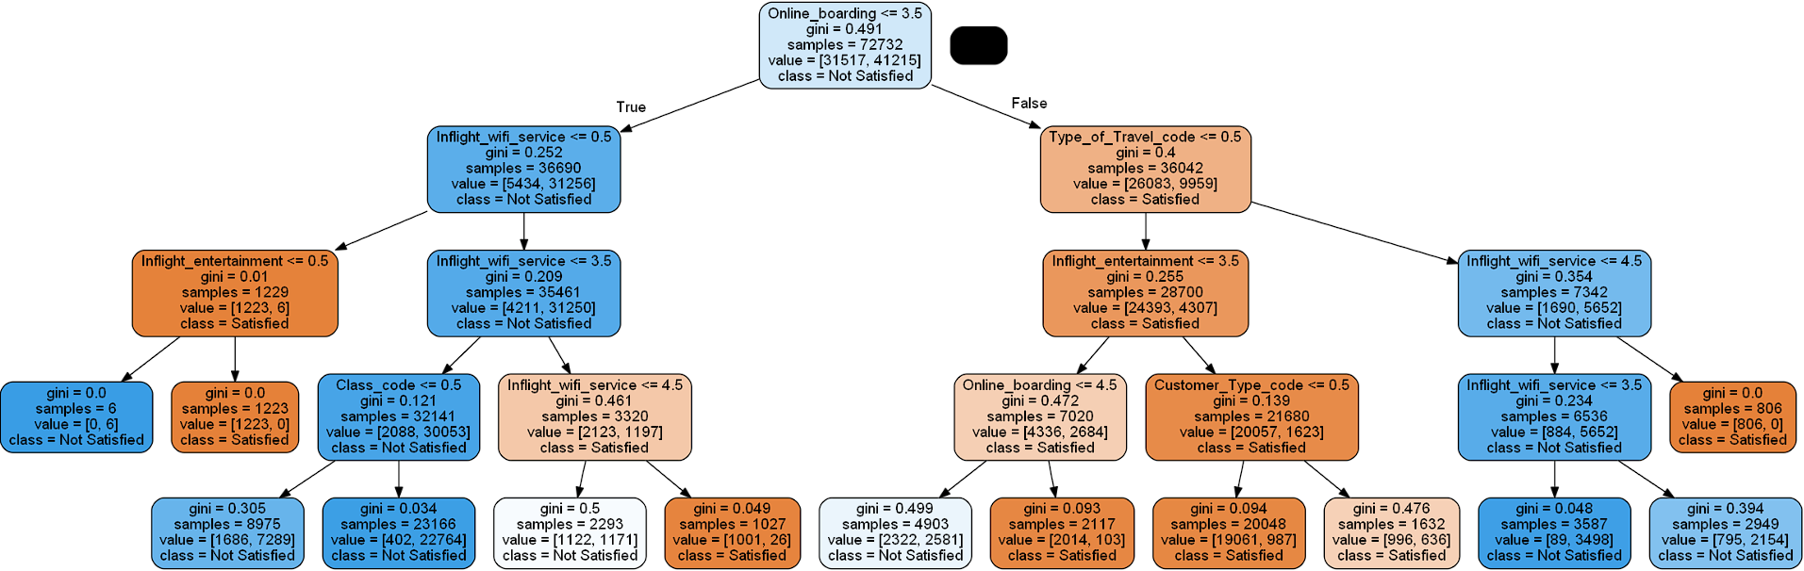
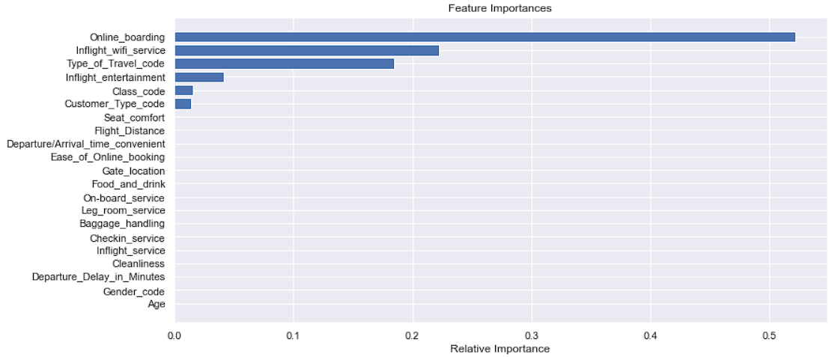
Pruning- Decision Tree
Observation:
From the Variable Feature Importance Graph we can infer that The following predictor variables influence the target variabl more then the rest of the predictor variables:
1) Online_Boarding 2) Inflight_wifi_service 3) Type_of_Travel_code 4) Inflight_entertainment 5) Customer_Type_Code.

Slide 14
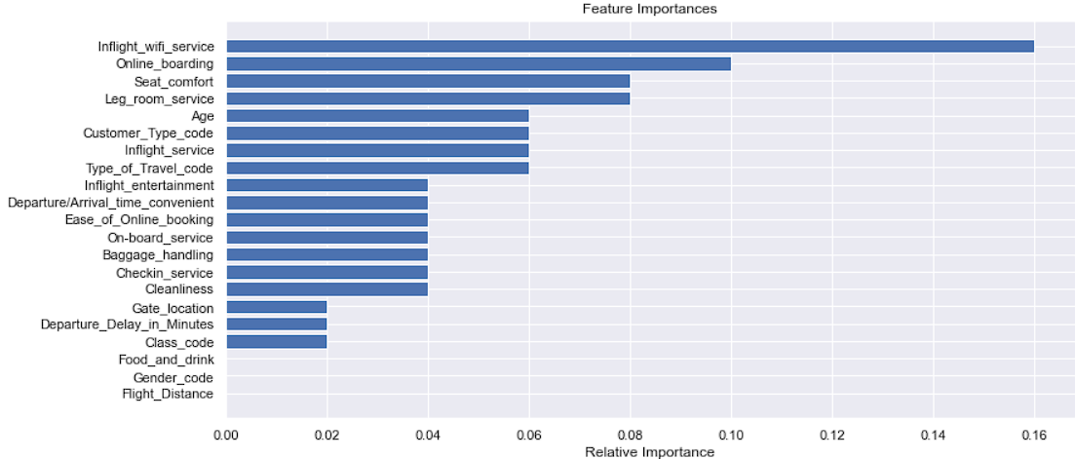
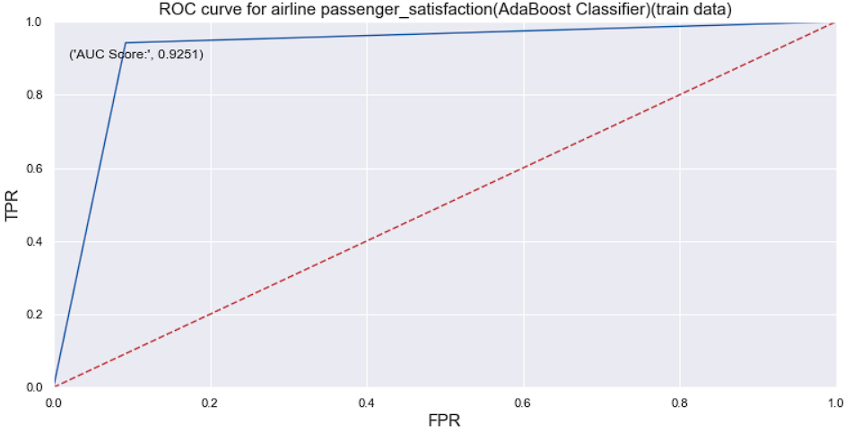
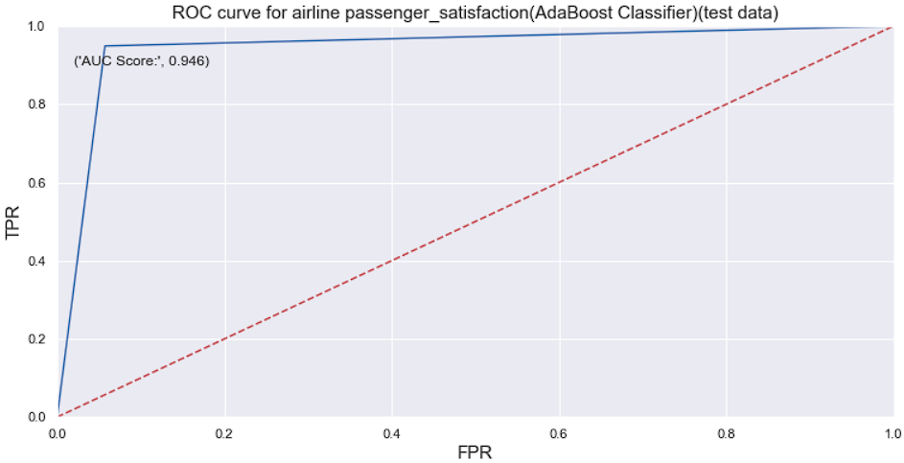
AdaBoost
Observation:
From the Variable Feature Importance Graph we can infer that The following predictor variables influence the target variabl more then the rest of the predictor variables:
1) Inflight_wifi_service 2) Online_Boarding 2) Seat_Comfort 3) Leg_Room_Service 4) Age 5) Customer_Type_Code 6) Inflight Service 7) Type of Travel Code.

Slide 15
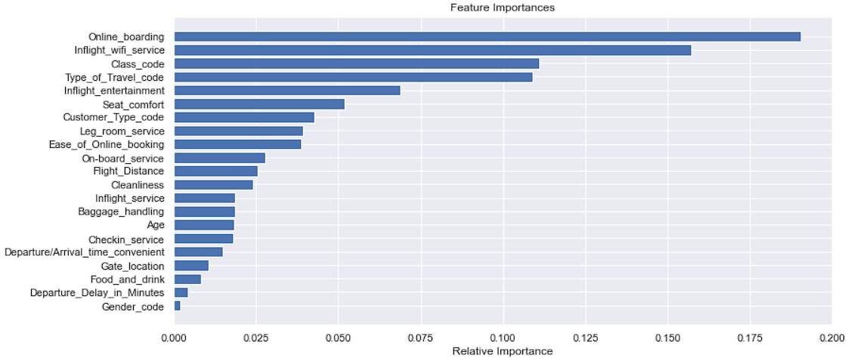
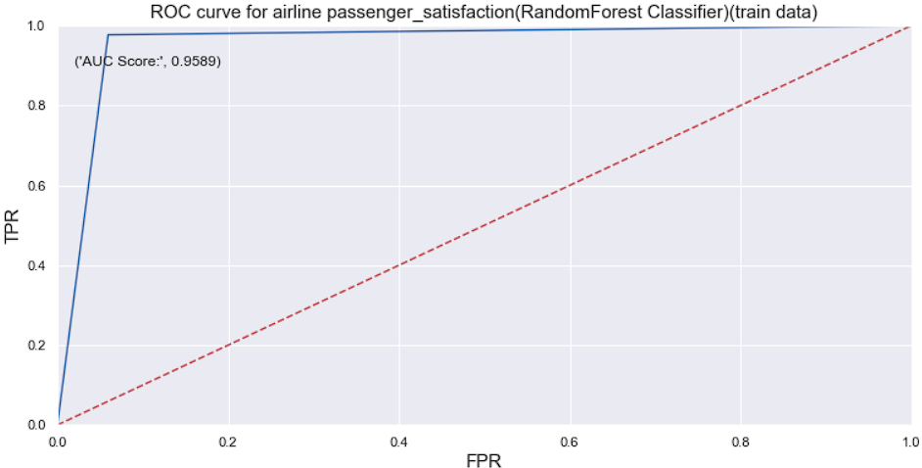
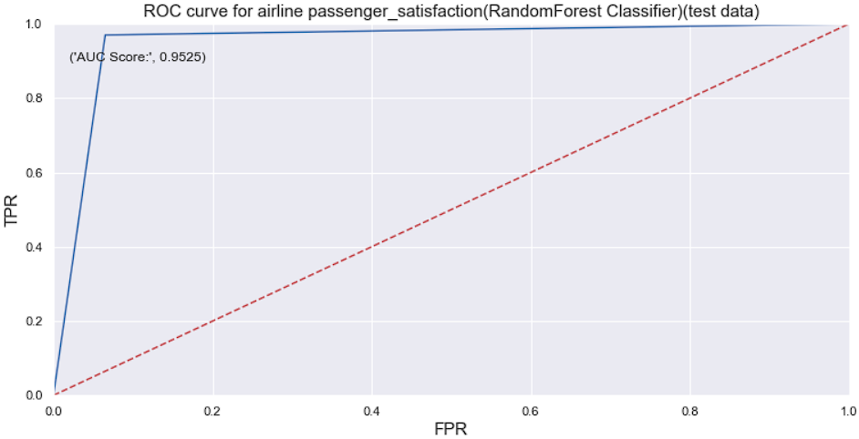
Random Forest
Observation
From the Variable Feature Importance Graph we can infer that The following predictor variables influence the target variabl more then the rest of the predictor variables:
1) Online_Boarding 2) Inflight_wifi_service 3) Class code 4) Type_of_Travel_code 5) Inflight_entertainment.

Slide 16
Conclusion
We can conclude that Random Forest gives us the best performance out of all the variants.
And from all the models below variables as per each model are influcing the target variable the most.
Decision Tree-Pruning:
1) Online_Boarding 2) Inflight_wifi_service 3) Type_of_Travel_code 4) Inflight_entertainment 5) Customer_Type_Code
AdaBoost:
1) Inflight_wifi_service 2) Online_Boarding 2) Seat_Comfort 3) Leg_Room_Service 4) Age 5) Customer_Type_Code 6) Inflight Service 7) Type of Travel Code
Random Forest:
1) Online_Boarding 2) Inflight_wifi_service 3)Class code 4) Type_of_Travel_code 5) Inflight_entertainment
Logistic Regression:
1) Type_of_Travel_code 2) Customer_Type_Code 3) Departure_Delay_in_Minutes 4) Class_Code and 5) Age
Here From the above measures we can conclude that 1) Type_of_travel_code 2) Customer_type_code 3) class_code.
has appeared in most of the models which are influencing the target model.

Slide 17
THANK YOU

