Slide 1
DEEPIKAA V
71772117301
3/21/2024 Annual Review

Slide 2
PROJECT TITLE
LSTM-based Next Word Prediction in NLP
3/21/2024 Annual Review

Slide 3


AGENDA
PROBLEM STATEMENT
PROJECT OVERVIEW
WHO ARE THE END USERS?
YOUR SOLUTION AND ITS VALUE PROPOSITION
THE WOW IN YOUR SOLUTION
MODELLING
RESULTS
3/21/2024 Annual Review

Slide 4

PROBLEM STATEMENT
Developing an LSTM-based model for predicting the next word in a sequence in NLP is vital for text generation, machine translation, and speech recognition.
Traditional methods often fail to capture long-term dependencies and contextual nuances accurately.
Leveraging LSTM's ability to capture such dependencies, the model aims to predict the next word in a sentence accurately, enhancing various NLP applications.
3/21/2024 Annual Review

Slide 5
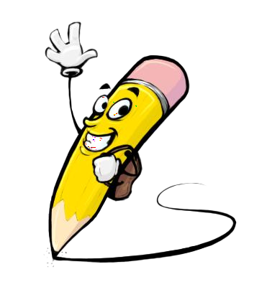
PROJECT OVERVIEW
This project aims to build an LSTM-based model for predicting the next word in a sequence, addressing a critical challenge in Natural Language Processing (NLP).
By leveraging LSTM's ability to capture long-term dependencies, the model aims to enhance accuracy in text generation, machine translation, and speech recognition tasks.
Key components include data acquisition, LSTM model construction, training, evaluation, and deployment.
Successful completion will lead to a robust prediction system, revolutionizing various NLP applications and advancing language understanding technologies.
3/21/2024 Annual Review

Slide 6

WHO ARE THE END USERS?
The end users of the LSTM-based next word prediction model in Natural Language Processing (NLP) can vary depending on the deployment context and application. Some potential end users include:
Content Creators and Writers
Language Learners
Translation Services
Virtual Assistants and Chatbots
Accessibility Tools
Educational Institutions
Researchers and Developers
3/21/2024 Annual Review

Slide 7

YOUR SOLUTION AND ITS VALUE PROPOSITION
Solution: LSTM-Based Next Word Prediction Model in NLP
Our solution utilizes cutting-edge Long Short-Term Memory (LSTM) architecture to accurately predict the next word in a sequence, addressing critical challenges in Natural Language Processing (NLP).
Its contextual understanding ensures coherent and relevant predictions, improving user experience across various applications.
With streamlined workflows and increased efficiency, our model saves time and effort for users, while its versatility allows adaptation to diverse domains and languages, making it indispensable for writers, language learners, and professionals alike.
3/21/2024 Annual Review

Slide 8

THE WOW IN YOUR SOLUTION
Our LSTM-based next word prediction model is not just another NLP solution—it's a game-changer.
By seamlessly integrating cutting-edge technology with advanced linguistic understanding, our model revolutionizes the way we interact with language.
Its ability to accurately predict the next word in a sequence, even in complex contexts, leaves users in awe.
With unparalleled accuracy, efficiency, and versatility, our solution sets a new standard in NLP, empowering users to communicate effortlessly and unlock new possibilities in text generation, translation, and beyond.
Experience the wow of next-level language processing with our LSTM-based model—it's more than just impressive; it's transformative.
3/21/2024 Annual Review

Slide 9
MODELLING
Model Design:
We define the architecture of our LSTM-based neural network. We create a Sequential model using Keras, adding an Embedding layer to convert input sequences into dense vectors of fixed size.
Training the Model:
Next, we train the model on our training data (`X_train`, `y_train`) for a specified number of epochs and batch size. We also validate the model's performance on a validation set (`X_val`, `y_val`) during training to monitor its progress.
Prediction:
To predict the next word in a sequence, we define a function `predict_next_word` that takes a trained model, tokenizer, and input sequence as inputs.
3/21/2024 Annual Review

Slide 10
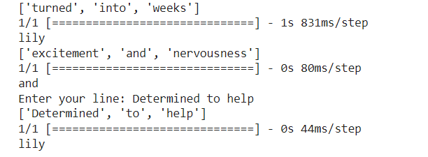
RESULTS
Enter your line: Determined to help (our input)
[‘Determined ’, ‘to’, ‘help’] (takes the last three words of our input)
lily (return a next word)
https://colab.research.google.com/drive/1AXrT7iE-pL357vUciCckyPOEzFARzRuz?usp=sharing
3/21/2024 Annual Review

