Slide 1
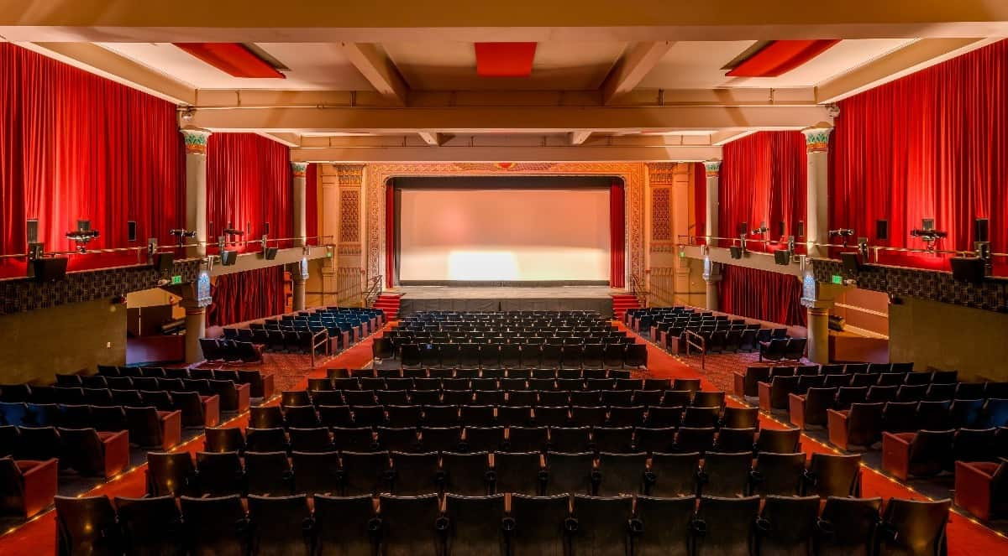
MOM
CAPSTONE PRESENTATION
MOVIE RENTAL DATA ANALYSIS
MENTOR’S NAME- MS.SHRUTI GODE
PRESENTED BY- DEEPIKA TYAGI

Slide 2
BUSINESS OBJECTIVES:
To analyze the data to understand what kind of movies and actors are often rented by the help of which it is easy to increase the rental rate of movies.
To understand that which genres of movies is highly in demand.
To maintain the stock of inventory of such movies which are highly in demand by audience.

Slide 3
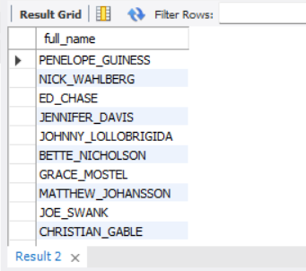
Task-1:Display all the full names of actors available in the database.
INTERPRETATION:
200 actors full name which has been extracted from actor table.

Slide 4
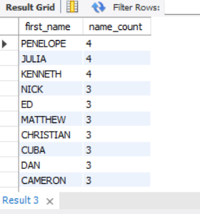
(A) : Display the number of times each first name appears in the database.
TASK-2-Management wants to know if there are any names of the actors appearing frequently.
INTERPRETATION:
128 names of actors with the name count.

Slide 5
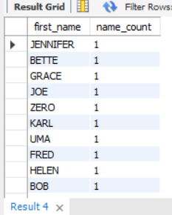
(B):What is the count of actors that have unique first name in the database? Display the first name of all these actors.
INTERPRETATION:
76 unique first name of actors with the name count available in the database.

Slide 6
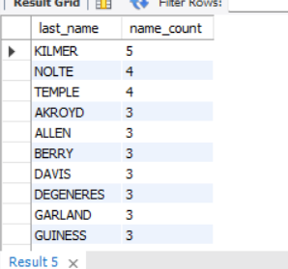
TASK-3- The management is interested to analyze the similarity in the last name of the actors. (A): Display the number of times each last name appears in the database.
INTERPRETATION:
121 unique last name of actors with the name count available in the database.

Slide 7
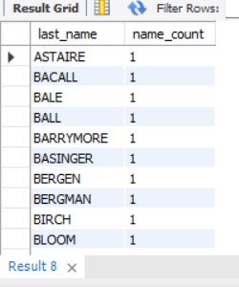
(B):Display all unique last name in the database.
INTERPRETATION:
66 last name of actors with name count in the database.

Slide 8
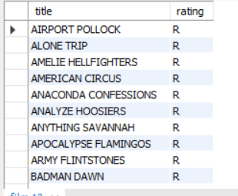
TASK-4:The Management wants to analyze the movies based on their rating to determine if they are suitable for kids or some parental assistance is required. Perform the following tasks to perform required analysis. (A) Display the list of records of the movies with rating 'R'.(The movies rating with 'R' are not suitable for audience under age 17 years.
INTERPRETATION:
A list of 195 movies with ‘R’ rating,i.e; the movies which are not suitable for audience under age 17 years.

Slide 9
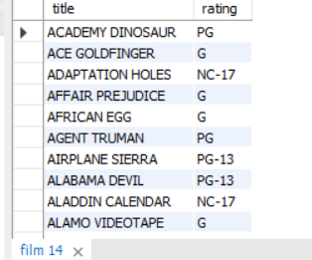
TASK-4 (B): Display the list of records for the movies that are not rated with 'R'.
INTERPRETATION:
List of 805 movies with rating other than ‘R’.

Slide 10
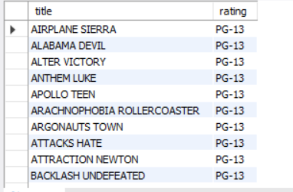
TASK-4 (C): Display the list of records for the movies that are suitable for the audience below 13 years of age.
INTERPRETATION:
There is a list of 223 movies with rating ‘PG-13’, the movies that are suitable for audience below 13 years of age.

Slide 11
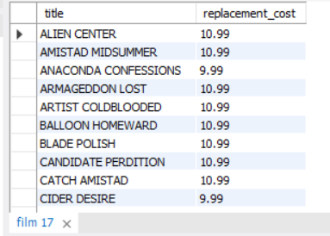
TASK-5 : The board member wants to understand the replacement cost of a movie copy.The replacement cost refers to the amount charged to the customer if the movie disc is not returned or is retuned in a damaged state. (A) Display the list of records for the movies where the replacement cost is up to $11.
INTERPRETATION:
90 movies where the replacement cost is up to $11

Slide 12
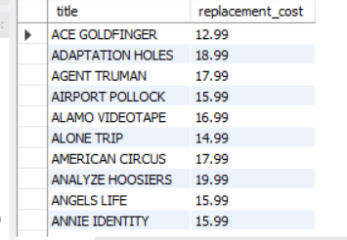
Task-5(B): Display the list of records for the movies where the replacement cost is between $11 and $20.
INTERPRETATION:
424 movies where the replacement cost is between $11 and $20.

Slide 13
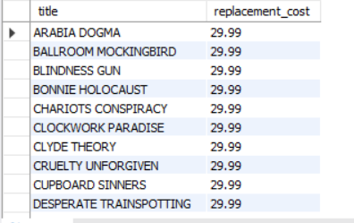
Task-5(C): Display the list of records for the movies in descending order of their replacement cost.
INTERPRETATION:
1000 movies recorded, where the replacement cost is in descending order.

Slide 14
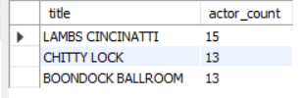
TASK-6 :Display the names of the top 3 movies with the greatest number of actors.
INTERPRETATION:
Movies name with the greatest number of actors by joining ‘Film’ and ‘Film_actor’ tables.

Slide 15
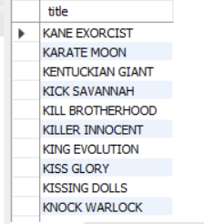
TASK-7: 'Music of Queen' and 'Kris Kristofferson' have seen an unlikely resurgence. As an unintended consequence, films starting with the letters 'K' and 'Q' have also soared in popularity. Display the titles of the movies starting with the letters 'K' and 'Q'.
INTERPRETATION:
15 movies titles starting with the letters 'K' and ‘Q’.

Slide 16
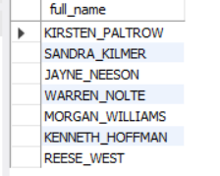
TASK-8:The film 'Agent Truman' has been a great success. Display the names of all actors who appeared in this film.
INTERPRETATION:
The film 'Agent Truman' has only 7 actors whose full name are shown in the adjacent snapshot.

Slide 17
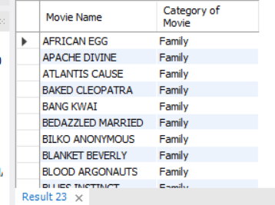
TASK-9:Sales have been lagging among young families, so the management wants to promote family movies. Identified all the movies categorized as 'Family Film'.
INTERPRETATION:
69 movies titles movies categorized as 'Family’.

Slide 18
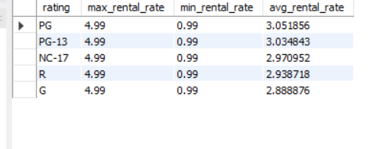
TASK-10:The management wants to observe the rental rates and rental frequencies. (Number of time the movie disc is rented) (A) Display maximum, minimum and average rental rates of movies based on their ratings. The output must be sorted in descending order of the average rental rates.
INTERPRETATION:
5 different types of rating with maximum, minimum and average rental rates of movies based on their ratings.

Slide 19
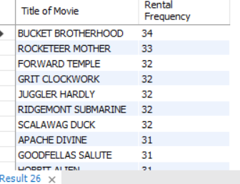
TASK-10(B):Display the movies in descending order of their rental frequencies, so the management can maintain more copies of those movies.
INTERPRETATION:
958 records of movies title, with descending order of their the rental frequency.
So, now it will be easy to maintain more copies of movies, those are in demand basis on their rental rates.

Slide 20
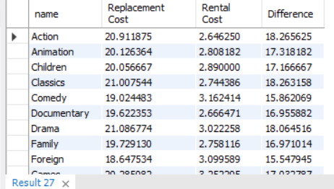
TASK-11(A): In how many film categories, the difference between the average film replacement cost and the average film rental rate is greater than $15?
INTERPRETATION:
15 film categories in which the difference between the average film replacement cost and the average film rental rate is greater than $15.

Slide 21
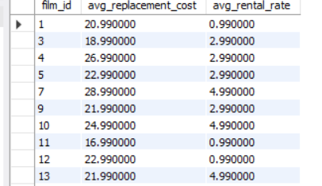
TASK-11(B): Display the list of all film categories identified above, along with the corresponding average film replacement cost and average film rental rate.
INTERPRETATION:
568 film categories along with the corresponding average film replacement cost and average film rental rate.

Slide 22

TASK-12: Display the film categories in which the number of movies is greater than 70.
INTERPRETATION:
Only 2 film categories ‘Foreign’ and ‘Sports’ in which count of movies is greater than 70.

Slide 23
CONCLUSION &RECOMMENDATIONS:
As we have solved all given tasks successfully, for data analyzation of Sakila Database in order to the increase the profit in Business. On the basis of solution of tasks for improving the growth of Business in a good way, some recommendations are as follows-
Movies with rating PG has more avg rental rate, so in order to increase rental rate we should promote this type of movies more as we can.
The movies with higher replacement cost i.e.; $29.99 should promote more so that maximum profit can be earn.
By knowing higher rental rate movies, the stock must be maintained properly of inventory with highly demanding movies.
‘Family’ category movie should promote more and stock should be maintain accordingly.

Slide 24


