Slide 1
CAPSTONE PRESENTATION TDMB MOVIE DATA ANALYSIS
MENTOR’S NAME – MS.SHRUTI GODE
PRESENTED BY- DEEPIKA TYAGI

Slide 2
BUSINESS OBJECTIVES:
Production company wants to analyze the movie data. Basically they wants to upgrow the business, so for the same they want some powerful insights with python programming.
to know that which kind of movie is high in demand and which genre is the popular among audience and so on.
TO UNDERSTAND THE RELATION BETWEEN POPULARITY AND BUDGET,IF ANY.
TO IDENTIFY THE MOVIES WITH THE HIGHEST BUDGET AND LOWEST BUDGET.
TO FIND THE TOP PRODUCTION COMPANIES BY WHICH HIGHEST NUMBER OF MOVIES ARE PRODUCED WHICH ARE IN DEMAND.

Slide 3
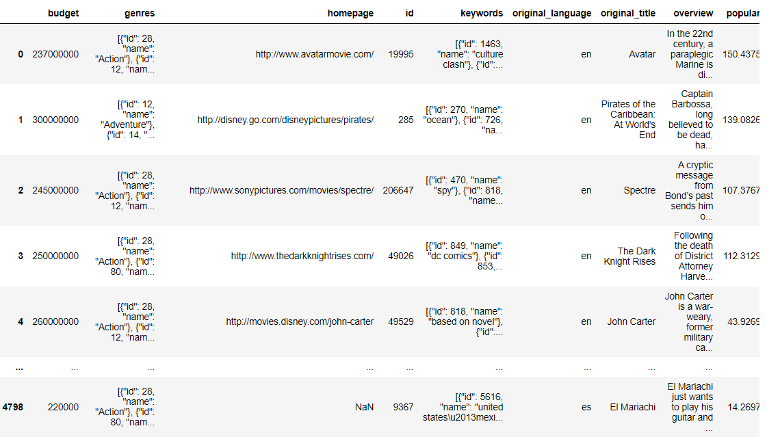
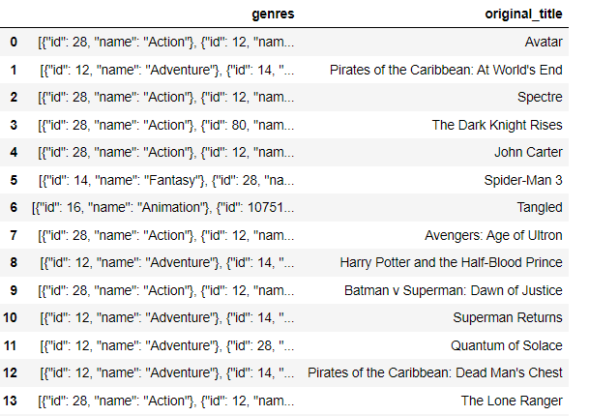

Task-1:Load the movie dataset in python notebook.Display the number of rows and columns in the dataset.Display the title and genres of the first 50 movies in the dataset.
INTERPRETATION: During Data Pre-processing using Python, firstly we have loaded the dataset in Jupyter notebook via various libraries of Python. There are 4803 rows and 20 columns in our dataset.

Slide 4
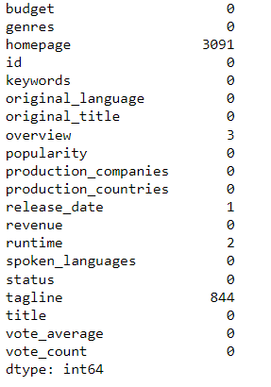
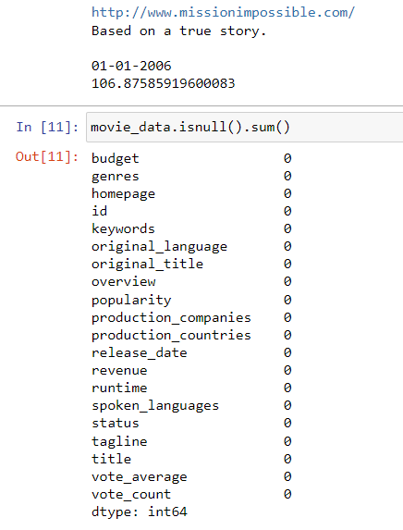
TASK-2 : Identify the columns that have null values and perform null values treatment.(Choose the imputation method based on the type of data in the columns of the dataset.)
INTERPRETATION: Later on we have checked the Null value in the dataset, and we have found 5 columns with null value ,so in order to fill the null value ,we are replacing the null values with measure of central tendency as per requirement.

Slide 5
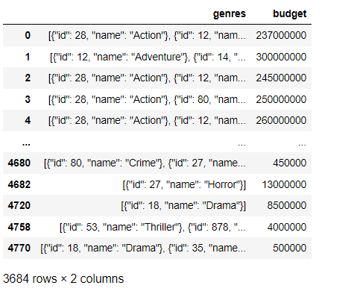
TASK-3 :Display the movie categories that have budget greater than $220,000.
INTERPRETATION:
We got 3684 MOVIE CATEGORIES that have budget greater than $220,000.on the basis of which we can say that ‘ACTION’ & ‘ADVENTURE’ ARE ON TOPMOST.

Slide 6
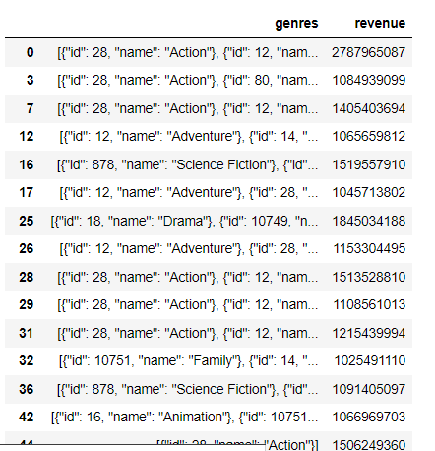
TASK-4- Display the movie categories where the revenue is greater than $961,000,000.
INTERPRETATION:
THERE ARE 480 MOVIE CATEGORIES that have revenue is greater than $961,000,000. IT SHOWS THAT ‘ACTION’,’ADVENTURE’,’SCIENCE FICTION’ &’DRAMA’ ARE MOVIE CATEGORIES WITH THE HIGHEST REVENUE.

Slide 7
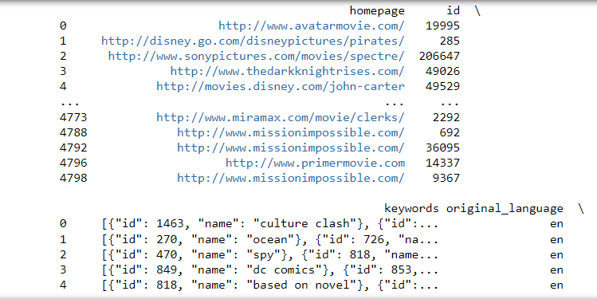
TASK-5: the dataset,there are some movies for which the budget and revenue columns have the value 0,which mean unknown values.Remove the rows with value 0 from both the budget and revenue columns.
INTERPRETATION:
After removing the rows with value 0 from both the budget and revenue columns, there ARE 64580 records of movie that we are having as output.

Slide 8
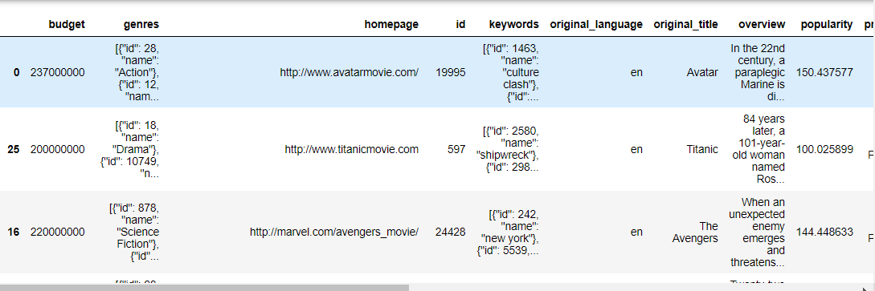

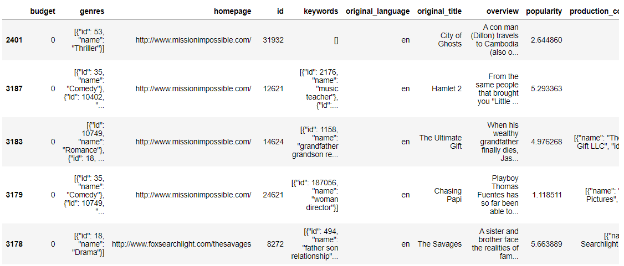
TASK-6:List the top 10 movies with the highest revenues and the top 10 movies with the least budget.

Slide 9
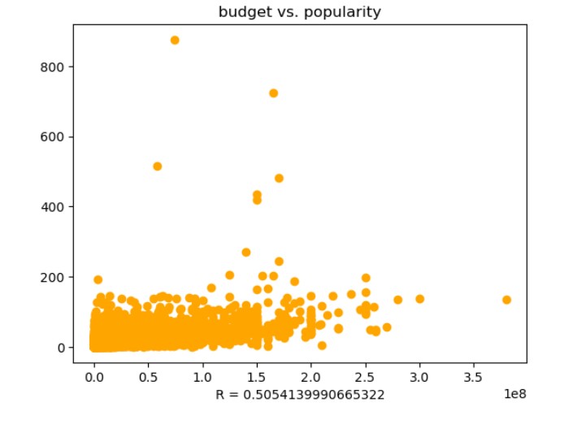
TASK-7: How are popularities of movies related with the movie budget?Are correlated or totally uncorrelated to each other?Write interpretation of your analysis.
INTERPRETATION:
there is a positive correlation between Movie Budget & the popularity with a moderate correlation coefficient.

Slide 10
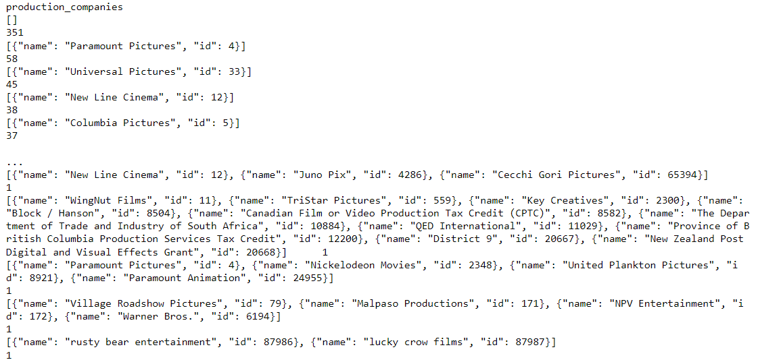
TASK-8: Identify and display the names of all production companies along the number of times they appeared in the dataset.
INTERPRETATION: Here we are having 351 records with production companies, ‘PARAMOUNT PICTURES’ APPEARED THE MAXIMUM NUMBER OF TIMES I.E; 58 IN THE DATASET.

Slide 11
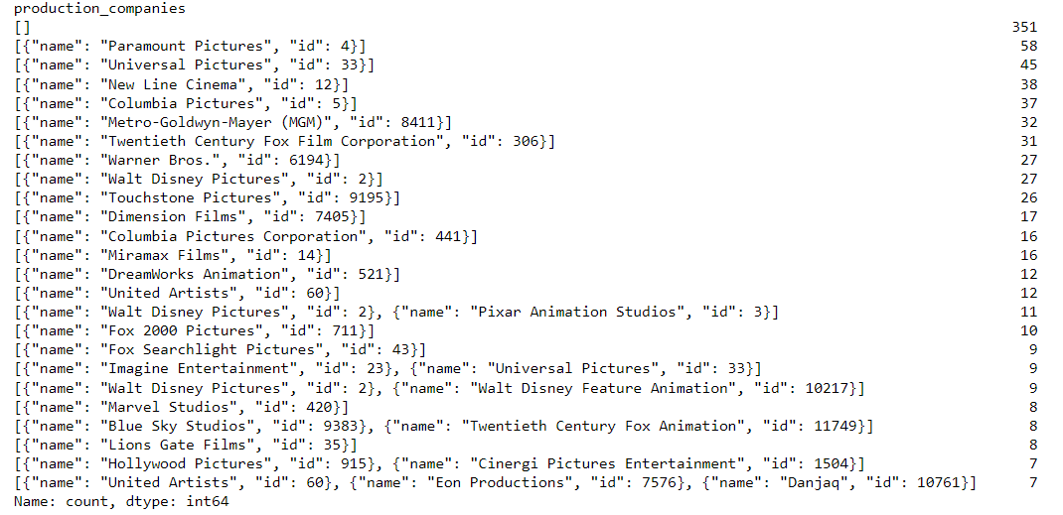
TASK-9:Display the name of top 25 production companies based on the number of movies they have produced in descending order of the number of movies produced.
INTERPRETATION: ‘paramount pictures’ produced maximum number of movies, followed by ‘universal pictures’ and so on.

Slide 12
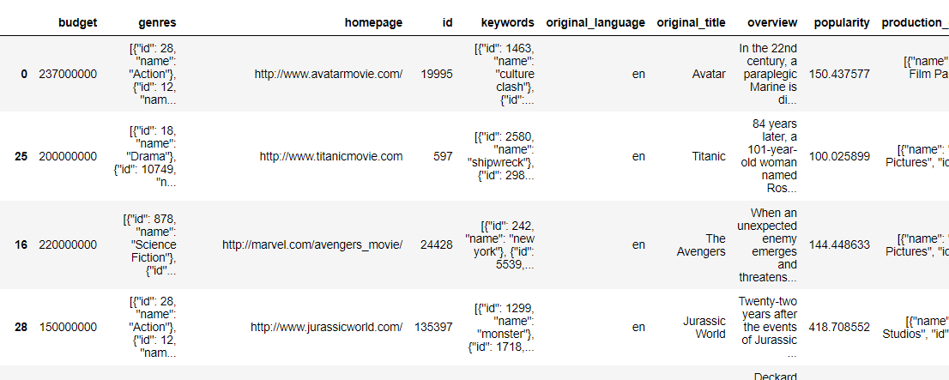
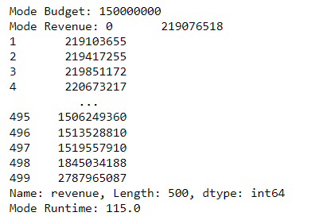


Task-10: Sort the data in descending order based on revenue and filter 500 movies.Find the measures of central Tendency for the three columns given below here i)MEAN ii) MEDIAN iii)MODE PERFORM THE OUTLIER ANALYSIS FOR ABOVE THREE COLUMNS USING BOX PLOTS.

Slide 13
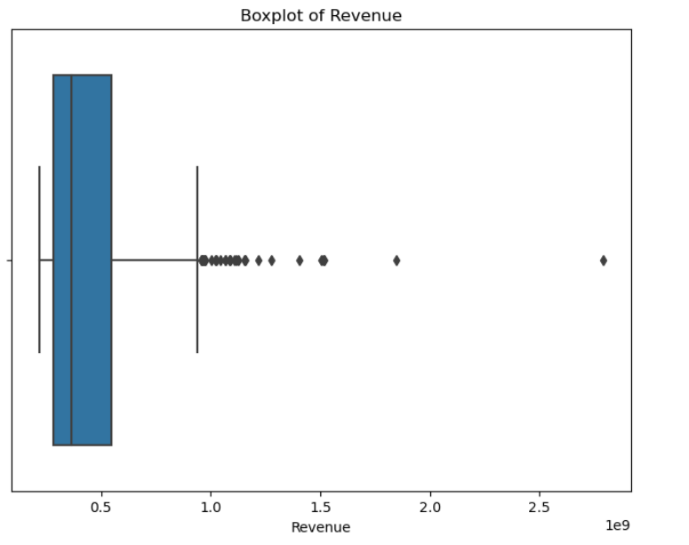
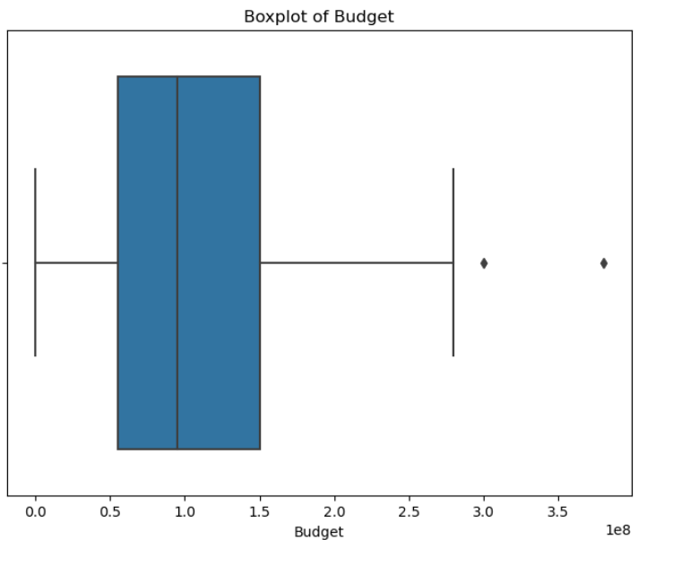
OUTLIER ANALYSIS USING BOX PLOT
INTERPRETATION: BOX PLOT IS SHOWING RIGHT SKEWNESS. THERE ARE SO MANY OUTLIERS VISIBLE IN ‘REVENUE' COLUMN.
INTERPRETATION: Box plot is showing right Skewness. There are only 2 outliers visible in 'Budget' column.

Slide 14
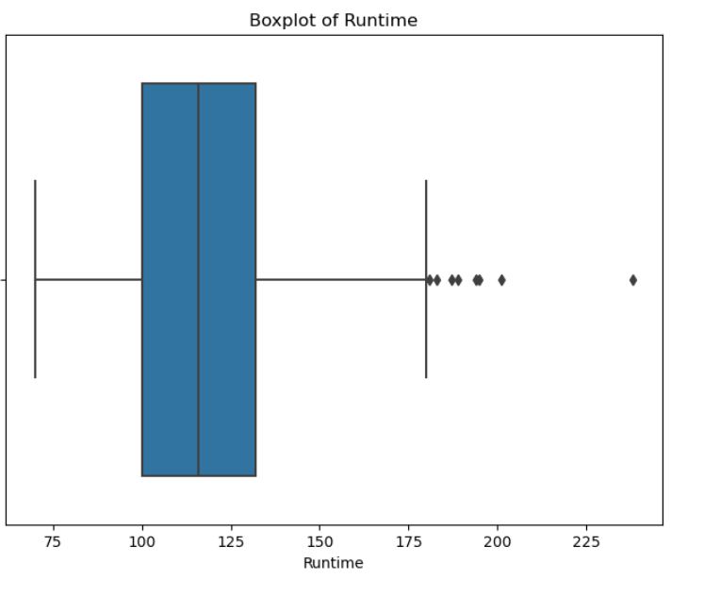
OUTLIER ANALYSIS USING BOX PLOT
INTERPRETATION: Box plot is showing right Skewness.There are also few outliers visible in 'Runtime' column.

Slide 15
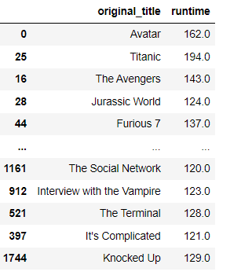
TASK-11:Identify and display the name of movies alongwith their runtimes for those movies that have above average runtime,using the data from previous task.
INTERPRETATION: 232 name of movies alongwith their runtimes for those movies that have above average runtime.

Slide 16
CONCLUSION:
As we have solved all given tasks successfully, SO ON THE BASIS OF WHICH THE FOLLOWING RECOMMENDATION MUST BE FOLLOWED FOR GETTING THE MAXIMUM PROFIT:
THE MOST POPULAR GENRES WHICH ARE HIGHLY IN DEMAND BY AUDIECE ARE ‘ACTION’, ‘ADVENTURE’,’SCIENCE-FICTION’ AND ‘DRAMA’.
“AVATAR” IS THE MOVIE WITH HIGHEST REVENUE,WHILE “CITY OF GHOSTS” IS THE MOVIE WITH LOWEST BUDGET.
THERE IS POSITIVE CORRELATION BETWEEN POPULARITY AND BUDGET OF THE MOVIES as well as BETWEEN BUDGET AND REVENUE.
“PARAMOUNT PICTURES” IS THE PRODUCTION COMPANY WITH THE HIGHEST NUMBER OF MOVIES THAT IS 48.

Slide 17
THANK YOU

