Slide 1

TECHNICAL PRESENTATION DATA SCIENTIST SALARY
MENTOR’S NAME- MS. SHRUTI GODE
PRESENTED BY- DEEPIKA TYAGI

Slide 2
BUSINESS OBJECTIVES
Data science is a rapidly growing field, and Data Scientists play a crucial role in analyzing and interpreting large volumes of data. As this profession becomes increasingly in demand, it is important to understand the factors that may influence Data Scientists' salaries. The main aim of this Analysis is to investigate the factors influencing the salaries of Data Scientists.
To achieve this, a dataset containing various relevant variables is given by here. This Analysis describes the exploratory analysis conducted to understand the relationship between these factors and Data Scientists' salaries.
This analysis focuses on investigating these factors and their impact on salaries.
To Analyze the Company Location & Company size effects on Data scientist Salaries.
To Know the Job title of Data Scientist which is the most popular nowadays.
To Analyze that how many years of experience with special skill is in demand among Data Scientist.
To Analyze year wise trend of the Data Scientist Salaries.
To Find out the residence wise highest salary location of Data Scientist.

Slide 3
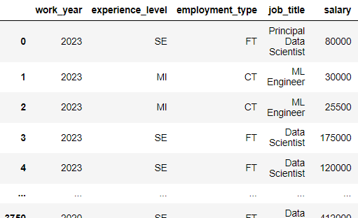
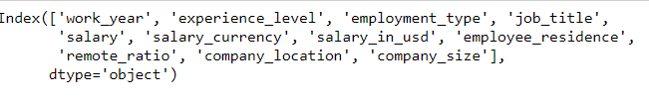

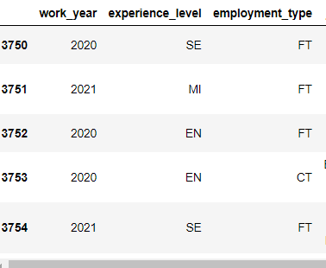
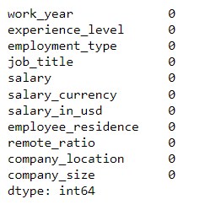
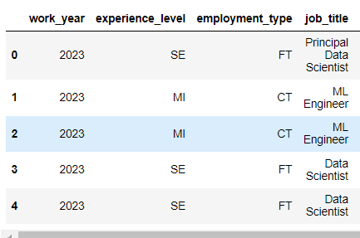
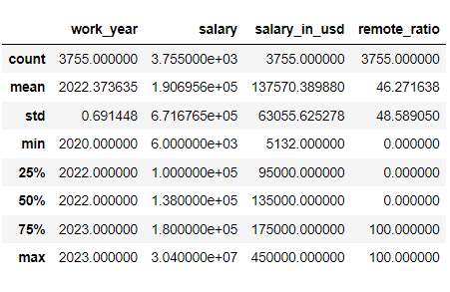
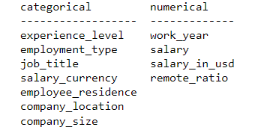
DATA PRE-PROCESSING USING PYTHON

Slide 4
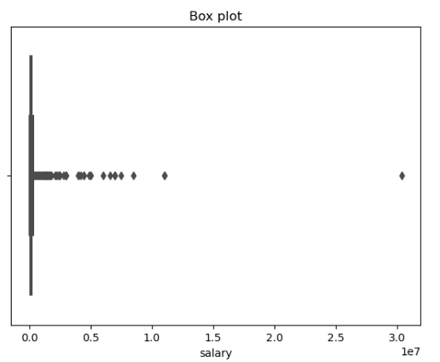
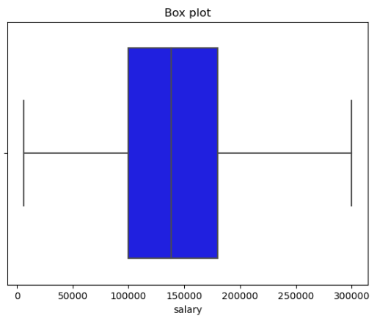
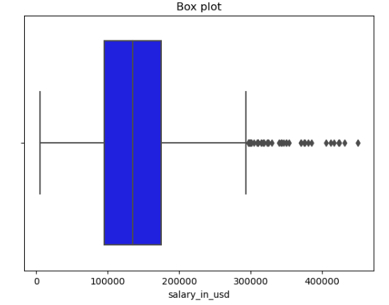
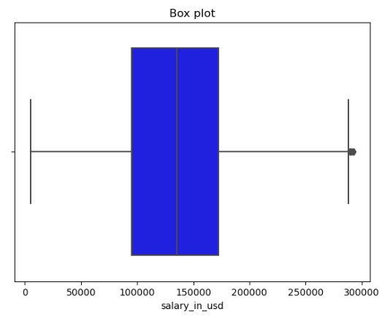
DATA PRE-PROCESSING USING PYTHON –OUTLIER ANALYSIS
INTERPRETATION: During Data Pre-processing using Python, firstly we have loaded the dataset in Jupyter notebook via various libraries of Python. There are 3755 rows and 11 columns in our dataset. There is no null value in the dataset. Later on, we are done with separation of Categorical and Numerical columns. By using Box-Plot method outliers have been visualized firstly, for further analysis, outliers removed from ‘salary’ and ‘salary in usd’ columns and shown by using IQR method. So for now our Data is completely ‘CLEANED DATA’ .So we are uploading this in ‘CSV’ file for further and deeper analysis through visualization.

Slide 5
DATA VISUALIZATION THROUGH TABLEAU

Slide 6
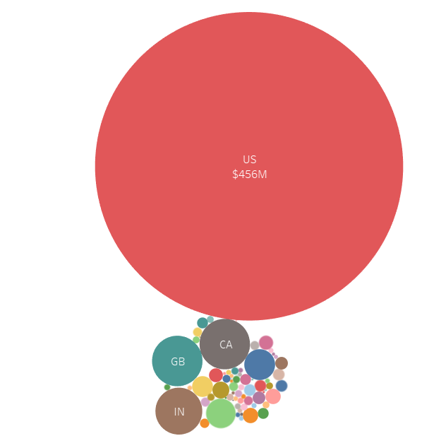
TASK-1: DISPLAY THE COMPANY LOCATION WISE DISTRIBUTION OF SALARY AMONG DATA SCIENTIST.
INTERPRETATION: As its clear from above visual that Data Scientist paid off highest salary in US based company location.

Slide 7
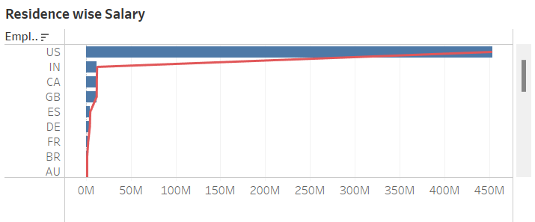
.
TASK-2: DISPLAY THE RESIDENCE WISE DISTRIBUTION OF SALARY AMONG DATA SCIENTIST.
INTERPRETATION:
Employees who are from US based residence are paid off highest Salary in comparison to other residence based employees.

Slide 8
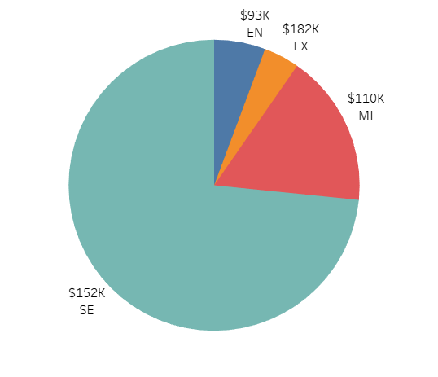
TASK-3: DISPLAY THE EXPERIENCE LEVEL WISE DISTRIBUTION OF SALARY AMONG DATA SCIENTIST.
INTERPRETATION:
Most of the data scientist having experience on Senior level or Expert are paid off highest salary and the Entry level or junior are paid off least Salary as compared to other categories.

Slide 9
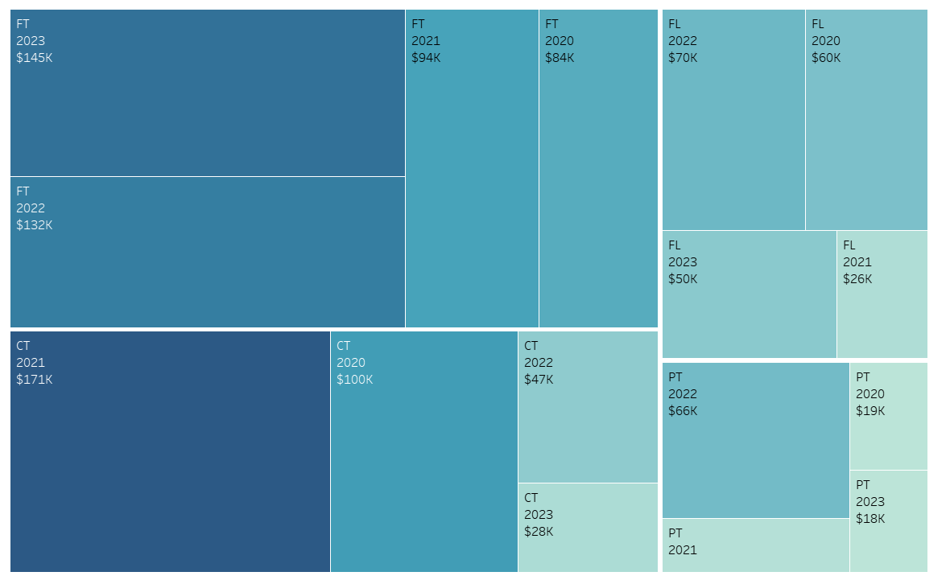
TASK-4: which type of employees are getting highest salaries? Display their average year wise.
INTERPRETATION: Full time employees working as Data Scientist are highest paid off in working year 2023 and contract type employees are highest paid off in working year 2021.

Slide 10
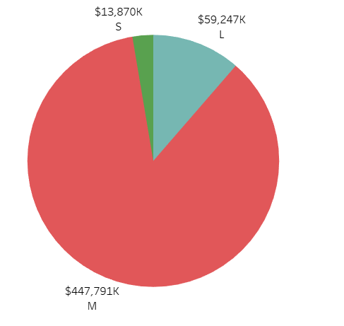
TASK-5:DISPLAY THE COMPANY SIZEWISE DISTRIBUTION OF SALARY AMONG DATA SCIENTIST.
INTERPRETATION: Medium size Company are paying highest salary to their employees as Data Scientist in comparison to Large and Small size Company.

Slide 11
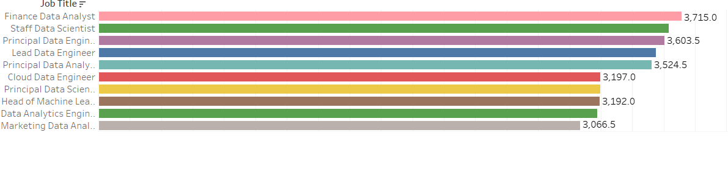
TASK-6: DISPLAY THE TOP 10 JOB TITLES AVERAGE salary WISE OF DATA SCIENTIST DOMAIN.
INTERPRETATION:
Finance Data Analyst is topmost job title with the highest average Salary.

Slide 12
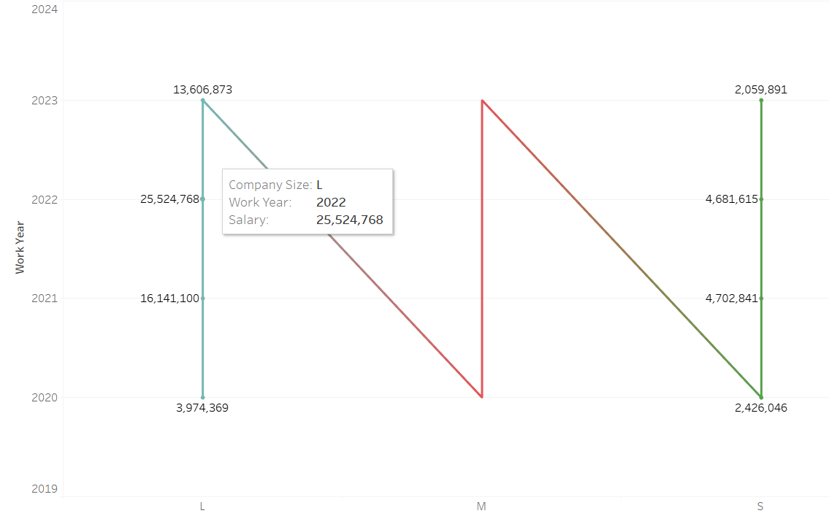
TASK-7: DISPLAY THE YEAR WISE TREND OF SALARY AS PER COMPANY SIZE AMONG DATA SCIETIST.
INTERPRETATION: 2023 is the highly paid off salary year in Large size company.

Slide 13
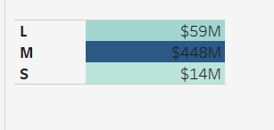
TASK-8: DISPLAY THE COUNT OF SALARY PER COMPANY SIZE AMONG DATA SCIETIST.
INTERPRETATION:
The total count of employees salary, working as Data Scientist is highest in Medium size and lowest in Small size Company.

Slide 14
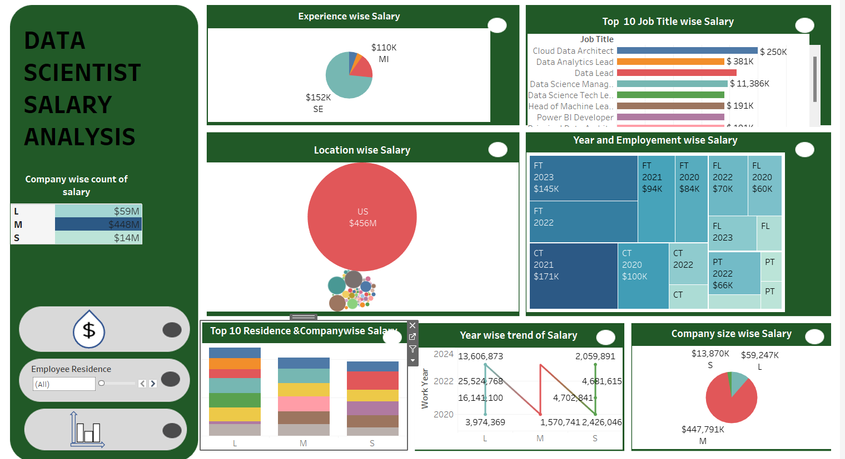
TASK-9:DISPLAY ALL THE RELEVANT VISUALS THROUGH AN INTERACTIVE DASBOARD USING ACTION FILTERS,WHERVER REQUIRED.

Slide 15
SUMMARY:
As we are done with our Data Scientist Salary Analysis, on the basis of which we have some important notes as follows:
Data scientist ,who are working in US company based location are paid off highest salary as compared to others locations.
US based residence employees working as a Data Scientist are highly paid by Companies.
Senior level or Expert working experience are preferred in Data Science field.
Data Scientist who are available for Full time job or contract type are highly in demand with highest salary.
Medium size company is highly preferred with maximum number of employees among Data Scientist as compared to Large and Small.
‘Finance Data Analyst’ is most popular job title with highest average salary among Data Scientists.
2023 was the highest Salary paid year for the Data Science field.

Slide 16
CONCLUSION:
On the basis of our analysis, the following important conclusions have made:
Company Size & Location Effect: Data scientists working in US-based company locations tend to receive the highest salaries compared to those in other locations. Medium-sized companies are the preferred choice for data scientists, with the highest number of employees compared to large and small companies.
Regional Disparities: Employees residing in the US region and working as data scientists are among the highest-paid by companies.
Experience and Expertise Impact: Senior-level or expert working experience is preferred in the field of data science, indicating a preference for seasoned professionals. Data scientists available for both full-time and contract positions are highly sought after, commanding the highest salaries.
Skills in High Demand: Among data scientists, the job title 'Finance Data Analyst' stands out as the most popular with the highest average salary.
Highest Salary Paid Year: 2023 was identified as the year with the highest salaries paid in the field of data science, indicating a peak in compensation during that period.

Slide 17


