Slide 1



Codebasics Resume Project Challenge : 1
AtliQ Grands Revenue Insights Analysis
Challenge 1 : Generate Revenue Insights in the Hospitality Domain

Slide 2
Table of contents
Introduction
Problem Statement
Task
Data Understanding
Key Attributes
Key Insights

Slide 3
INTRODUCTION
AtliQ Grands owns multiple five-star hotels across India. They have been in the hospitality industry for the past 20 years.
Due to strategic moves from other competitors and ineffective decision-making in management, AtliQ Grands are losing its market share and revenue in the luxury/business hotels category. As a strategic move, the managing director of AtliQ Grands wanted to incorporate “Business and Data Intelligence” to regain their market share and revenue. However, they do not have an in-house data analytics team to provide them with these insights. Their revenue management team had decided to hire a 3rd party service provider to provide them with insights from their historical data.

Slide 4
TASK
I am a data analyst who has been provided with sample data and a mock-up dashboard to work on the following task.
Create the metrics according to the metric list.
Create a dashboard according to the mock-up provided by stakeholders.
Create relevant insights that are not provided in the metric list/mock-up dashboard.

Slide 5
Data understanding
We have provided the dataset of 3 months May, June, July of fiscal year 2022 is available.
AtliQ Grands fiscal year starts from 1st September and ends on 31st August.
It has 5 tables.
dim_date
dim_hotels
dim_rooms
fact_aggregated_bookings
fact_bookings

Slide 6
Key Attributes
RevPAR : Means Revenue generated per available room(booked as well as non booked).
ADR(Average Daily Rate) : This is the measure of average paid for rooms sold in a given time.
DSRN(Daily Sellable Room Nights) : This metrics tells us on an average how many rooms are ready to be sold for a day.
DBRN(Daily Booked Room Nights) : This metric tells us how many rooms are booked per night and also includes cancellation & no show measures.
DURN(Daily Utilized Room Nights) This metric tells us how many rooms are utilized per night.
Occupancy % : It Means how many rooms are occupied amongst all the available rooms.
Realisation % : Means successful “checked out“ over all bookings happened.
Cancellation % : Means the customers who cancelled their bookings and got a refund of 40%.
No Show % : Means the customers who neither cancelled their bookings nor showed up.

Slide 7
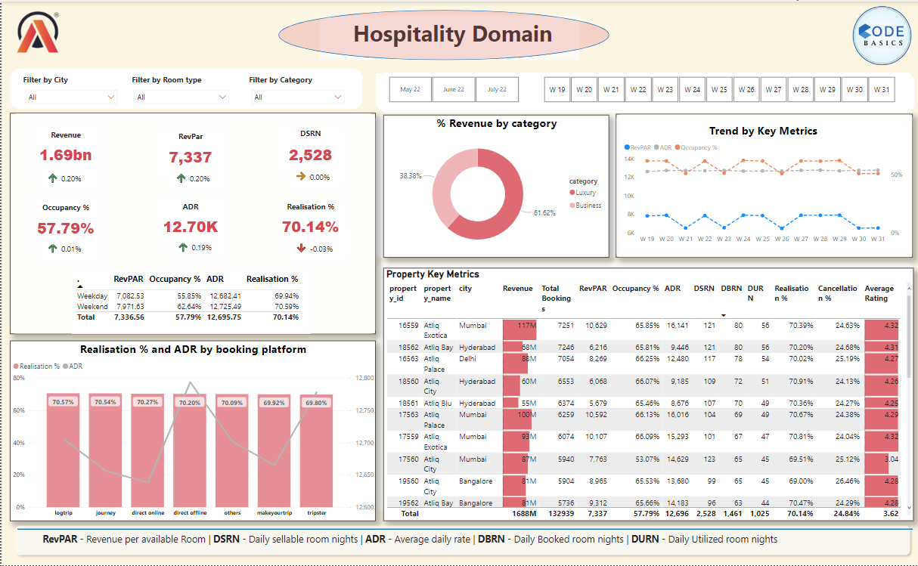
DASHBOARD VIEW :

Slide 8
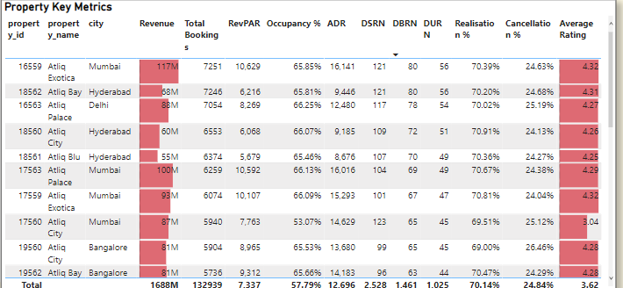
Insights :
As we see that Mumbai city is generating highest Revenue of 117M while, Delhi city generating lowest Revenue of 36M.
AtliQ Exotica property has highest rating while, AtliQ Seasons has the lowest rating among all properties.

Slide 9
Some of the Key Insights from the Dashboard:
Luxury category has more bookings than the Business category.
Majority of bookings come from sources called others. Needs to identify what source it is.
Occupancy rate is higher on Weekends and Presidential Classes compare to Weekdays.
Highest revenue was generated in the month of May and then it dropped in June but somewhat recovered in July so need to identify what was done differently in July compared to June to generate more revenue.
Elite class is generating high revenue among all classes.

Slide 10
Recommendations :
Based on my analysis, I recommend that AtliQ Grands take the following actions to improve their revenue and market share:
Implement targeted marketing campaigns to attract more customers in cities other than Mumbai.
Focus on optimizing the pricing strategy based on seasonal and weekday/weekend demand fluctuations
User ratings have a direct impact on bookings, hence the management can work on improving user experience (good service, cleanliness, complimentary meal, overall user experience etc.) to improve ratings and consequently increase revenue.
Explore ways to differentiate their hotels from competitors and improve the customer experience.

Slide 11
THANK YOU

