Slide 1

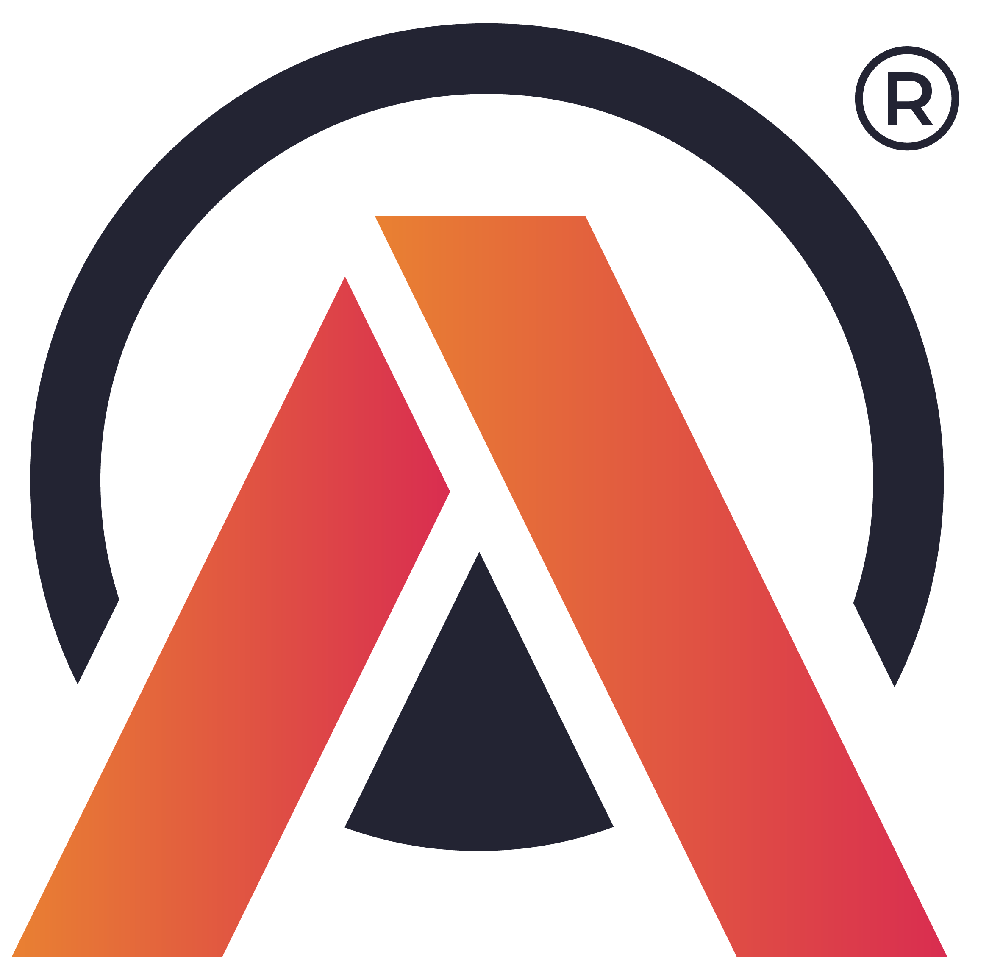

AtliQ Mart Supply Chain Analysis
Codebasics Resume Project Challenge : 2
Challenge 2 : Generate Insights to solve Supply chain issues in the FMCG Domain

Slide 2
TABLE OF CONTENTS
Introduction
Problem Statement
Task
Data Understanding
Key Insights

Slide 3
INTRODUCTION
AtliQ Mart is a growing FMCG manufacturer headquartered in Gujarat, India.
It is currently operational in three cities Surat, Ahmedabad and Vadodara. They want to expand to other metros/Tier 1 cities in the next 2 years.
It has mainly 3 categories, they are Food, Beverages and Dairy.

Slide 4
Problem Statement
AtliQ Mart is currently facing a problem where a few key customers did not extend their annual contracts due to service issues. It is speculated that some of the essential products were either not delivered on time or not delivered in full over a continued period, which could have resulted in bad customer service. Management wants to fix this issue before expanding to other cities and requested their supply chain analytics team to track the ’On time’ and ‘In Full’ delivery service level for all the customers daily basis so that they can respond swiftly to these issues. The Supply Chain team decided to use a standard approach to measure the service level in which they will measure ‘On-time delivery (OT) %’, ‘In-full delivery (IF) %’, and OnTime in full (OTIF) %’ of the customer orders daily basis against the target service level set for each customer.

Slide 5
TASK
Create the metrics according to the metrics list.
Create a dashboard according to the requirements provided by stakeholders in the business review meeting. You will be provided with the transcript of this business review meeting in comic form.
Create relevant insights not provided in the metric list/stakeholder meeting.

Slide 6
DATA UNDERSTANDING
The dataset of fiscal year 2022 is available.
AtliQ Mart fiscal year starts from 1st September and ends on 31st August.
It has 6 tables.
1. dim_customers.csv
2. dim_products.csv
3. dim_date
4. dim_targets_orders
5. fact_order_lines.csv
6. fact_orders_aggregate.csv

Slide 7
KEY INSIGHTS

Slide 8
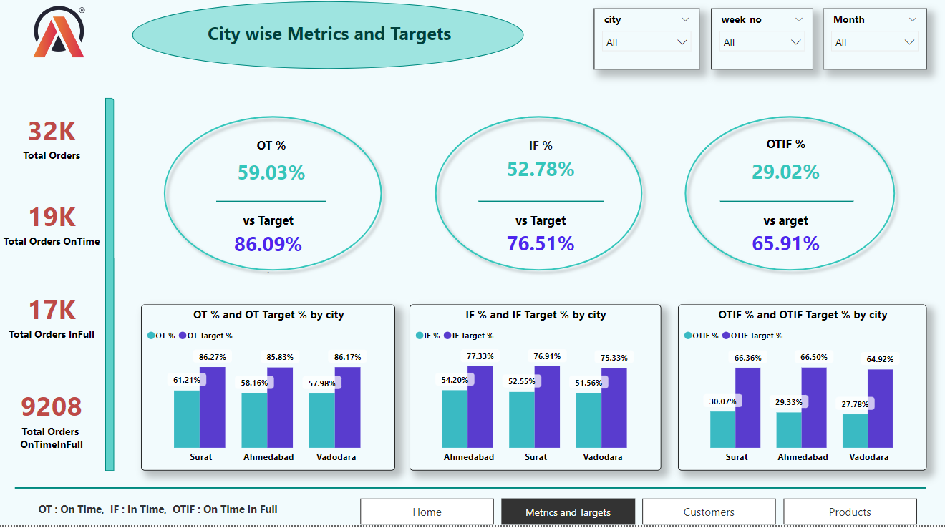
Insight :
From the above dashboard, we can clearly say that “ On time delivery (OT %)”, “In Full delivery (IF %)” and “On time In full delivery (OTIF %)” of the customer orders on a daily basis are lower than compared with their Target % values.

Slide 9
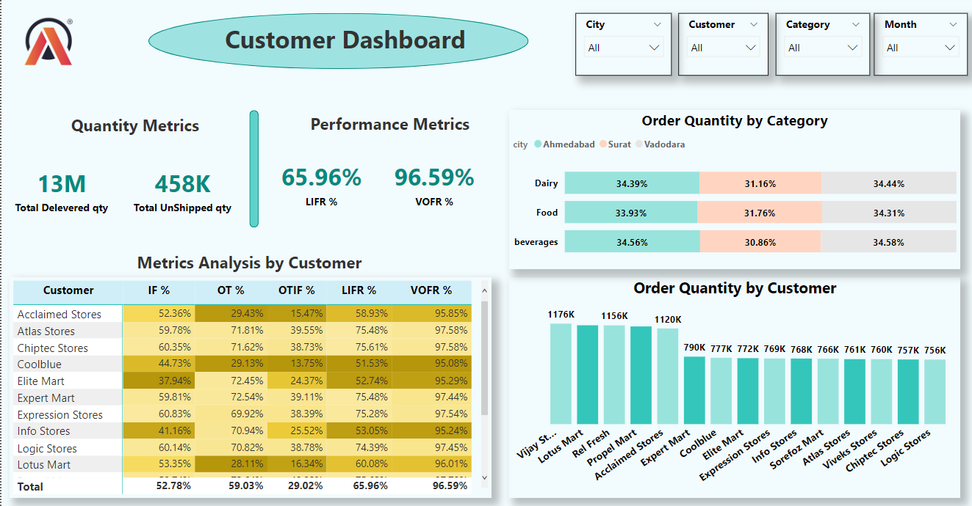
Insights :
There are total of 13M order quantity, out of 458k products are unshipped.
We can see that “Vijay Stores” customer has ordered more quantity products while “Logic Stores” has ordered in low quantity products.

Slide 10
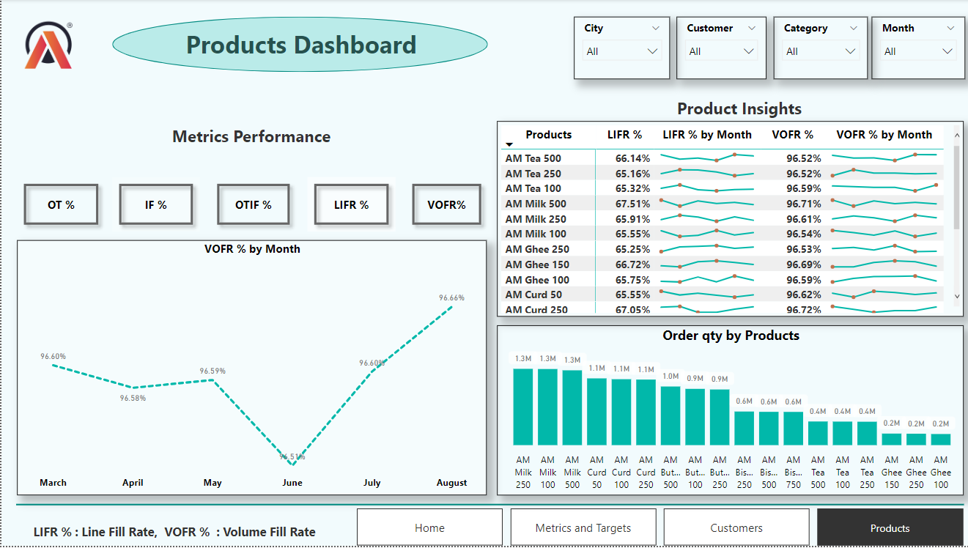

Slide 11
Insights from the Products dashboard:
We can observe that order quantity, delivered quantity and undelivered quantity are more for AM Milk products.
AM Milk products are also high in on-time deliveries and delayed deliveries.
We are unable to supply the products on time and in full quantity because of lack of stock. So, we can conclude that AM Milk products have high supply demand.
Order lines are more for AM Butter, so we can estimate that most of the customers prefer AM Butter in their orders.
As AM Curd has a high line fill rate, we can say AM Curd is supplied more in full quantity irrespective of delivery time (in time is not considered).
VOFR% is almost similar to all 6 products.

Slide 12
THANK YOU

