Slide 1

EMPLOYEE DATA ANALYSIS USING EXCEL
STUDENT NAME : DEEPIKA P
REGISTER NO : 312206489
DEPARTMENT : COMMERCE
COLLEGE : AGURCHAND MANMULL JAIN COLLEGE

Slide 2

PROJECT TITLE
Employee Performance
Analysis using
Excel

Slide 3

AGENDA
Problem Statement
Project Overview
End Users
Our Solution and Proposition
Dataset Description
Modelling Approach
Results and Discussion
Conclusion

Slide 4

PROBLEM STATEMENT
This analysis is created to track the performance of the employees, in order to provide promotions, incentives to the respective employees.
This analysis helps the organisation to grow by the growth of the employees of the organisation.

Slide 5

PROJECT OVERVIEW
Employee performance analysis helps organizations identify areas of strength and weakness, enabling them to make informed decisions on employee development needs.

Slide 6

WHO ARE THE INTENDED USERS?
Employees
Managers
Employers
Managerial organisations
Industrial organisations

Slide 7

OUR SOLUTION AND ITS VALUE PROPOSITION
Conditional formatting ~ missing
Pivot tables ~ summary
Charts ~ trend
Filtering and Formula ~ performance
Graph ~ data visualization

Slide 8

Dataset Description
Employee = Kaggle
26 – Features
9 - Features
Employee id – numerical values
Name – text
Employee type
Performance level
Employee rating – numerical values

Slide 9

THE "WOW" IN OUR SOLUTION
Performance level =IFS(Z8>=5,”VERY HIGH”,Z8>=4,”HIGH”,Z8>=3,”MED”,TRUE,”LOW”)

Slide 10

MODELLING
Data collection
Downloaded from Edunet dashboard
Data cleaning
Identified the missing values
Filter out missing values
Performance level
Created a formula
Summary
Pivot table
Graph

Slide 11
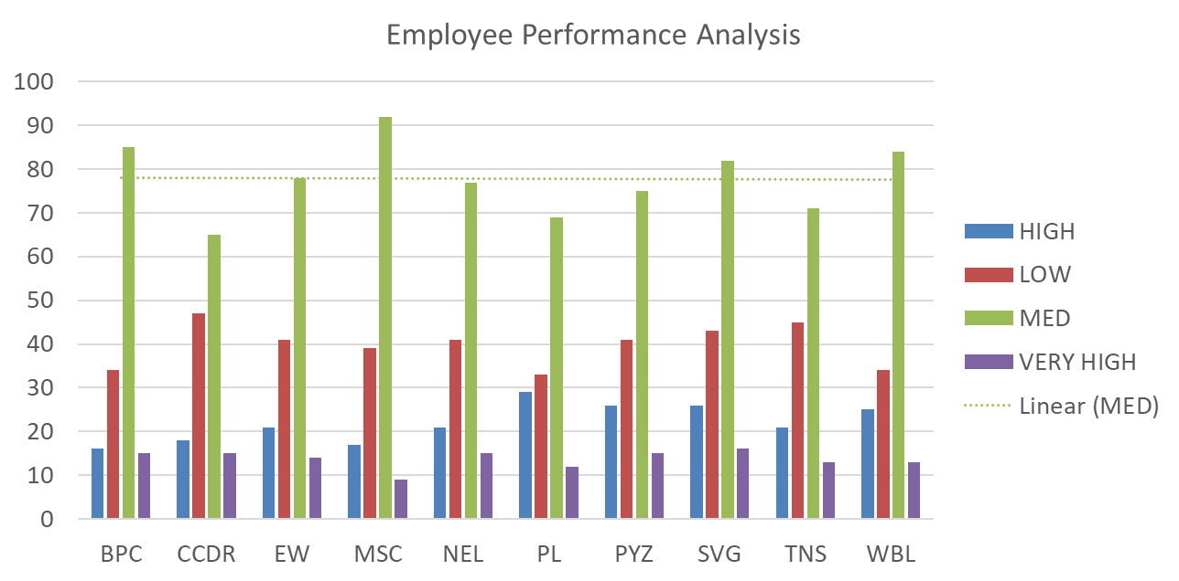
Results

Slide 12

Conclusion
Upon reviewing employee performance, it became clear that the PL sector of the organization has a disproportionately high number of top-performing employees.
To optimize organizational performance, it is recommended that we implement a tailored task assignment strategy, leveraging the unique strengths of employees across various sectors, thereby fostering enhanced motivation, productivity, and overall excellence.

