Slide 1
Get item E-commerce Website
PROJECT TITLE
MENTOR NAME : Mr. M. Hari
TEAM DETAILS :-
P. Aruna sumasri ( TL )
S. Uma devi
P. Lokesh
S. Sai mohan

Slide 2
Problem statement :
Online business is exchange of products through the online and major platform for online business is E-commerce . In the E-commerce the private seller is create an seller account in the existence platforms like Flipkart and Amazon and they will agree the terms and conditions to sell a products. And the local business mans want to expand their business but not by more investment and they want individual E-commerce site to expand their business with less investment

Slide 3
ABSTRACT:
E-commerce (electronic commerce) refers to all online activity that involves the buying and selling of products and services. In other words, ecommerce is a process for conducting transactions online. In the existing platforms we agree a many terms and conditions. And very difficult to maintain. To reduce the such problems need a individual platforms which helps in investments and maintainability.
We proposed that called GETITEM this is fully functionality E-commerce site with individual own privacy conditions and esay maintainability this help local sellers to expand their business over through getitem.

Slide 4
start
rigister
Sign in
Sign up
Home page and search for book
Architecture for buy a book:
Add to cart
Buy now
Add to cart
Confirm buy
Add shipping info
done
payment
Wrong
end
Product
shipping
Recived
stop

Slide 5
FUNCTIONAL
NON-FUNCTIONAL
Minimum steps to make a purchase.
Mobile-responsive.
Unique, recognizable design.
Relevant, useful content.
Shipping & payment systems integration.
Security
Performance
Maintainability
Scalability
Usability

Slide 6
REQUIREMENTS
SOFTWARES
HARDWARES
Html
CSS
Java script
Bootstrap
Python
Django
MY SQL
Processor : | 1.9 gigahertz (GHz) x86- or x64-bit dual core processor
Memory : | 2-GB RAM
Display : | Super VGA with a resolution of 1024 x 768

Slide 7
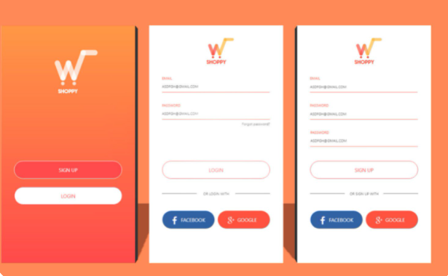
SCREENS:
Signup and sign in screens:

Slide 8
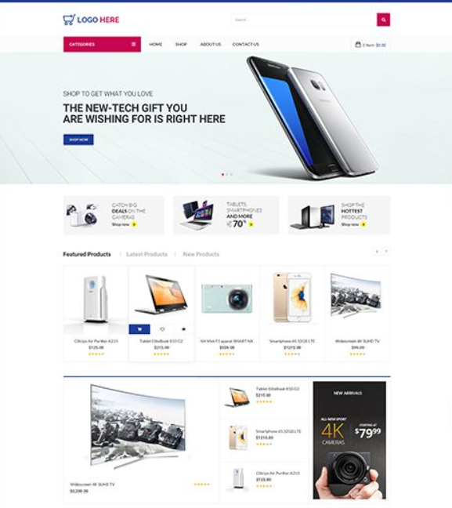
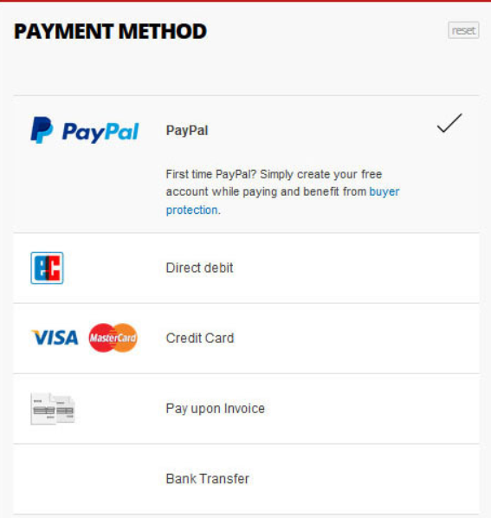
HOME SCREEN:
PAYMENT SCREEN:

