Slide 1
EARLY CLASSIFICATION OF ALZHEIMER'S DISEASE WITH CNN USING MRI IMAGE

Slide 2
CONTENTS
ABSTRACT
OBJECTIVE
EXISTING SYSTEM
PROBLEM STATEMENT
PROPOSED SYSTEM
METHODOLOGY
DATASET
PREPROCESSING
CNN MODEL
TRAINING AND EVALUATION
DFD
PERT CHART
FUTURE SCOPE
CONCLUSION

Slide 3
ABSTRACT
Alzheimer's disease, a neurodegenerative disorder affecting millions globally, presents a significant challenge in diagnosis and treatment.
This study proposes a CNN architecture to extract the features of a MRI brain image and classifies according to the severity of Alzheimer’s disease.
The dataset has 4 classes labelled as Mild-Demented, Moderate-Demented, Non-Demented, Very Mild-Demented .
The dataset has class imbalance problem which is mitigated through the use of a resampling algorithm SMOTEEN.
The CNN model achieves a remarkable accuracy of 99.8% on unseen test data, signifying its capability to effectively distinguish between different severities of Alzheimer's disease.

Slide 4
OBJECTIVE
To train a CNN model which accurately predicts the stages of Alzheimer’s disease.
The existing models were trained on small datasets ,this model tries to train on larger datasets.
The complexity of class imbalance has to be reduced which makes the model training effectively,
The existing model tries to capture the broader features of MRI brain images ,were we try to capture the all relevant features.
Increase the metrics values to a much greater values comparing to the existing system.

Slide 5
EXISTING SYSTEM
The existing study proposes a classification system to predict the stage of Alzheimer’s disease to 4 classes.
Numerous studies have shown promising results using CNN architectures like VGG and ResNet for Alzheimer's disease classification.
Researchers employ techniques like transfer learning using pre-trained models and data augmentation for early diagnosis.
Medical imaging datasets often suffer from class imbalance,where these problems are resolved using resampling algorithms like SMOTE and combination of SMOTE with other algorithms(eg.SMOTETomek).

Slide 6
PROBLEM STATEMENT
Early detection of Alzheimer’s disease is crucial because as it effect the memory and cognitive skills of a defected person.
Existing methods for diagnosis may not be as accurate or can be time-consuming and has problems of class imbalance which causes the model learning inefficient.
This project aims to develop a deep learning model using CNN to analyze MRI scans and achieve high accuracy in classifying Alzheimer's disease stages, including early detection.

Slide 7
PROPOSED SYSTEM
The proposed system utilizes MRI scan data from the publicly available OASIS dataset on Kaggle for Alzheimer’s disease classification.
The MRI images undergo preprocessing, including rescaling pixel intensities and resizing images to a uniform size for consistent model input.
Since the data might have uneven numbers of scans for each dementia severity, we use a technique called SMOTEENN to create synthetic MRI scans. This helps the model learn better from all severity levels.
The CNN architecture leverages convolutional layers for feature extraction with progressive filter size increase and pooling for dimensionality reduction, incorporating dropout for regularization.

Slide 8
The model is trained using the Stochastic Gradient Descent (SGD) optimizer with categorical cross-entropy loss.
Its performance is evaluated using a comprehensive set of metrics, including accuracy ( 99.86%), AUC(99.91%), F1-score(99.85%), precision(99.86%) and recall(99.86%).

Slide 9
METHODOLOGY
INPUT IMAGE
RESHAPING
RESIZING
IMBALANCE HANDLING
SPLITTING DATA
FEATURE EXTRACTION
MODEL TRAINING
MODEL TESTING
OUTPUT

Slide 10
DATASET
The proposed system is trained on OASIS (Open Access Series of Imaging Studies) MRI dataset from Kaggle.
It contains 9488 brain MRI images categorized into four classes based on Alzheimer's progression such as Mild-demented ,Moderate-demented, Non-demented and Very mild–demented.
Brain images were sliced along the z-axis into 256 pieces, with slices ranging from 100 to 160 selected from each patient.
The primary goal of this dataset is to offer a valuable resource for analyzing and identifying early indicators of Alzheimer's disease.

Slide 11
PREPROCESSING
The goal of preprocessing in image classification is to transform raw image data into a format that facilitates optimal learning by the deep learning model.
Initially ,we rescale the images from their original range of 0-255 to a range of 0-1. This normalization technique helps to place all pixel values on a common scale.
Then, resize the image to a width of 176 pixels and height of 208 pixels.
To resolve the class imbalance problem ,we use a resampling algorithm “SMOTEEN” (SMOTEENN stands for SMOTE (Synthetic Minority Oversampling Technique) for ENN (Edited Nearest Neighbors),which generates synthetic data points for the under-represented classes.
Finally, we split the preprocessed data into three distinct sets: training, validation, and test sets.

Slide 12
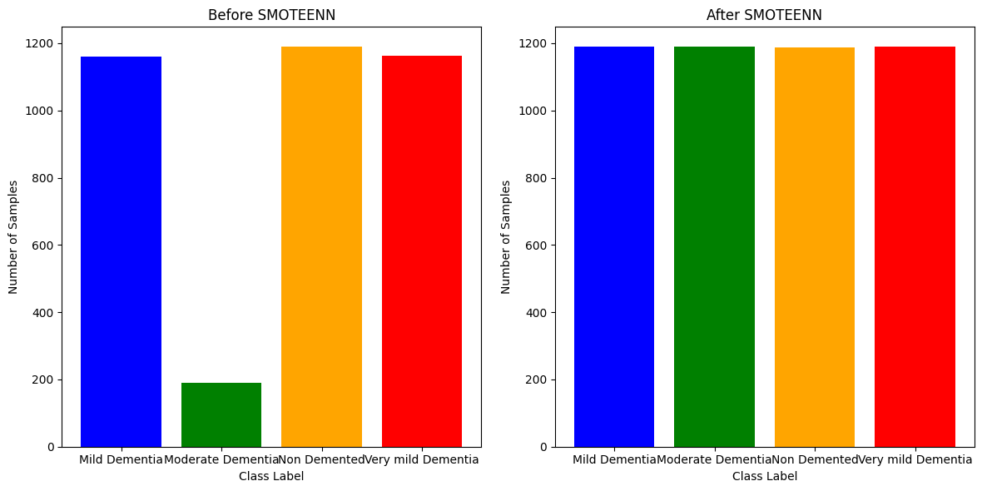

Slide 13
CNN MODEL
This CNN extracts features from brain images using convolutional layers with increasing complexity.
The first layer is an input layer with a shape ,height of 176 pixels, a width of 208 pixels, and 3 colour channels (RGB).
The core of feature extraction happens through several convolutional blocks. Each block typically consists of a convolutional layer followed by a pooling layer.
There are 4 convolutional blocks with “ELU” as the activation function and Kernal size as “3x3” for the first 3 layers and “5x5” for the last layer .

Slide 14
The convolutional blocks employ a progressive increase in filter count, starting with 16, then 32, 64, and finally 128 filters for learning features of growing complexity.
A combination of “AVERAGE POOLING” and “MAXPOOLING” is used in these 4 Convolutional blocks with a poling size of (2,2).
A Dropout layer with a rate of 0.05 is added after the convolutional blocks.
Dropout randomly drops a certain percentage of activations during training, helping to prevent overfitting.
Fully connected layers with 512 and 4 neurons (classes) process flattened features from convolutions, using ELU activation and Dropout (0.2) for regularization, with “SOFTMAX” for probability distribution.

Slide 15
TRAINING AND EVALUATION
We train the model with an SGD optimizer (learning rate: 0.05) and Categorical Cross entropy loss, ideal for our 4-class classification task.
Model performance is tracked with Accuracy, AUC, F1 Score, Precision, and Recall.
We used callback function as ,ReduceLROnPlateau which monitors validation loss, automatically reducing the learning rate if improvement stalls for a certain period to prevent overfitting.
The model trains for 40 epochs with SGD optimizer, categorical Cross entropy loss, and early stopping using ReduceLROnPlateau.

Slide 16
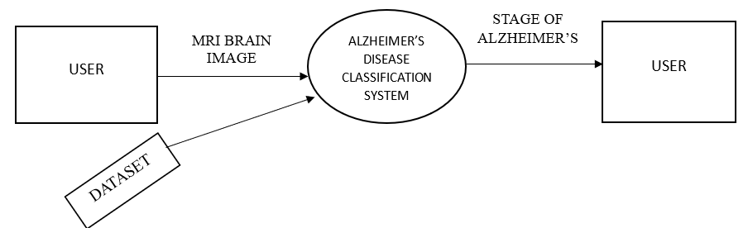
DATA FLOW DIAGRAM-Level 0

Slide 17
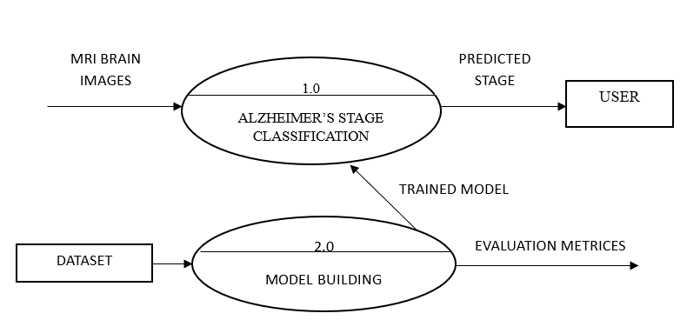
DATA FLOW DIAGRAM-Level 1

Slide 18
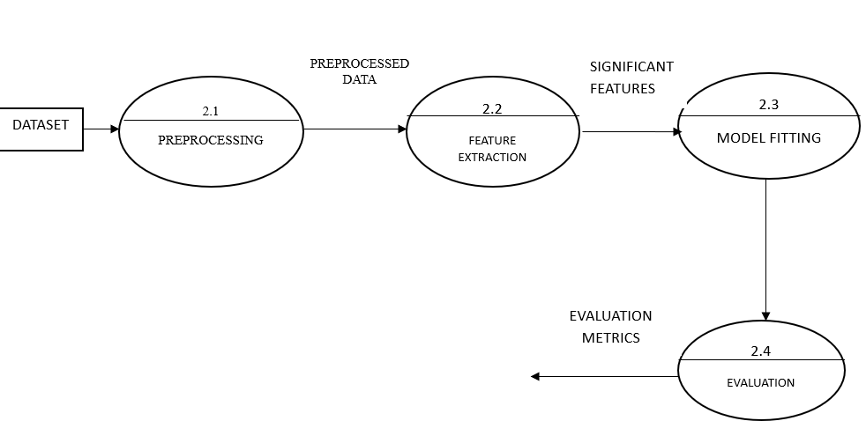
DATA FLOW DIAGRAM-Level 2

Slide 19
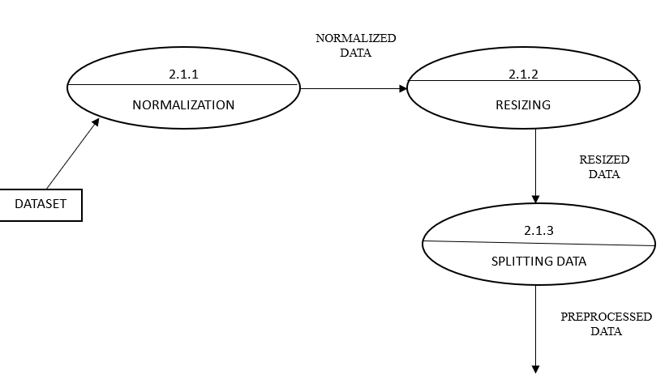
DATA FLOW DIAGRAM –Level 3

Slide 20
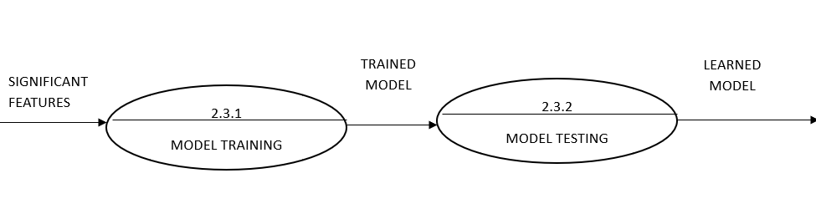
DATA FLOW DIAGRAM-Level 3

Slide 21
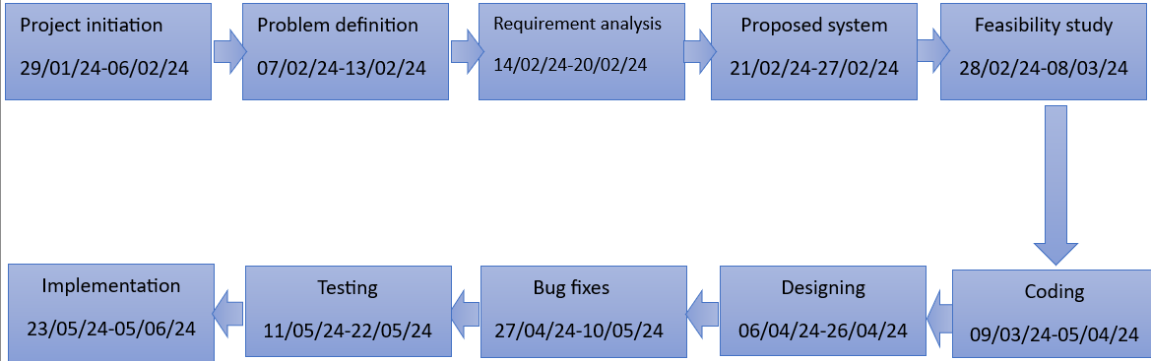
PERT CHART

Slide 22
FUTURE SCOPE
Early intervention potential: Refine the model to predict Alzheimer's risk, enabling earlier intervention and potentially slowing disease progression.
Clinical integration: Develop a user-friendly interface for seamless integration with clinical workflows, aiding doctors in accurate and efficient diagnoses.
Multimodal approach: Explore combining brain images with genetic data, cognitive tests, or biomarkers for a more robust and accurate classification model.

Slide 23
CONCLUSION
SMOTEENN oversampling balanced the training data, preventing bias towards common dementia severities.
The model achieved a remarkable 99.8659% testing accuracy in classifying dementia severity from brain scans.
The CNN architecture effectively extracted relevant features from brain scans, likely capturing crucial information about structural differences.
The project establishes a strong foundation for further exploration. Experimenting with network architecture and hyperparameters could potentially lead to even better classification results.

Slide 24
THANK YOU

