Slide 1
Risk Management
Risk: It is an undesirable ,unexpected event that occurs in a project.
Some common project risk are:
Product does not meet specified requirements/or performance
Project cost is higher than planned
Product delivered late

Slide 2
Activities under risk management
Project risk
Staff turnover
Hardware unavailability
Size under estimate
Requirement changes
Product risk
Specification delays
Poor performance of the tools used
Business risk
Technology changes
Product competition

Slide 3
Process of risk management
Risk management
IDENTIFY
ANALYSE
PLAN
MONITOR
RESPOND

Slide 4
Process visibility
Each activity should end with documentation. Those documents makes the software process visible.
Steps required for process visibility include
Documentation
Diagrams

Slide 5
Professional responsibility
Confidentiality
Competence
Intellectual property rights
Computer misuse

Slide 6
Computer based system engineering
System engineering is the activity which provides the framework, within which complex system can be defined ,analysed, specified, manufactured, operated and supported.
Focus of SE is on the system as a whole.
System may include
Software
Hardware
People
System is a collection of inter related components, working together to achieve a pre defined common objective.

Slide 7
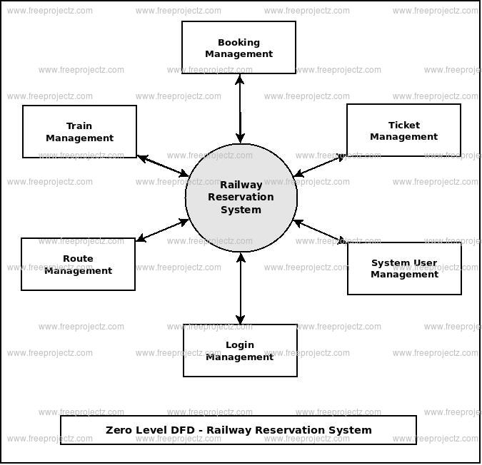
Examples: railway reservation system -subsystems

Slide 8
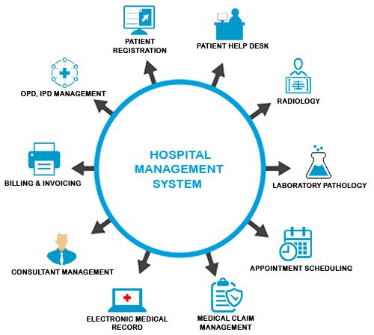
Hospital management system- subsystems

Slide 9
System and their environment
System environment must be understood by system engineers for 2 reasons:
The system is affected by changes in its environment. The correct working of the system can be assessed only by the effects on the environment.
The way in which the system is affected is difficult to predict.
Eg: power supply in the building may be affected by environment changes outside the building. A power cable might be cut in the street or a lightning storm might have affected the power supply.

Slide 10
System procurement
A system for a large company may be produced as a whole or as separate parts which may be integrated or may be specially designed and developed.
Before procuring-system specification and architectural design must be done.
Process of acquiring a system:
The best approach to acquire a system
The best supplier
System procurement can be done for:
Existing system where COTS method can be used
Custom system

Slide 11
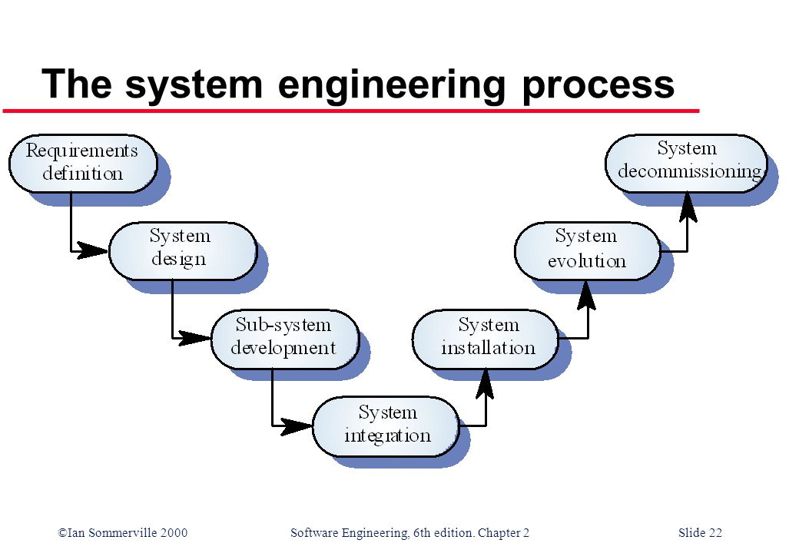
System engineering process

Slide 12
System architecture
It is an abstract view of the subsystem making up the system
It is normally presented as a block diagram showing the major sub systems and the interconnection between these subsystems.
First the system is decomposed into its subsystem. Each sub system is further decomposed in a similar manner until the system decomposes into functional components.

Slide 13
Human factors
All systems have human users.
Human factors which must be taken into account by system engineers include:
Process change
Whenever the system requires changes to the work process, training will have to be organized.
Job change
When a new system is installed, the users may have to change the way they work.
Organizational change
The political power structure in an organization may be influenced by the new system

Slide 14
System reliability engineering
System reliability is always considered at system level rather than at individual component level. Since components are inter dependent ,faults in one component may affect the operation of other components.so it is impossible to produce a system that is guaranteed never to fail.
The overall system reliability is a function of:
Hardware reliability
Software reliability
Operator reliability
The ability of a system to continue to operate in spite of one or more components failures is known as resilience of the system.

