Slide 1
Software Requirements
SRS is the starting point of software development activity.
It forms the basis of software development process.
Software requirements can classified into:
Functional requirements
Non-functional requirements

Slide 2
FUNCTIONAL REQUIREMENTS
Functional requirements in an SRS document (software requirements specification) indicate what a software system must do and how it must function.
Example:User story 1: as an applicant, I must be able to register and enter the website
Functional requirements:
Sign-up and register page
Logging in with Google and its verification
Phone number verification
An “I forgot my password” section that sends a link to the verified email

Slide 3
Non-functional requirements
Non-functional requirements in an SRS document (software requirements specification) specify the quality attributes of a software system, such as responsiveness, usability, and reliability. As functional requirements indicate what a system must do, non-functional requirements support them and determine how the system must perform. These features are usually expressed as constraints or criteria that define a level of freedom for developers or users.
Example: The Application shall support Online-Backup

Slide 4
NON FUNCTIONAL REQUIREMNETS
Product requirements
Organizational requirements
External requirements
Efficiency, reliability, portability, usability
delivery requirements
Inter-operability, ethical requirements, privacy and safety

Slide 5
Requirement Engineering Process(REP)
The process to gather the software requirements from client, analyze and document them is known as requirement engineering.
The goal of requirement engineering is to develop and maintain sophisticated and descriptive ‘System Requirements Specification’ document.

Slide 6
Requirement Engineering Process
It is a four step process, which includes –
1)Feasibility Study
2)Requirement Gathering
3)Software Requirement Specification
4)Software Requirement Validation

Slide 7
1)Feasibility study
Goal: to assess whether the proposed system is economically and technically viable.
The result of a feasibility study would be a report that recommends the feasibility of carrying on with the requirements engineering process and system development process.
Feasibility study includes:
Information assessment
Information gathering
Report writing

Slide 8
Information assessment can be done by
Organizational feasibility: The system should contribute to the overall objectives of the organization.
Technical feasibility: The system must be developed within cost and schedule constraints.
Operational feasibility: It should be possible to integrate the new system with other existing system.

Slide 9
Information gathering by
Asking questions to
Managers
Software engineers
Technology experts
End users

Slide 10
Report writing
After collecting information, a feasibility report must be prepared.
Report may propose change to
scope
Budget
Schedule of system development
Can suggest more requirements

Slide 11
2)Requirement elicitation and analysis
If the feasibility report is positive towards undertaking the project, next phase starts with gathering requirements from the user. Analysts and engineers communicate with the client and end-users to know their ideas on what the software should provide and which features they want the software to include.

Slide 12
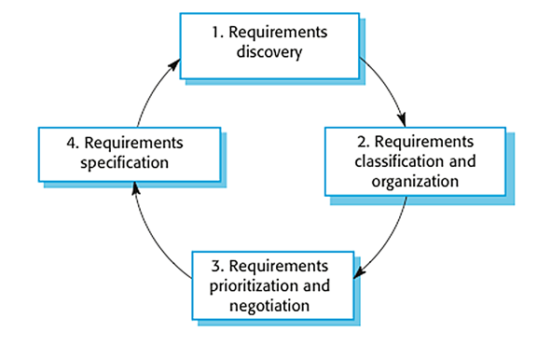
4 main processes of requirements elicitation and analysis.

Slide 13
1)Requirements Discovery
It’s the process of interacting with, and gathering the requirements from, the stakeholders about the required system and the existing system (if exists).
2)Requirements Classification & Organization
It’s very important to organize the overall structure of the system.
Putting related requirements together, and decomposing the system into sub-components of related requirements. Then, we define the relationship between these components.
3) Requirements Prioritization & Negotiation
Prioritizing your requirements will help you later to focus on the essentials and core features of the system, so you can meet the user expectations. It can be achieved by giving every piece of function a priority level. So, functions with higher priorities need higher attention and focus.
4) Requirements Specification
The requirements are then documented

Slide 14
Techniques for requirement elicitation
Viewpoint orientation
Interviewing
Scenarios

Slide 15
Viewpoint oriented elicitation
View points are a means of structuring the requirements collected from different classes of stakeholders(any person or group who is affected by the system ,end users, engineers, business managers, domain experts)
Each view point represents a part of the specification of the system.
Complete specification is created by integrating the requirements from each view point.
View point classifications:
Interactor viewpoints-provides detailed system requirements
Indirect viewpoints-provides higher lever organizational requirements and constraints
Domain view points-provides the characteristics and constraints of the domain which influence the system requirements

Slide 16
ATM stakeholders
Bank customers
Bank managers
Database administrators
Marketing department
H/w and s/w maintenance engineers
Bank regulators
Representatives of other banks
Counter staff
Security managers

Slide 17
All viewpoints of ATM
Bank customers
Bank staff
Database administrators
Counter staff
Bank managers
Representative of others banks
Security managers
Marketing department
Hardware and software maintenance engineers
National bank regulators
Interactor
Indirect
Domain

Slide 18
Interviewing
An interview is a structured conversation where one participant asks questions, and the other provides answers
Structured closed interviews, where every single information to gather is decided in advance, they follow pattern and matter of discussion firmly.
Non-structured open interviews, where information to gather is not decided in advance, more flexible and less biased.
Oral interviews
Written interviews
One-to-one interviews which are held between two persons across the table.
Group interviews which are held between groups of participants. They help to uncover any missing requirement as numerous people are involved.

Slide 19
Surveys -Organization may conduct surveys among various stakeholders by querying about their expectation and requirements from the upcoming system.
Brainstorming-An informal debate is held among various stakeholders and all their inputs are recorded for further requirements analysis.
Questionnaires- A document with pre-defined set of objective questions and respective options is handed over to all stakeholders to answer, which are collected and compiled.
A shortcoming of this technique is, if an option for some issue is not mentioned in the questionnaire, the issue might be left unattended.

Slide 20
3) Software Requirement Specification
SRS is a document created by system analyst after the requirements are collected from various stakeholders. SRS defines how the intended software will interact with hardware, external interfaces, speed of operation, response time of system, portability of software across various platforms, maintainability, speed of recovery after crashing, Security, Quality, Limitations etc

Slide 21
4)Software Requirement Validation
After requirement specifications are developed, the requirements mentioned in this document are validated. Experts may interpret the requirements incorrectly. This results in huge increase in cost if not nipped in the bud. Requirements can be checked against following conditions
If they can be practically implemented
If they are valid and as per functionality and domain of software
If there are any ambiguities

Slide 22
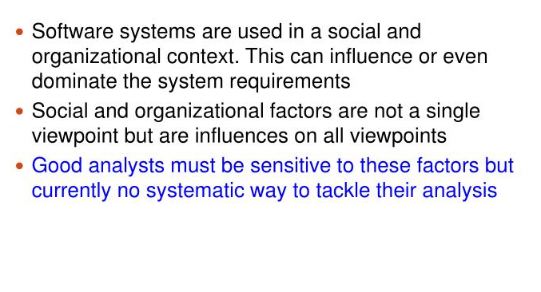
SOCIAL AND ORGANIZATIONAL FACTORS

Slide 23
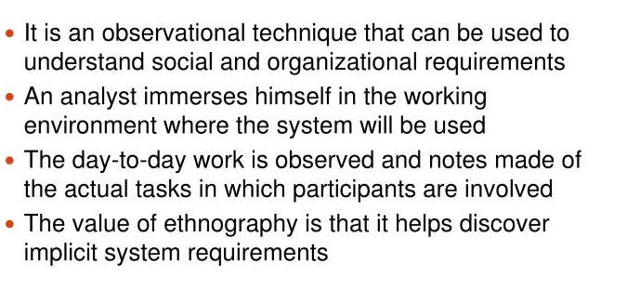
ETHNOGRAPHY

Slide 24
SYSTEM MODELS
System modelling is the process of developing the abstract models of a system, with each model presenting a different view or perspective of that system. Abstraction leaves out the details and picks out the most salient characteristics.
It helps the analyst to understand the functionality of the system and models are used to communicate with customers.
Types of system models:
Context model
Behavioural model
Data model
Object model

Slide 25
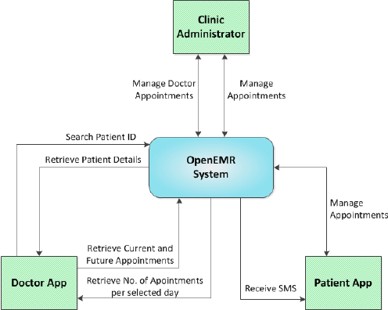
Context model
Used to illustrate the operational context of a system. They show what lies outside the system boundaries. Social and organizational concerns may affect the decision on where to position system boundaries

Slide 26
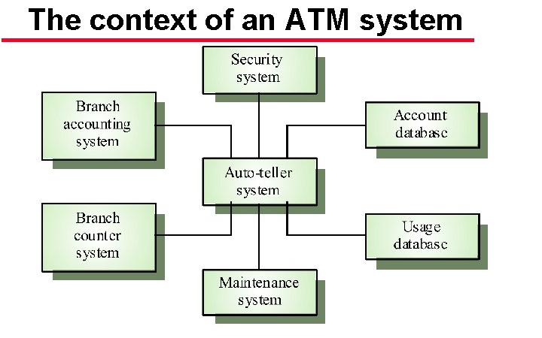
Example of architectural model for system context specification: an ATM system and its environment

Slide 27
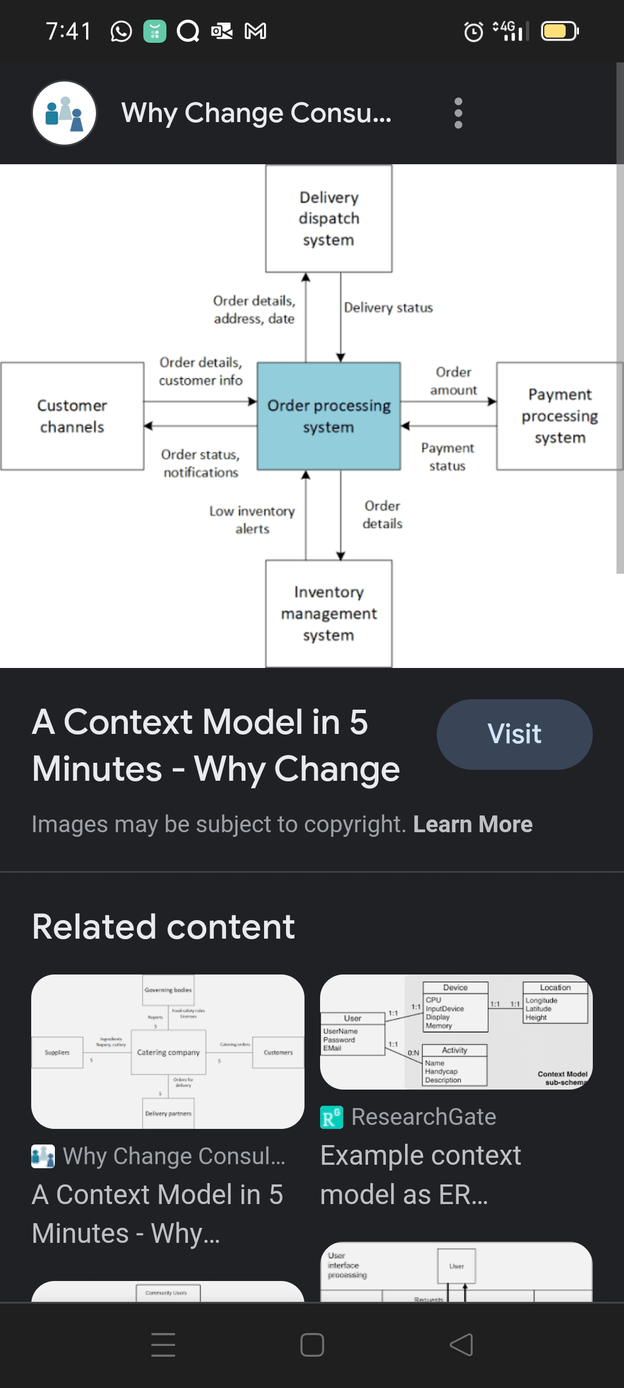

Slide 28
Behavioural models
It describes the overall behaviour of the system.it shows what happens or what should happen when a system responds to a stimulus from its environment.
Behavioural models are of two types
DFD
State machine model

Slide 29
DFD
A Data Flow Diagram (DFD) is a traditional way to visualize the information flows within a system. A neat and clear DFD can depict a good amount of the system requirements graphically.
It shows how information enters and leaves the system, what changes the information and where information is stored.
It is usually beginning with a context diagram as level 0 of the DFD diagram, a simple representation of the whole system. To elaborate further from that, we drill down to a level 1 diagram with lower-level functions decomposed from the major functions of the system. This could continue to evolve to become a level 2 diagram when further analysis is required.

Slide 30
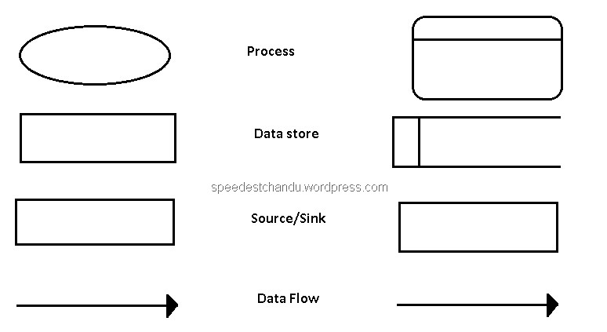
DFD Diagram Notations

Slide 31
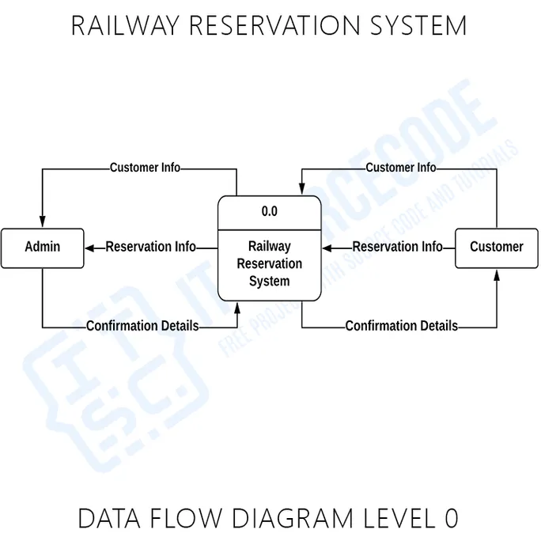

Slide 32
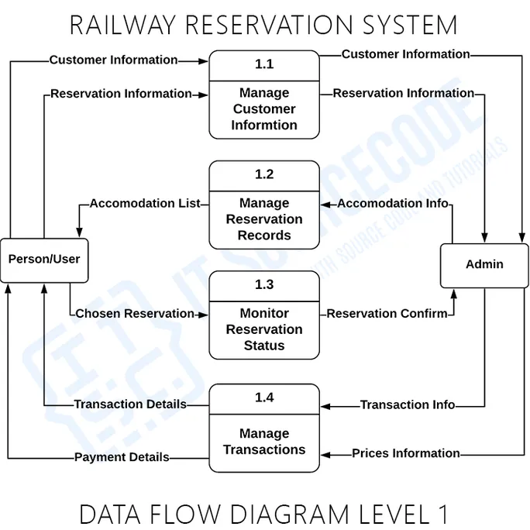

Slide 33
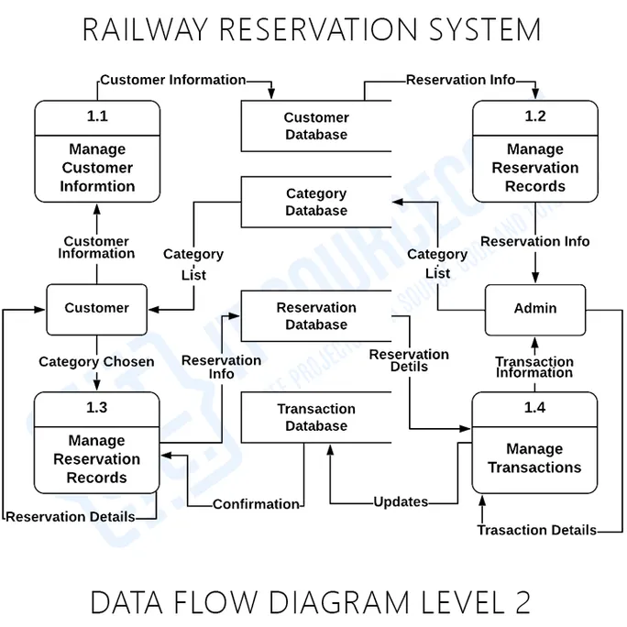

Slide 34
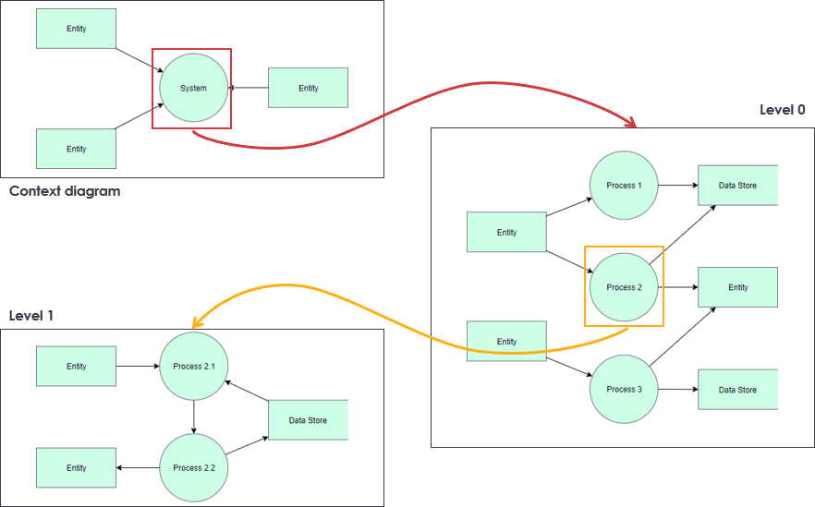

Slide 35
DATA MODEL
The semantic data model is a method of structuring data in order to represent it in a specific logical way. It is a conceptual data model that includes semantic information that adds a basic meaning to the data and the relationships that lie between them.

Slide 36
Semantic Data Models…
Data models describe the logical structure of data processed by the system
The Entity-Relationship-Attribute model, ERA
(also known as Entity-Relationship model, ER) shows:
Entities in the system
Relationships between entities
Attributes of entities and relationships

Slide 37
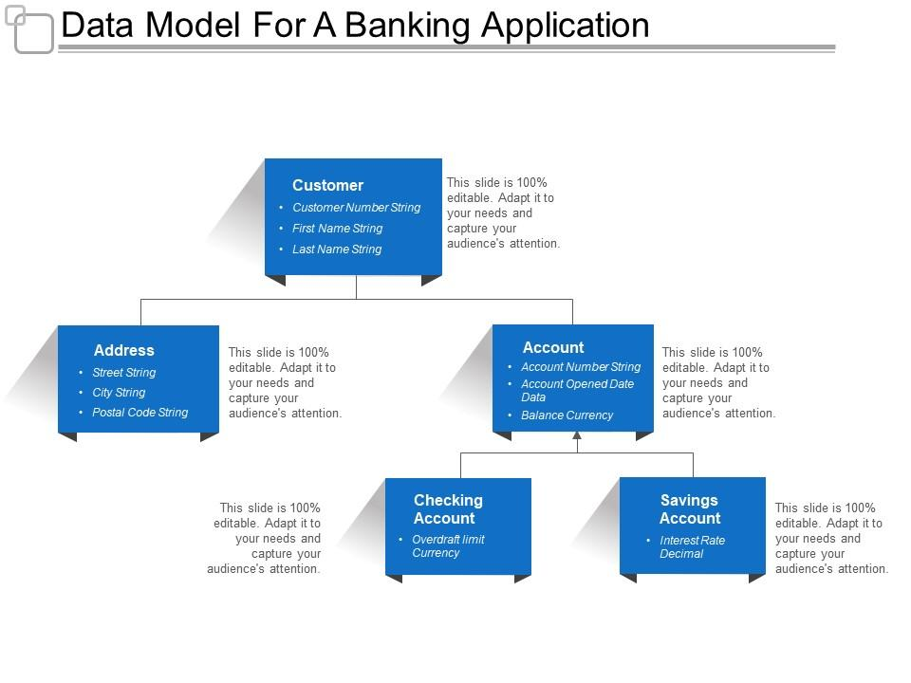

Slide 38
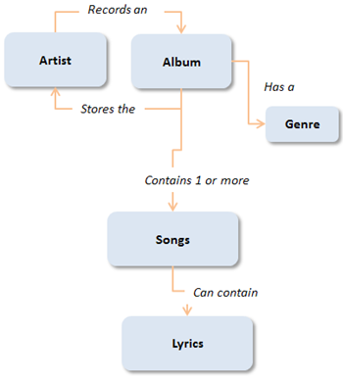

Slide 39
Object Models……..
Objected-oriented modeling is centered around the concepts of object and class
An object is an entity described in terms of attributes (data) and operations (functionality)
A class is a template for objects that have similar features (attributes and operations).
More exactly, the objects that belong to the same class have the same structure and behavior,

Slide 40
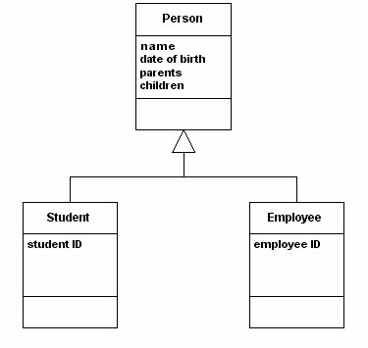
Inheritance model

Slide 41
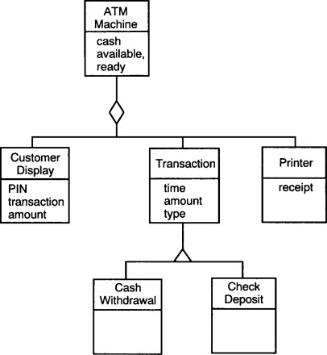
Object Aggregation Model

Slide 42
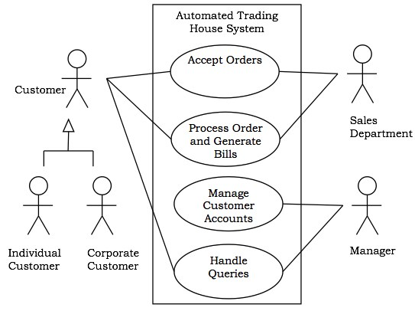
Object behaviour modelling

Slide 43
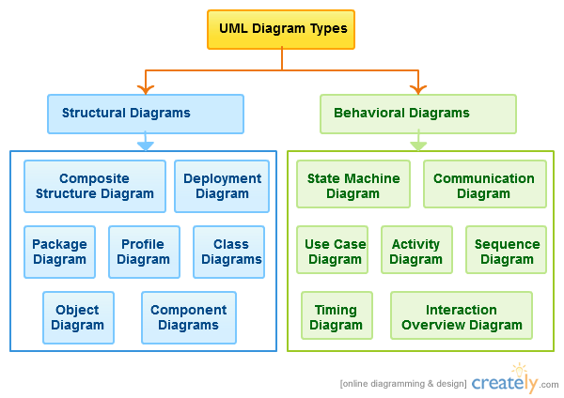
UML
UML (Unified Modeling Language) is a general-purpose, graphical modeling language in the field of Software Engineering. UML is used to specify, visualize, construct, and document the artifacts (major elements) of the software system.

Slide 45
