Slide 1
LET’S START WITH A QUESTION……

Slide 2
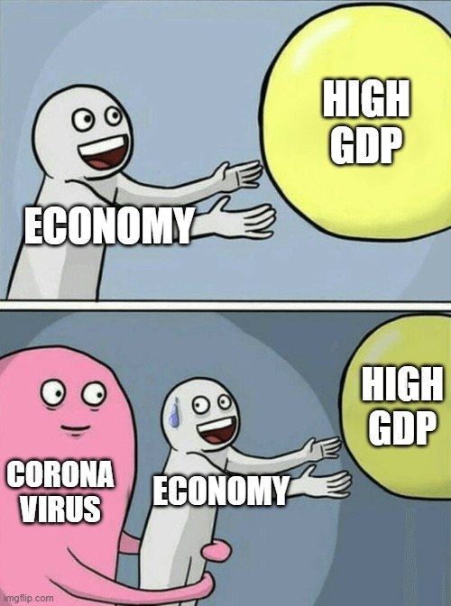

Slide 3
CANADIAN PERSPECTIVE SURVEY SERIES 3, 2020: RESUMING ECONOMIC AND SOCIAL ACTIVITIES DURING COVID-19
GROUP C – 12 CHARMIE THAKKER & DEEP JARIWALA

Slide 4
TABLE OF CONTENT
INTRODUCTION
ABOUT THE DATA (DESCRIPTION AND STATS)
LITERATURE REVIEW
HYPOTHESES AND MODEL
RESULTS
CONCLUSION

Slide 5
INTRODUCTION
Covid-19 pandemic has hit hard the across the globe and it resulted in the lowering of the economic growth of the countries.
Currently, businesses are coping with lost revenue and disrupted supply chains as factory shutdowns and quarantine measures spread across the globe, restricting movement and commerce.
Covid-19 has brought a shift of 180 degrees to the lifestyle of every individual and their spending habits on various things which has a significant impact on nation's economy.

Slide 6
CONTINUE…
To analyze the impact of the change in spending habits and economic recovery due to COVID-19, we decided to go ahead with the series 3 dataset out of the survey.
The Canadian Perspectives Survey Series (CPSS) is a set of short, online surveys beginning in March 2020 which was used to collect information on the knowledge and behaviors of residents of the 10 Canadian provinces.
Objective: To summarize the change in spending habits of the people on food, clothing, medicines and public transportation due to different health risk concerns and precaution measures like social gathering and wearing a mask

Slide 7
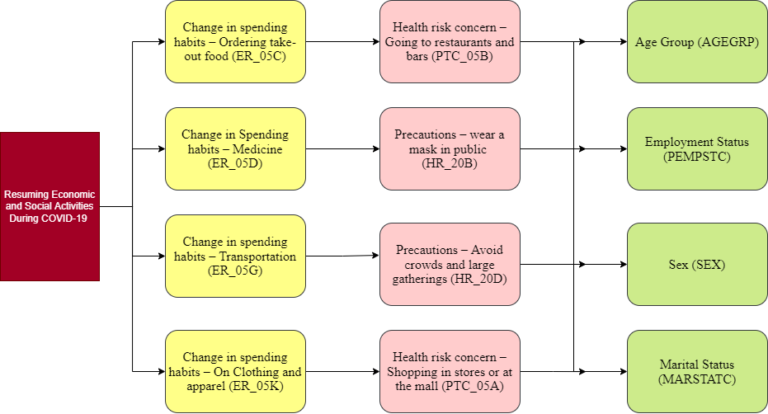

Slide 8
LITERATURE REVIEW
Literature Review | Result
As per the survey conducted by Food Canada, nearly 45% of Canadians have picked up the curb-side pick up of food due to risk of Covid-19 and it has remained still same after the downfall of the COVID cases. | Literature supports hypothesis
Amount spend on medicine has increased by 12% compared to pre-covid but not due to precautions taken. | Literature does not support hypothesis
Approximately 30% of Canadians have stopped using public transport as a precaution to COVID-19. | Literature supports hypothesis
There is reduction of 84% in in-store shopping of clothes and apparel due to COVID which resulted in whopping increase of around 85% in online shopping. | Literature supports hypothesis

Slide 9
CONTROL VARIABLES
Variables | Observations | Mean | Standard Deviation | Variable type | Min | Max
AGE GROUP | 4082 | 4.25 | 1.6364 | Ordinal | 1 | 7
SEX | 4082 | 1.54 | 0.4982 | Binary | 1 | 2
PEMPSTC | 4082 | 2.31 | 1.4548 | Numeric | 1 | 4
MARSTATC | 4082 | 2.07 | 1.2361 | Numeric | 1 | 4
Variables | Skewness | Kurtosis
AGE GROUP | - 0.19638 | - 0.9354
SEX | - 0.17403 | - 1.9701
PEMPSTC | 0.2458 | - 1.8893
MARSTATC | 0.55285 | - 1.3821

Slide 10
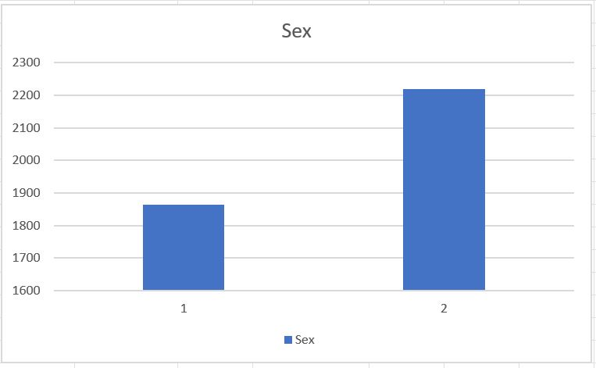
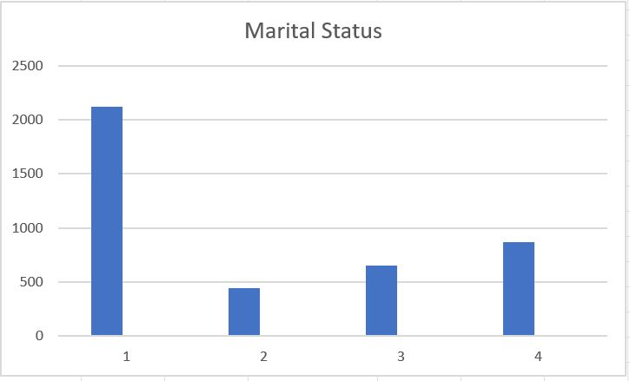
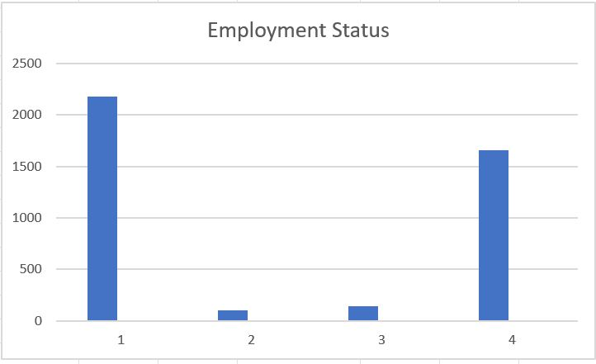
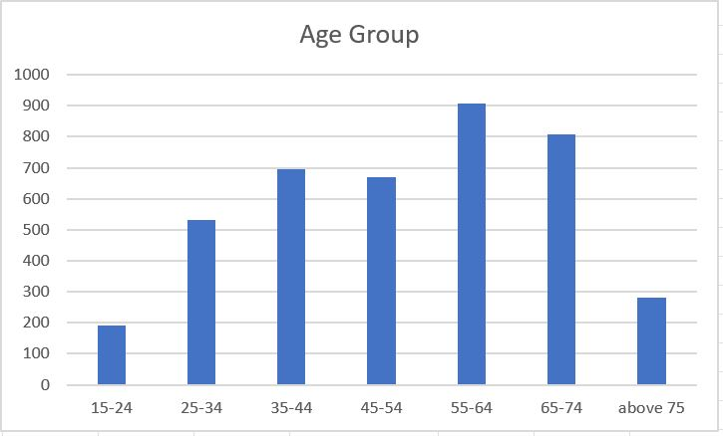

Slide 11
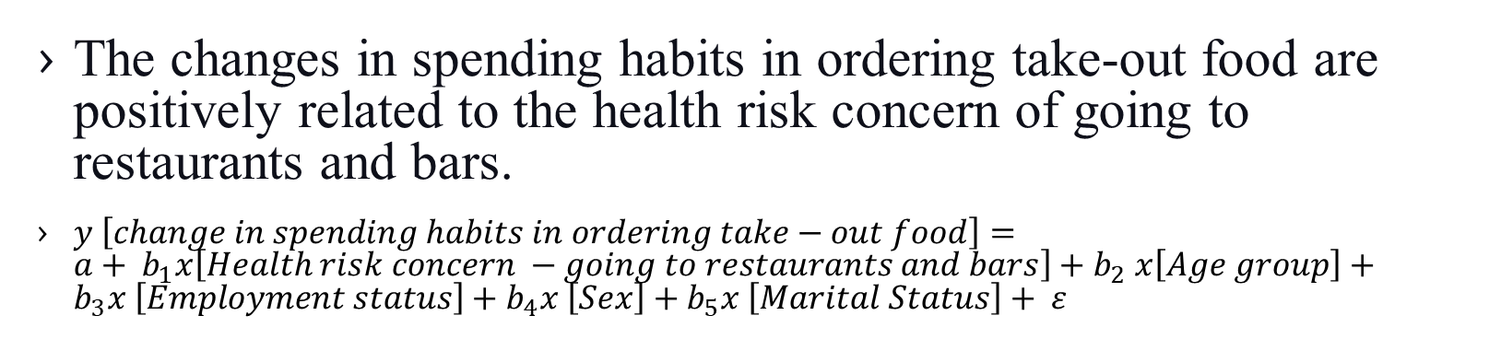
HYPOTHESIS 1
The changes in spending habits in ordering take-out food are positively related to the health risk concern of going to restaurants and bars.
$y \left[change in spending habits in ordering take−out food\right]={a+ b}_{1}x\left[Health risk concern −going to restaurants and bars\right]{+ b}_{2}x\left[Age group\right]+b_{3}x \left[Employment status\right]+b_{4}x \left[Sex\right]+b_{5}x \left[Marital Status\right]+ ε$
Variables | Observations | Mean | Standard deviation | Variable type
Change in spending habits – Ordering take out food (ER_05C) | 4082 | 2.55 | 0.8532 | DV- Numeric
Health risk concern – Going to restaurants and bars (PTC_20B) | 4082 | 1.16 | 0.7381 | IDV – Numeric

Slide 12
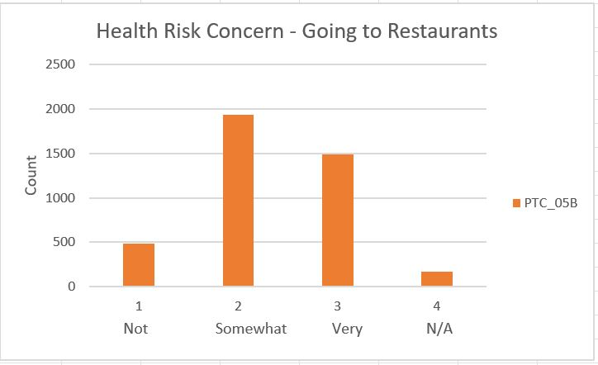
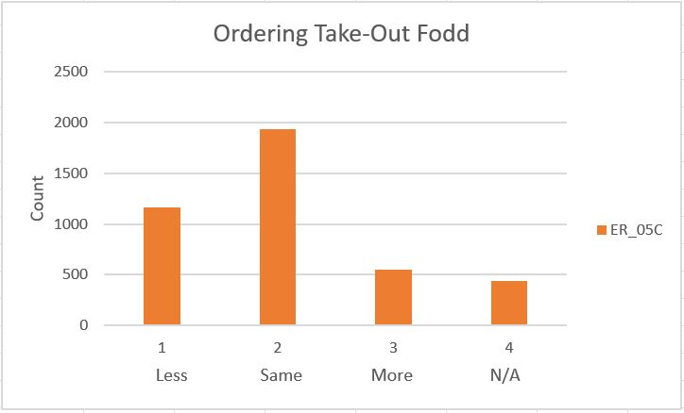
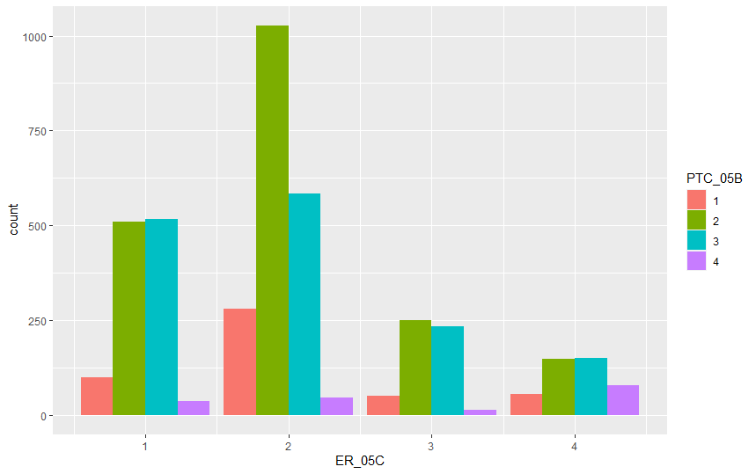

Slide 13
OLS REGRESSION MODEL RESULTS SUMMARY
 | Estimate | Std. Error | T - value | Pr ( >|t|) | Signif.
Intercept | 1.667838 | 0.077866 | 21.419 | < 2e-06 | ***
PTC_05B | 0.048014 | 0.019603 | 2.449 | 0.0144 | *
MARSTATC | 0.029967 | 0.012014 | 2.494 | 0.0127 | *
SEX | 0.005714 | 0.029051 | 0.197 | 08441 | -
AGEGRP | 0.040128 | 0.010188 | 3.939 | 8.32e-05 | ***
PEMPSTC | 0.017680 | 0.011105 | 1.532 | 0.11114 | -
Significance Code: 0 ‘***’ 0.001 ‘**’ 0.01 ‘*’ 0.05 ‘ . ’ 0.1 ‘ ’ 1
Metric | Value
Multiple – R - squared | 0.01013
Adjusted – R - squared | 0.008914
F - Statistic | 8.341 on 5 and 4076 DF
P - value | < 7.4e-08

Slide 14
ORDINAL LOGISTIC MODEL RESULTS SUMMARY
 | Value | Std. Error | T - value | P-Value
PTC_05B2 | -0.26029909 | 0.09337460 | -2.7876862 | 5.308594e-03
PTC_05B3 | -0.35770807 | 0.09785787 | -3.6553836 | 2.567977e-04
PTC_05B4 | 1.16105255 | 0.17993666 | 6.4525625 | 1.099745e-10
AGEGRP 2 | -0.07834118 | 0.16233799 | -0.4825807 | 6.293935e-01
AGEGRP 3 | -0.18052264 | 0.16306509 | -1.1070588 | 2.682685e-01
AGEGRP 4 | -0.19731530 | 0.16461695 | -1.1986330 | 2.306707e-01
AGEGRP 5 | -0.11786229 | 0.16163675 | -0.7291801 | 4.658915e-01
AGEGRP 6 | 0.17249947 | 0.16736632 | 1.0306702 | 3.026955e-01
AGEGRP 7 | 0.51233725 | 0.19759683 | 2.5928415 | 9.518664e-03
SEX 2 | 0.03413456 | 0.06028564 | 0.5662137 | 5.712485e-01
PEMPSTC 2 | 0.15806737 | 0.18570051 | 0.8511952 | 3.946609e-01
PEMPSTC 3 | -0.18008467 | 0.16737258 | -1.0759508 | 2.819492e-01

Slide 15
ORDINAL LOGISTIC MODEL RESULTS SUMMARY
 | Value | Std. Error | T - value | P-Value
PEMPSTC 4 | -0.03648512 | 0.07438639 | -0.4904811 | 6.237935e-01
MARSTATC 2 | 0.05657585 | 0.0984 5444 | 0.5746399 | 5.655348e-01
MARSTATC 3 | -0.05452895 | 0.08626230 | -0.6321295 | 5.273022e-01
MARSTATC 4 | 0.10090962 | 0.08483050 | 1.1895440 | 2.342257e-01
1|2 | -1.17016148 | 0.17776957 | -6.5824622 | 4.627206e-11
2|3 | 0.93792934 | 0.17697048 | 5.2999198 | 1.158536e-07
3|4 | 1.94712543 | 0.18069098 | 10.7759968 | 4.469148e-27
AIC : 9858.894 & Residual Deviance: 9820.894

Slide 16
ASSUMPTION TEST AND RESIDUALS
TEST | RESULT
Durbin Watson Test | DW = 2.0317, p-value = 0.8444
Shapiro-Wilk Normality test (ER_05C) | W = 0.8277, p-value < 2.2e-16
Shapiro-Wilk Normality test (PTC_05B) | W = 0.84322, p-value < 2.2e-16
Mean V. I. F regression model | 1.152482
Correlation between PTC_05B & ER_05C | z = 0.29505, p-value = 0.768 tau = 0.00407957
Chi-Square Test of independence | X-squared = 656.09, df = 4081, p-value = 1

Slide 17
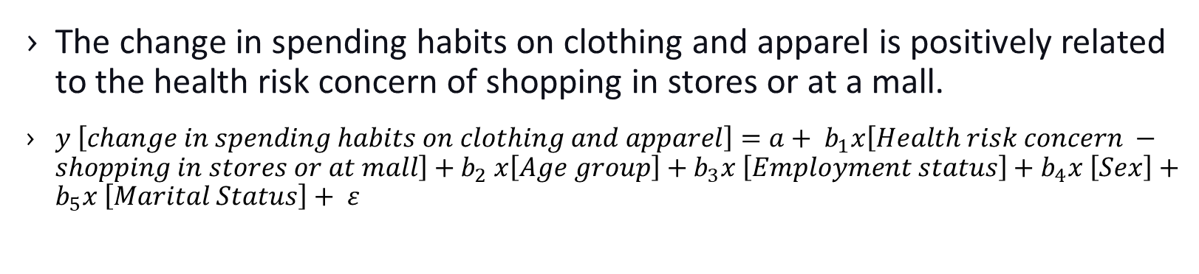
HYPOTHESIS 2
The change in spending habits on clothing and apparel is positively related to the health risk concern of shopping in stores or at a mall.
$y \left[change in spending habits on clothing and apparel\right]={a+ b}_{1}x\left[Health risk concern −shopping in stores or at mall\right]{+ b}_{2}x\left[Age group\right]+b_{3}x \left[Employment status\right]+b_{4}x \left[Sex\right]+b_{5}x \left[Marital Status\right]+ ε$
Variables | Observations | Mean | Standard deviation | Variable type
Change in spending habits – On Clothing and apparel (ER_05K) | 4082 | 1.86 | 0.7279 | DV- Numeric
Health risk concern – Shopping in stores or at the mall (PTC_05A) | 4082 | 2.10 | 0.6310 | IDV – Numeric

Slide 18
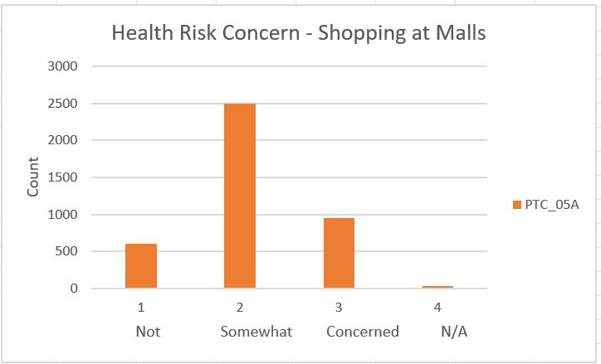
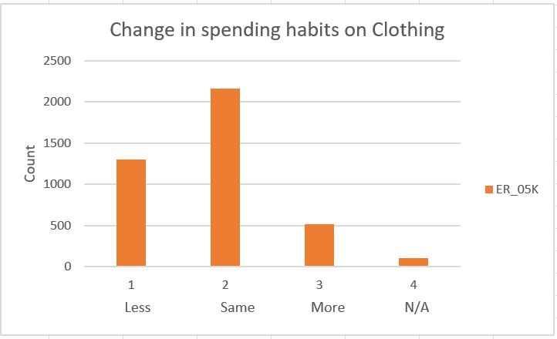
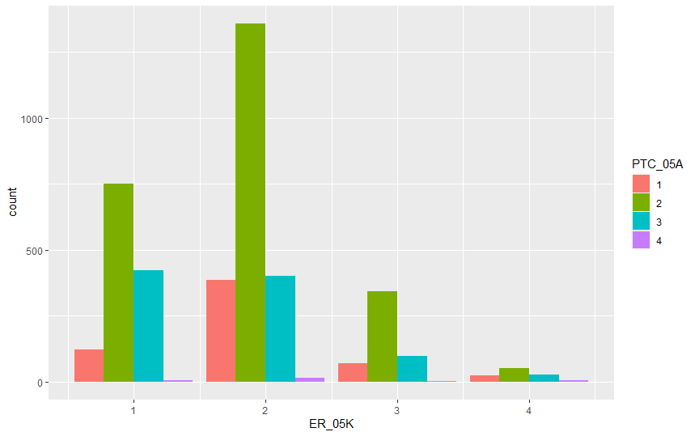

Slide 19
OLS REGRESSION MODEL RESULTS SUMMARY
 | Estimate | Std. Error | T - value | Pr ( >|t|) | Signif.
Intercept | 2.189883 | 0.062930 | 34.799 | < 2e-16 | ***
PTC_05A | -0.113838 | 0.018045 | -6.309 | 3.11e-10 | ***
MARSTATC | 0.029607 | 0.009494 | 3.118 | 0.001831 | **
SEX | -0.078638 | 0.023003 | -3.419 | 0.000636 | ***
AGEGRP | -0.024359 | 0.008019 | -3.038 | 0.002398 | **
PEMPSTC | 0.031372 | 0.008774 | 3.576 | 0.000354 | ***
Significance Code: 0 ‘***’ 0.001 ‘**’ 0.01 ‘*’ 0.05 ‘ . ’ 0.1 ‘ ’ 1
Metric | Value
Multiple – R - squared | 0.01977
Adjusted – R - squared | 0.01856
F - Statistic | 16.44 on 5 and 4076 df
P - value | 4.25e-16

Slide 20
ORDINAL LOGISTIC MODEL RESULTS SUMMARY
 | Value | Std. Error | T - value | P-Value
PTC_05A2 | -0.27837768 | 0.08718140 | -3.1930857 | 1.407611e-03
PTC_05A3 | -0.80168879 | 0.10178658 | -7.8761736 | 3.375591e-15
PTC_05A4 | 0.61845713 | 0.38577521 | 1.6031542 | 1.089006e-01
AGEGRP 2 | -0.33318384 | 0.17178865 | -1.9394986 | 5.244065e-02
AGEGRP 3 | -0.54027425 | 0.17199323 | -3.1412530 | 1.682266e-03
AGEGRP 4 | -0.65607790 | 0.17290819 | -3.7943716 | 1.480179e-04
AGEGRP 5 | -0.61285588 | 0.16985877 | -3. 6080321 | 3.085283e-04
AGEGRP 6 | -0.61035259 | 0.17493633 | -3.4889985 | 4.848338e-04
AGEGRP 7 | -0.45858559 | 0.20333758 | -2.2552919 | 2.411501e-02
SEX 2 | -0.24908897 | 0.06214301 | -4.0083186 | 6.115257e-05
PEMPSTC 2 | 0.08337769 | 0.19606090 | 0.4252642 | 6.706441e-01
PEMPSTC 3 | -0.22334162 | 0.17125606 | -1.3041385 | 1.921864 e-01

Slide 21
ORDINAL LOGISTIC MODEL RESULTS SUMMARY
 | Value | Std. Error | T - value | P-Value
PEMPSTC 4 | 0.13558214 | 0.07670350 | 1.7676133 | 7.712557e-02
MARSTATC 2 | 0.22645996 | 0.10289945 | 2.2007887 | 2.775098e-02
MARSTATC 3 | 0.04646415 | 0.08852802 | 0.248525 | 5.996857e-01
MARSTATC 4 | 0.19268818 | 0.08679079 | 2. 2201455 | 2.640889e-02
1|2 | -1.67179558 | 0.18521669 | -9.0261604 | 1.778009e-19
2|3 | 0.87560977 | 0.18347926 | 4.7722548 | 1.821748e-06
3|4 | 2.78260921 | 0.20240228 | 13.7479147 | 5.241875e-43
AIC : 8522.637 & Residual Deviance: 8484.637

Slide 22
ASSUMPTION TEST AND RESIDUALS
TEST | RESULT
Durbin Watson Test | DW = 1.9479, p-value = 0.04799
Shapiro-Wilk Normality test (ER_05K) | W = 0.80526, p-value < 2.2e-16
Shapiro-Wilk Normality test (PTC_05A) | W = 0.78907, p-value < 2.2e-16
Mean V. I. F regression model | 1.149368
Correlation between PTC_05A & ER_05K | z = -8.2368, p-value < 2.2e-16 tau = -0.1174593
Chi-Square Test of independence | X-squared = 656.09, df = 4081, p-value = 1

Slide 23
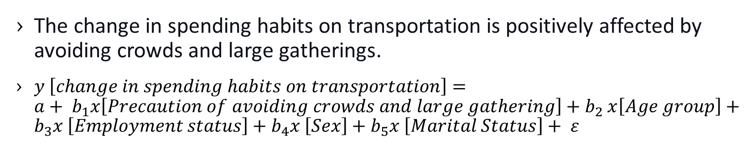
HYPOTHESIS 3
The change in spending habits on transportation is positively affected by avoiding crowds and large gatherings.
$y \left[change in spending habits on transportation\right]={a+ b}_{1}x\left[Precaution of avoiding crowds and large gathering\right]{+ b}_{2}x\left[Age group\right]+b_{3}x \left[Employment status\right]+b_{4}x \left[Sex\right]+b_{5}x \left[Marital Status\right]+ ε$
Variables | Observations | Mean | Standard deviation | Variable type
Change in spending habits on transportation (ER_05G) | 4082 | 2.46 | 0.7432 | DV- Numeric
Precautions – Avoid crowds and large gathering (HR_20D) | 4082 | 1.37 | 0.6311 | IDV – Numeric

Slide 24
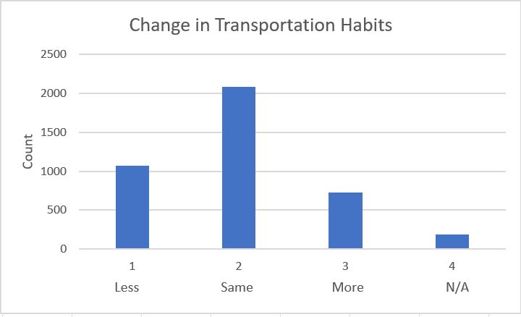
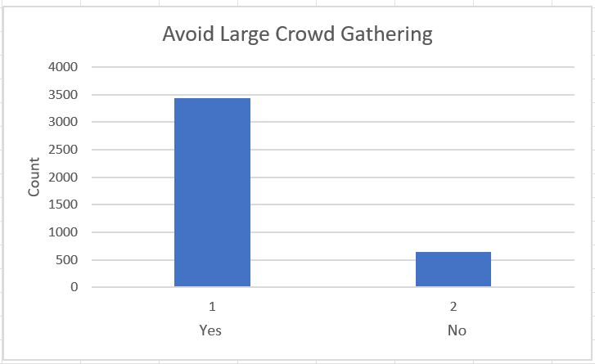
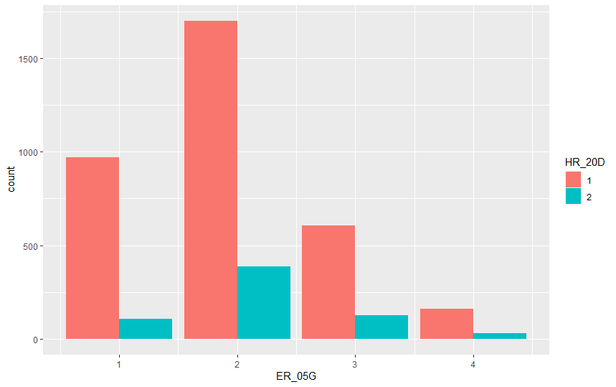

Slide 25
OLS REGRESSION MODEL RESULTS SUMMARY
 | Estimate | Std. Error | T - value | Pr ( >|t|) | Signif.
Intercept | 1.684866 | 0.075898 | 22.199 | < 2e-16 | ***
HR_20D | 0.138986 | 0.034344 | 4.047 | 5.29e-05 | ***
MARSTATC | 0.028863 | 0.010399 | 2.776 | 0.005533 | **
SEX | 0.040116 | 0.025162 | 1.594 | 0.110944
AGEGRP | -0.008227 | 0.008807 | -0.934 | 0.350298
PEMPSTC | 0.033037 | 0.009603 | 3.440 | 0.000587 | ***
Significance Code: 0 ‘***’ 0.001 ‘**’ 0.01 ‘*’ 0.05 ‘ . ’ 0.1 ‘ ’ 1
Metric | Value
Multiple – R - squared | 0.009983
Adjusted – R - squared | 0.008769
F – Statistic | 8.22 on 5 and 4076 DF
P – value | 9.777e-08

Slide 26
ORDINAL LOGISTIC MODEL RESULTS SUMMARY
 | Value | Std. Error | T - value | P-Value
HR_20D2 | 0.36492667 | 0.0807511 | 4.5200491 | 6.182528e-06
MARSTATC 2 | 0.23190745 | 0.10114305 | 2.2928659 | 2.185573e-02
MARSTATC 3 | 0.04538370 | 0.08628553 | 0.5259711 | 5.989083e-01
MARSTATC 4 | 0.17397286 | 0.08458484 | 2.0567853 | 3.970688e-02
SEX 2 | 0.08497839 | 0.06078734 | 1.3979620 | 1.621245e-01
AGEGRP 2 | -0.38597172 | 0.16929669 | -2.2798539 | 2.261635e-02
AGEGRP 3 | -0.54872359 | 0.16902730 | -3.2463607 | 1.168906e-03
AGEGRP 4 | -0.51201355 | 0.17032529 | -3.0060923 | 2.646287e-03
AGEGRP 5 | -0.44689815 | 0.16684289 | -2.6785568 | 7.394020e-03
AGEGRP 6 | -0.34963744 | 0.17214549 | -2.0310578 | 4.224914e-02
AGEGRP 7 | -0.33676913 | 0.20121541 | -1.6736747 | 9.419455e-02

Slide 27
ORDINAL LOGISTIC MODEL RESULTS SUMMARY
 | Value | Std. Error | T - value | P-Value
PEMPSTC 2 | 0.15652015 | 0.19072849 | 0.8206438 | 4.118492e-01
PEMPSTC 3 | 0.24602879 | 0.17297613 | 1.4223280 | 1.549311e-01
PEMPSTC 4 | 0.08942469 | 0.07477456 | 1.1959240 | 2.317262e-01
1|2 | -1.23723865 | 0.17035113 | -7.2628730 | 3.789537e-13
2|3 | 1.04777788 | 0.16995687 | 6.1649635 | 7.049938e-10
3|4 | 2.84400116 | 0.18055696 | 15.7512685 | 6.731732e-56
AIC : 9327.493 & Residual Deviance: 9293.493

Slide 28
ASSUMPTION TEST AND RESIDUALS
TEST | RESULT
Durbin Watson Test | DW = 1.9837, p-value = 0.301
Shapiro-Wilk Normality test (ER_05G) | W = 0.83457, p-value < 2.2e-16
Shapiro-Wilk Normality test (HR_20D) | W = 0.43771, p-value < 2.2e-16
Mean V. I. F regression model | 1.153087
Correlation between HR_20D & ER_05G | z = 4.5214, p-value = 6.143e-06 tau = 0.06654852

Slide 29
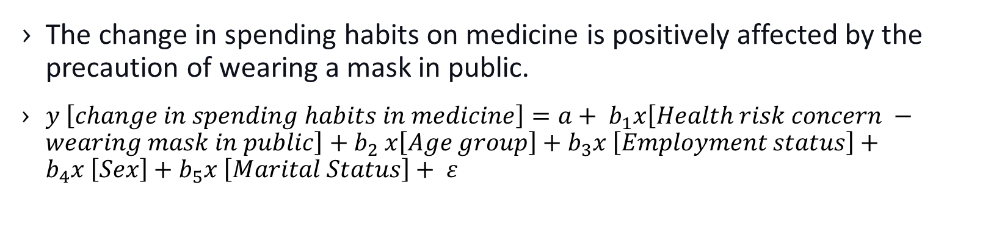
HYPOTHESIS 4
The change in spending habits on medicine is positively affected by the precaution of wearing a mask in public.
$y \left[change in spending habits in medicine\right]={a+ b}_{1}x\left[Health risk concern −wearing mask in public\right]{+ b}_{2}x\left[Age group\right]+b_{3}x \left[Employment status\right]+b_{4}x \left[Sex\right]+b_{5}x \left[Marital Status\right]+ ε$
Variables | Observations | Mean | Standard deviation | Variable type
Change in spending habits – Medicine (ER_05D) | 4082 | 2.98 | 0.5435 | DV- Numeric
Precautions – Wear a mask in pubic (HR_20B) | 4082 | 2.10 | 0.4819 | IDV – Numeric

Slide 30
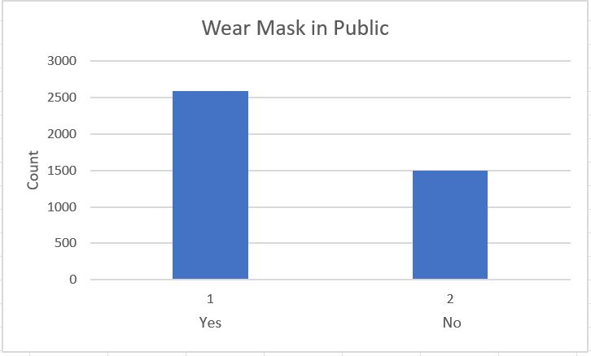
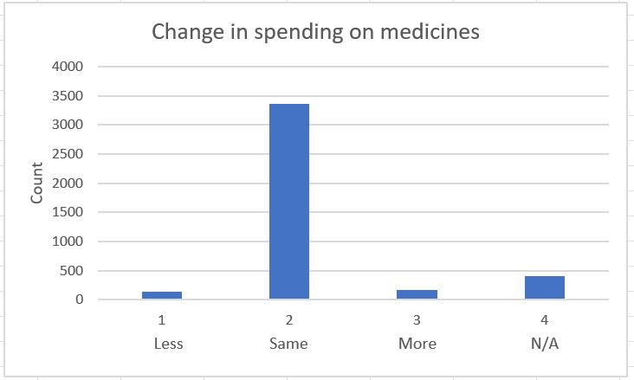
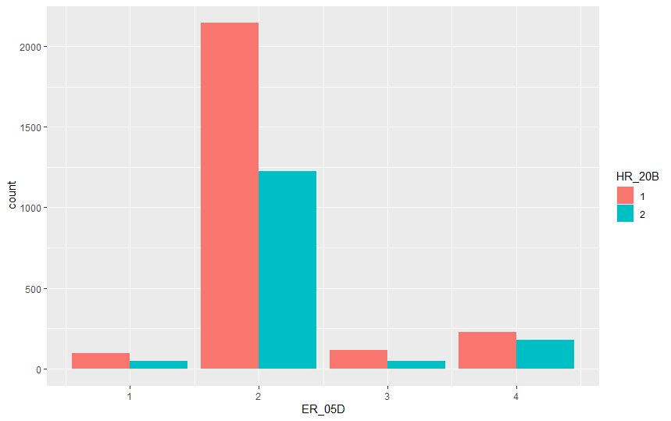

Slide 31
OLS REGRESSION MODEL RESULTS SUMMARY
 | Estimate | Std. Error | T - value | Pr ( >|t|) | Signif.
Intercept | 2.166 | 0.06180 | 35.052 | < 2e-16 | ***
HR_20B | 0.03577 | 0.02171 | 1.647 | 0.0995 | .
MARSTATC | 0.03560 | 0.008603 | 4.139 | 3.56e-05 | ***
SEX | 5.788e-05 | 0.02087 | 0.003 | 0.9978
AGEGRP | -0.01424 | 0.007293 | -1.952 | 0.0510 | .
PEMPSTC | -0.01111 | 0.007948 | -1.398 | 0.1623
Significance Code: 0 ‘***’ 0.001 ‘**’ 0.01 ‘*’ 0.05 ‘ . ’ 0.1 ‘ ’ 1
Metric | Value
Multiple – R - squared | 0.007644
Adjusted – R - squared | 0.00643
F - Statistic | 6.295 on 5 and 4086 DF
P - value | 7.933e-06

Slide 32
ORDINAL LOGISTIC MODEL RESULTS SUMMARY
 | Value | Std. Error | T - value | P-Value
HR_20B 2 | 0.11980771 | 0.08715647 | 1.3746278 | 1.692469e-01
AGEGRP 2 | -0.64817086 | 0.21377453 | -3.0320303 | 2.429148e-03
AGEGRP 3 | -0.52880218 | 0.21172586 | -2.4975795 | 1.250444e-02
AGEGRP 4 | -0.46736684 | 0.21246006 | -2.1997868 | 2.782203e-02
AGEGRP 5 | -0.38513799 | 0.20768264 | -1.8544544 | 6.3671418e-02
AGEGRP 6 | -0.46746919 | 0.21647392 | -2.2594712 | 3.081363e-02
AGEGRP 7 | -0.59797813 | 0.26037693 | -2.2965865 | 2.164237e-02
SEX 2 | 0.01291398 | 0.08510337 | 0.15117446 | 8.793884e-01
PEMPSTC 2 | -0.09108721 | 0.26663303 | -0.3416021 | 7.326368e-01
PEMPSTC 3 | 0.9190576 | 0.22625763 | 0.4061996 | 6.845959e-01
PEMPSTC 4 | -0.19348494 | 1.10400047 | -1.8604238 | 6.282560e-02

Slide 33
ORDINAL LOGISTIC MODEL RESULTS SUMMARY
 | Value | Std. Error | T - value | P-Value
MARSTATC 2 | 0.06545861 | 1.43339413 | 0.4564943 | 6.480345e-01
MARSTATC 3 | 0.12361538 | 0,12158008 | 1.0167404 | 3.092770e-01
MARSTATC 4 | 0.37173283 | 0.11642590 | 3.1928707 | 1.408660e-03
1|2 | -3.72779489 | 0.23050351 | -16.1723998 | 7.896170e-59
2|3 | 1.45026401 | 0.21689036 | 6.6866226 | 2.283798e-11
3|4 | 1.84307379 | 0.21825969 | 8.4444075 | 3.055913e-17
AIC : 5174.544 & Residual Deviance: 5140.544

Slide 34
ASSUMPTION TEST AND RESIDUALS
TEST | RESULT
Durbin Watson Test | DW = 1.9964, p-value = 0.4542
Shapiro-Wilk Normality test (ER_05D) | W = 0.5214, p-value < 2.2e-16
Shapiro-Wilk Normality test (HR_20B) | W = 0.61017, p-value < 2.2e-16
Mean V. I. F regression model | 1.160427
Correlation between HR_20B & ER_05D | z = 2.0739, p-value = 0.03809 tau = 0.03165979

Slide 35
FINAL RESULTS
HYPOTHESIS | EXPECTED RESULT | FINAL RESULT
The changes in spending habits in ordering take-out food are positively related to the health risk concern of going to restaurants and bars. | Positive | Positive
The change in spending habits on clothing and apparel is positively related to the health risk concern of shopping in stores or at a mall. | Positive | Positive
The change in spending habits on transportation is positively affected by avoiding crowds and large gatherings. | Positive | Positive
The change in spending habits on medicine is positively affected by the precaution of wearing a mask in public. | Positive | Positive

Slide 36

THANK YOU
for listening to us

Slide 37
REFERENCES
Many Canadians intend to order food online at least weekly after the pandemic - Food In CanadaFood In Canada
Online shopping has doubled during the pandemic, Statistics Canada says | CBC News
Canadians avoid public transit due to COVID-19 - Plant.caPlant.ca
Health care spending in Canada to surge beyond $300-billion due to COVID-19, report says - The Globe and Mail

