Slide 1
CAR PRICE PREDICTION
DEEPJOY DEY
BT18CS008

Slide 2
Content
Aim
What this project does
How this project does
Flow chart
Glimpse of the project

Slide 3
Aim
This project aims to predict the Price of an used Car by taking it's Company name, it's Model name, Year of Purchase, and other parameters.

Slide 4
What this project does?
This project takes the parameters of an used car like: Company name, Model name, Year of Purchase, Fuel Type and Number of Kilometers it has been driven.
It then predicts the possible price of the car.

Slide 5
Dataset Features
Car Name
Car Company
Year
KMS Driven
Fuel type
Price

Slide 6
How this project does?
First of all the data was scraped from Quikr.com
The data was cleaned and analysed..
This project was given the form of an website built on Flask where we used the Linear Regression model to perform predictions.

Slide 7
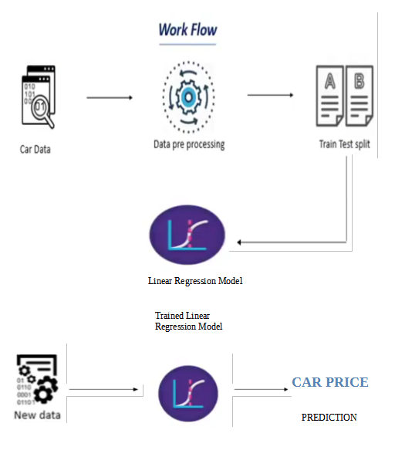

Slide 8
Why do we need this
It will make an easy way for the users to know the approximate price of the car they want to buy

Slide 9
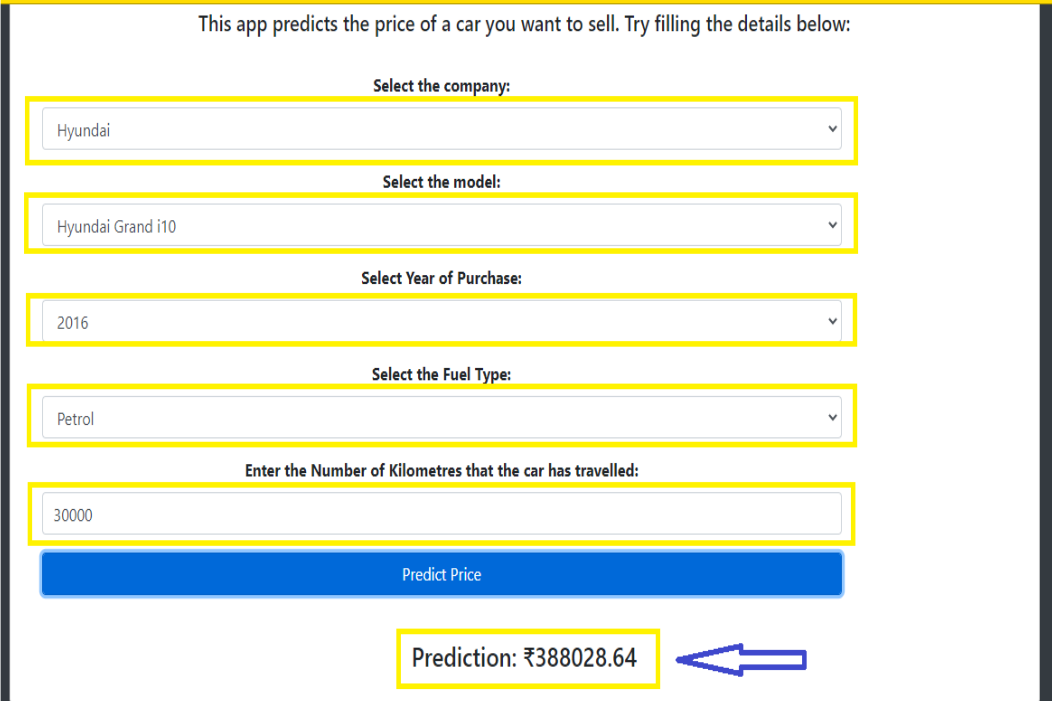
Glimpse of the result

Slide 10
THANK YOU

