Slide 1
RISC-V

Slide 2








Eight Great Ideas
Link
Design for Moore’s Law
Use abstraction to simplify design
Make the common case fast
Performance via parallelism
Performance via pipelining
Performance via prediction
Hierarchy of memories
Dependability via redundancy

Slide 3
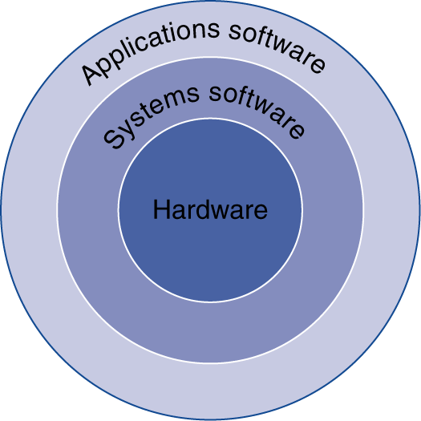
Below Your Program
Application software
Written in high-level language
System software
Compiler: translates HLL code to machine code
Operating System: service code
Handling input/output
Managing memory and storage
Scheduling tasks & sharing resources
Hardware
Processor, memory, I/O controllers

Slide 4
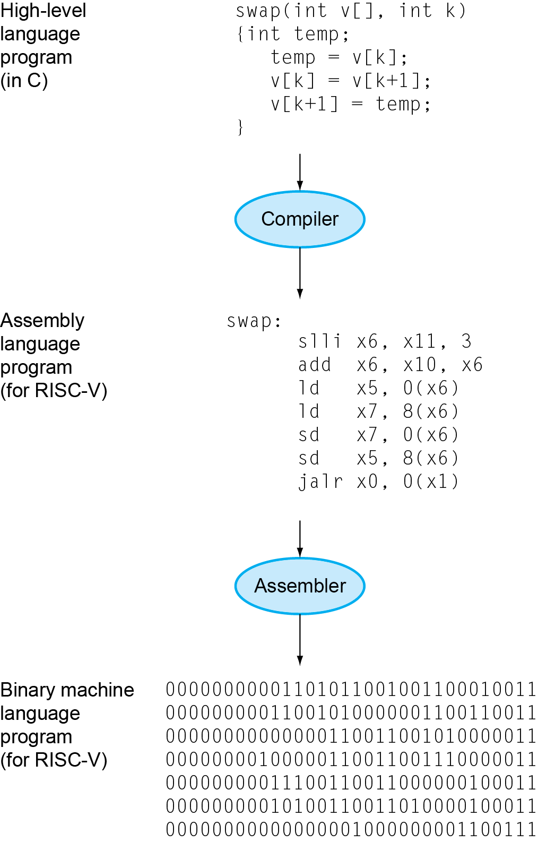
Levels of Program Code
High-level language
Level of abstraction closer to problem domain
Provides for productivity and portability
Assembly language
Textual representation of instructions
Hardware representation
Binary digits (bits)
Encoded instructions and data

Slide 5
Why RISC V?
Silicon vendors look for ways to innovate, reduce costs and stay ahead of the competition, many are now turning to RISC-V, the open standard instruction set architecture (ISA).
RISC-V is enabling a new, collaborative era of processor innovation.
Because it’s open standard, architects, designers and developers can modify and improve upon the existing ISA codebase as needed.
This flexibility has allowed teams to experiment with architectures and chip designs within the same ISA and has enabled a collaborative environment

Slide 6
History of RISC-V.
The development of the RISC-V standard began in 2010 when researchers at the University of California, Berkeley created a simple, yet powerful ISA that could be used by anyone with minimal restrictions.
It was released in 2015 as a free and open-standard ISA that allows anyone to design, manufacture and sell processors based on the RISC-V specification — without royalties or license fees.
Now managed by the RISC-V Foundation (riscv.org)

Slide 7
Industry Opinion about RISC V & Applications
RISC-V has grown rapidly due to its flexibility and cost-saving benefits because it can be an ideal way to customize computing environments without the high costs of proprietary ISA’s.
These advantages are quickly being recognized across industries, and businesses have been taking advantage of RISC-V cores for all kinds of applications including LINK
Artificial intelligence (AI) image sensors,
Security management,
AI computing,
Machine control systems for 5G networks, and
More sophisticated storage, graphics and machine learning applications.

Slide 8
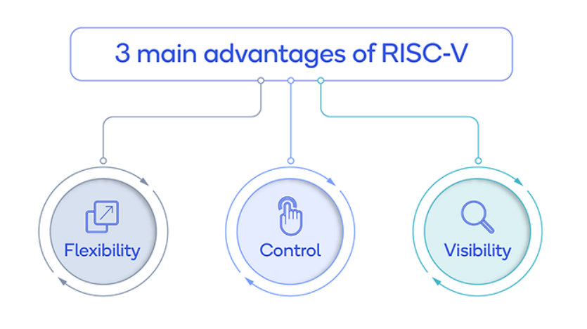

Slide 9
Advantage of RISC V
The 3 main advantages of RISC-V
Flexibility: RISC-V offers a unique set of features that allow users to customize and optimize both software and hardware for specific use cases, resulting in faster development cycles and better design tradeoffs for performance, power and area.
Control: This open ISA provides designers and developers with greater control over their computing environments, allowing them to fine-tune their systems without relying on third parties or incurring additional license fees associated with proprietary architectures.
Visibility: The open-standard nature of RISC-V also means that developers have more visibility into the codebase, making it easier to understand the roadmap and identify potential security risks before they become an issue.

Slide 10
ARM vs RISC V : ISA Comparison
ISAs can be broadly categorized into two types:
Open ISA
Closed ISA
Closed ISAs, like ARM, are proprietary and tightly controlled by specific companies (Arm Holdings here), offering established reliability and compatibility but limiting customization.
Open ISAs, exemplified by RISC-V, are community-driven and provide greater flexibility for customization, fostering innovation and adaptation to specific needs.

Slide 11
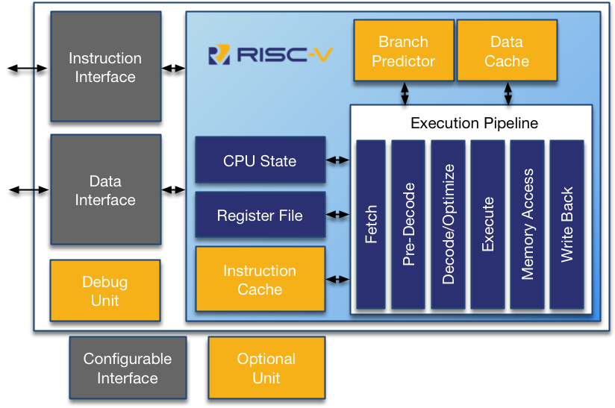
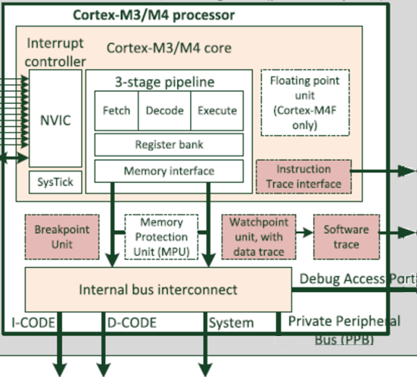
ARM vs RISC V : Architectural Overview
16bit compressed instruction is decompressed into 32bit Instruction

Slide 12
ARM vs RISC V : Performance
In the performance comparison between RISC-V and ARM,
ARM's consistent iteration, comprehensive ecosystem, and wide range of options give it a notable performance advantage.
However, RISC-V's modular nature and customization potential hold promise for specific use cases. The ongoing efforts of RISC-V proponents to narrow the performance gap will be a crucial factor in determining how well RISC-V can match ARM's established performance standards in the future.

Slide 13
ARM vs RISC V : Power Efficiency
ARM's refined power management techniques and specialized cores give it a major advantage in power efficiency.
While RISC-V holds promise due to its customization potential, its open nature requires a more extensive investment of time and resources to fully harness its energy-saving capabilities.

Slide 14
RISC V Architecture
The RISC-V architecture is based on the RISC principles (as compared to CISC), which emphasize a small, simple, and efficient instruction set.
The key architectural features of RISC-V include
load-store architecture
fixed-length 32-bit instruction format
small number of general-purpose registers
RISC-V supports various integer instruction set extensions, such as RV32I (32-bit), RV64I (64-bit), and RV128I (128-bit), which define the base integer instruction set for different address space sizes.
RISC-V utilizes little-endian byte ordering within the memory system, implying that the smallest significant byte of multi-byte data is stored at the lowest memory address.

Slide 15
RISC V Architecture: Modularity & Extensibility
One of the defining characteristics of RISC-V is its modularity and extensibility.
The ISA is designed to be easily extended with custom instructions and coprocessors, allowing for tailored implementations that meet specific application requirements.
This flexibility is achieved through a modular design, where the base ISA can be combined with optional standard extensions, such as the M extension for integer multiplication and division, the A extension for atomic operations, and the F and D extensions for single- and double-precision floating-point arithmetic.

Slide 16
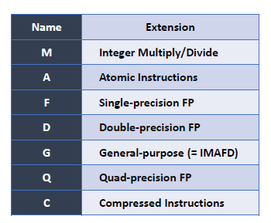
Standard extensions
Standard RISC encoding in a fixed 32- bit instruction format
The “C” extension (compressed extension) offers shorter 16-bit versions of common 32-bit RISC-V instructions (can be intermixed with 32-bit instructions)
Do not confuse C extension with C programming language!

Slide 17
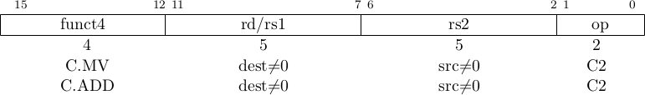
RISC V Architecture: Compressed Instruction set
Compared to ARM’s Thumb instruction set, RISC-V also supports a compressed instruction set extension called RV32C (or RV64C for 64-bit), which provides 16-bit compressed instructions that can be mixed with the standard 32-bit instructions.
This feature helps reduce code size and improve energy efficiency, making RISC-V particularly suitable for embedded systems and low-power applications.

Slide 18
2 Versions of RISC-V (based on maximum width of registers supported)
RISC-V 32 (RV32): max register width (XLEN) is 32 bits
RISC-V 64 (RV64): max register width (XLEN) is 64 bits
RV64 supports RV32 also.
Both versions have 32 registers.
Register file
32-bit in RV32 64-bit in RV64
x0 x1 x2 x3 x4 x5
…
In both of them, each instruction is encoded into 32 bits.
x31

Slide 19
RISC V Modes: Privilege levels & Virtual Memory
The RISC-V Privileged Architecture Specification defines three privilege levels:
machine mode (M-mode),
supervisor mode (S-mode),
user mode (U-mode).
These privilege levels provide a mechanism for isolating the operating system kernel, hypervisors, and user applications, ensuring system security and stability.
RISC-V also supports a virtual memory system based on a multi-level page table scheme, enabling efficient memory management and protection.

Slide 20
RISC-V Modes
RISC-V Privileged Specification defines 3 levels of privilege, called Modes
Machine mode is the highest privileged mode and the only required mode
Flexibility allows for a range of targeted implementations from simple MCUs to high- performance Application Processors
Example for Simple bare metal application Machine mode is enough and it’s the default and mandatory mode, for an isolation boundary between the application and more direct hardware access, M and U mode may both be supported.
A robust system, such as a server or desktop machine will support M, S, and U as the Supervisor mode will bring the benefits of Virtualization and Hypervisor called Hypervisor-extended Supervisor (HS)
Machine, Hypervisor, Supervisor modes each have Control
and Status Registers (CSRs)
RISC-V Modes
Level | Name | Abbr.
0 | User/Application | U
1 | Supervisor | S
2 | Hypervisor | HS
3 | Machine | M
Supported Combinations of Modes
Supported Levels | Modes
1 | M
2 | M, U
3 | M, S, U
4 | M, HS, S, U

Slide 21
We will discuss 4 addressing modes (relevant for RISC-V)
Immediate
Register direct
Register indirect
Base-offset
NOTE: Register indirect is a special case of base-offset. If we set offset as zero, we get register indirect mode

Slide 22
1. Immediate addressing mode
Value ← imm
The value (e.g., 4, 8, 0x13, -3 etc) is available in the instruction itself. No need to access register file
imm
value

Slide 23
2. Register Direct Mode
Value ← r1
The value is obtained from the register directly.
r1
r0 r1
186
784
410
r15
784
value
register file

Slide 24
Examples of instructions that use those modes
Register direct: sub r3, r1, r2
r1 and r2 values are fetched from registers. Result is stored in r3
Immediate: addi r3, r1, 500
Here, r1 and r3 are accessed from registers and 500 is the immediate value available in the instruction itself.
RISC-V: at most one operand can be an immediate.

Slide 25
3. Register Indirect Mode
Read value of r1 from register file. This gives a memory address
Read the value stored in memory at that address
Value ← (r1)
0
4
4019
_{r1} r0
148
r1
100
r15
4019
value
register file
148
Memory

Slide 26
4. Base-offset Addressing Mode
Value ← offset(r1)
Read value of r1 from register file. Add offset to it. This gives a memory address
Read the value stored in memory at that address
Let offset = 9
0
4
8914
_{r1} r0
451
r1
offset
100
r15
8914
value
register file
460
memory

Slide 27
Examples of instructions that use those modes
Load and store instructions use register indirect and base-offset addressing modes
lw r1, 10(r2)
memory
sw r1, 10(r2)
memory
register
register
file
10
file
10
r1
r1
r2
r2
Lw = load word
Sw= store word
(a)
(b)

Slide 28
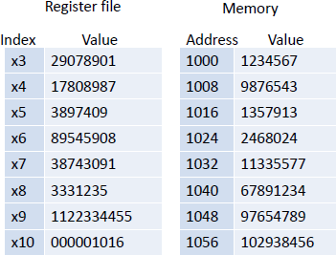
Solved Example
Consider below instructions that are executed when the state of register file and memory is as given here.
ld x6, 24(x10)
sd x5, 16(x10)
Show only the changed values in RF and memory after these instructions are executed.
Solution: x10+24 is 1040. ld instruction will load from 1040 and store that value in register x6. So, x6 will become 67891234
x10+16 is 1032. sd instruction will store the value of x5 at address 1032. Hence, memory address 1032 will change to 3897409

Slide 29
Arithmetic Operations
Add and subtract, three operands
Two sources and one destination
add a, b, c // a gets b + c
All arithmetic operations have this form
Design Principle 1: Simplicity favors regularity
Regularity makes implementation simpler
Simplicity enables higher performance at lower cost

Slide 30
Arithmetic Example
C code:
f = (g + h) - (i + j);
Compiled RISC-V code:
add t0, g, h // temp t0 = g + h add t1, i, j // temp t1 = i + j sub f, t0, t1 // f = t0 - t1

Slide 31
Register Operands
Arithmetic instructions use register operands
RISC-V has a count of 32 registers having a width (64-bit or 32bit)
Use for frequently accessed data
64-bit data is called a “double word”
32 x 64-bit/32-bit general purpose registers x0 to x31
32-bit data is called a “word”
Design Principle 2: Smaller is faster
Compact flash main memory: millions of locations

Slide 32
RISC-V Registers
x0: the constant value 0
x1: return address
x2: stack pointer
x3: global pointer
x4: thread pointer
x5 – x7, x28 – x31: temporaries
x8: frame pointer
x9, x18 – x27: saved registers
x10 – x11: function arguments/results
x12 – x17: function arguments

Slide 33
RISC-V Registers
RV32I/64I have 32 Integer Registers
Optional 32 FP registers with the F and D extensions
RV32E reduces the register file to 16
integer registers for area constrained embedded devices
Width of Registers is determined by ISA
RISC-V Application Binary Interface (ABI)
defines standard functions for registers
Allows for software interoperability
Development tools usually use ABI names for simplicity
Register | ABI Name | Description | Saver
x0 | zero | Hard-wired zero | -
x1 | ra | Return address | Caller
x2 | sp | Stack pointer | Callee
x3 | gp | Global pointer | -
x4 | tp | Thread pointer | -
x5-7 | t0-2 | Temporaries | Caller
x8 | s0/fp | Saved register/Frame pointer | Callee
x9 | s1 | Saved register | Callee
x10-11 | a0-1 | Function Arguments/return values | Caller
x12-17 | a2-7 | Function arguments | Caller
x18-27 | s2-11 | Saved registers | Callee
x28-31 | t3-6 | Temporaries | Caller

Slide 34
Register Description
Register x0 RISC-V dedicates register x0 to be hard-wired to the value zero.
Return address A link to the calling site that allows a procedure to return to the proper address; in RISC-V it is stored in register x1.
Program counter(PC) The register containing the address of the instruction in the program being executed.
Stack pointer A value denoting the most recently allocated address in a stack that shows where registers should be spilled or where old register values can be found. In RISC-V, it is register sp, or x2.
Global pointer The register that is reserved to point to the static area where static variables are stored.
Frame pointer A value denoting the location of the saved registers and local variables for a given procedure.
Argument registers: x10 to x17 are used to pass arguments to a function. Before calling a function, arguments are copied to these registers. If more than 8 arguments need to be passed, we use the stack.
Temporary registers (t0 to t6): used to hold intermediate values during instruction or function execution.
Thread-pointer register, tp, that is designed for thread-local data.

Slide 35
Register Operand Example
C code:
f = (g + h) - (i + j);
f, …, j in x19, x20, …, x23
Compiled RISC-V code:
add x5, x20, x21 add x6, x22, x23 sub x19, x5, x6

Slide 36
Memory Operands
What is XLEN in RISC-V?
RISC-V is little-endian and comes in 32 and 64 bit flavours. In keeping with the RISC-V documents, the flavour (either 32 or 64) is called XLEN in further slides at few places where it matters.
Main memory used for composite data
Arrays, structures, dynamic data
To apply arithmetic operations
Load values from memory into registers
Store result from register to memory
Memory is byte addressed
Each address identifies an 8-bit byte
RISC-V is Little Endian
Least-significant byte at least address of a word
c.f. Big Endian: most-significant byte at least address
RISC-V does not require words to be aligned in memory
Unlike some other ISAs

Slide 37
Memory Operand Example
C code:
A[12] = h + A[8];
h in x21, base address of A in x22
Compiled RISC-V code:
Index 8 requires offset of 32
4 bytes per word
ld x9, 32(x22) add x9, x21, x9 sd x9, 48(x22)

Slide 38
Registers vs. Memory
Registers are faster to access than memory
Operating on memory data requires loads and stores
More instructions to be executed
Compiler must use registers for variables as much as possible
Only spill to memory for less frequently used variables
Register optimization is important!

Slide 39
RV32 and RV64
Although the RISC-V registers in this course are 32 bits wide, the RISC-V architects conceived multiple variants of the ISA.
In addition to this variant, known as RV32, a variant named RV64 has 64-bit registers, whose larger addresses make RV64 better suited to processors for servers and smart phones.

Slide 40
Immediate Operands
Constant data specified in an instruction
addi x22, x22, 4
Make the common case fast
Small constants are common
Immediate operand avoids a load instruction

Slide 41
Example on add
Mapping of variables
i→ x19, g→ x20
to registers:
C codes | C code (simplified) | RISC-V code
i++ | i++ | addi x19, x19, 1
g = ++i | i++ g=i | addi x19, x19, 1 add x20, x19, x0
g = i++ | g=i i++ | add x20, x19, x0 addi x19, x19, 1

Slide 42
LI and MV (pseudo) instructions
Load Immediate (LI) loads register rd with an immediate value
Syntax: li rd, imm
li t0, 0x4A
mv t1, t0
# Load register t0 with a value
# Copy contents of register t0 to register t1
Pseudo instructions are similar to macros in C/C++.
Assuming v and r are stored in t0 and t1, respectively.
C codes | RISC-V code
v= 10 | li t0, 10
v=r | mv t0, t1

Slide 43
RISC-V R-format Instructions
funct7
rs2
rs1
funct3
rd
opcode
7 bits
5 bits
5 bits
3 bits
5 bits
7 bits
Instruction fields
opcode: operation code
rd: destination register number
funct3: 3-bit function code (additional opcode)
rs1: the first source register number
rs2: the second source register number
funct7: 7-bit function code (additional opcode)

Slide 44
R-format Example
funct7
rs2
rs1
funct3
rd
opcode
7 bits
5 bits
5 bits
3 bits
5 bits
7 bits
add x9,x20,x21
0
21
20
0
9
51
0000000
10101
10100
000
01001
0110011
0000 0001 0101 1010 0000 0100 1011 0011_{two} =
015A04B3₁₆

Slide 45
RISC-V I-format Instructions
immediate
rs1
funct3
rd
opcode
12 bits
5 bits
3 bits
5 bits
7 bits
Immediate arithmetic and load instructions
rs1: source or base address register number
immediate: constant operand, or offset added to base address
2s-complement, sign extended
Design Principle 3: Good design demands good compromises
Different formats complicate decoding, but allow 32-bit instructions uniformly
Keep formats as similar as possible

Slide 46
RISC-V S-format Instructions
imm[11:5]
rs2
rs1
funct3
imm[4:0]
opcode
7 bits
5 bits
5 bits
3 bits
5 bits
7 bits
Different immediate format for store instructions
rs1: base address register number
rs2: source operand register number
immediate: offset added to base address
Split so that rs1 and rs2 fields always in the same place

Slide 47
The 6 Instruction Formats
R-Format: instructions using 3 register inputs
add, xor, mul —arithmetic/logical ops
I-Format: instructions with immediates, loads
addi, lw, jalr, slli
S-Format: store instructions: sw, sb
SB-Format: branch instructions: beq, bge
U-Format: instructions with upper immediates
lui, auipc —upper immediate is 20-bits
UJ-Format: jump instructions: jal

Slide 48
Logical Operations
Instructions for bitwise manipulation
Operation | C | Java | RISC-V
Shift left | << | << | slli
Shift right | >> | >>> | srli
Bit-by-bit AND | & | & | and, andi
Bit-by-bit OR | | | | | or, ori
Bit-by-bit XOR | ^ | ^ | xor, xori
Bit-by-bit NOT | ~ | ~
Useful for extracting and inserting groups of bits in a word

Slide 49
Shift Operations
funct6
immed
rs1
funct3
rd
opcode
6 bits
6 bits
5 bits
3 bits
5 bits
7 bits
immed: how many positions to shift
Shift left logical
Shift left and fill with 0 bits
slli by i bits multiplies by 2^{i}
Shift right logical
Shift right and fill with 0 bits
srli by i bits divides by 2^{i} (unsigned only)

Slide 50
Conditional Operations
Branch to a labeled instruction if a condition is true
Otherwise, continue sequentially
beq rs1, rs2, L1
if (rs1 == rs2) branch to instruction labeled L1
bne rs1, rs2, L1
if (rs1 != rs2) branch to instruction labeled L1

Slide 51
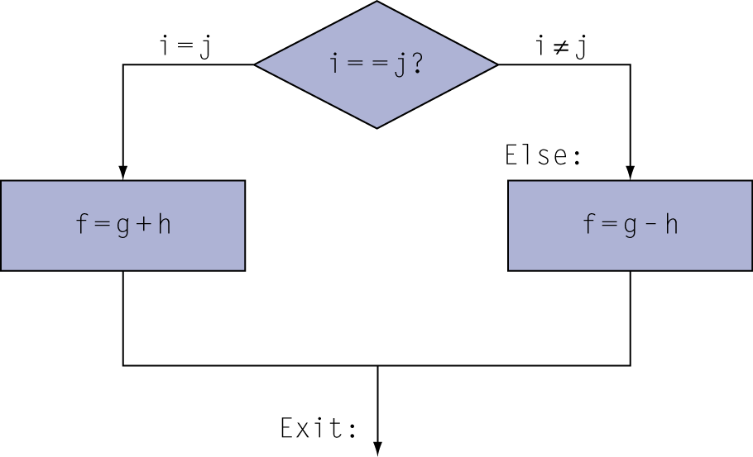
Compiling If Statements
C code:
if (i==j) f = g+h; else f = g-h;
f, g, … in x19, x20, …
Compiled RISC-V code:
bne x22, x23, Else add x19, x20, x21 beq x0,x0,Exit // unconditional Else: sub x19, x20, x21 Exit: …
Assembler calculates addresses

Slide 52
Compiling Loop Statements
C code:
while (save[i] == k) i += 1;
i in x22, k in x24, address of save in x25
Compiled RISC-V code:
Loop: slli x10, x22, 3 add x10, x10, x25 ld x9, 0(x10) bne x9, x24, Exit
addi x22, x22, 1 beq x0, x0, Loop Exit: …
Assume “long int” variables (8B).
Base address of Arr is in a0. i is in a1. val is in a2
C code | Simplified C code | RISC-V code
Arr[i] =5; | temp=5 Offset = i*8 addr = Arr + offset Memory[addr] = temp | li a3, 5 slli a4, a1, 3 add a5, a4, a0 sd a3, 0(a5)
val = Arr[7] |  | ld a2, 56(a0)

Slide 53
More Conditional Operations
blt rs1, rs2, L1
if (rs1 < rs2) branch to instruction labeled L1
bge rs1, rs2, L1
if (rs1 >= rs2) branch to instruction labeled L1
Example
if (a > b) a += 1;
a in x22, b in x23
bge x23, x22, Exit // branch if b >= a
addi x22, x22, 1
Exit:

Slide 54
Signed vs. Unsigned
A number stored in a register or memory address can be interpreted as signed (2’s complement) or unsigned. Both may lead to different decimal numbers.
x22 = 1111 1111 1111 1111 = 65535 (unsigned), -1 (signed)
x23 = 0000 0000 0000 0001 = 1 (signed), 1 (unsigned)
On comparing them, result depends on whether you take them as signed or unsigned.
On signed comparison, x22<x23 because -1 < +1
On unsigned comparison, x22 > x23 because +65535 > +1

Slide 55
Signed and unsigned comparison
To take this into account, RISC-V has two variants of comparison/branching instructions.
Signed comparison: blt, bge
Unsigned comparison: bltu, bgeu

Slide 56
SLT:SET On Less Than (signed comparison) and SLTU (unsigned comparison)
Syntax: slt rd, rs1, rs2
SLT writes 1 to rd if rs1 < rs2, 0 otherwise. Example code:
li x5, 39 | # x5 | ← 39
li x3, 57 | # x3 | ← 57
slt x1, x5, x3 | # x1 | ← x5 < x3. So, x1 will store 1
C code | RISC-V code
if (a<b) c=1; else c=0; | slt a2, a0, a1
Assuming a/b/c are stored in
a0/a1/a2 respectively.

Slide 57
Comparison Instructions (SLT and SLTU)
SLT and SLTU perform signed and unsigned compares respectively, writing 1 to rd if rs1 < rs2, 0 otherwise.
li a0, -4
li a1, 3
slt a2, a0, a1 sltu a3, a0, a1
# a0 ← 0xFFFFFFFC (in hex)
# a1 ← 3
# a2 ← 1 because -4<3 is true
# a3 ← 0 because 0xFFFFFFFC <3 is False
li a0, 4
li a1, -3
slt a4, a0, a1 sltu a5, a0, a1
# a0 ← 4
# a1 ← 0xFFFFFFFD
# a4 ← 0 because 4<-3 is false
# a5 ← 1 because 0x4< 0xFFFFFFFD is true

Slide 58
Variants of SLT
SEQZ: Set If Equal to Zero . Example: seqz x6, x5
Syntax: seqz rd, rs1
If x5 was zero, then x6 is set to 1. Otherwise, x6 is set to 0.
Similar instructions:
SGTZ: Set If Greater Than Zero SLTZ: Set If Less Than Zero
SNEZ: Set If Not Equal to Zero
Assuming a/b/c are stored in a0/a1/a2 respectively.
C code | RISC-V code
if (a==0) c=1; else c=0; | seqz a2, a0

Slide 59
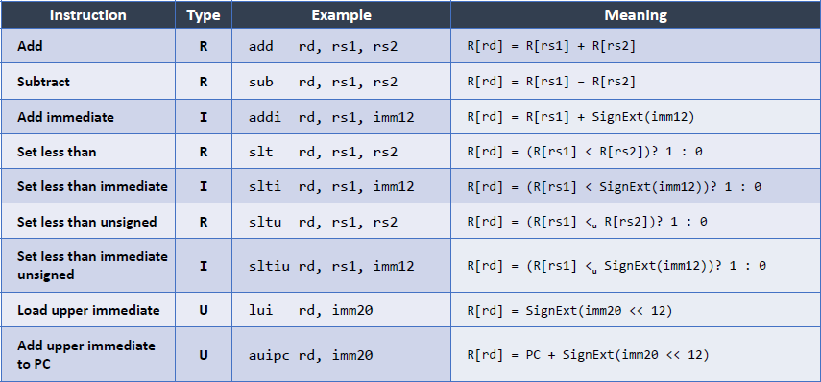

Slide 60
Procedure Calling
Steps required
Place parameters in registers x10 to x17
Transfer control to procedure
Acquire storage for procedure
Perform procedure’s operations
Place result in register for caller
Return to place of call (address in x1)
Caller
The program that instigates a procedure and provides the necessary parameter values.
Callee
A procedure that executes a series of stored instructions based on parameters provided by the caller and then returns control to the caller.

Slide 61
Procedure Call Instructions
Procedure call: Jump and link
jal x1, ProcedureLabel
Address of following instruction put in x1
Jumps to target address ProcedureLabel
Procedure return (Also a Pseudo Instruction):
ret
Jumps to address in x1
ret is same as “jalr x0, x1, 0”
Jump and link register
jalr x0, 0(x1)
Like jal, but jumps to 0 + address in x1
Use x0 as rd (x0 cannot be changed)

Slide 62
How to pass arguments/ return values
Solution : use registers
.func:
add a0, a0, a1 ret
.main:
li a0, 3
li a1, 5
jal x1, .func add a2, a0, 10
0x1F0
0x1F4
0x100
0x104
0x108
0x10C
Before calling a function, arguments
are copied to registers a0 and a1.
a0 is same as x10 a1 is same as x11
Return value is stored in a0 itself
X1 = 0x10C
.func ->0x1F0

Slide 63
Limitations with use of registers for argument passing or returning results
Space Problem
We have a limited number of registers
We cannot pass more than certain number of arguments
Solution : Use memory also
Overwrite Problem
What if a function calls itself ? (recursive call)
The callee can overwrite the registers of the caller
Solution : Spilling
Note: spilling is a technique in which, a variable is moved out from a register space to the main memory(the RAM) to make space for other variables, which are to be used in the program currently under execution.

Slide 64
Register Spilling
caller saved scheme
The caller can save the set of registers its needs
Call the function
And then restore the set of registers after the function returns
Known as the caller saved scheme
callee saved scheme
The callee saves the registers, and later restores them

Slide 65
caller or callee-saver conventions
Caller
Caller
Save registers
Callee
Callee
Save registers
Restore registers
Restore registers
(a)
Caller saved
(b)
Callee saved
Saver is “caller”: means that a function caller must save that register somewhere before calling e.g. main()
Saver is “callee”: means that if a function wants to use that register, it
must first save it somewhere, and restore it before returning e.g. sum()

Slide 66
Limitations with our approach
Using memory, and spilling solves both the space problem and overwrite problem
However, there needs to be :
a strict agreement between the caller and the callee regarding the set of memory locations that need to be used
Secondly, after a function has finished execution, all the space that it uses needs to be reclaimed
17

Slide 67
Activation Block
Activation block
int foo(int arg1) {
int a, b, c;
a = 3; b = 4;
c = a + b + arg1; return c;
}
Arguments
Return address
Register spill area
Local variables
Activation block → memory map of a function
arguments, register spill area, local variables

Slide 68
Organising Activation Blocks
All the information of an executing function is stored in its activation block
These blocks need to be dynamically created and destroyed – millions of times
What is the correct way of managing them, and ensuring their fast creation and deletion ?
Is there a pattern ?

Slide 69
Pattern of Function Calls
test
test2
main
foo
foobar
foobarbar
main() {
test() {
test2() {
test();
foo();
...
test2(); return;
...
return;
}
}
}
foo() {
...
foobar(); return;
}
foobar() {
...
foobarbar(); return;
}
foobarbar() {
...
return;
}

Slide 70

Pattern of Function Calls
Last in First Out
Use a stack to store activation blocks
Stack
•
foo
foo
foo
foobar
foobarbar
foo
foobar
foobar
(a)
(b)
(c)
(d)
21

Slide 71
Issues solved by stack
Space problem
Pass as many parameters as required in the activation block
Overwrite problem
Solved by activation blocks
Management of activation blocks
Solved by the notion of the stack
22

Slide 72
Working with the Stack
Allocate a part of the memory to save the stack
Traditionally stacks are downward growing.
The first activation block starts at the highest address
Subsequent activation blocks are allocated lower addresses
The stack pointer register (sp) points to the beginning of an activation block
Allocating an activation block : sp ← sp - <constant>
De-allocating an activation block: sp ← sp + <constant>
23

Slide 73
Saving variable in stack (pushing and popping)
myFunction:
addi sp,sp,-24
sd x5,16(sp)
sd x6,8(sp)
sd x20,0(sp) add x5,x10,x11
add x6,x12,x13
sub x20,x5,x6
addi x10,x20,0 ld x20,0(sp)
ld x6,8(sp)
ld x5,16(sp) addi sp,sp,24 ret
Save x5, x6, x20 on stack (called pushing)
Do some processing of a function
Resore x5, x6, x20 from stack (called popping)
Return to caller
This is an example of callee saved scheme

Slide 74
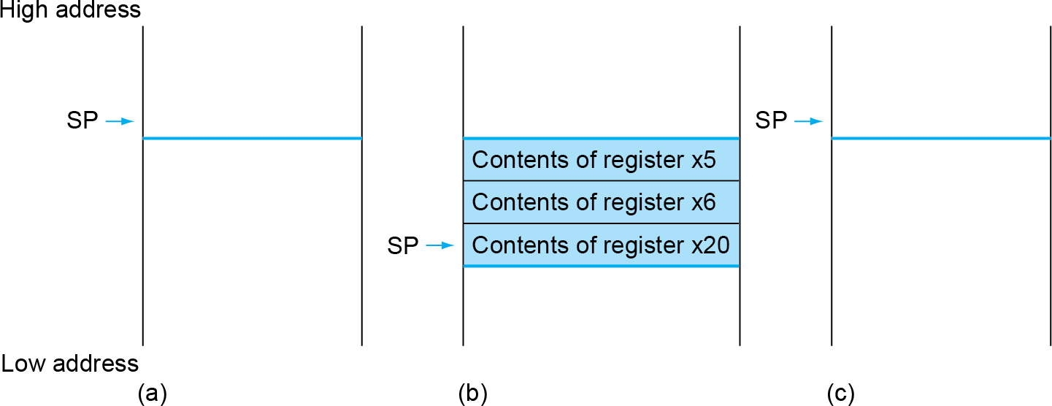
How Stack Functions
Stack grows downwards

Slide 75
A Question on Stack
Byte addresses
1011
1012
1013
1014
1015
1016
1017
1018
1019
1020
1021
1022
1023
1024
1025
1026
?
?
?
?
?
?
?
?
Consider 32b version of RISC-V and see below code.
addi sp,sp,-12 sw x5,8(sp) sw x6,4(sp) sw x20,0(sp)
Initially, we have value of
x5 as 0x12345678, x6 as 0xABCDEF09 x20 as 0xACE02468.
sp is 1024.
In this figure, write the values shown by ?

Slide 76
Solution
Byte addresses
Byte addresses
1011
1012
1013
1014
1015
1016
1017
1018
1019
1020
1021
1022
1023
1024
1025
1026
68
24
E0
AC
09
EF
CD
AB
78
56
34
12
1011
1012
1013
1014
1015
1016
1017
1018
1019
1020
1021
1022
1023
1024
1025
1026
AC
E0
24
68
AB
CD
EF
09
12
34
56
78
(b) is correct for any Big-endian ISA
RISC-V is little endian
Hence, (a) is correct for RISC-V
(a) Little Endian
(b) Big Endian

Slide 77
Leaf Procedure Example
C code:
long long int leaf_example ( long long int g, long long int h, long long int i, long long int j) { long long int f; f = (g + h) - (i + j); return f; }
Arguments g, …, j in x10, …, x13
f in x20
temporaries x5, x6
Need to save x5, x6, x20 on stack

Slide 78
Leaf Procedure Example
RISC-V code:
leaf_example:
addi sp,sp,-24
sd x5,16(sp)
sd x6,8(sp)
sd x20,0(sp
add x5,x10,x11
add x6,x12,x1
sub x20,x5,x6
addi x10,x20,0
ld x20,0(sp)
ld x6,8(sp)
ld x5,16(sp)
addi sp,sp,24
jalr x0,0(x1)
Save x5, x6, x20 on stack
x5 = g + h
x6 = i + j
f = x5 – x6
copy f to return register
Resore x5, x6, x20 from stack
Return to caller

Slide 79
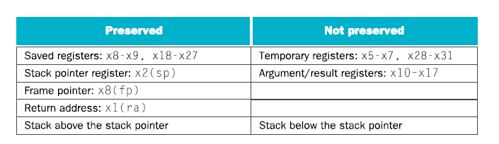
Register Usage
x5 – x7, x28 – x31: temporary registers
Not preserved by the callee
x8 – x9, x18 – x27: saved registers
If used, the callee saves and restores them
What is and what is not preserved across a procedure call

Slide 80
Byte/Halfword/Word Operations
RISC-V byte/halfword/word load/store
Load byte/halfword/word: Sign extend to 64 bits in rd
lb rd, offset(rs1)
lh rd, offset(rs1)
lw rd, offset(rs1)
Load byte/halfword/word unsigned: Zero extend to 64 bits in rd
lbu rd, offset(rs1)
lhu rd, offset(rs1)
lwu rd, offset(rs1)
Store byte/halfword/word: Store rightmost 8/16/32 bits
sb rs2, offset(rs1)
sh rs2, offset(rs1)
sw rs2, offset(rs1)

Slide 81
RISC-V SB-format Instructions: Branch Addressing
Branch instructions specify
Opcode, two registers, target address
Most branch targets are near branch
Forward or backward
SB format:
imm [10:5]
rs2
rs1
funct3
imm [4:1]
opcode
imm[12]
imm[11]
PC-relative addressing
Target address = PC + immediate × 2

Slide 82
RISC-V UJ-format Instructions : Jump Addressing
Jump and link (jal) target uses 20-bit immediate for larger range
UJ format:
imm[10:1]
imm[19:12]
rd
opcode
5 bits
7 bits
imm[20]
imm[11]
For long jumps, eg, to 32-bit absolute address
lui: load address[31:12] to temp register
jalr: add address[11:0] and jump to target

Slide 83
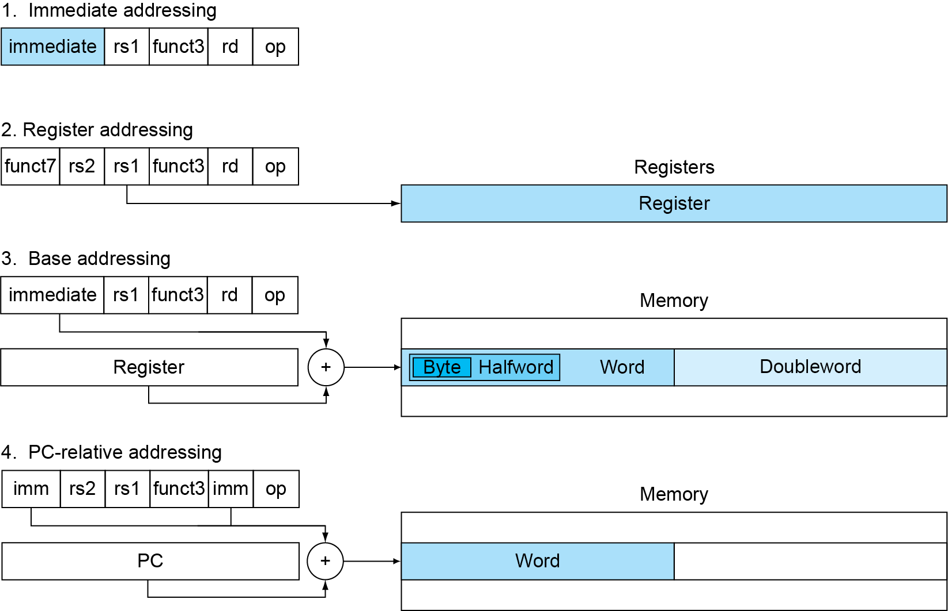
RISC-V Addressing Summary

Slide 84
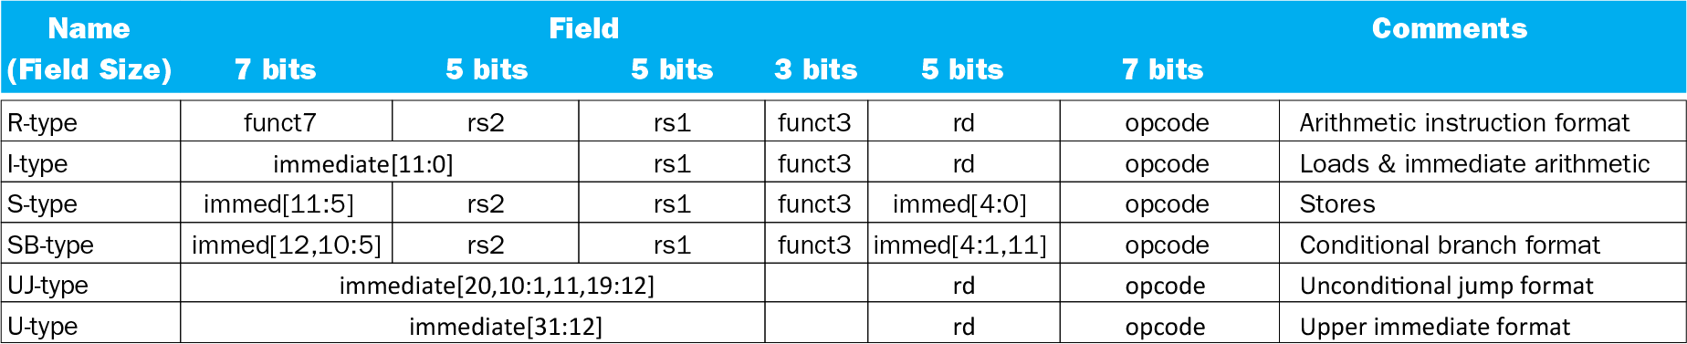
RISC-V Encoding Summary

Slide 85
RISC-V Multiplication
Four multiply instructions:
mul: multiply
Gives the lower 64 bits of the product
mulh: multiply high
Gives the upper 64 bits of the product, assuming the operands are signed
mulhu: multiply high unsigned
Gives the upper 64 bits of the product, assuming the operands are unsigned
mulhsu: multiply high signed/unsigned
Gives the upper 64 bits of the product, assuming one operand is signed and the other unsigned
Use mulh result to check for 64-bit overflow

Slide 86
RISC-V Division
Four instructions:
div, rem: signed divide, remainder
divu, remu: unsigned divide, remainder
Overflow and division-by-zero don’t produce errors
Just return defined results
Faster for the common case of no error

Slide 87
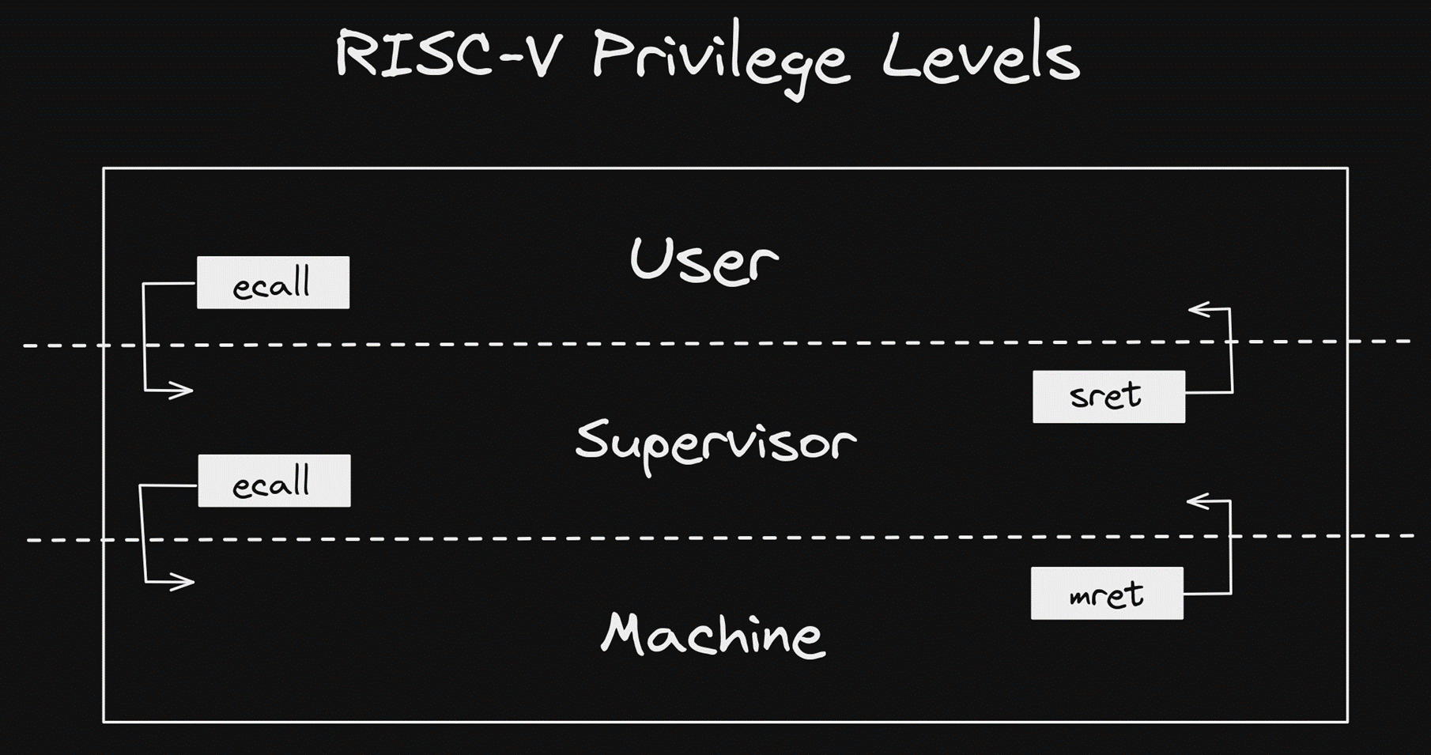
CSR and ECALL Instructions
Control and Status Registers (CSRs) have their own dedicated instructions :
Read/Write
Read and Set bit
Read and Clear bit
Environment Call instruction used to transfer control to the execution environment and a higher privileged mode
Triggers a synchronous Interrupt (discussed later)
Example: User mode program can use an ECALL to transfer control to a Machine mode OS kernel, aka System Call

Slide 88
What are Control and Status Registers (CSRs)
CSRs are Registers which contain the working
state of a RISC-V machine
CSRs are specific to a Mode
Machine Mode has ~17 CSRs (not including performance monitor CSRs)
Supervisor Mode has a similar number, though most are subsets of their equivalent Machine Mode CSRs
Machine Mode can also access Supervisor CSRs
CSRs are defined in the RISC-V privileged specification
We will cover a few key CSRs here

Slide 89


Identification CSRs
misa – Machine ISA Register
Reports the ISA supported by the hart (i.e. RV32bit , 64bit, 128bit)
mhartid – Machine hart/Core ID
Integer ID of the Hardware Thread (Core)
mvendorid – Machine Vendor ID
JEDEC Vendor ID
marchid – Machine Architecture ID
Used along with mvendorid to identify a implementation. No format specified
mimpid - Machine Implementation ID
Implementation defined format
Note: In RISC V Architecture we call Core as hart(hardware Thread)

Slide 90
Machine Status (mstatus) - The Most Important CSR
Control and track the hart’s current operating state
Bits | Field Name | Description
0 | UIE | User Interrupt Enable
1 | SIE | Supervisor Interrupt Enable
2 | Reserved
3 | MIE | Machine Interrupt Enable
4 | UPIE | User Previous Interrupt Enable
5 | SPIE | Supervisor Previous Interrupt Enable
6 | Reserved
7 | MPIE | Machine Previous Interrupt Enabler
8 | SPP | Supervisor Previous Privilege
[10:9] | Reserved
[12:11] | MPP | Machine Previous Privilege
Bits | Field Name | Description
[14:13] | FS | Floating Point State
[16:15] | XS | User Mode Extension State
17 | MPRIV | Modify Privilege (access memory as MPP)
18 | SUM | Permit Supervisor User Memory Access
19 | MXR | Make Executable Readable
20 | TVM | Trap Virtual memory
21 | TW | Timeout Wait (traps S-Mode wfi)
22 | TSR | Trap SRET
[23:30] | Reserved
[31] | SD | State Dirty (FS and XS summary bit)
RV32 mstatus CSR

Slide 91

Timer CSRs
mtime
RISC-V defines a requirement for a counter exposed as a memory mapped register
There is no frequency requirement on the timer, but
It must run at a constant
frequency
The platform must expose frequency
mtimecmp
RISC-V defines a memory mapped timer compare register
Triggers an interrupt when mtime is greater than or equal to mtimecmp
Bits | Field Name | Description
[63:0] | mtime | Machine Time Register
Bits | Field Name | Description
[63:0] | mtimecmp | Machine Time Compare Register
mtime CSR
mtimecmp CSR

Slide 92
Supervisor CSRs
Most of the Machine mode CSRs have Supervisor mode equivalents
– Supervisor mode CSRs can be used to control the state of Supervisor and User Modes.
Bits | Field Name | Description
[21:0] | PPN | Physical Page Number of the root page table
[30:22] | ASID | Address Space Identifier
31 | MODE | MODE=1 uses Sv32 Address Translation
Most equivalent Supervisor CSRs have the same mapping as Machine mode without Machine mode control bits
sstatus, stvec, sip, sie, sepc, scause, satp, and more
RV32 satp CSR
satp - Supervisor Address Translation and Protection Register
– Used to control Supervisor mode address translation and protection
– Virtual Memory is only supported in Supervisor mode
Bits | Field Name | Description
[43:0] | PPN | Physical Page Number of the root page table
[59:44] | ASID | Address Space Identifier
[63:60] | MODE | Encodings for Sv32, Sv39, Sv48
RV64 satp CSR

Slide 93
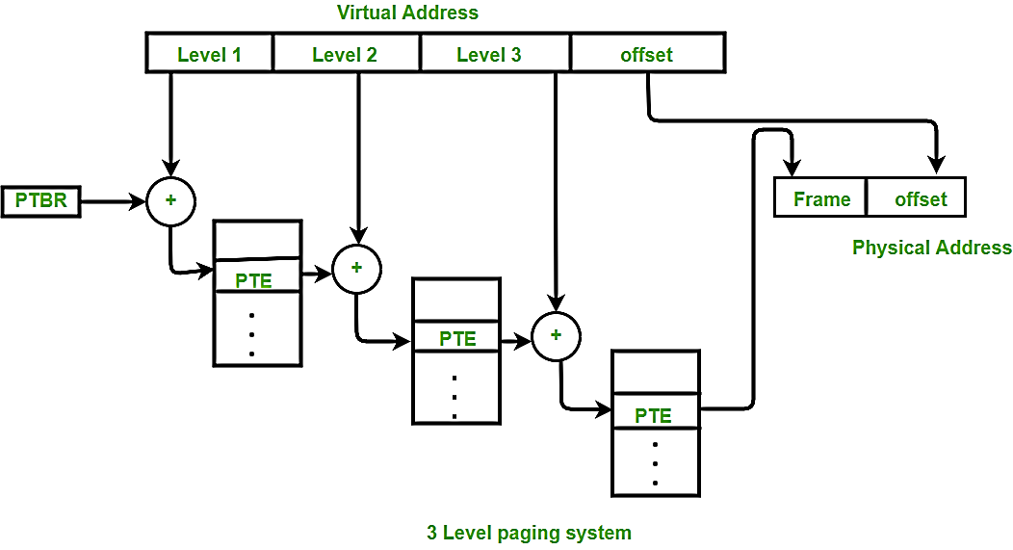
Virtual Memory
0xFFFF_FFFF
0xFFFF_FFFF
Physical Address
RISC-V has support for Virtual Memory allowing for sophisticated memory management and OS support (Linux)
Requires an S-Mode implementation
Sv32
32bit Virtual Address
4KiB, 4MiB page tables (2 Levels)
Sv39 (requires an RV64 implementation)
39bit Virtual Address
4KiB, 2MiB, 1GiB page tables (3 Levels)
Sv48 (requires an RV64 implementation)
48bit Virtual Address
4KiB, 2MiB, 1 GiB, 512GB page tables (4 Levels)
Page Tables also contain access permission
attributes
Virtual Address
0x0000_0000
0x0000_0000
Virtual Address Map
Physical Address Map

Slide 94
Physical Memory Protection (PMP)
Can be used to enforce access
restrictions on less privileged modes
– Machine Mode can Prevent Supervisor and User Mode software from accessing unwanted memory
0xFFFF_FFFF
n Locked.
 |  | Locked Region
le after a
as full |  | User Mode
s |  | Context
as Read |  | User Mode Data
s
as |  | Shared Library
 |  | Code
4 Byte Regio Only accessi reset
User Mode h RWX Privileg
Up to 16 regions with a minimum region size of 4 bytes
Can define entire address map as not accessible
to U-Mode in 1 register
User Mode h only Privileg
Ability to Lock a region
A locked region enforces permissions on all accesses, including M-Mode i.e. none of the mode will be able to gain access here
Only way to unlock a region is a
Reset
User Mode h Execute only Privileges
0x0000_0000
Example PMP Memory Map
If USER mode tries to enter other regions apart from grey zones then the software will then TRAP to machine mode

Slide 95
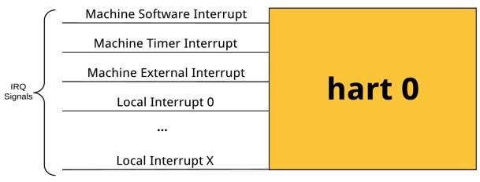
RISC-V Interrupts
RISC-V defines the following interrupts per Hart/ Core
Software – architecturally defined software interrupt
Timer – architecturally defined timer interrupt
External – Peripheral Interrupts
Local – Hart/Core specific Peripheral Interrupts i.e. specific to a particular core
Optionally per privilege level
Can have Supervisor Software/Timer/Machine Interrupts
Can have User Software/Timer/Machine
Local interrupts are optional and implementation specific
Can be used for hart-specific peripheral interrupts
Useful for latency-sensitive embedded systems or small embedded systems with a small number of interrupts
For more Details Refer: https://five-embeddev.com/quickref/interrupts.html

Slide 96
Machine Status (mstatus) – As it relates to Interrupts
Bits | Field Name | Description
0 | UIE | User Interrupt Enable
1 | SIE | Supervisor Interrupt Enable
2 | Reserved
3 | MIE | Machine Interrupt Enable
4 | UPIE | User Previous Interrupt Enable
5 | SPIE | Supervisor Previous Interrupt Enable
6 | Reserved
7 | MPIE | Machine Previous Interrupt Enabler
8 | SPP | Supervisor Previous Privilege
[10:9] | Reserved
[12:11] | MPP | Machine Previous Privilege
Bits Field Name | Description
[14:13] FS | Floating Point State
[16:15] XS | User Mode Extension State
17 MPRIV | Modify Privilege (access memory as MPP)
18 SUM | Permit Supervisor User Memory Access
19 MXR | Make Executable Readable
20 TVM | Trap Virtual memory
21 TW | Timeout Wait (traps S-Mode wfi)
22 TSR | Trap SRET
[23:30] Reserved
[31] SD | State Dirty (FS and XS summary bit)
Interrupt Specific Bits for different Modes
RV32 mstatus CSR
M/S/U IE – Global Interrupt Enables for Modes which supports interrupts
M/S/U PIE – Encodes the state of interrupt enables prior to an interrupt.
These bits can also be written to in order to enable interrupts when returning to lower privilege modes
M/S PP – Encodes the privilege level prior to the previous interrupt
These bits can also be written to in order to enter a lower privilege mode when executing MRET or SRET instructions

Slide 97

Machine Interrupt Cause CSR (mcause)
Interrupt = 0 (exception)
Exception Code | Description
0 | Instruction Address Misaligned
1 | Instruction Access Fault
2 | Illegal Instruction
3 | Breakpoint
4 | Load Address Misaligned
5 | Load Access Fault
6 | Store/AMO Address Misaligned
7 | Store/AMO Access Fault
8 | Environment Call from U-mode
9 | Environment Call from S-mode
10 | Reserved
11 | Environment Call from M- mode
12 | Instruction Page Fault
13 | Load Page Fault
14 | Reserved
15 | Store/AMO Page Fault
≥16 | Reserved
Interrupts are identified by reading the
mcause CSR
The Interrupt field determines if a trap was caused by an interrupt or an exception
Interrupt = 1 (interrupt)
Exception Code | Description
0 | User Software Interrupt
1 | Supervisor Software Interrupt
2 | Reserved
3 | Machine Software Interrupt
4 | User Timer Interrupt
5 | Supervisor Timer Interrupt
6 | Reserved
7 | Machine Timer Interrupt
8 | User External Interrupt
9 | Supervisor External Interrupt
10 | Reserved
11 | Machine External Interrupt
12 - 15 | Reserved
≥16 | Local Interrupt X
Bits | Field Name | Description
XLEN-1 | Interrupt | Identifies if an interrupt was synchronous or asynchronous
[XLEN-2:0] | Exception Code | Identifies the exception
mcause CSR

Slide 98
Machine Interrupt-Enable and Pending CSRs (mie, mip)
mie used to enable/disable a given interrupt
mip indicates which interrupts are currently pending
Can be used for polling
Lesser-privilege bits in mip are writeable
i.e. Machine-mode software can be used to generate a supervisor interrupt by setting the STIP bit
mip has the same mapping as mie
Bits | Field Name | Description
0 | USIE | User Software Interrupt Enable
1 | SSIE | Supervisor Software Interrupt Enable
2 | Reserved
3 | MSIE | Machine Software Interrupt Enable
4 | UTIE | User Timer Interrupt Enable
5 | STIE | Supervisor Timer Interrupt Enable
6 | Reserved
7 | MTIE | Machine Timer Interrupt Enable
8 | UEIE | User External Interrupt Enable
9 | SEIE | Supervisor External Interrupt Enable
10 | Reserved
11 | MEIE | Machine External Interrupt Enable
12-15 | Reserved
≥16 | LIE | Local Interrupt Enable
mie CSR

Slide 99

Machine Trap Vector CSR (mtvec)
mtvec sets the Base interrupt vector and the interrupt Mode
Bits | Field Name | Description
[XLEN-1:6] | Base | Machine Trap Vector Base Address. 64-byte Alignment
[1:0] | Mode | MODE Sets the interrupt processing mode.
mtvec Modes
Value | Name | Description
0x0 | Direct | All Exceptions set PC to mtvec.BASE Requires 4-Byte alignment
0x1 | Vectored | Asynchronous interrupts set pc to mtvec.BASE + (4×mcause.EXCCODE) Requires 4-Byte alignment
> 0x01 |  | Reserved
mtvec CSR
mtvec.Mode = Direct
All Interrupts trap to the address mtvec.Base
Software must read the mcause CSR and react accordingly
mtvec.Mode = Vectored
Interrupts trap to the address mtvec.Base + (4*mcause.ExCode)
Eliminates the need to read mcause for asynchronous exceptions

Slide 100


Trap Handler – Entry and Exit
mtevc.MODE = Direct
On entry, the RISC-V hart will
– Save the current state
– PC is Copied to Machine Exception Program Counter
– Privilege mode is Copied to M Status Prev. Priv. Mode
– Int. EN is Copied to Machine Status Previous Int. EN
Typical trap handler software will
Stacking
determine type of Int.
Push Registers
…
interrupt = mcause.msb if interrupt
branch isr_handler[mcause.code] else
branch exception_handler[mcause.code]
…
Pop Registers MRET
PC
Priv
MIE
MEPC
mstatus.MPP
mstatus.MPIE
– Then set PC = mtvec (address), mstatus.MIE = 0(to disable Interrupt)
– At this Point we are in Trap Handler
MRET instruction restores state
Interrupt handler pseudo code
Machine Return and Unstacking
PC
Priv
MIE
MEPC
mstatus.MPP
mstatus.MPIE

Slide 101
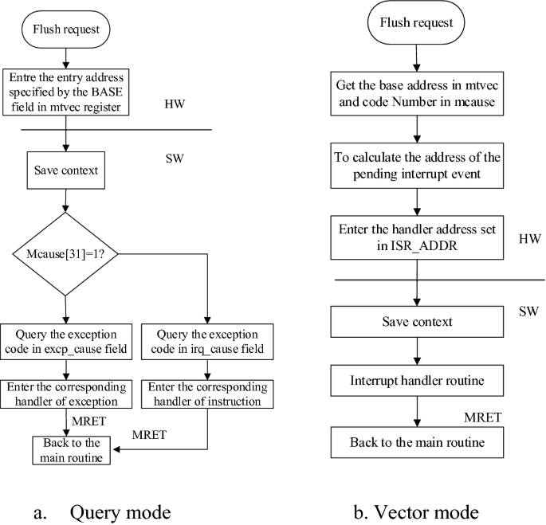


Flow

Slide 102

Interrupt Handler Code
RISC-V Assembly interrupt handler to Push and Pop register file
C Code Handler determines interrupt cause and branches to the appropriate function
Step 4
Step 2
.align 2
.global trap_entry trap_entry:
addi sp, sp, -16*REGBYTES
//store ABI Caller Registers STORE x1, 0*REGBYTES(sp) STORE x5, 2*REGBYTES(sp)
…
STORE x30, 14*REGBYTES(sp) STORE x31, 15*REGBYTES(sp)
//call C Code Handler call handle_trap
//restore ABI Caller Registers
LOAD x1, 0*REGBYTES(sp)
LOAD x5, 2*REGBYTES(sp)
…
LOAD x30, 14*REGBYTES(sp) LOAD x31, 15*REGBYTES(sp)
addi sp, sp, 16*REGBYTES mret
void handle_trap()
{
unsigned long mcause = read_csr(mcause); if (mcause & MCAUSE_INT) {
//mask interrupt bit and branch to handler
isr_handler[mcause & MCAUSE_CAUSE] ();
} else {
//branch to handler exception_handler[mcause]();
}
}
//write trap_entry address to mtvec
write_csr(mtvec, ((unsigned long)&trap_entry));
Step 3
Step 1
Step 5

Slide 103

Compiler Interrupt Attribute
Pushing and Popping Registers in Assembly
is a pain
Interrupt handler with interrupt attribute.
No assembly Code necessary
void handle_trap(void) attribute((interrupt));
void handle_trap()
{
unsigned long mcause = read_csr(mcause);
if (mcause & MCAUSE_INT) {
//mask interrupt bit and branch to handler isr_handler[mcause & MCAUSE_CAUSE] ();
} else {
//synchronous exception, branch to handler exception_handler[mcause & MCAUSE_CAUSE]();
}
}
//write handle_trap address to mtvec write_csr(mtvec, ((unsigned long)&handle_trap));
The interrupt attribute was added to GCC to facilitate interrupt handlers written entirely in C
Interrupt functions only saves/restores necessary registers onto the stack
Align function on an 8-byte boundary
Calles MRET after popping register file back
off the stack

Slide 104
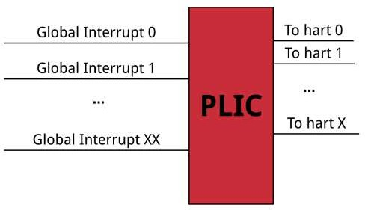

RISC-V Global Interrupts
RISC-V defines Global Interrupts as a Interrupt which can be routed to any hart in a system
Global Interrupts are prioritized and distributed by the Platform Level Interrupt Controller (PLIC)
The PLIC is connected to the External Interrupt signal for 1 or more harts in an implementation
37

Slide 105

PLIC Interrupt Code Example
In this example an interrupt is presented to the PLIC
The PLIC signals an interrupt to a hart using the Machine External Interrupt (interrupt 11)
The interrupt handler (handle_trap) branches to the defined function to handle the Machine External Interrupt
C Code placed the address of machine_external_interrupt function in location 11 of the async_handler vector table
The machine_external_interrupt handler does the following:
Reads the PLIC’s claim/complete register to determine highest priority pending interrupt
Uses another vector table to branch to the interrupt’s specific handler
Completes the interrupt by writing the interrupt number back to the PLIC’s claim/complete
void handle_trap(void) attribute((interrupt));
void handle_trap()
{
unsigned long mcause = read_csr(mcause); if (mcause & MCAUSE_INT) {
//mask interrupt bit and branch to handler isr_handler[mcause & MCAUSE_CAUSE] ();
} else {
//synchronous exception, branch to handler exception_handler[mcause & MCAUSE_CAUSE]();
}
}
//install PLIC handler at MEIP Location isr_handler[11] = machine_external_interrupt;
//write trap_entry address to mtvec write_csr(mtvec, ((unsigned long)&handle_trap));
void machine_external_interrupt()
{
//get the highest priority pending PLIC interrupt uint32_t int_num = plic.claim_comlete;
//branch to handler plic_handler[int_num]();
//complete interrupt by writing interrupt number
back to PLIC
plic.claim_complete = int_num;
}

Slide 106
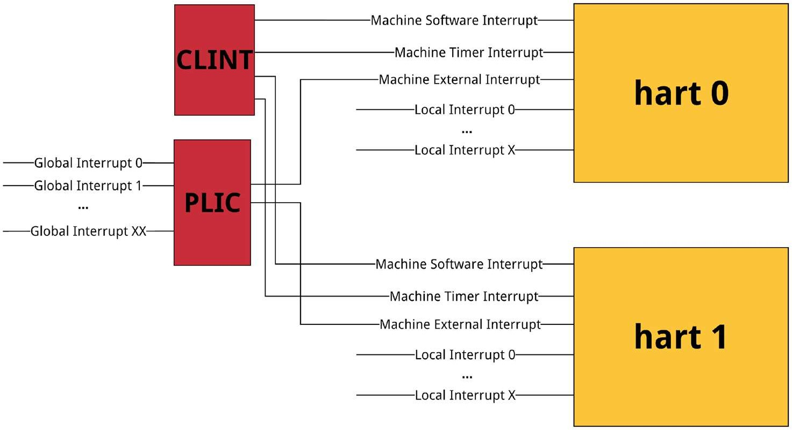
RISC-V Interrupt System Architecture (M-mode only example)
Core Local Interruptor(CLINT) is a memory mapped peripheral used to generate Software and Timer Interrupts
The Platform Level Interrupt Controller(PLIC) handles the majority of the Core Complex’s Interrupts
The PLIC has a programmable number prioritization levels
Only the highest priority pending interrupt is presented on the claim/complete register
Multi-Core interrupt distribution
The PLIC is globally addressable and is connected to the Machine External Interrupt signal of all cores in the Core Complex

