Slide 1
FreeRTOS Environment Setup and Lab Handbook for STM32F4 Discovery Board

Slide 2
Part 1: Building a FreeRTOS Project

Slide 3
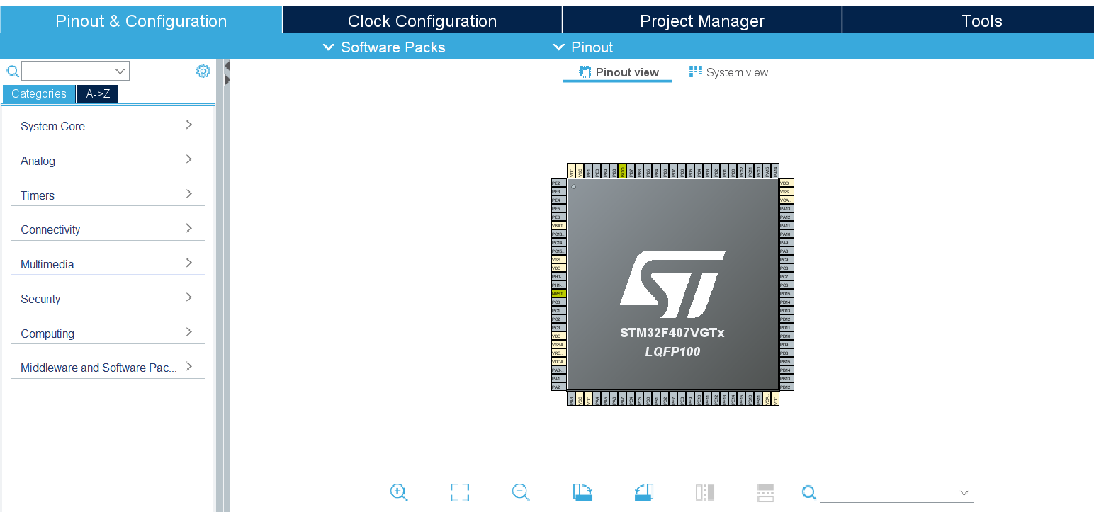
1. Create new(Cube) STM32F407VGT Project

Slide 4
Time base source selection
FreeRTOS uses ARM Cortex Mx processor's internal Systick timer as its time base (RTOS ticking)
STM32 Cube HAL layer also by default uses Systick timer as its time base source.
If you are using both freeRTOS and STM32 Cube HAL layer in your project, there will be a conflict to use a timebase source.
To resolve this, it is strongly recommended to use STM32 cube HAL layer timebase source other than Systick timer (use any timer peripheral of the microcontroller)E.g. TIM1

Slide 5
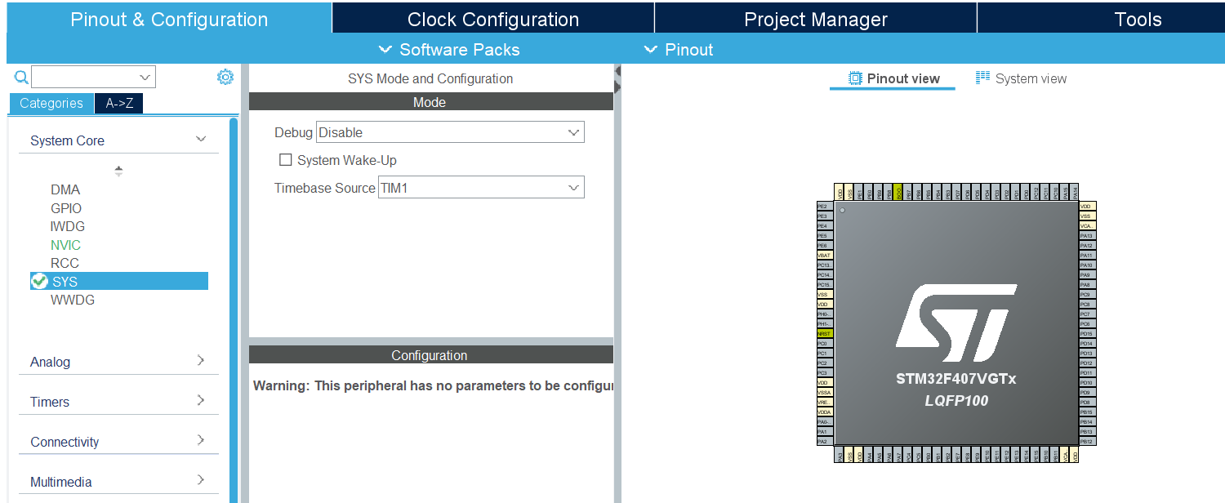
2. Selecting Timebase Source other than SysTick

Slide 6
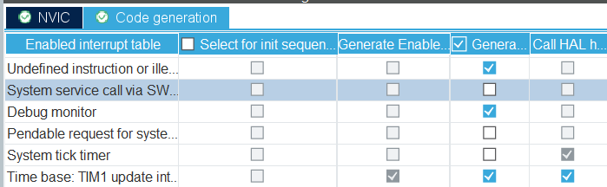
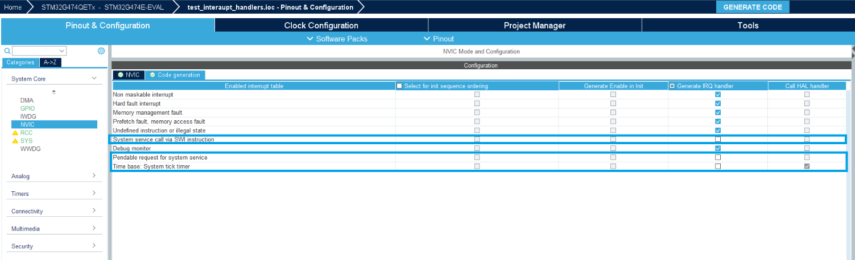
3. Disable the Code Generation for Below three Interrupt Handlers
System service call via SWI Instruction [SVC()]
Pendable request for System Service [PendSV()]
System Tick Timer [SysTick()]
As these handlers are already defined in FreeRTOS files.

Slide 7

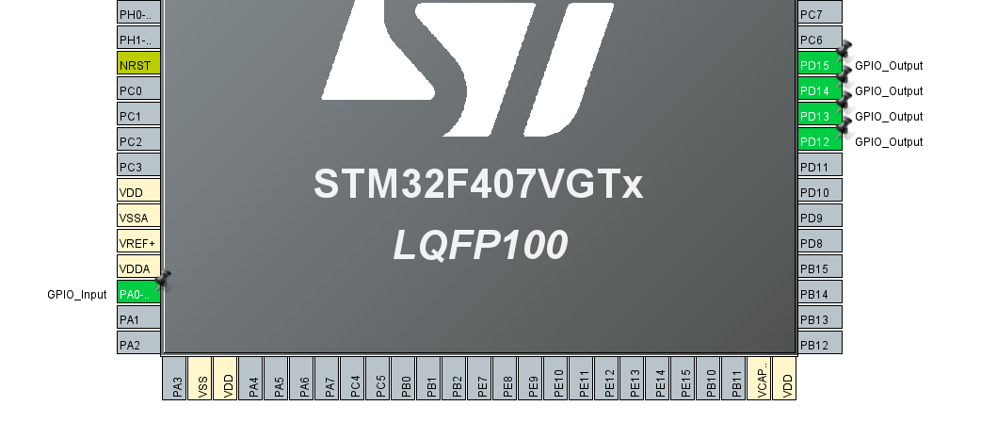
4. Update your Pin Configuration in Device Configuration Tool and Generate the Code
Make the 4 LED’s as GPIO Output
Make the Switch as GPIO Input

Slide 8
Steps to Manually add FreeRTOS
Download it from Github of PG-DESD

Slide 9
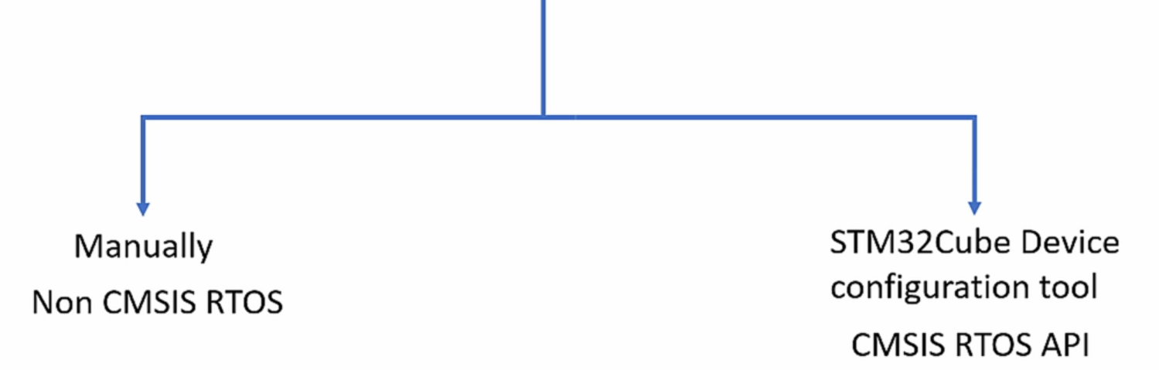
5. Once the Code is Generated , Now You have an Option of Adding FreeRTOS Manually
6. Adding FreeRTOS Kernel to your Project
Using this Method

Slide 10
Layered Architecture of Project
Just an Information Slide to tell at which layer the Free RTOS will fit

Slide 11
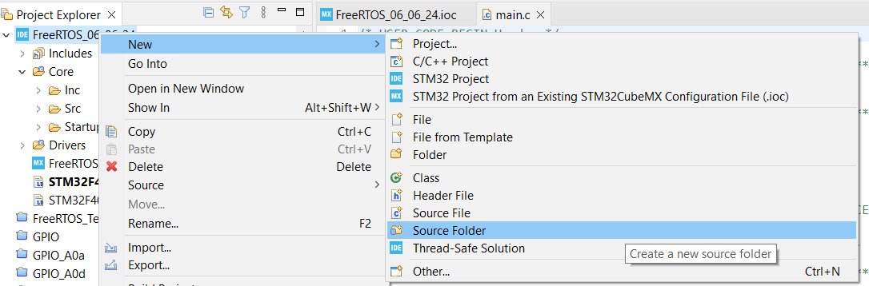
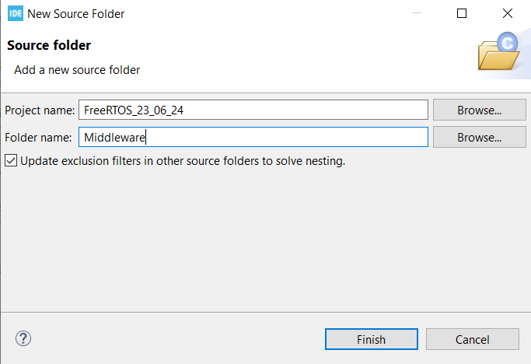
7. To Add FreeRTOS Manually Create a “Middleware” Source Folder
1
2
Name the Source Folder as “Middleware”

Slide 12
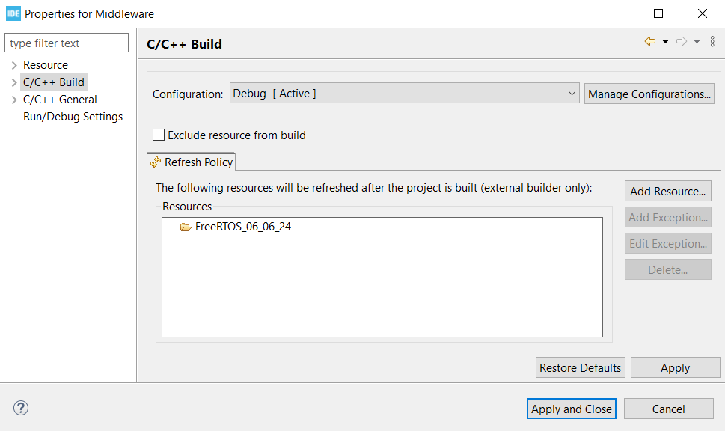
8. Make Sure that “Middleware” Folder is not Excluded from build by Right Click the Middleware Folder -> Properties
Uncheck

Slide 13
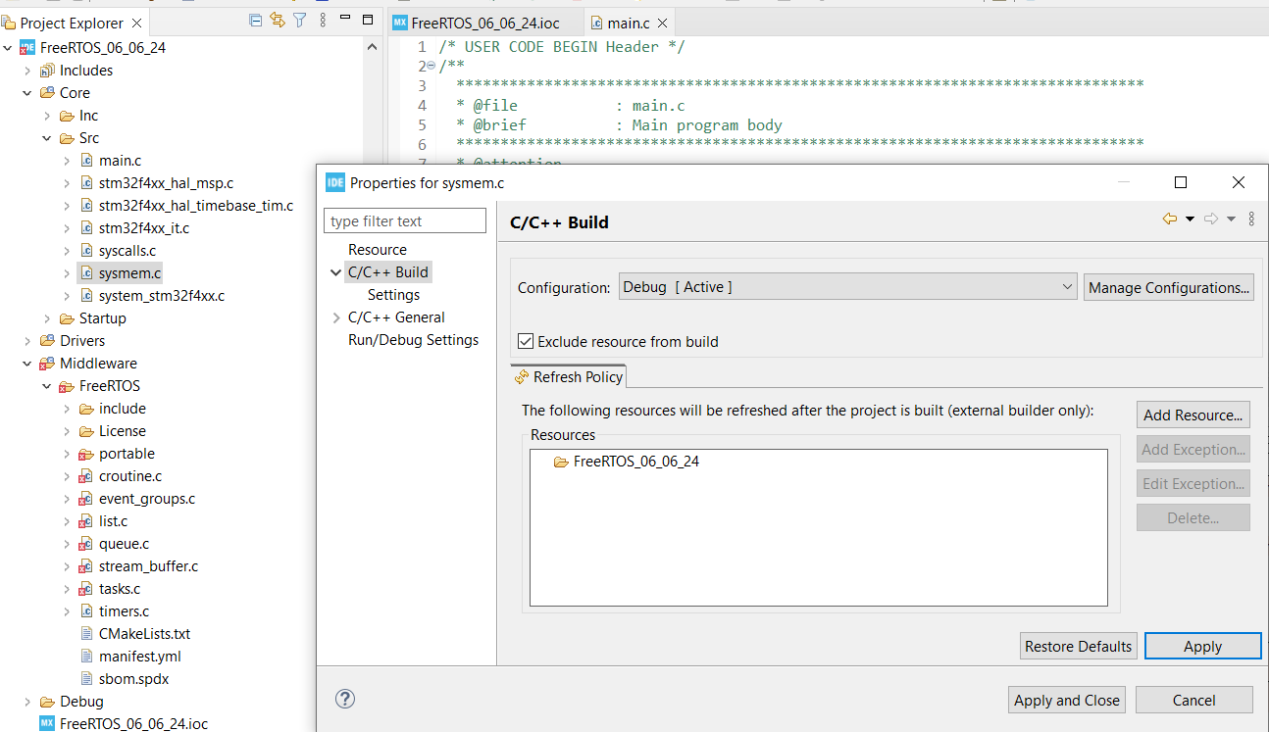
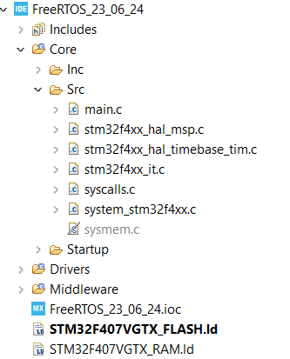
9. Exclude sysmem.c file as now RTOS will handle Memory Management
1
2
3

Slide 14
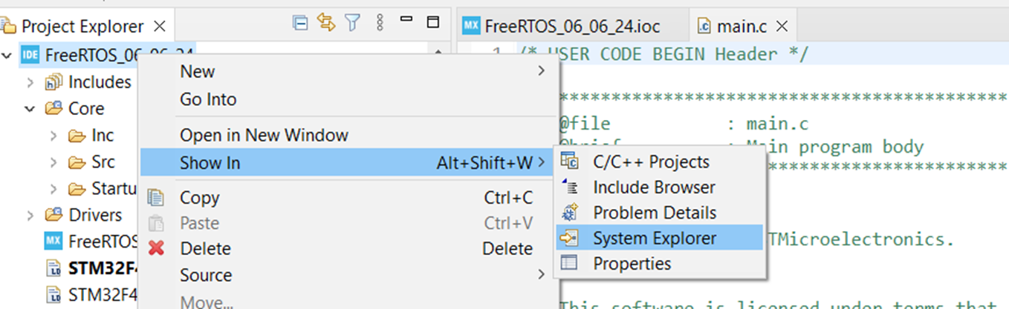
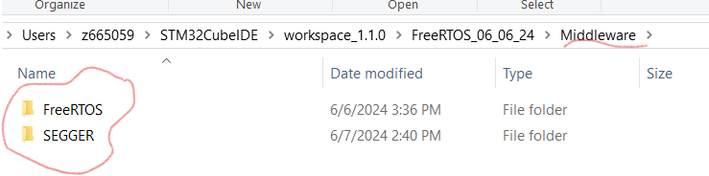
10. Open Your Project via System Explorer and Add FreeRTOS and SEGGER Folders in Middleware Folder
Step 1: You can Download the FreeRTOS and SEGGER Folder from GitHub Link , just copy paste the folder , no changes are required.
Step 2:After Pasting the Content Just Refresh your Project using Refresh option in STM32Cube IDE (Right Click over your Project name) in project explorer

Slide 15
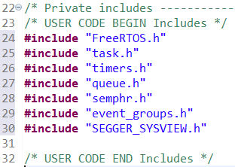
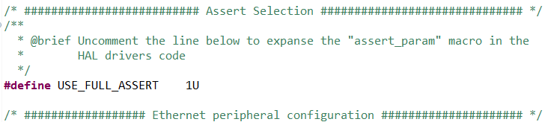
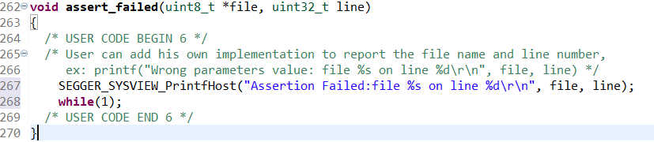
11. Headers to Include in main.c and Enable Assert Selection
Step1
#include "FreeRTOS.h"
#include "task.h"
#include "timers.h"
#include "queue.h"
#include "semphr.h"
#include "event_groups.h"
#include "SEGGER_SYSVIEW.h"
Step2
Open : Project_Name->Core->Inc->stm32f4xx_hal_conf.h
Around Line No. 202 Uncomment the #define USE_FULL_ASSERT 1U
Step3
Paste below code in Assert Failed Function:
SEGGER_SYSVIEW_PrintfHost("Assertion Failed:file %s on line %d\r\n", file, line);
while(1);

Slide 16
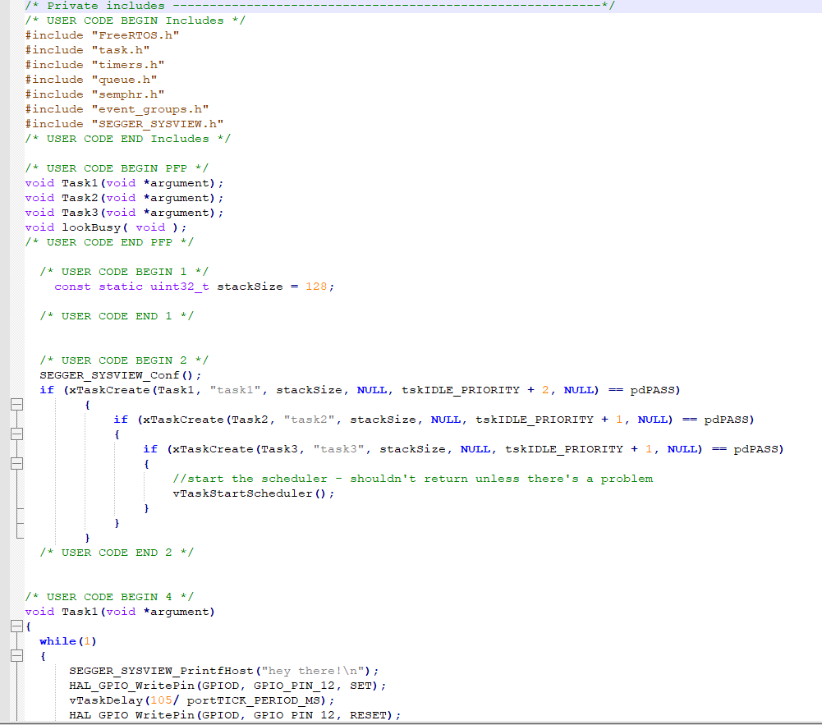
12. Main.c file snippet for Blinking 3 Led’s (Green, Orange, Red) in 3 Task
Code snippet for Bilking 3 LED’s in 3 task, copy and paste it to the Relevant section in main.c
GitHub\CDAC_Sharing_Data\RTOS\Lab\01_Sample_First_Program

Slide 17
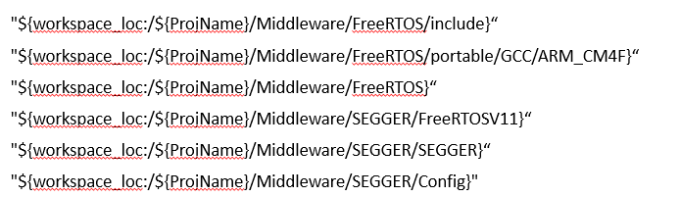
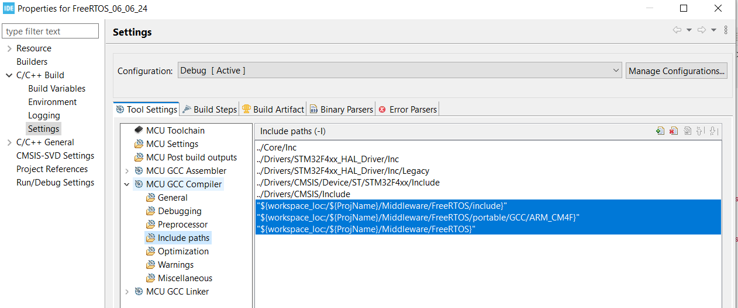
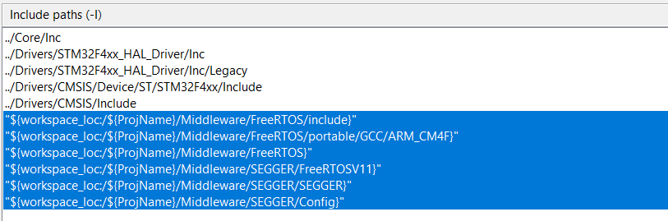
13. Include Path Settings

Slide 18
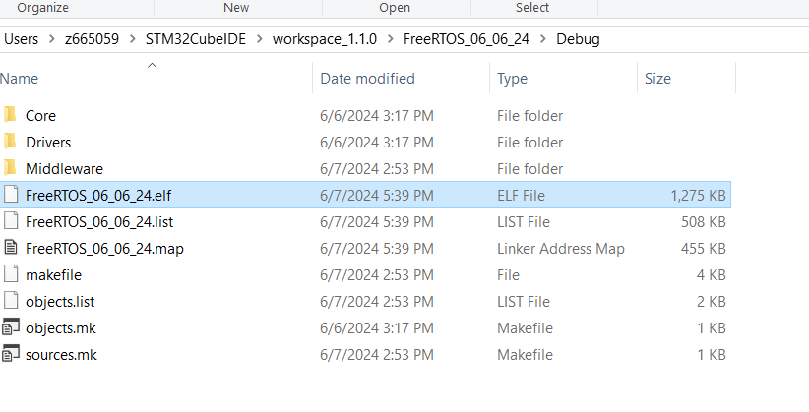
14. After Including the Paths build your Project and Genrate the *. ELF File

Slide 19
Part 2: Flashing and Real Time view of Task in SEGGER Ozone and SEGGER SystemView

Slide 20
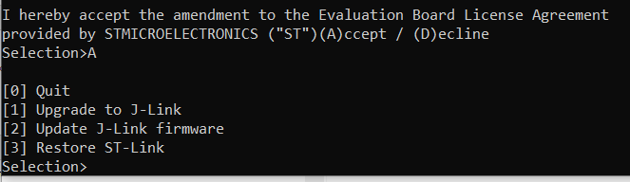
Installing J-Link and STLinkReflash Utility
Download the appropriate J-Link utilities for your OS from
https://www.segger.com/downloads/jlink#J-LinkSoftwareAndDocumentationPack
Install the J-Link utilities— the default options are fine.
Download the SEGGER J-Link Reflash utility (for Windows OS only) from
https://www.segger.com/downloads/jlink#STLink_Reflash
Unzip the contents of STLinkReflash_190812.zip— it will contain two files: JLinkARM.dll,STLinkReflash.exe
Now, we will convert ST-Link to J-Link.
Follow these steps to upload J-Link firmware to the ST-Link on the Nucleo development
board:
1. Plug in a mini USB cable to STM32F4 Disc board and attach it to your Windows PC.
2. Open STLinkReflash.exe.
3. Read through and accept the two license agreements.
4. Select the first option: Upgrade to J-Link (For RTOS Lab)
5. You can also restore it : Restore ST-Link (For ARM Lab)

Slide 21
Flashing and Debugging Program via SEGGER Ozone
Download Segger Ozone via link https://www.segger.com/downloads/jlink#Ozone
Install it using the default options.
SEGGER Ozone is a piece of software that is meant to debug an already-written application.
Ozone is independent of the underlying programming environment used to create the application. It can be used in many different modes, but we'll focus on importing an *.elf file and cross referencing it with source code to provide FreeRTOS-aware debugging capability to a project created with any toolchain.
*.elf file is Present in Debug folder of STM32CubeIDE Project when application is Build successfully

Slide 22
STM32F407 SVD File input to Ozone
*.svd: Contains information that maps registers and descriptions to the memory map of the target device.
By providing an accurate *.svd file, Ozone will be able to display peripheral views that are very helpful when troubleshooting MCU peripheral code.
Download the stm32f407.svd from the Utilities Folder in RTOS Link

Slide 23
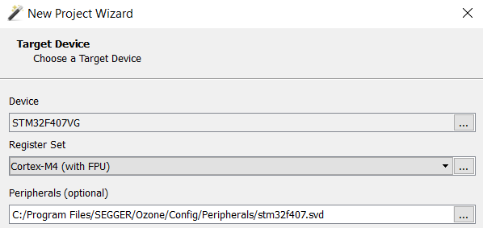
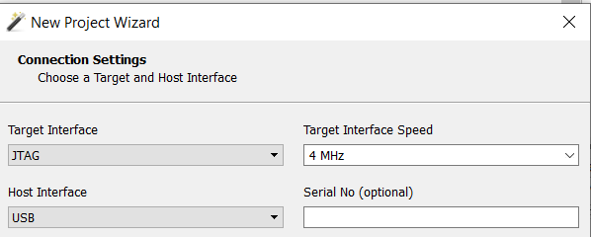
Creating Ozone Project
When first opened, select File->New->New Project Wizard prompt.
For the Device field, select STM32F407VG.
For Peripherals, input the directory and location of the STM32F407.svd file that you downloaded from github (Prev Slide)
Click next to land on the Connection Settings Page and select below Options.
Next

Slide 24
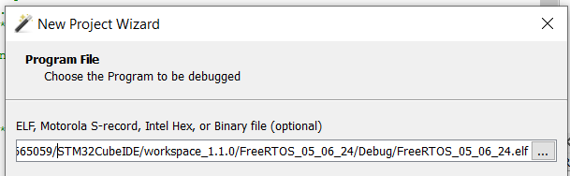
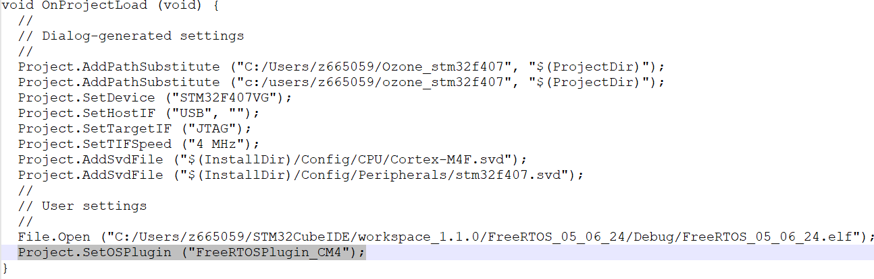
Ozone Project Cont..
On the Program File dialog screen, navigate to the *.elf file that is generated by STM32CubeIDE. It should be in the Debug folder of your project:
Save the *.jdebug project file and close Ozone.
Open the *.jdebug file with a text editor.
Add a line to the *.jdebug project file to enable FreeRTOS plugin for Cortex M4 (only add last highlighted line):

Slide 25
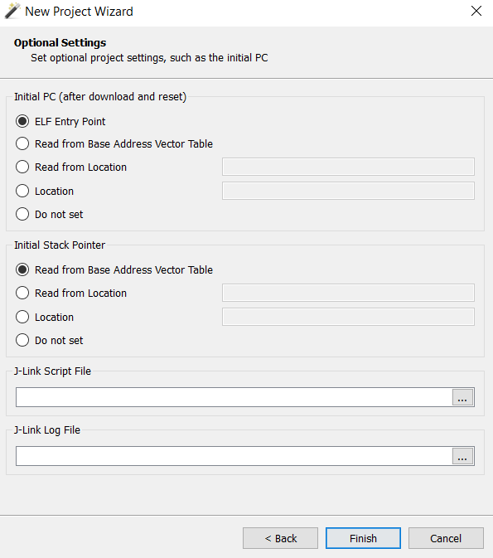
Ozone Project Cont.
Select the optional settings as mentioned

Slide 26
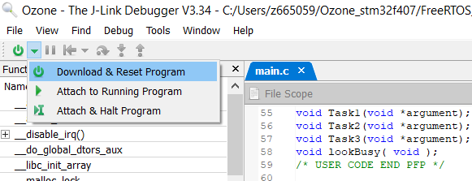
Attach Ozone to STM32F4 Disc Board
Open Ozone->File->Open-> <Project_Name>.jdebug file
To Flash the File, click below Options
Push the play button to start the application (you should see the red, blue, and green LEDs flashing).

Slide 27
Viewing Task in Ozone
A quick view overview of tasks can be seen by enabling the FreeRTOS task view. Using these tasks can prove to be very beneficial while developing RTOS applications:
1. After the MCU program has been started, pause execution by clicking the Pause button.
2. Now, navigate to View -> FreeRTOS Task View:
This view shows many useful pieces of information at a glance:
Task names and priorities.
Timeout: How many ticks a blocked task has until it is forced out of the blocked state.
Each task's stack usage (only the current stack usage is shown by default). Maximum stack usage is disabled in the preceding screenshot (seen by N/A
Mutex Count: How many mutexes a task currently holds.
Notifications: Details on each task's notifications.

Slide 28
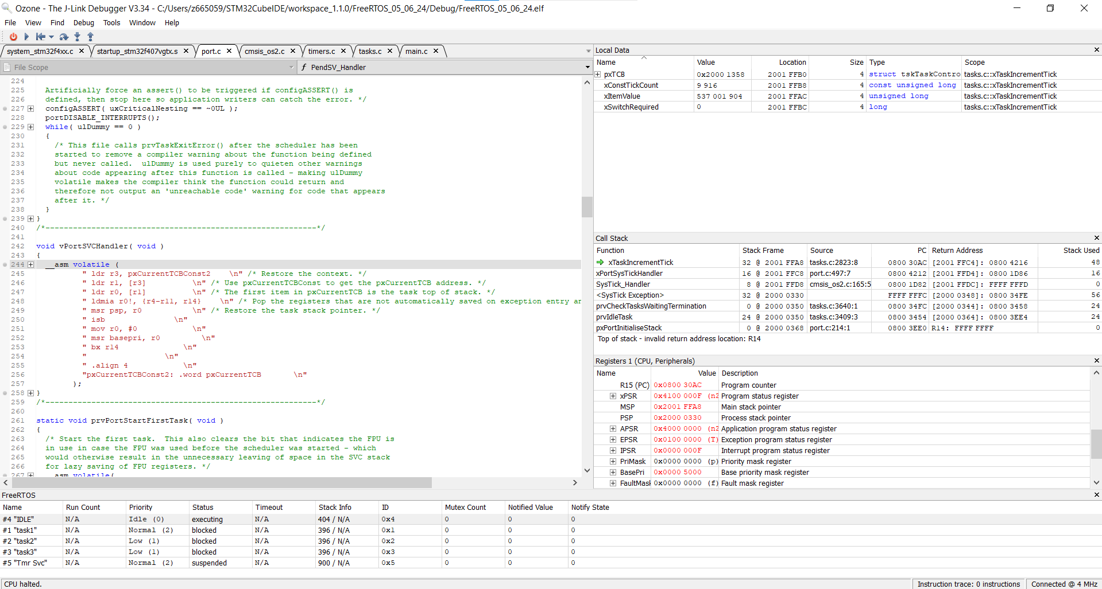
Ozone Layout

Slide 29
From Ozone to System View
SEGGER Ozone provides both a task-aware call stack view and a heads-up view for all running tasks in the system.
This combination gives us a powerful tool to dive into the most minute details of each task running on the system.
But what happens when we need a bigger picture view of the system? Instead of looking at each task individually, what if we’d prefer to look at the interaction between tasks in the system?
This is an area where SEGGER SystemView can help, It provides a means to visualize the flow of tasks and interrupts in a system.
Unlike Ozone, SystemView doesn't have any programming or debugging capabilities, it is only a viewer.

Slide 30
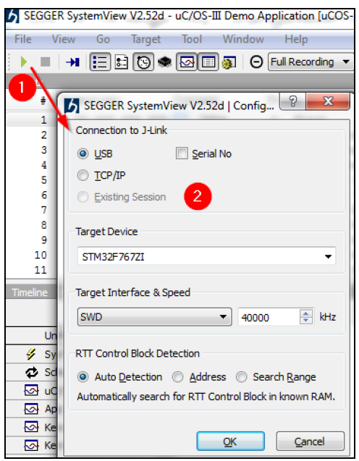
Using System View
To start a capture, make sure you have a running target and your debugger and MCU are connected to the computer:
1. Push the Play button.
2. Select the appropriate target device settings (shown here):

Slide 31
Segger System View
1. Timeline shows a visual representation of task execution, including different
states.
2. The Events view shows a list of events. Selected events are linked to the timeline.
3. The Context view shows statistics for all events.
4. Terminal can be used to show printf-like messages from your code.
4
2
1
3

Slide 32
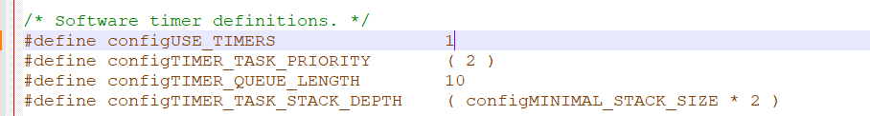
For Timer Related Practical's
In FreeRTOSConfig.h make configUSE_TIMERS == 1

